Slide 1
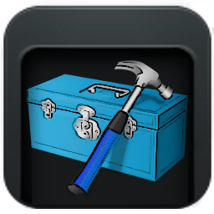
Power Options
This is a tutorial for using the “Power Options” section of the DSR ToolBox application.

Slide 2
Table of Contents
Introduction
Instant Power Options
Delayed Power Options
Using Power Options on a Remote Machine
Summary

Slide 3
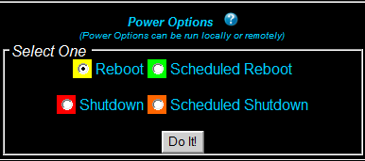
Introduction
The “Power Options” section of the DSR ToolBox can prove to be very handy in the even that you ever need to reboot or shutdown a machine. All of the options will work on your own machine as well as a specified remote machine as long as the machine is reachable through the network.

Slide 4
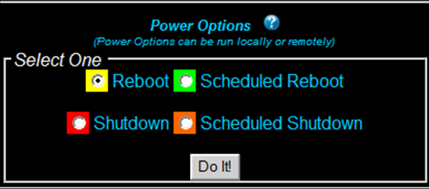
Instant Power Options
The 2 Power Options that will react instantly are the “Reboot” and “Shutdown” options. You simply click on the radio button associate with your choice of action and click on the “Do It!” button to have the application…well…do it! It is as simple as that. If you need to shutdown or reboot your own machine, using this area will prove to be faster than using the buttons built into Windows simply because it is right there in front of you instead of being hidden in a menu that is accessed from the bottom corner of the screen. If you need to shutdown or reboot a remote machine, this area can prove to be very useful. More on that in the “Using Power Options on a Remote Machine” section of this tutorial.

Slide 5
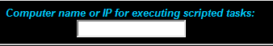
Delayed Power Options
The delayed options both have the word “Scheduled” in the titles. Both options will prompt you for a time of execution. As long as the time is entered in military time format with a colon separating hours from minutes, the reboot or shutdown will not occur until the time you specified. As usual, you can you either of these tasks on your machine or on a remote machine.
On the right half of the DSR ToolBox application you
will see the area pictured on the right. This is the area for entering the name of a remote machine for which to run a remote task. Simply type a computer name or IP address in the field before pressing the “Do It!” button and you will be presented with the option to execute the selected Power Option on the machine you specified.

Slide 6
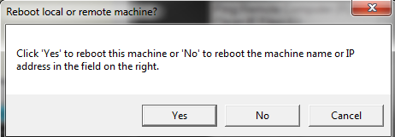
Using Power Options on a Remote Machine
All 4 Power Options can be run on your own, local machine or a remote machine. Once you select a radio button and click on “Do It!” you will be presented with the pop-up window seen above. If you read the text in the window then the buttons in the pop-up window will do exactly what you would expect. Clicking “Yes” will execute the action for your own machine, “No” will execute the action on a remote machine, and “Cancel” will simply quit and let you go on with your day.
Both the delayed and instant Power Options execute in a similar manner. The simplest way to make this possible was to a batch file to the remote machine then set it as a scheduled task. If you select an instant Power Option, it will schedule it to occur in less than 2 minutes. The delayed Power Options execute at the time you specify.

Slide 7
Summary
You will find that the “Power Options” section of the DSR ToolBox will save you a lot of time in various situations. Maybe you remotely installed software on a client’s machine that requires a reboot but the client doesn’t want the reboot to happen until a certain time because they are working. No problem. This section of the DSR ToolBox can automate that for you. Whatever the case, I’m sure you will find this a useful addition to the DSR ToolBox application.

