Slide 1

Text Area
This is a tutorial of how to use the “Text Area” of the DSR ToolBox application.

Slide 2
Table of Contents
Introduction
Using as a “Post-It”
Using it to create lists
Summary

Slide 3
Introduction
Have you ever been on the phone with a client and found yourself frantically searching for a pen and paper to write down a time, address, phone number, etc? That was the inspiration for adding the “Text Area” to the DSR ToolBox. You can jot down anything you need on the fly, copy and paste it to another app or field, or even save it for later use.
As the DSR ToolBox app grew, a need for generating lists of computer names was realized and the Text Area evolved to what it is now.

Slide 4
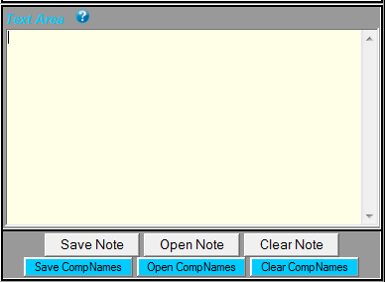
Using as a “Post-It”
As you can see, the “Text Area” only consists of a large space for typing and six buttons. You can type whatever you need in the area and it will stay there until you delete it or close the ToolBox app.
This area uses the top 3 buttons to extend this functionality for you. If you have typed something in this area you will need later you can click “Save Note” and the text is appended to C:\Phrasekeys\TextArea.txt. This way it only adds to your existing note without modifying anything you’ve added in the past.
The “Open Note” button will display TextArea.txt in Notepad so you can see what you’ve added. If you come to a point that you wish to clear out the text file, simply click “Clear Note” to get a fresh start.

Slide 5
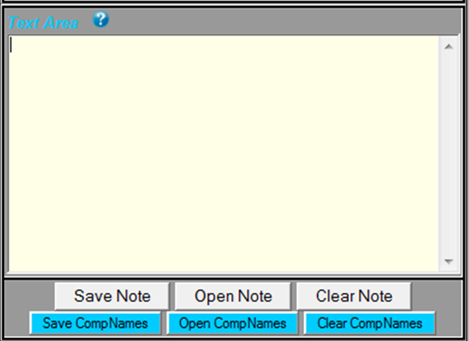
Using it to Create Lists
Another function of the Text Area is list creation. This was added primarily as a quick and easy way to generate lists of computer names for the scripted tasks section of the DSR ToolBox, but you can use it to create any sort of list you wish.
The bottom 3 blue buttons are for creating lists. Once your list, you can click “Save CompNames” to save the list to C:\Phrasekeys\CompNames.txt. This overwrites the file deleting anything you had save there before.
Again, clicking on “Open CompNames” will open the text document in Notepad for you to view it and “Clear CompNames” will delete all of the contents of that file for a fresh start.

Slide 6
Summary
The Text Area can prove to be very useful once you get used to it. Never again should you find yourself scrambling for pen and paper!

