Slide 1
Data Security and Privacy Protection Issues in Cloud Computing
Jinnan Ge

Slide 2
Questions…
What is cloud computing?
What is security?
What are the security concerns for cloud computing?

Slide 3
What is Cloud Computing?
Cloud Computing is a general term for the delivery of hosted service over the Internet.
Three Service Models:
Cloud Software as a Service (SaaS)
Cloud Platform as a Service (Paas)
Cloud Intrastructure as a Service (laaS)
Four Deployment Models:
Private, community, public and hybrid cloud

Slide 4
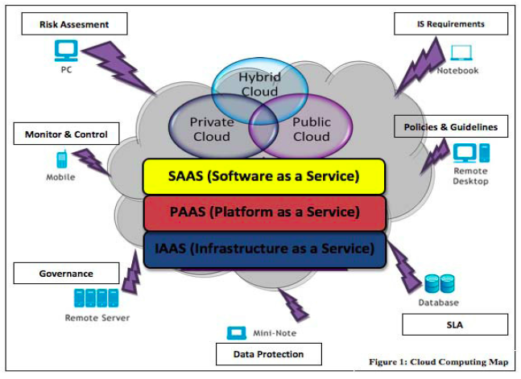

Slide 5
Why Cloud Computing?
(especially for small & medium enterprises)
lead to gains in efficiency and effectiveness in developing and deployment and save the cost in purchasing and maintaining the infrastructure.

Slide 6
Risks of Cloud Computing
From a consumer’s perspective…
security is a major concern
Issues that appear:
Amazon’s Simple Storage Service (Feb 2009 and July 2009)
Google Docs leakage of user private information (March 2009)
Microsoft’s Azure, 22 hours of outage

Slide 7
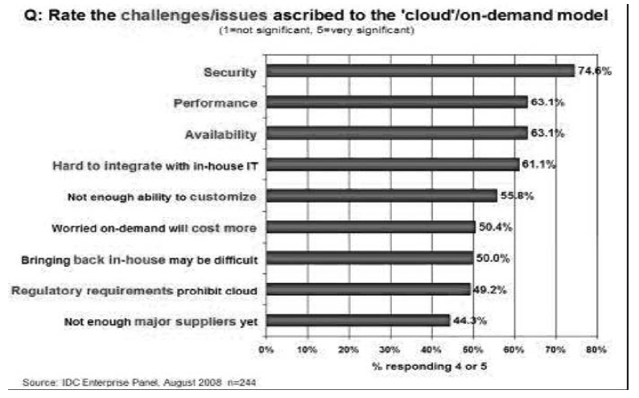

Slide 8
Why Cloud Computing is facing challenges in security?
No fixed infrastructure and security boundaries
Multiple providers… conflict of interest,
no unified security measures
Multi-tenant -> unauthorized users
Massive information storage

Slide 9
What is Cloud Computing Security?
Wikipedia says…
Cloud computing security (sometimes referred to simply as “cloud security”) is an evolving sub-domain of computer security, network security, and, more broadly, information security.
It refers to a broad set of policies, technologies, and controls deployed to protect data, applications, and the associated infrastructure of cloud computing.

Slide 10
Opinions about Solution to Cloud Security
[Gartner, 2008]
Users should ask the vendors seven specific safety issues
[Mohamed AI Morsy]
cloud architecture, service delivery models, cloud characteristics and cloud stakeholders
[Chen] two aspects:
complexities of multi-party trust considerations, ensuing need for mutual aditability

Slide 11
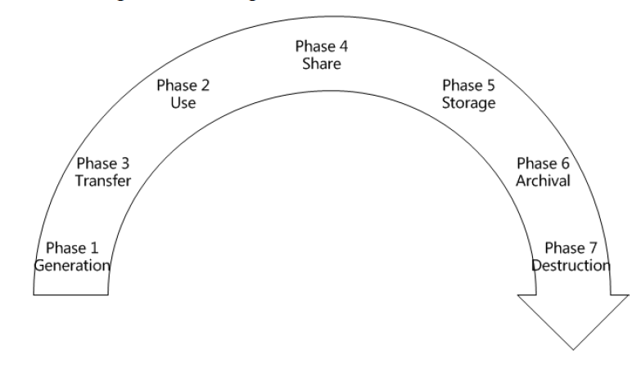
Data Life Cycle

Slide 12
Data Storage
1. Information security:
(1) confidentiality
(2) integrity
(3) availability
2. Confidentiality → encryption
(1) encryption algorithm
(2) key strength
(3) processing speed
(4) computation efficiency
Key management problem→ who owns the key?
Data owners?
Cloud providers?
Too many keys? Too complex?

Slide 13
3. Data Integrity
Users don’t know where the data is stored… How to directly verify the integrity of data in cloud storage without having to first download the data and then upload the data?
4. Data Availability
(1) availability of cloud computing services
(2) whether the cloud providers would continue to operate in the future?
(3) Whether the cloud storage services provide backup?

Slide 14
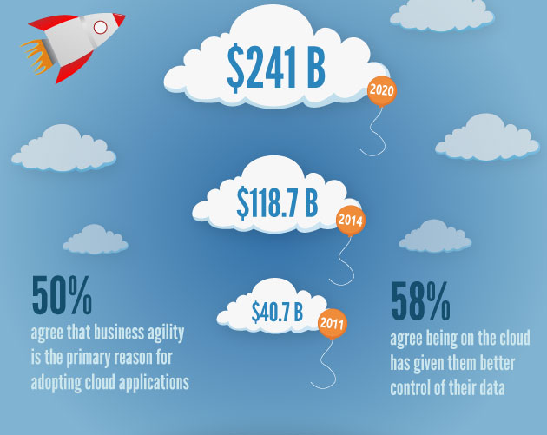
Cloud Computing Future

Slide 15
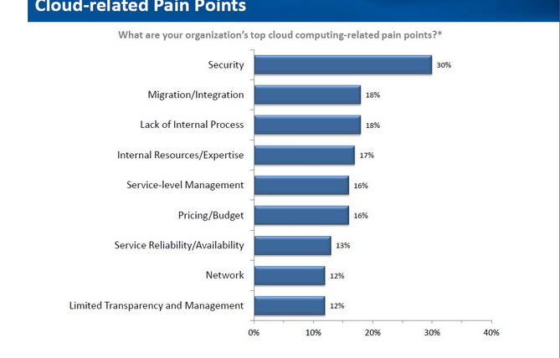

Slide 16
Future of Cloud Computing
E-commerce
Health Data
International Data Transfer
Etc.

