Slide 1
Cuatro en Raya
Project 0 – Revature
Javier Gomez

Slide 2

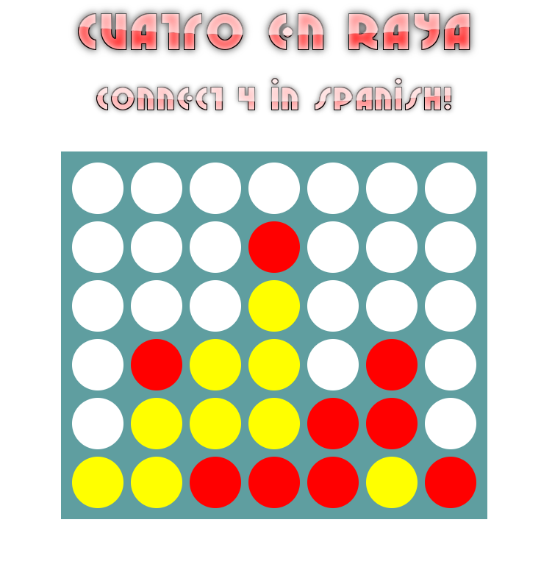
What is Cuatro en Raya?
"Cuatro en Raya" translated means four in a row.
Two Players
Player wins if it connects 4 slots in a row (vertically, horizontally or diagonally)

Slide 3

Cuatro en Raya - Technologies

Slide 4
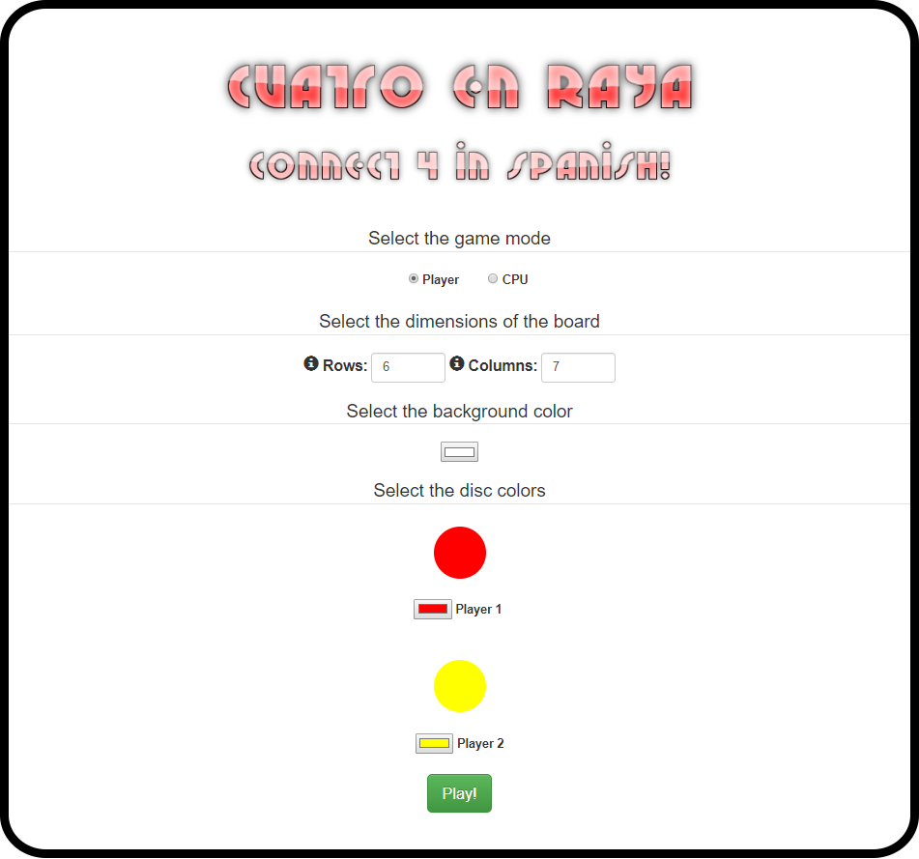
Cuatro en Raya – Main Menu
2 Players or CPU
CPU has many difficulty levels.
Customizable board
Background color
Rows and Columns
Player's discs.

Slide 5
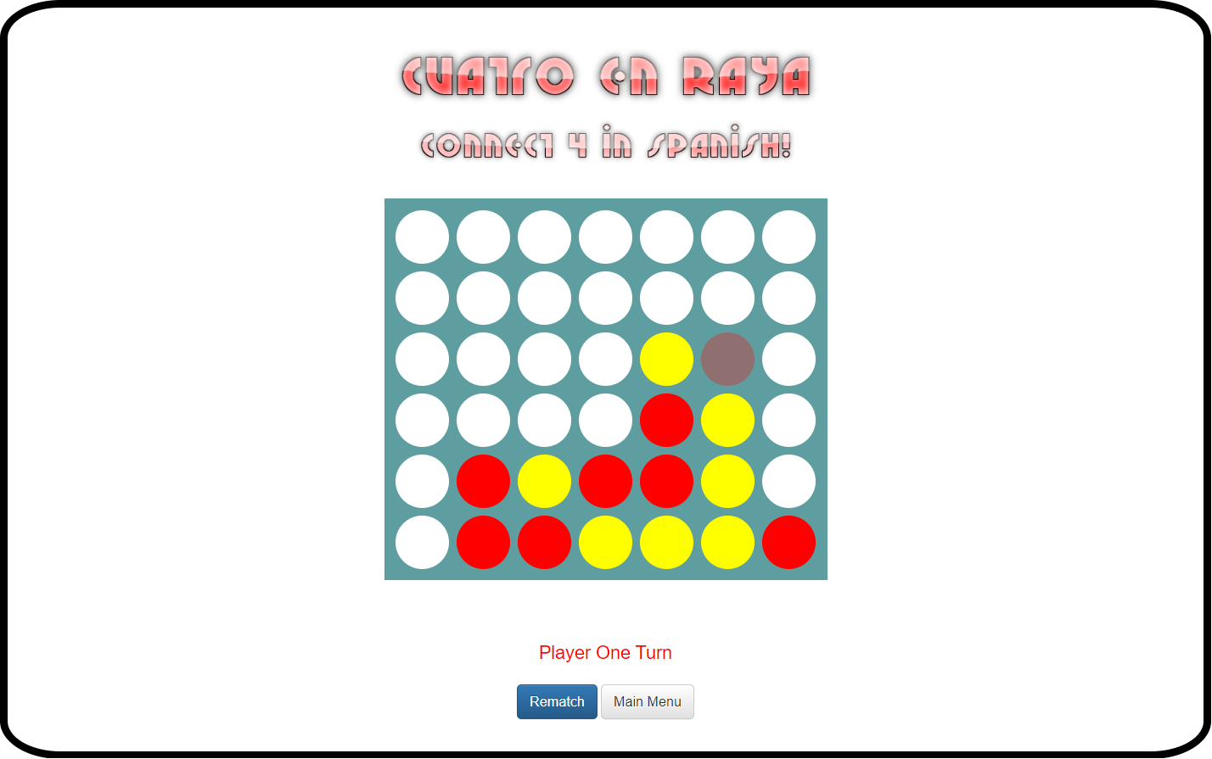
Cuatro en Raya – Game Board
Players clicks on a column to place a disc on it.
When the game is finished (draw or win) a modal pops up and shows the end state of the game.

Slide 6
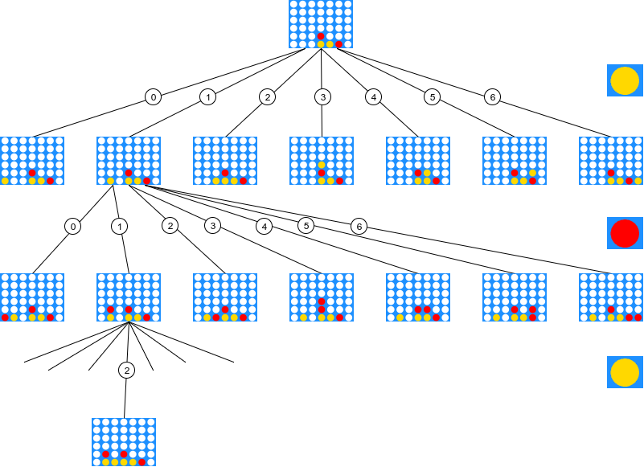
Cuatro en Raya – Minimax Algorithm

Slide 7

Thank you!

