Slide 1
Cuatro en Raya
Project 0 – Revature
Javier Gomez

Slide 2
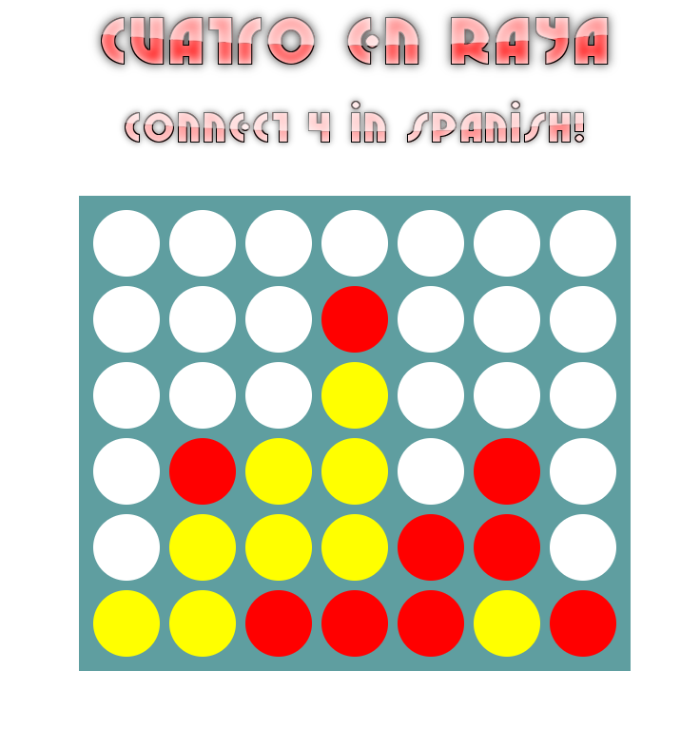
What is Cuatro en Raya?
“Cuatro en Raya” literally means four in a row.
Two Players
Game ends when a player connects four slots in a row, or when the board is full.

Slide 3
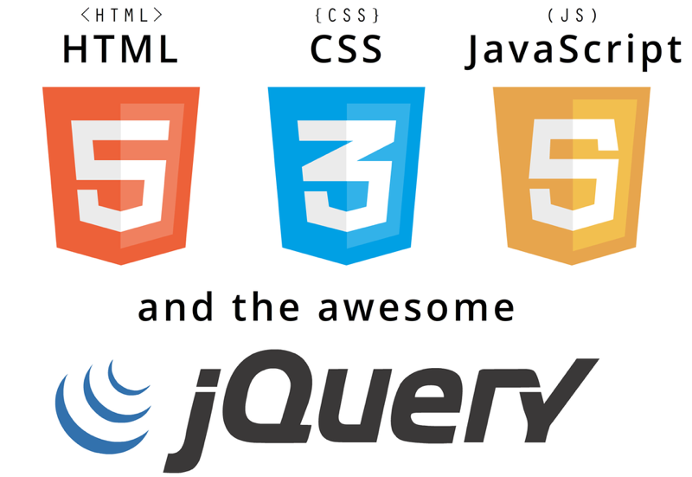
Cuatro en Raya - Technologies

Slide 4
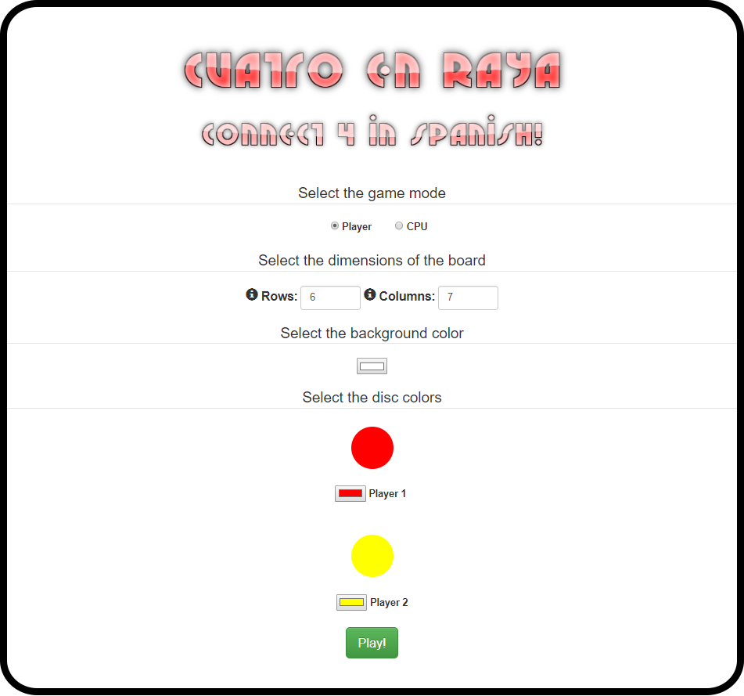
Cuatro en Raya – Main Menu
Vs Player/ Vs CPU.
Customizable dimensions and colors.
Different levels of difficulty against CPU.

Slide 5
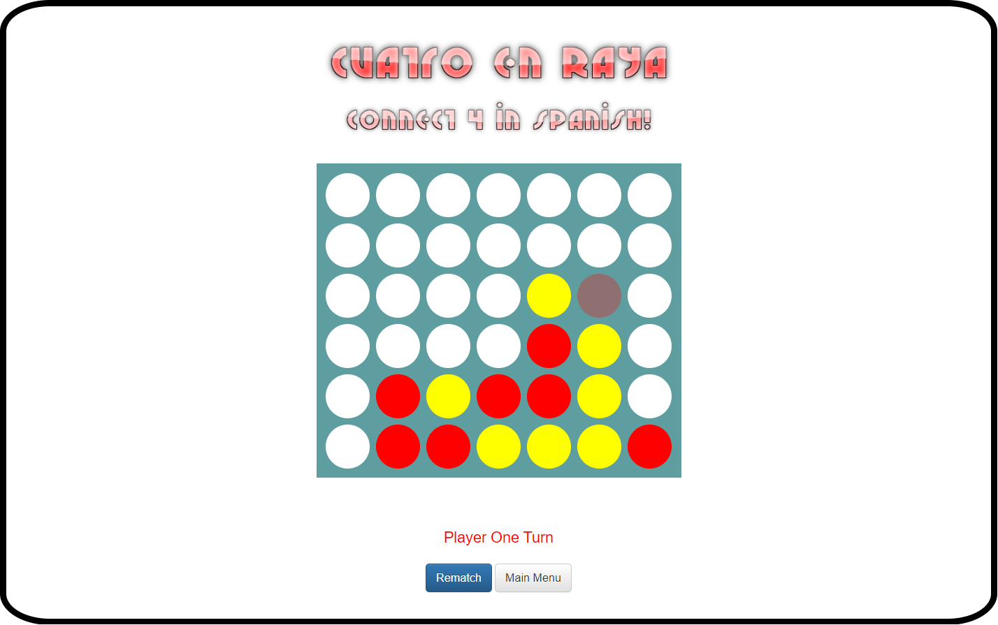
Cuatro en Raya – Game Board
Player clicks on the column to place the disc.
Buttons for Rematch or return to Main Menu
Modal will show up when the game has ended, displaying the appropriate information

Slide 6
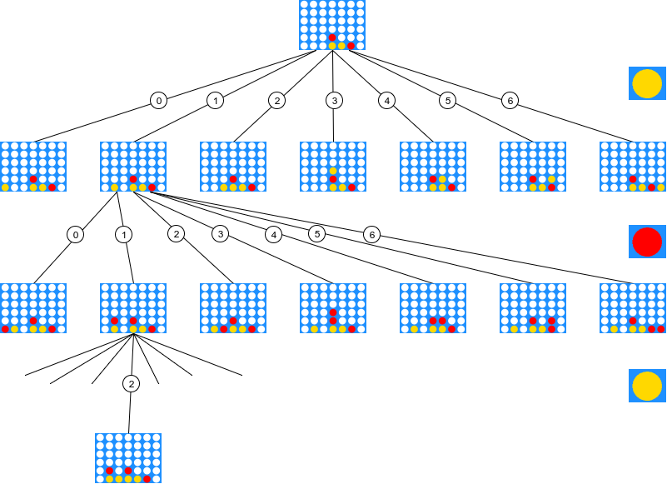
Cuatro en Raya – Minimax Algorithm

Slide 7

Thank you!

