Slide 1

Loops
Josh Gee

Slide 2
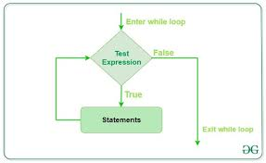
While loop
A while loop is used when the amount if times the loop needs to continue is unknown
For example you would use a while loop when you need to know how long a statement would be true
Such as when you start with a large number and apply a mathematical equation, then repeat the equation with the new answer each time, until it no longer meets the conditions required.

Slide 3
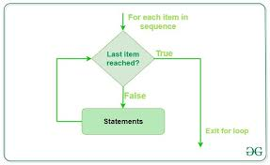
For loop
A for loop is used when you know how many times a loop needs to iterate
For example you would want to use a for loop when you need the loop to repeat 50 times such as if you need to check the GPA of 50 students

