Slide 1

Flowcharts and Linear Sequences
Josh Gee

Slide 2
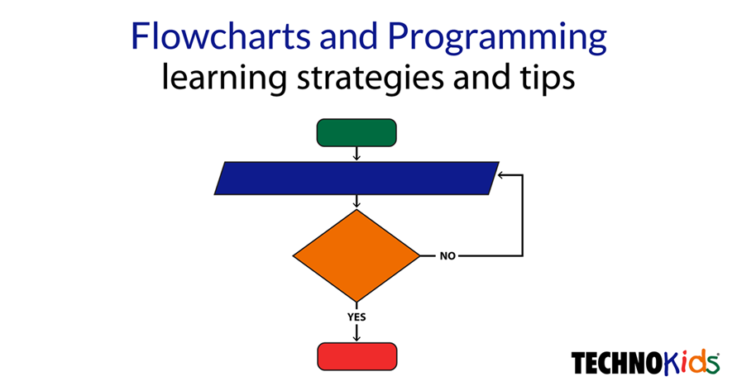
Flowcharts
Flowcharts are important because they allow coders to break their coding down
They make it easier to see how the data is going to function
Easier to see what goes where and potential problems

Slide 3
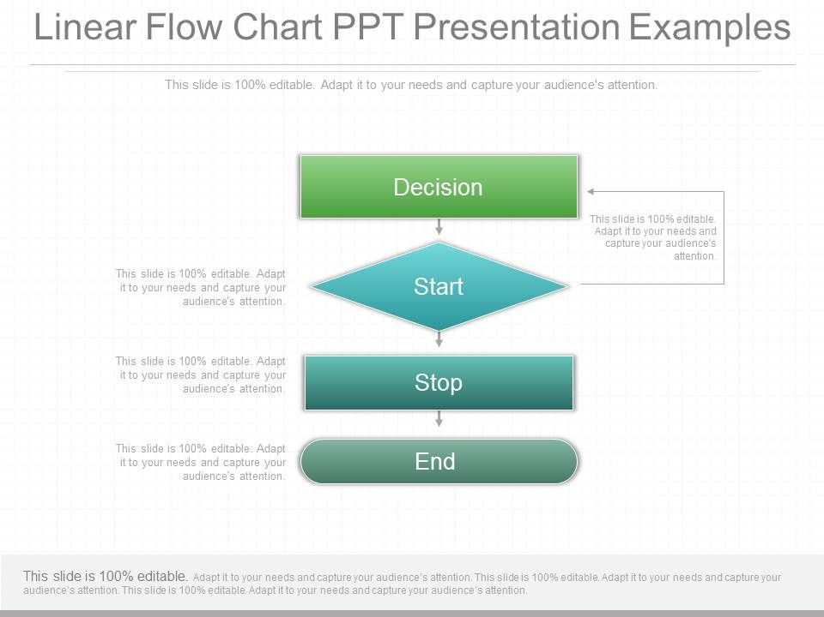
Linear sequences
This is used to describe the sequence of steps in a process
It shows the problem the decision and the output in a simple easy to read sequence
Simple and easy to understand for basic codes
Helps with trouble shooting

Slide 4
Sources
https://study.com/academy/lesson/programming-flowcharts-types-advantages-examples.html#:~:text=Flow%20charts%20help%20programmers%20develop,code%20that%20is%20not%20working.
https://powerslides.com/powerpoint-charts/flow-chart-templates/linear-flow-chart/#:~:text=A%20linear%20flow%20chart%20describes,our%20linear%20flow%20chart%20templates.&text=Using%20visually%20expressive%20linear%20flowcharts,steps%20in%20a%20given%20process

