Slide 1

Getting Started with R
3 September 2021 Molly Lewis
Lab
Artwork by @allison_horst

Slide 2
Why R for working with data
Free and open-source
Programming language (not point-and-click)
Excellent graphics
Easy to generate with reproducible reports
Easy to integrate with other tools
CC by A. Chouldechova

Slide 3
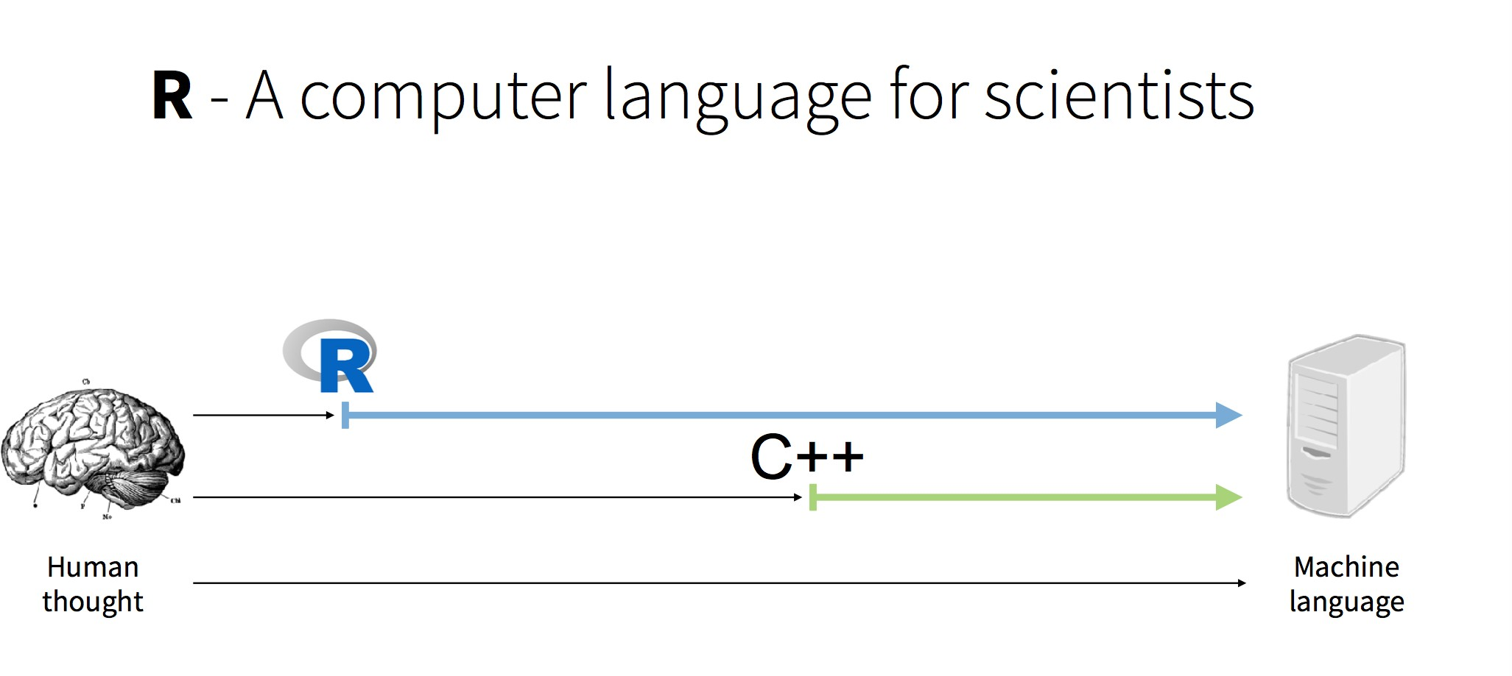
CC G. Grolemund

Slide 4
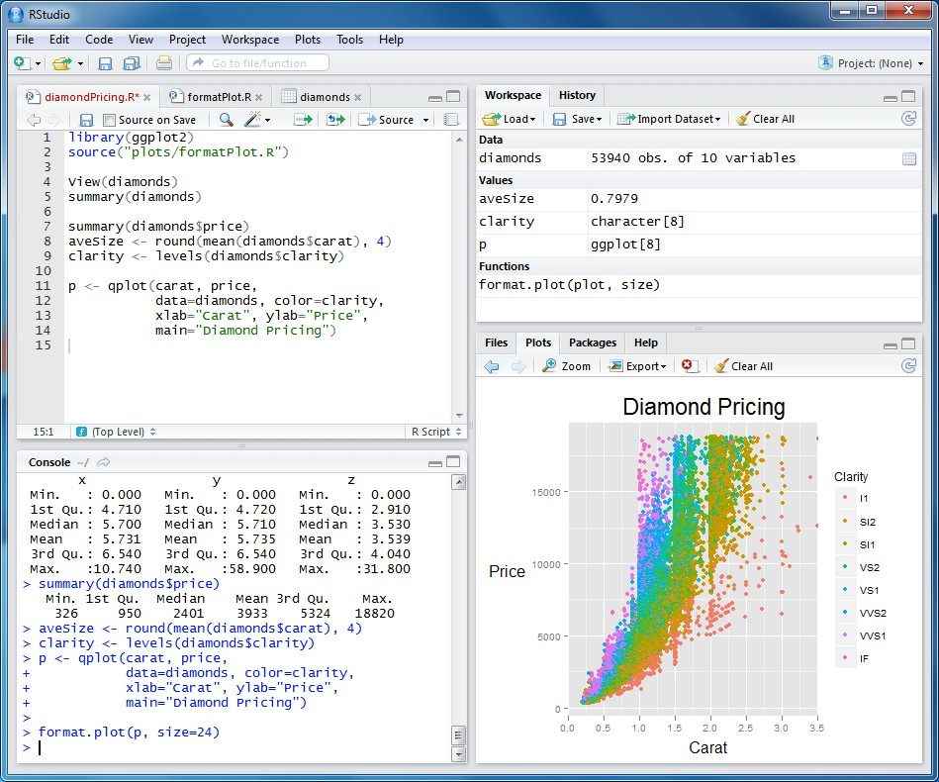
Rstudio Integrated Development Environment (IDE)
Workspace/History: see list of variables and previous commands
Source: edit file that you can run again later.
Files/Plots/Package s/Help
Console: type/paste commands to get output from R

Slide 5
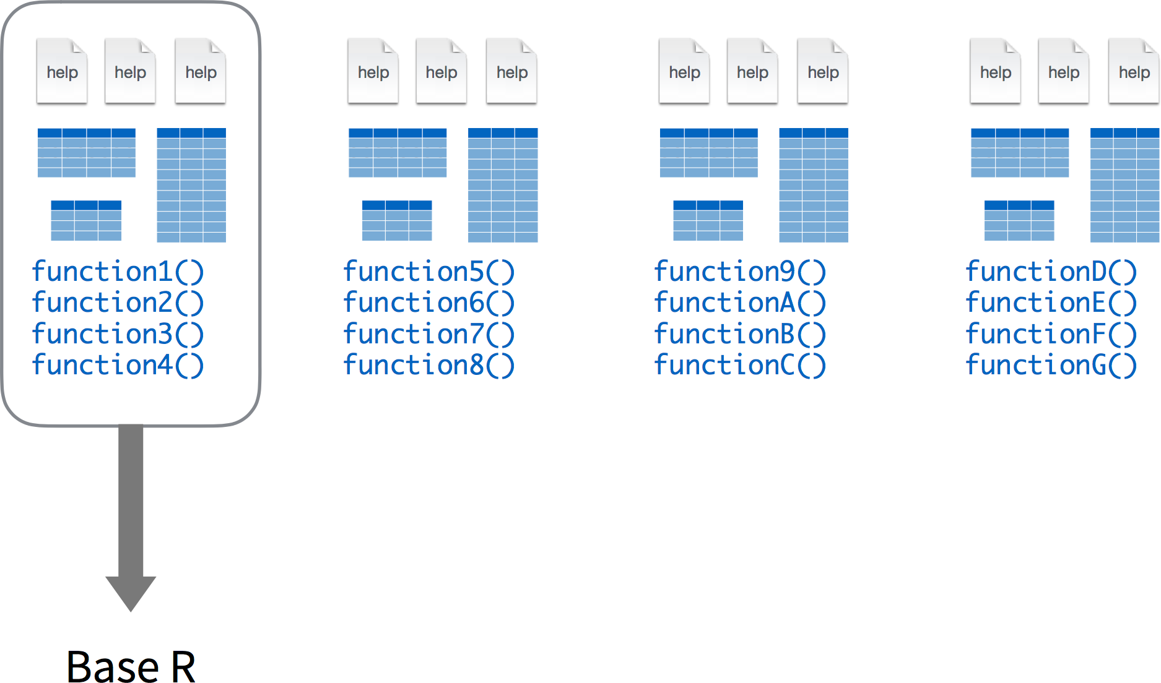

Slide 6
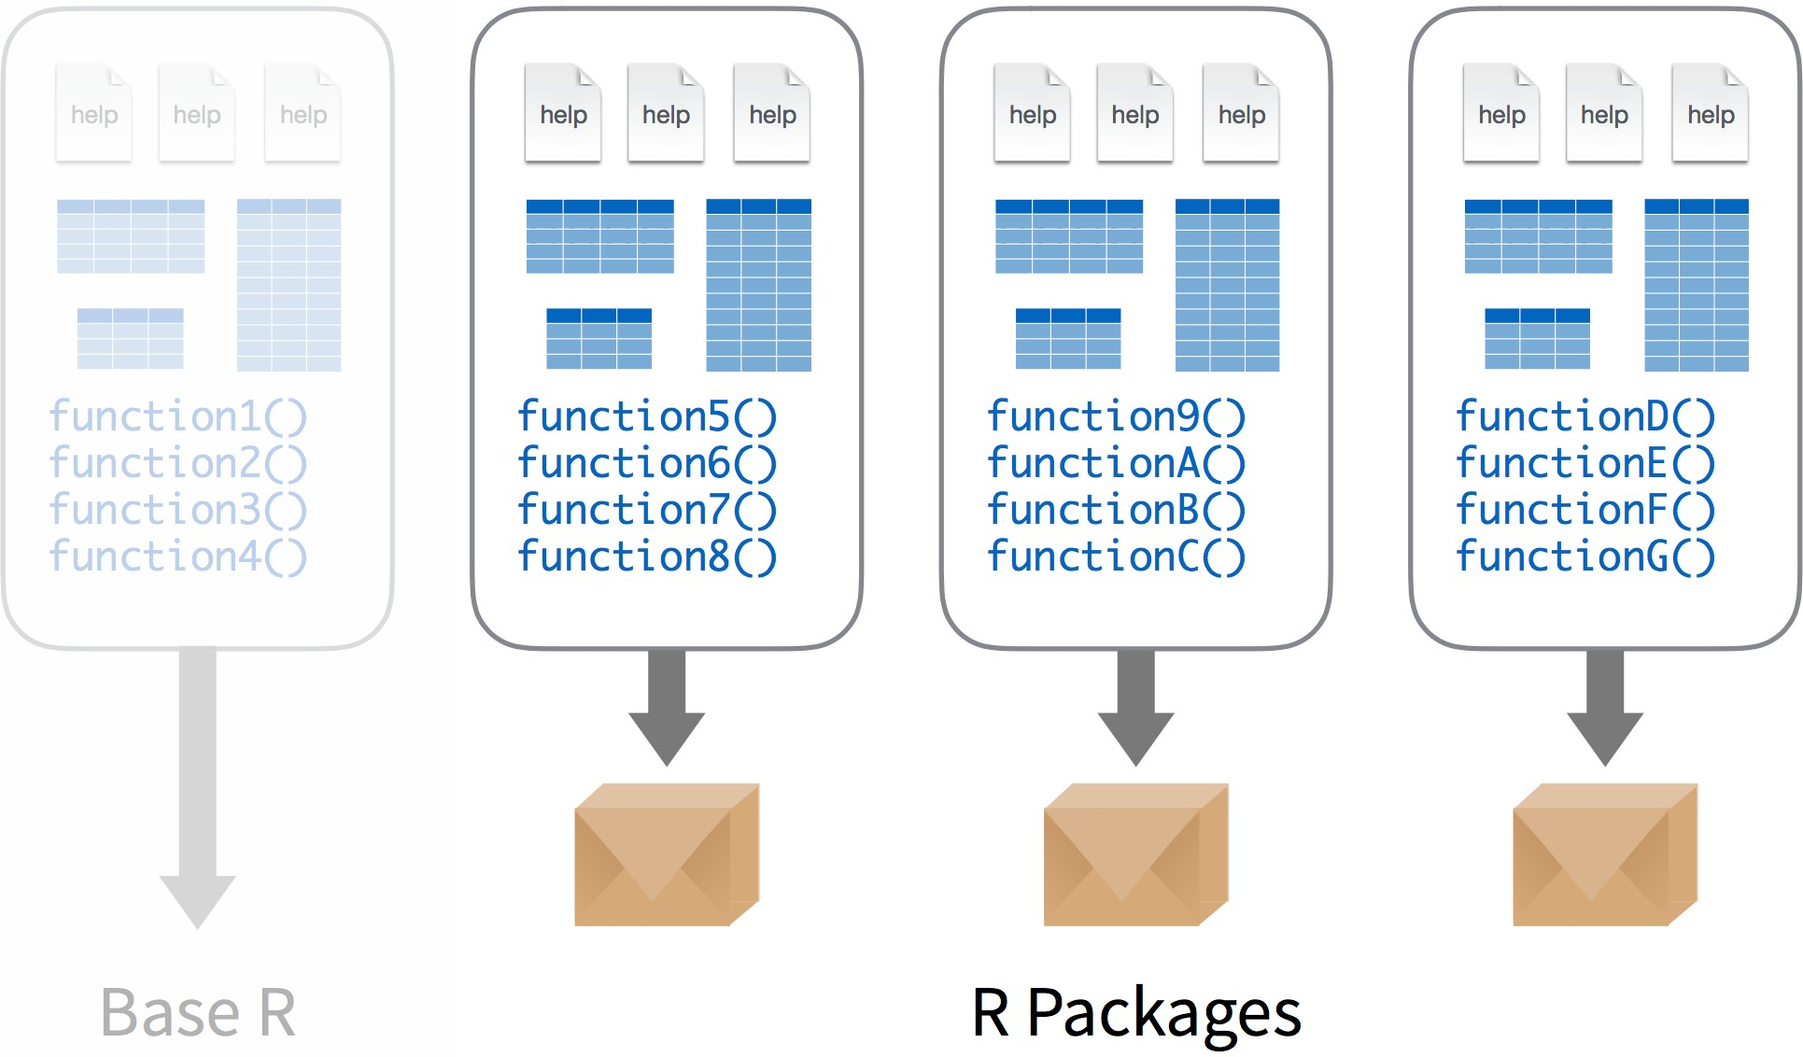

Slide 7
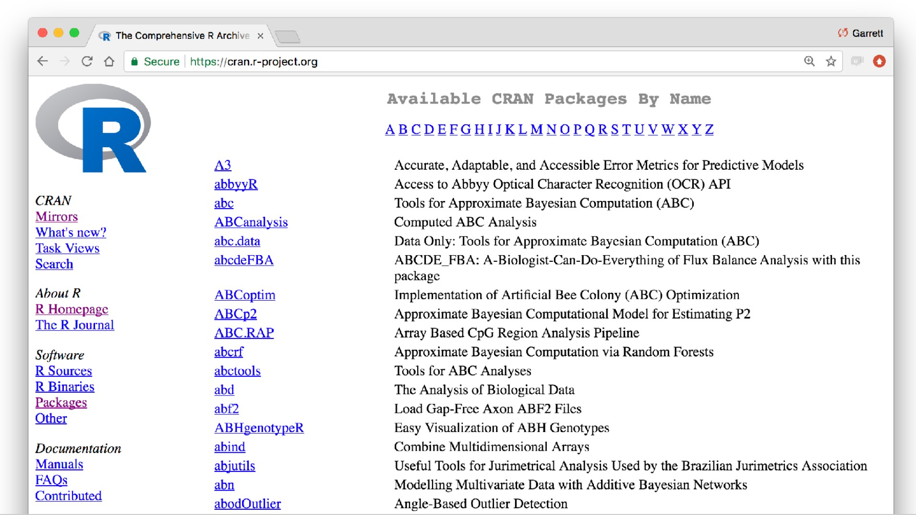

Slide 8
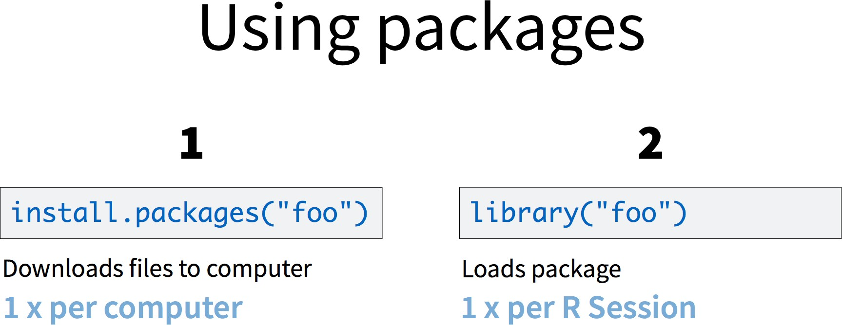

Slide 9
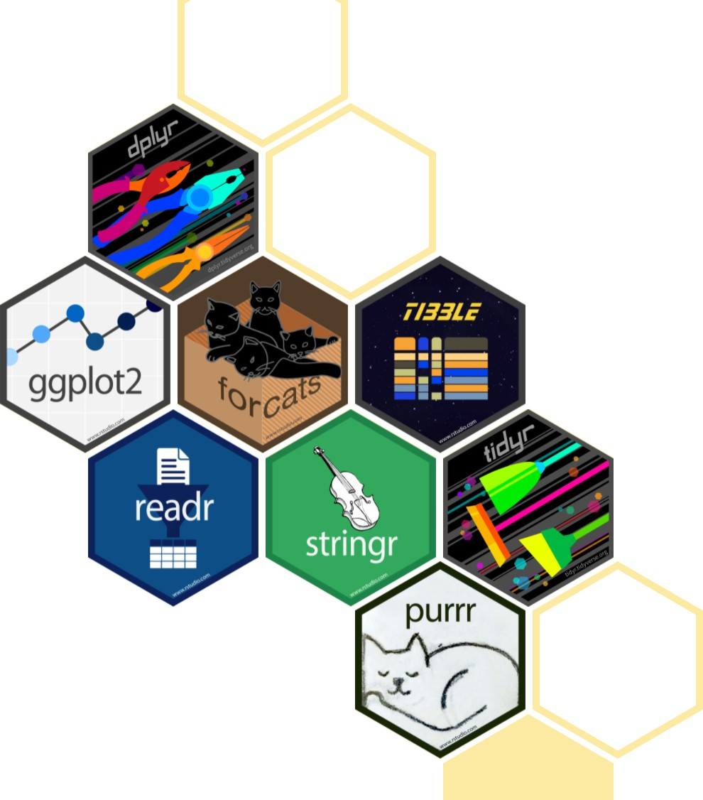
Tidyverse
The tidyverse is an opinionated collection of R packages designed for data science. All packages share an underlying design philosophy, grammar, and data structures.

Slide 10
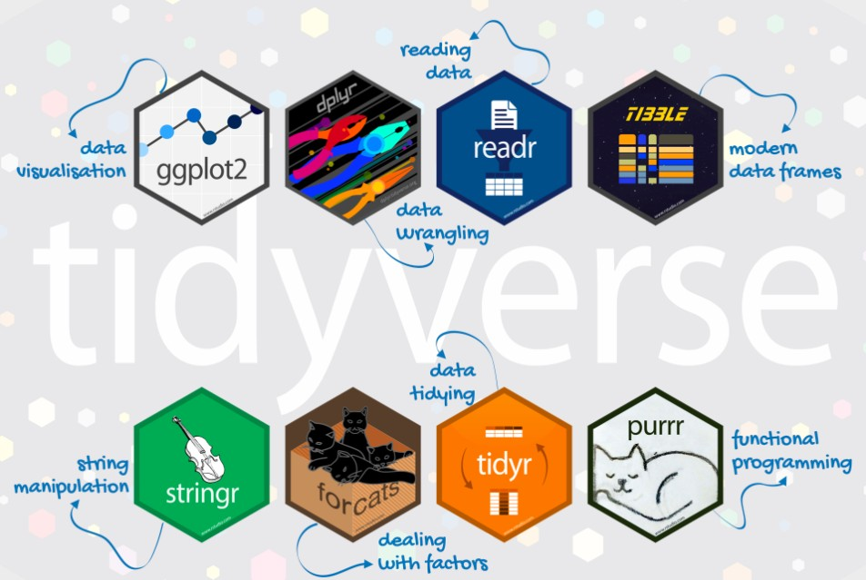

Slide 11
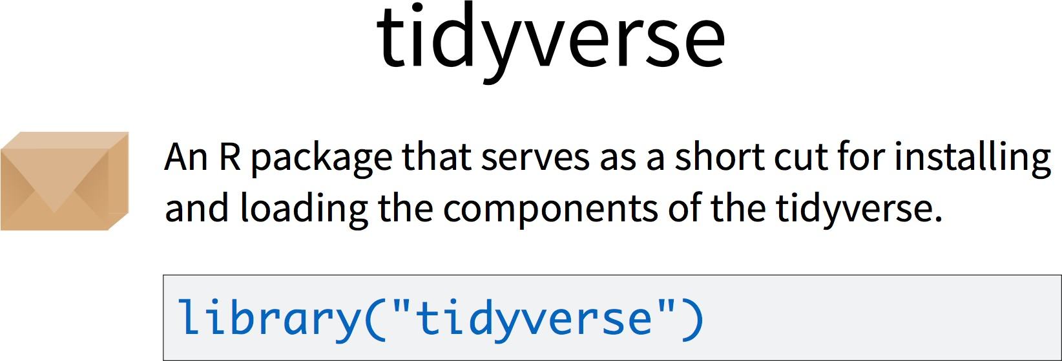

Slide 12
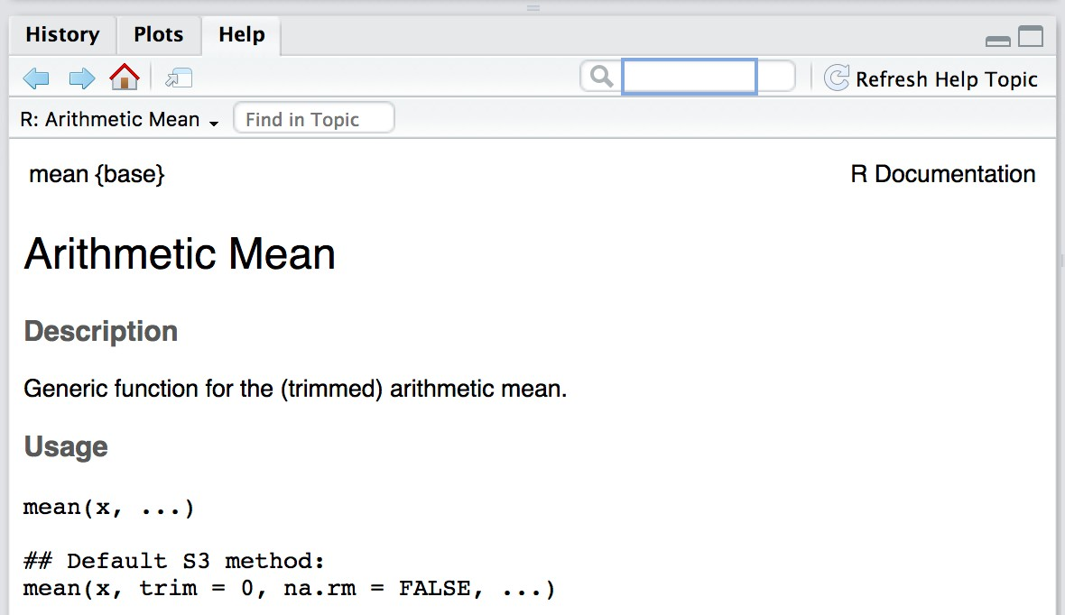
Getting help
1. R help files

Slide 13
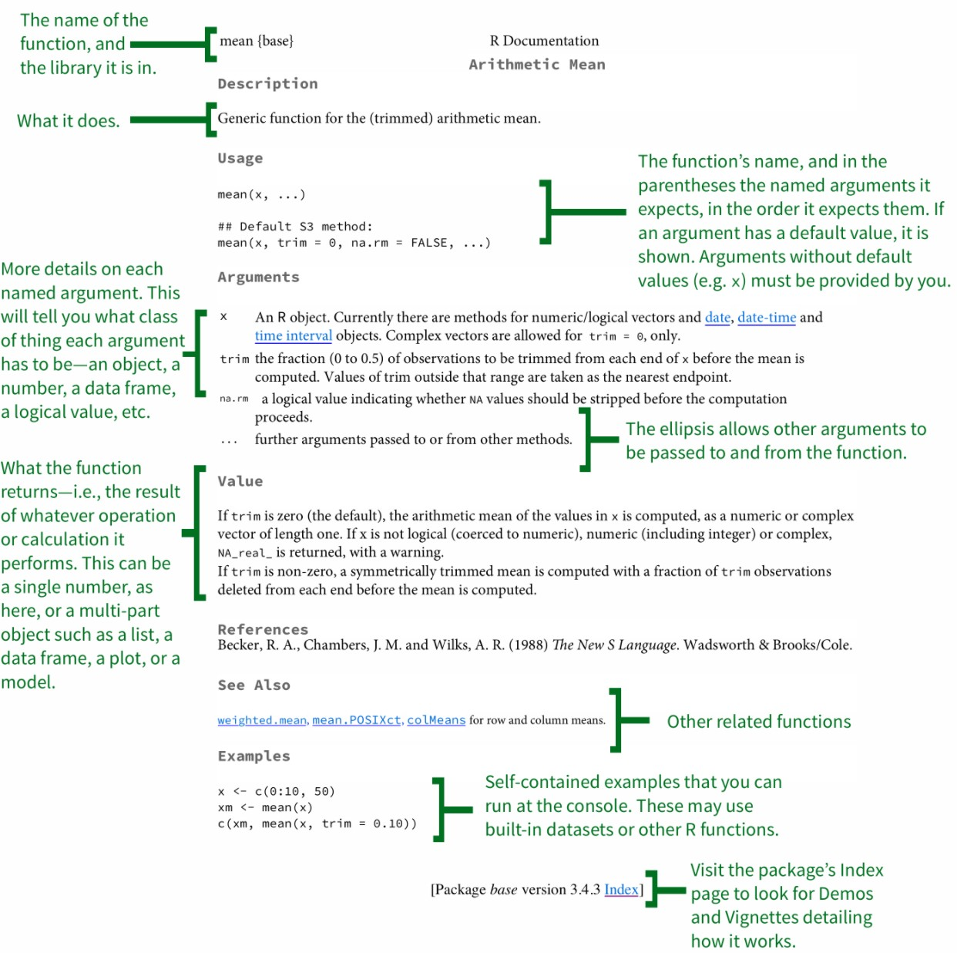
Anatomy of an R help file
Two ways to access:
Peruse in Help pane
?<name> in console
Adapted from: https://socviz.co/appendix.html#a-little-more-about-r

Slide 14
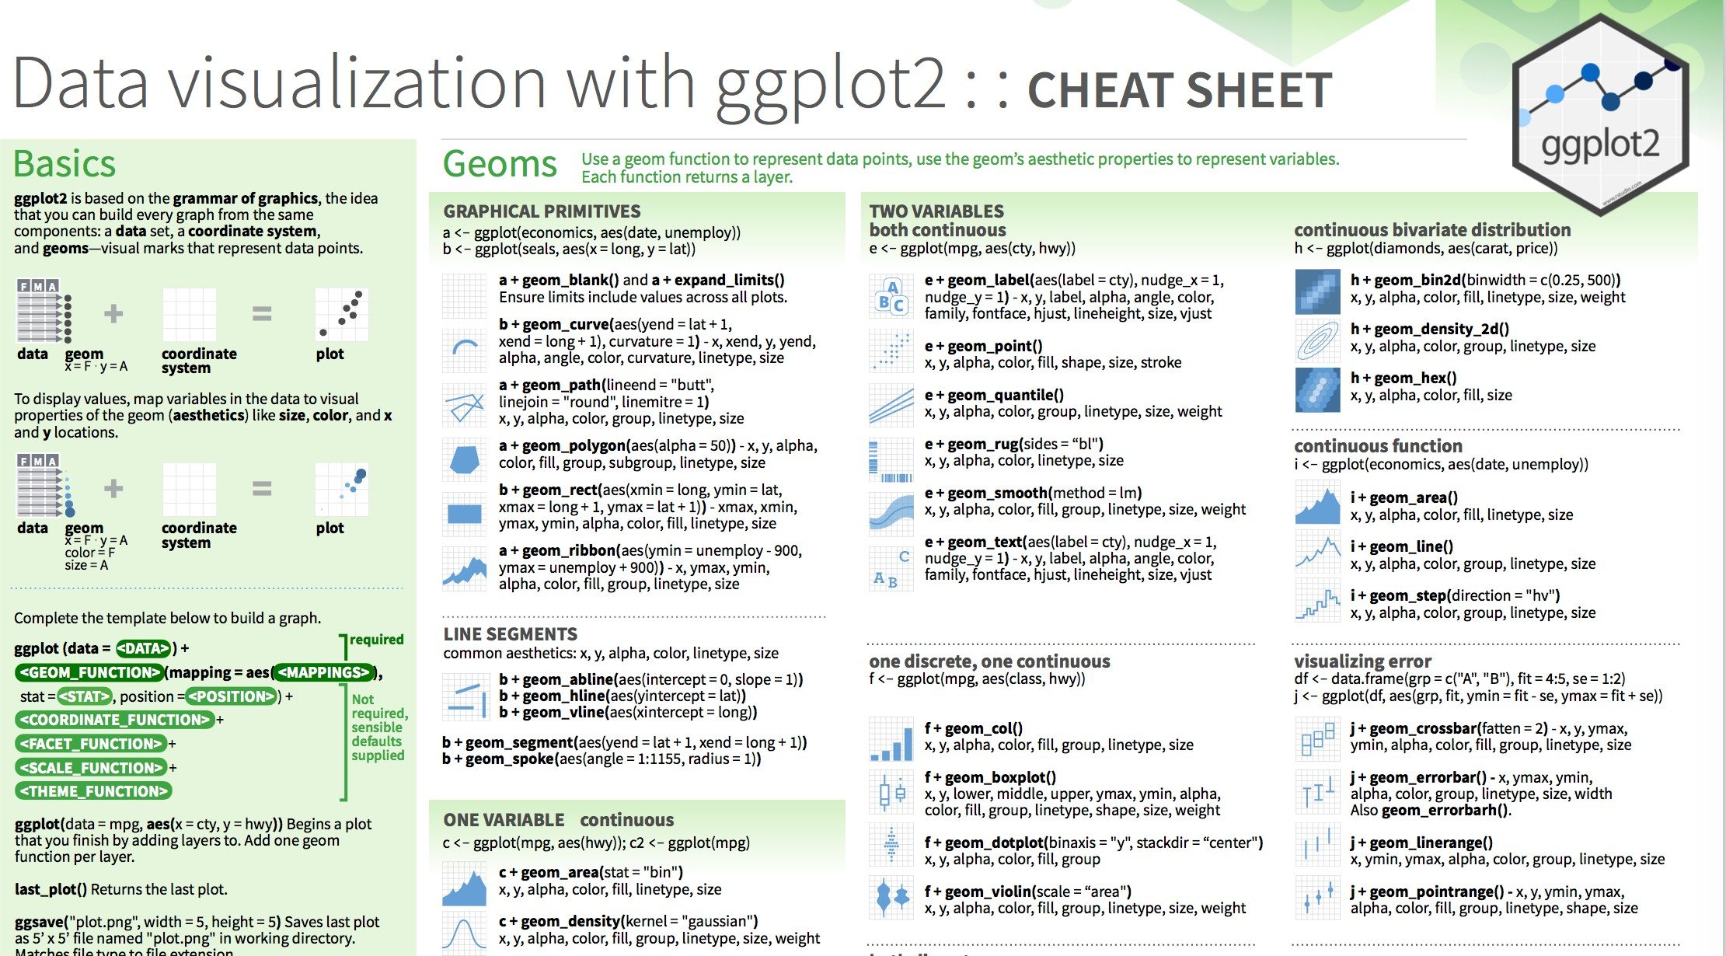
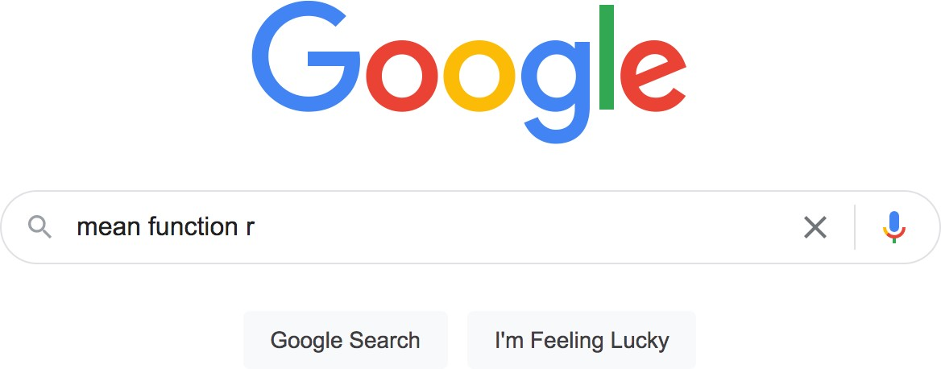
Getting help
R help files
Cheatsheets (https://rstudio.cloud/le arn/cheat-sheets)
Google!

Slide 15
Today
Make sure you have R, Rstudio and tidyverse installed on your laptop
Work through online tutorial on R programming basics: https://rstudio.cloud/learn/primers/1.2
(complete readings for today)

Slide 16
Acknowledgements
Slide 2 adapted from https://www.andrew.cmu.edu/user/achoulde/94842/ by CC license
Slides 3-11, adapted from
https://github.com/rstudio-education/remaster-the-tidyverse/
By CC license
Slide 10 adapted from https://education.rstudio.com/blog/2020/07/teaching-the- tidyverse-in-2020-part-1-getting-started/ by CC license

