Slide 1
PS Quantitative Research in Linguistics
Class 11b: Inferential stats: Exercises

Slide 2
Exercise 1: Psycholinguistics
You conducted a study on the tip-of-the-tongue (TOT) with a group of monolinguals (n = 30) and bilinguals (n = 30) suffering from Alzheimer’s disease. You recorded each participant during a 30-minute conversation with one family member.
How can you test if bilinguals are more likely to experience a TOT state during a daily-life conversation than the monolinguals? Explain your decision.
IV =
language condition (monolingual vs. bilingual)
categorical, nominal
DV =
experience of the TOT state
categorical, nominal (yes vs. no)
Design =
between-subjects design
H0 =
Statistical test → Chi-square test
Bilinguals suffering from Alzheimer’s are not more likely to experience a TOT state than monolinguals

Slide 3
Exercise 1 modified
You conducted a study on the tip-of-the-tongue with a group of monolinguals (n = 30) and bilinguals (n = 30) suffering from Alzheimer’s disease. You recorded each participant during a 30-minute conversation with one family member.
How can you test if bilinguals experience a higher number of tip-of-the tongue states during a daily-life conversation than the monolinguals? Explain your decision.
IV =
language condition (monolingual vs. bilingual)
categorical, nominal
DV =
number of TOT experiences
continuous
Design =
between-subjects design
H0 =
Statistical test → Independent-sample t-test (or Mann-Whitney U-test if normality not assumed)
The TOT state does not occur more often among bilinguals than among monolinguals suffering from Alzheimer’s

Slide 4
Exercise 2: Psycholinguistics
In a self-paced reading task, you presented your participants with both ambiguous and non-ambiguous sentences.
How can you test if the reading speed differed significantly between the two experimental conditions? Explain your decision.
IV =
ambiguity condition (ambiguous vs. non- ambiguous)
categorical, nominal
DV =
reading speed (milliseconds)
continuous, ratio
Design =
within-subjects design
H0 =
Non-ambiguous and ambiguous sentences are read at the same speed
Statistical test → Paired-samples t-test (or Wilcoxon signed-rank test if non-normal data)
Notes:
Again, read and try to extract the info and see which test would work
Self-paced reading is when you see one word at a time on the screen, and you have to press the button when you want to see the next word, so as a participant you naviguate yourself how quickly you want to read the sentence. And here participants read ambiguous and non-ambiguous sentences.
IV: indeed categorical, and ordinal or nominal? nominal because we cannot do more that just state what these two categories are (you cannot rank them or anything)
DV
Design: only one group with two different experimental conditions, so within (each participants read both types of sentences) → I know that one coulds have understood from the exercise that we had different participants for each conditions, but here it is implied that it is just one group of participants
H0
Which stat test? Why? (take them through thr chart if they don’t know)

Slide 5
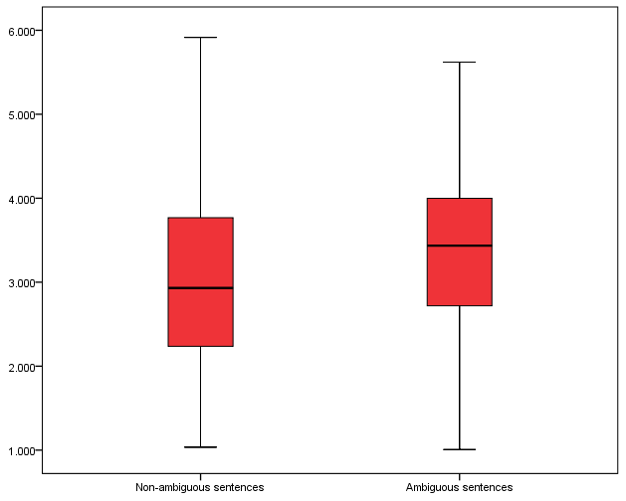
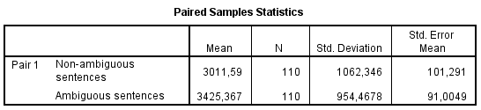
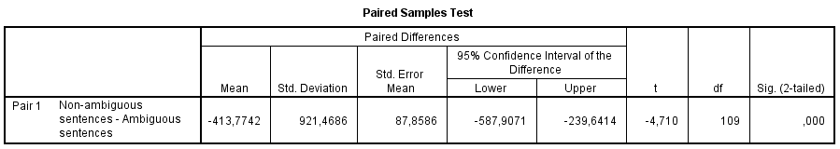
Exercise 2 – finding interpretation
What can we conclude?
Results of a paired samples t-test revealed that participants could read the non-ambiguous sentences significantly faster, t(109) = -4.71, p < .001.
Notes:
What does this all mean? (if they don’t react: )
Let’s start by looking at the mean values: if you were to verbalise this, what would you say? → difference of about 400 ms. Q? Is this smth you would expect? (yes!)
The same piece of info is visualised in the graph. Q? What kind of graph is this? (box plot) → Q? Thick line in the middle, is this the info about the mean? → no, info about the median, which tells us about what? → not the same type of average as mean, but about the “middle score”, if you wish, so half of the data is above and half of the data is below this value. Bottom whisker captures 25% of the data, below box 25% of the data, etc. So the median is higher for ambiguous than for non-ambiguous sentences, and this also speaks to the information that we have about the mean (in the case of a normal distribution, mean and median align)
mean difference we see in the table.
To know if this numerical difference in our sample is also representative for the whole population, we look at the p-value. So, what does this mean in this case? → There is a difference.
! do not report a p-value of .000 but smaller than .001
Go to example 7

Slide 6
Exercise 3: Sociolinguistics
You computed the MLU (= Mean Length of Utterance, e.g., the mean number of words per sentence) in a corpus of complaint letters to mobile phone provider written by teenagers and by senior citizens.
How can you find out if the MLU’s of teenagers and senior citizens differ significantly from each other? Explain your decision.
IV =
age group (teenagers vs. seniors)
categorical, nominal
DV =
MLU
continuous, ratio
Design =
between-subjects design
H0 =
the MLU is equal for teenagers and seniors
Statistical test → Independent-sample t-test (or Mann-Whitney U-test if normality not assumed)
Notes:
do at home

Slide 7
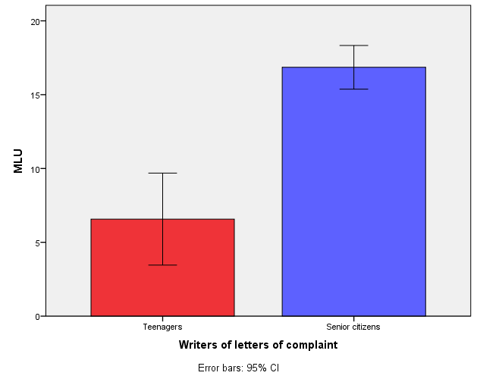
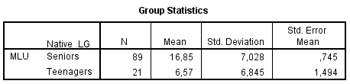
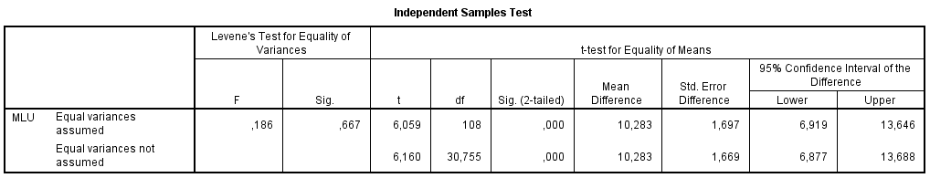
Exercise 3 - finding interpretation
What can we conclude?
Results of an independent-samples t-test showed that senior citizens used significantly longer utterances in their letters of complaint than teenagers, t(108) = 6.06, p < .001.

Slide 8
Exercise 4: Applied linguistics
You tested EFL learners at Mannheim university (N = 100) with a standardized vocabulary test. You also asked them to report for how long (not at all, some weeks, 3-6 months, > 6 months) they had stayed in an English-speaking country.
How can you find out if the stay abroad had an effect on the vocabulary test performance? Explain your decision.
IV =
stay abroad (4 conditions: not at all, some weeks, 3 – 6 months, <6 months)
categorical, ordinal
DV =
vocabulary test performance (test score)
continuous, interval
Design =
between-subjects design
H0 =
Stays in an English-speaking country do not affect EFL vocabulary test performance
Statistical test → One-way ANOVA (or non-parametric alternative)
Notes:
What would be your hypothesis?
IV: length of stay could be continuous, but here, we grouped participants, so categorical (4 categories)
DV: continuous, interval (not ratio because there is no absolute zero here)
Why couldn’t we use a t-test here?

Slide 9
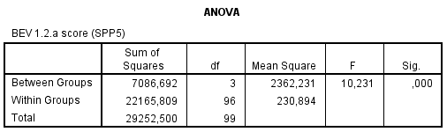
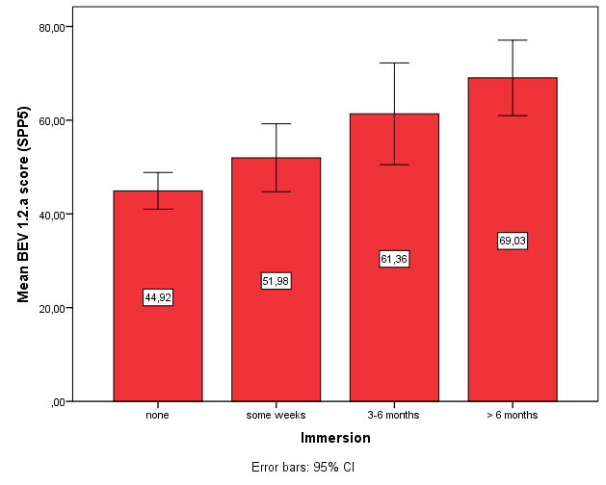
Exercise 4 - finding interpretation
Results: There was a main effect of stay abroad (immersion) on vocabulary test performance (BEV score), F(3, 96) = 10.23, p < .001.
Can we stop there?
Notes:
Interpretation of output + Q? Why do we need the Tukey table?
2 of these conditions do not make a difference in voc dvlpt: 3-6 months & some weeks and 3-6 months & <& mohts
Does this make sense to you?
Do you remember what these little whiskers tell you?
(If time: annotation: DF1 = nbr of groups -1, DF2 = nbr of groups – nbr of participants)

Slide 10
Exercise 4 – finding interpretation (2)
Post-hoc
What can we conclude?

Slide 11
Exercise 5: Second language acquisition
EFL learners completed a reading comprehension test. Their L1 was either French or German. They were asked about their vocabulary learning habits and classified as explicit or implicit learners (learning word lists or learning vocabulary incidentally while reading).
How can you find out if L1 and vocabulary learning type affect reading comprehension skills in EFL? Explain your decision.
IV =
L1 (French vs. German)
categorical, nominal
IV =
vocabulary learning habit (explicit vs. implicit)
categorical, nominal
DV =
reading comprehension test performance
continuous, interval
Design =
between-subjects design
H0 =
EFL learners’ reading comprehension is independent of their L1 and of their vocabulary learning habits
Statistical test → Factorial ANOVA (or non-parametric alternative)

Slide 12
Exercise 6: Psycholinguistics
In an experiment, you presented the same information in an advertisement in an informational, affectional, or emotional frame to three groups of students and measured how credible they rated the ad on a 7-point Likert scale ranging from “I totally disagree” to “I totally agree”.
How can you find out if the perceived credibility of the ad message differed significantly between the three framing conditions? Explain your decision.
IV =
framing condition (3 conditions: informational, affectional, emotional)
categorical, nominal
DV =
credibility
ordinal / continuous, interval
Design =
between-subjects design
H0 =
mean credibility of ad messages is equal in all three frame conditions; faming does not affect credibility
Statistical test → One-way ANOVA (or non-parametric alternative)

Slide 13
Exercise 7: Applied linguistics
Students take an EFL speaking test. Then they take part in a one-week English theatre camp. Back in school they take the same speaking test again.
How can you test if the theatre camp improved speaking skills significantly? Explain your decision.
IV =
intervention program (theatre camp)
DV =
speaking test performance
continuous, interval
Design =
within-subjects design, pretest-post-test design
H0 =
mean speaking skills are equal before and after the intervention; theatre camp does not improve speaking skills
Statistical test → Paired-samples t-test (or Wilcoxon signed-rank test if non-normal data)

Slide 14
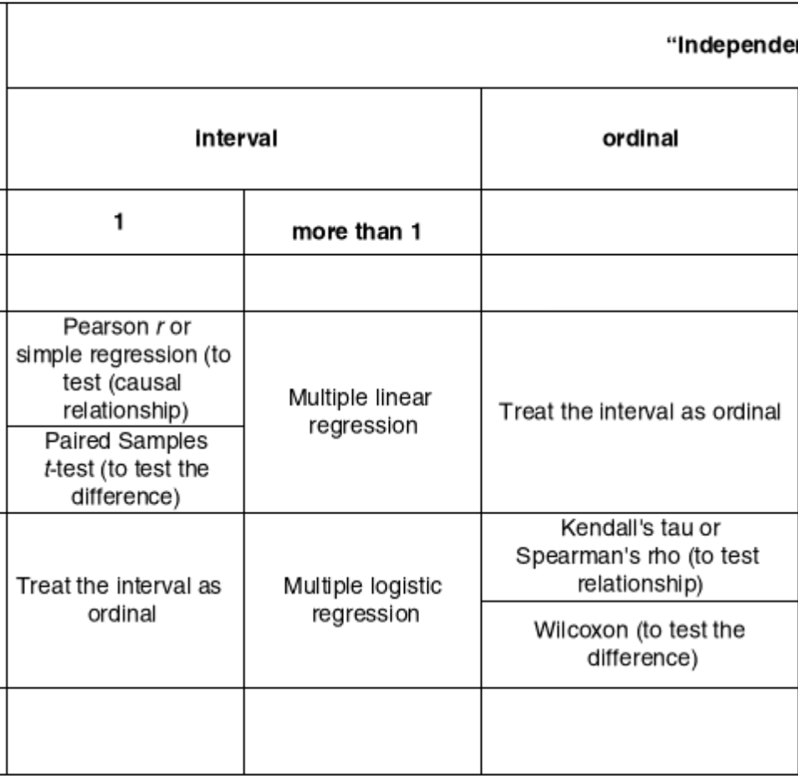
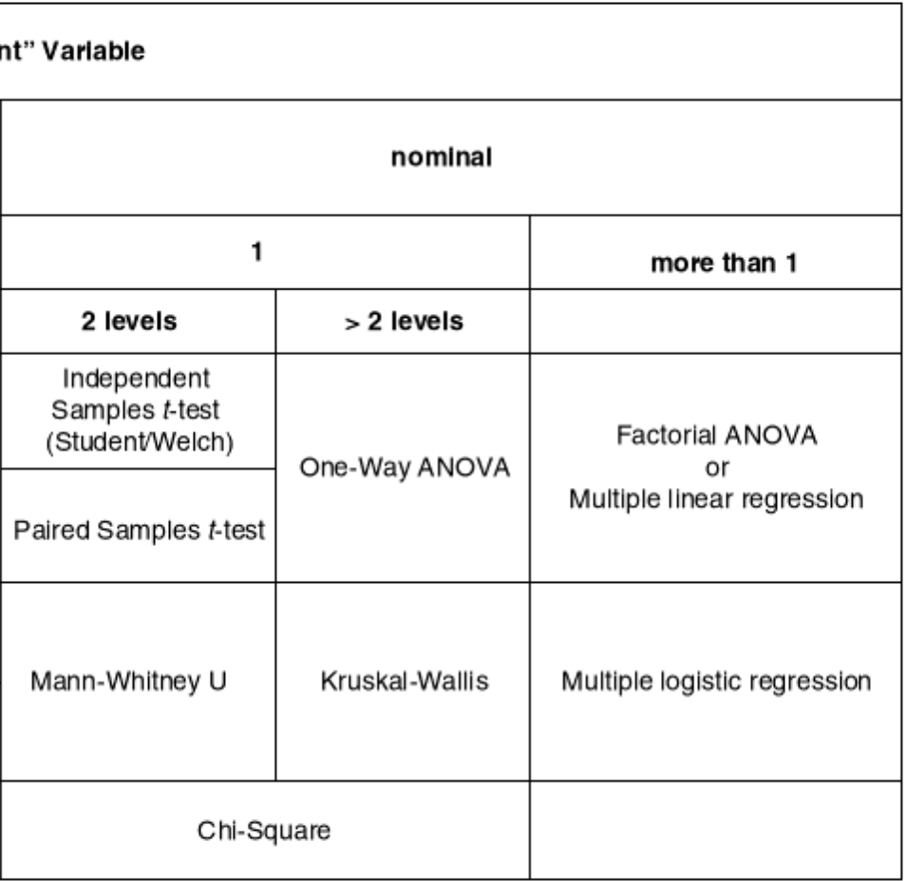
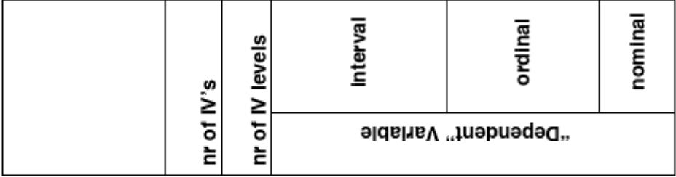
Overview: Statistical hypothesis testing
Loerts, Lowie & Seton (2020, p. 112)
Notes:
One more piece of info: these designs we’ve looked at so far have one DV and one IV variable, but you can imagine that in research, we usually work with situations that are more complex, maybe with more than one factor, and this within versus between subject situation can be more complex, sometimes we can have a mixed design. When could that be the case? So when could I have both a within and a between subject design in the same experiment?
(You need to have more than one IV: mono-bi-multilinguals = btw subject element, but if each of these three groups would read both the ambiguous and unambiguous sentences, this would be within subject) → So in the term paper you might have smth sightly more complex than the examples we have seen today.

Slide 15
Exercise 1: Second language acquisition
Over a period of four months, you visited a three-year old L2-learner of German four times. You played the “where-is-the-dolly-game” with her and recorded your conversation. Afterwards you transcribed the data and counted for each session how many of the 30 possible prepositions were used correctly.
How can you find out if the use of prepositions changed significantly over time? Which test(s) would be appropriate for statistical hypothesis testing? How could you visualize the results? Explain your decision.
IV =
time (recording session t1 – t4)
categorical scale, ordinal
DV =
correct prepositions (number in absolute frequency)
categorical, nominal
H0 =
frequencies for correct propositions are equal in each session t1 – t4
Statistical test → chi-square test
Notes:
First, Read this study description.
Before we start answering the questions asked in the second bullet point, it’s always handy to know what are your IVs, DVs and H0.
IV Time is regarded as categotrical because each month is seen as one category, but we see it as ordinal because the third session follows the 2nd one etc
DV = correct prepositions –> cat or continuous? It depends how we go about this info: there is more than one possibility, but If we go ahead with absolute frequencies, then we are with continuous scale because we have the pool of answers available (30 prep are available to be produces correctly) and eacht ime we counted the prep (40, 15, etc), so here we can treat it as continuous.
H0=
Given those pieces of info, which test would be appropriate in this case? (DV = ABSOLUTE FREQ → chi square! Not even needed to follow the chart)

Slide 16
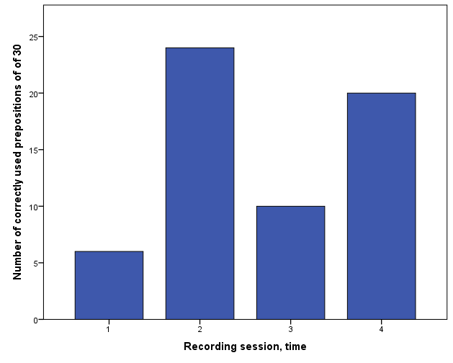
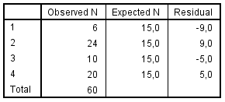
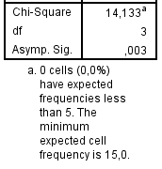
Exercise 1 - findings
Results:
A chi-square test showed that the number of correctly used prepositions varied significantly between the four sessions when the child was recorded, χ²(3) = 14.13, p = .003.
Notes:
In Jasp you would be able to produce a line chart, but you read it in the same way ( you could produce this in excel)
So what have they found here? → The hypo is about: is there change? The answer is yes: there are numerical differences between the various sessions (expected values differ from the observed ones, and the chi square tell us that these numerical differences are statistically significant, so we can reject the null hypo (with 99.7% confidence) that we can accept the alternative hypo, so it means that there is significant change over time.
(Translate statistics into English !)
If you want to report the results, you can say (click and read) : 3 = df
Any Q about this example or about this procedure of extracting the info and interpreting the outcome?

