Slide 1

From speech biomechanics to phonology:
children use intrinsic vowel pitch for contrast enhancement

Slide 2

Musical experiment

Slide 3




Are the sounds identical?
Sound A
Sound B
Sound C
→ Different instruments

Slide 4

Are the sounds identical?
Sound A
Sound B
Sound C
→ Different musical notes

Slide 5
The pronunciation of vowels
Notes:
Now, let me introduce you to our laboratory participant, our speaker, who is positioned sagittally. You might recall them from your initial encounters with phonetics in your textbooks. When we request our speaker to articulate vowels with varying qualities, our participant modulates the resonance cavities spanning from the larynx to the lips, effectively amplifying specific frequencies and shaping the formants that ultimately define the distinct vowel sounds.

Slide 6
The pronunciation of vowels
/i/
/u/
/a/
Notes:
And if we have a closer look at it, we can observe that the main articulator responsible for the shaping of the resonance cavities is the tongue thanks to changes in position and according to the place of maximal structure… this shapes what we know to be the articulatory and acoustic vowel triangles…

Slide 7

Speech experiment

Slide 8
Are the sounds identical?
F2
/i/
/u/
F1
F0
→ Different musical notes
/a/
Notes:
I referred to it as the "acoustic vowel space" because we can effectively map the articulatory vowel space onto the acoustic plane, using F1 and F2 to represent the first and second formants, respectively. Now, I'd like to give you the opportunity to listen to these three vowels, and I invite you to discern whether you can distinguish one from the others.
Now i ll let you hear three other sounds and you will tell me if you are also able to distinguish them as three different sounds. Yes , you can … well the three sounds you have just heard are the three vowels you previously heard but with the exception that I neutralized all spectral information but one… this means that in those sounds there was no F2 information there was no F1 information but still you could distinguish them because one thing was still different and that thing was the fundamental frequency …. In other words the pitch quality inherent to each vowel made you able to distinguish those vowels → this is what is called intrinsic vowel pitch.

Slide 9
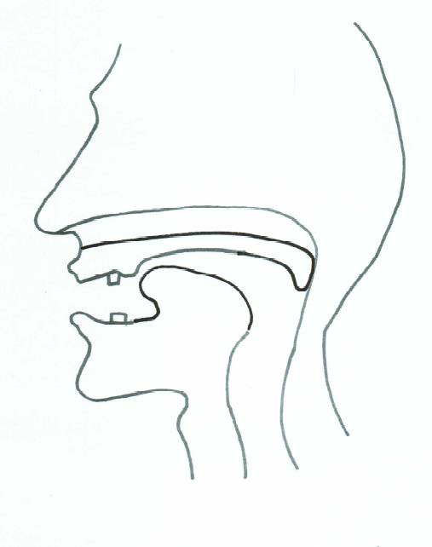
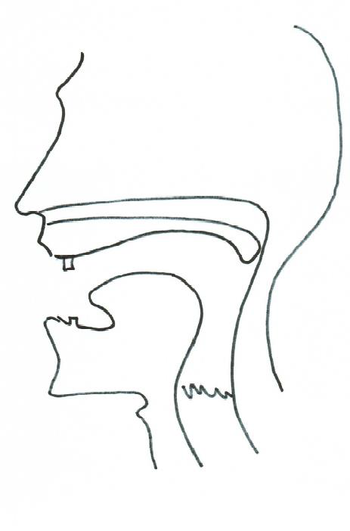
One big question ?
VS
High vowels
Low vowels
HIGH F0
LOW F0
Intrinsic Vowel Pitch (= IF0)
Notes:
Tackle one big question
One distinction
High voice vs low voice

Slide 10

Two competing theories
VS
Biomechanical
Functional
High vowels
≠
Low vowels
Notes:
Tackle one big question
One distinction
High voice vs low voice

Slide 11

Different expectations
VS
Biomechanical
Functional
Automatic
Innate
No developmental effect
Not automatic
Acquired
Developmental effect
Notes:
Tackle one big question
One distinction
High voice vs low voice

Slide 12



Res. Questions?
Is there IF0 in the early vocalizations ?
Is there a developmental trajectory in the size of IF0?
F1-F0
Low vowels
High vowels
Low vowels
High vowels
Development
Notes:
Tackle one big question
One distinction
High voice vs low voice

Slide 13


Res. Questions?
Corpus:
CLiPS Child Language Corpus (CCLC)
Longitudinal – monthly recordings
Monolingual Belgian Dutch environment
19 recordings from 6 to 24 months
30 children
20-minute transcription for each recording
Notes:
Tackle one big question
One distinction
High voice vs low voice

Slide 14
Methods
Acoustic analysis:
Automatic detection of vowels
Parselmouth API (Jadoul et al., 2018) of PRAAT (Boersma & Weenink, 2023)
Syllable_nuclei_v3 (De Jong et al., 2021) fine-tuned based on n° of vowels in human transcription
F0, F1 measurements
1st pass with PRAAT standard parameters
2nd pass with tuned-parameters per child and per recording (Keelan et al., 2010)
Exclusion of outliers (Garrelek et al., 2023)
Normalization per speaker/session through
regression modelling (Barreda & Nearey., 2018)
Notes:
Tackle one big question
One distinction
High voice vs low voice

Slide 15

Methods
Statistical analysis:
Generalized Additive Mixed Modeling
Development of F1-F0 distance –
Model selection (cfr. Kirkham et al. 2019):
Parametric term:
Single smooths:
Tensor product interaction:
Difference smooth:
Random smooth:
Notes:
Tackle one big question
One distinction
High voice vs low voice

Slide 16
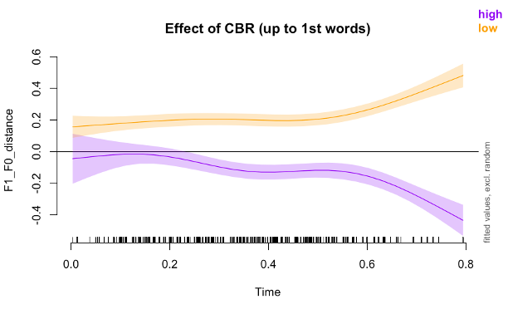
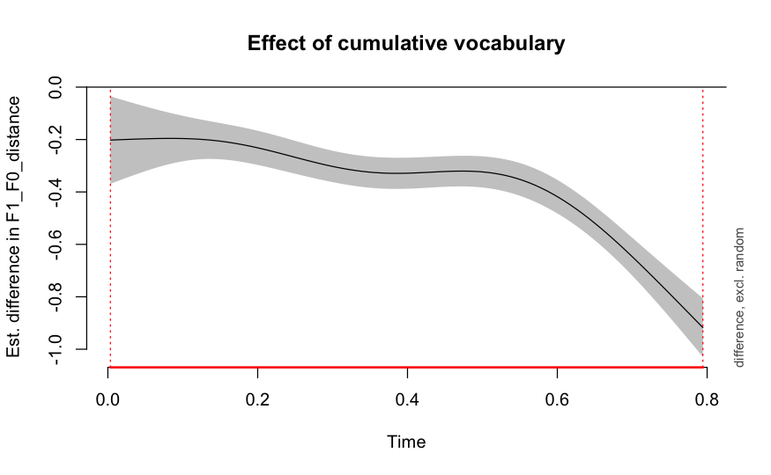
Results
[dada]
Prelexical utterances:
No significant differences between high and low vowels at 6 months
The perceptual difference between high and low vowels increases as the 1st words approach
Notes:
Tackle one big question
One distinction
High voice vs low voice

Slide 17
Results
[dada]
Prelexical utterances:
Formula:
F1_F0_distance ~ hgt + s(CHILD, bs = "re") + s(CHILD, hgt, bs = "re") + s(Time, by = hgt, k = nr_smooth) + s(Time, k = nr_smooth)
Parametric coefficients:
Estimate Std. Error t value Pr(>|t|)
(Intercept) -0.11528 0.02064 -5.585 2.39e-08 ***
hgtlow 0.33298 0.02740 12.151 < 2e-16 ***
---
Signif. codes: 0 ‘***’ 0.001 ‘**’ 0.01 ‘*’ 0.05 ‘.’ 0.1 ‘ ’ 1
Approximate significance of smooth terms:
edf Ref.df F p-value
s(CHILD) 0.003999 29.000 0.000 0.97001
s(CHILD,hgt) 48.434434 58.000 12.687 < 2e-16 ***
s(Time):hgthigh 2.573431 2.878 4.463 0.00248 **
s(Time):hgtlow 3.599983 3.902 15.720 < 2e-16 ***
s(Time) 1.000106 1.000 7.175 0.00740 **
---
Signif. codes: 0 ‘***’ 0.001 ‘**’ 0.01 ‘*’ 0.05 ‘.’ 0.1 ‘ ’ 1
Rank: 103/104
R-sq.(adj) = 0.214 Deviance explained = 21.8%
-ML = 2524.9 Scale est. = 0.098556 n = 11859
No significant differences between high and low vowels at 6 months
The perceptual difference between high and low vowels increases as the 1st words approach
Notes:
Tackle one big question
One distinction
High voice vs low voice

Slide 18

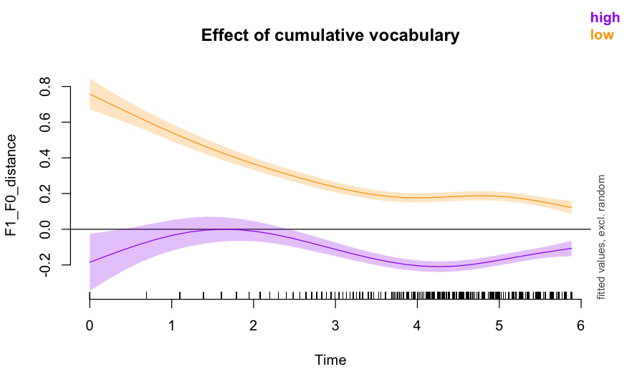
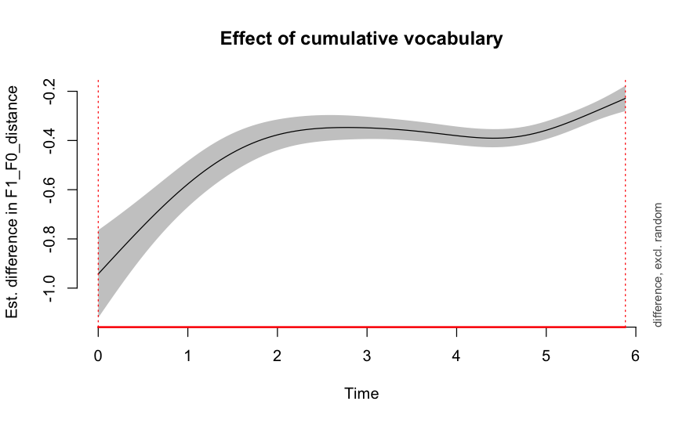
Results
[dædi]
Lexical utterances:
As the children’s lexicon grows, the size of IF0 also diminishes
Notes:
Tackle one big question
One distinction
High voice vs low voice

Slide 19
Results
[dædi]
Lexical utterances:
As the children’s lexicon grows, the size of IF0 also increases
Parametric coefficients:
Estimate Std. Error t value Pr(>|t|)
(Intercept) -0.15757 0.01276 -12.34 <2e-16 ***
hgtlow 0.35393 0.01676 21.12 <2e-16 ***
---
Signif. codes: 0 ‘***’ 0.001 ‘**’ 0.01 ‘*’ 0.05 ‘.’ 0.1 ‘ ’ 1
Approximate significance of smooth terms:
edf Ref.df F p-value
s(CHILD) 2.228 29.000 0.447 0.45861
s(CHILD,hgt) 46.272 58.000 7.711 < 2e-16 ***
s(Time):hgthigh 3.735 4.419 13.992 < 2e-16 ***
s(Time):hgtlow 4.918 5.565 23.144 < 2e-16 ***
s(Time) 1.019 1.022 8.737 0.00298 **
---
Signif. codes: 0 ‘***’ 0.001 ‘**’ 0.01 ‘*’ 0.05 ‘.’ 0.1 ‘ ’ 1
Rank: 109/110
R-sq.(adj) = 0.303 Deviance explained = 30.6%
-ML = 883.88 Scale est. = 0.072141 n = 12818
Notes:
Tackle one big question
One distinction
High voice vs low voice

Slide 20
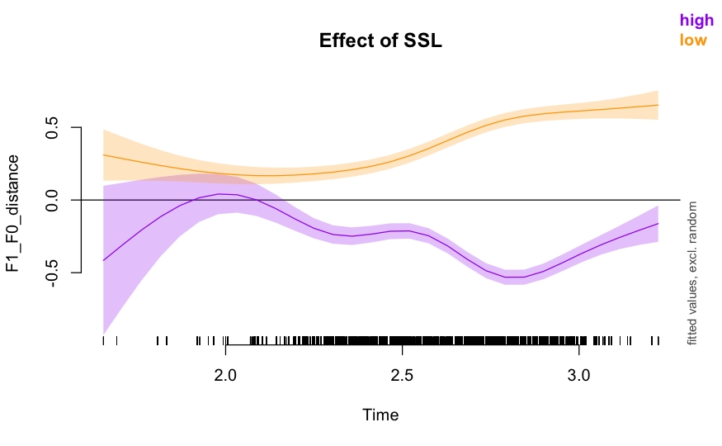
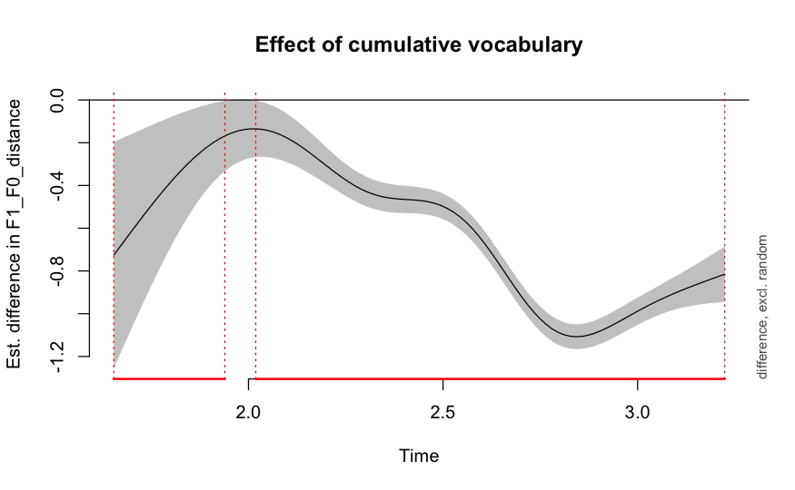
Results
[dædi]
[dada]
The whole story:
As the children’s lexicon grows, the size of IF0 also increases
Notes:
Tackle one big question
One distinction
High voice vs low voice

Slide 21
Results
[dædi]
[dada]
The whole story:
F1_F0_distance ~ hgt * type + s(CHILD, bs = "re") + s(CHILD,
hgt, bs = "re") + s(CHILD, type, bs = "re") + s(Time, by = hgt,
k = nr_smooth) + s(Time, by = type, k = nr_smooth) + s(Time,
k = nr_smooth)
Parametric coefficients:
Estimate Std. Error t value Pr(>|t|)
(Intercept) 0.05600 0.02712 2.065 0.0389 *
hgtlow 0.14016 0.02906 4.824 1.41e-06 ***
typeprelexical -0.41431 0.02533 -16.354 < 2e-16 ***
hgtlow:typeprelexical 0.65788 0.01649 39.891 < 2e-16 ***
---
Signif. codes: 0 ‘***’ 0.001 ‘**’ 0.01 ‘*’ 0.05 ‘.’ 0.1 ‘ ’ 1
Approximate significance of smooth terms:
edf Ref.df F p-value
s(CHILD) 0.004517 29.00000 0.000 1.000000
s(CHILD,hgt) 44.518821 58.00000 39.342 0.000917 ***
s(CHILD,type) 34.204756 58.00000 13.059 0.705392
s(Time):hgthigh 4.763230 4.96873 40.430 < 2e-16 ***
s(Time):hgtlow 5.272699 5.79523 17.417 < 2e-16 ***
s(Time):typelexical 1.000502 1.00097 3.441 0.063675 .
s(Time):typeprelexical 1.000818 1.00149 11.327 0.000760 ***
s(Time) 0.015406 0.01728 0.320 0.940718
---
Signif. codes: 0 ‘***’ 0.001 ‘**’ 0.01 ‘*’ 0.05 ‘.’ 0.1 ‘ ’ 1
Rank: 182/184
R-sq.(adj) = 0.258 Deviance explained = 26%
-ML = 26948 Scale est. = 0.26078 n = 37347
As the children’s lexicon grows, the size of IF0 also increases
Notes:
Tackle one big question
One distinction
High voice vs low voice

Slide 22


Conclusions
F1-F0 distance of low vowels higher from early on
Even when perceptually not relevant
= BIOMECHANICAL ORIGIN
Perceptual relevance of vowel height increases
Size of IF0 also increases
= PERCEPTUAL RELEVANCE
MIXED ORIGIN
of IF0
IF0
[dædi]
[dada]
Notes:
Tackle one big question
One distinction
High voice vs low voice

Slide 23



Thank you ! ! !
Stay tuned
Notes:
Tackle one big question
One distinction
High voice vs low voice

