Slide 1


Intrinsic Vowel Pitch in Children
Acoustic analysis of a child speech corpus

Slide 2

Musical experiment

Slide 3




Are the sounds identical?
Sound A
Sound B
Sound C
→ Different instruments

Slide 4

Are the sounds identical?
Sound A
Sound B
Sound C
→ Different musical notes

Slide 5
The pronunciation of vowels
Notes:
Now, let me introduce you to our laboratory participant, our speaker, who is positioned sagittally. You might recall them from your initial encounters with phonetics in your textbooks. When we request our speaker to articulate vowels with varying qualities, our participant modulates the resonance cavities spanning from the larynx to the lips, effectively amplifying specific frequencies and shaping the formants that ultimately define the distinct vowel sounds.

Slide 6
The pronunciation of vowels
/i/
/u/
/a/
Notes:
And if we have a closer look at it, we can observe that the main articulator responsible for the shaping of the resonance cavities is the tongue thanks to changes in position and according to the place of maximal structure… this shapes what we know to be the articulatory and acoustic vowel triangles…

Slide 7

Speech experiment

Slide 8
Are the sounds identical?
F2
/i/
/u/
F1
F0
→ Different musical notes
/a/
Notes:
I referred to it as the "acoustic vowel space" because we can effectively map the articulatory vowel space onto the acoustic plane, using F1 and F2 to represent the first and second formants, respectively. Now, I'd like to give you the opportunity to listen to these three vowels, and I invite you to discern whether you can distinguish one from the others.
Now i ll let you hear three other sounds and you will tell me if you are also able to distinguish them as three different sounds. Yes , you can … well the three sounds you have just heard are the three vowels you previously heard but with the exception that I neutralized all spectral information but one… this means that in those sounds there was no F2 information there was no F1 information but still you could distinguish them because one thing was still different and that thing was the fundamental frequency …. In other words the pitch quality inherent to each vowel made you able to distinguish those vowels → this is what is called intrinsic vowel pitch.

Slide 9
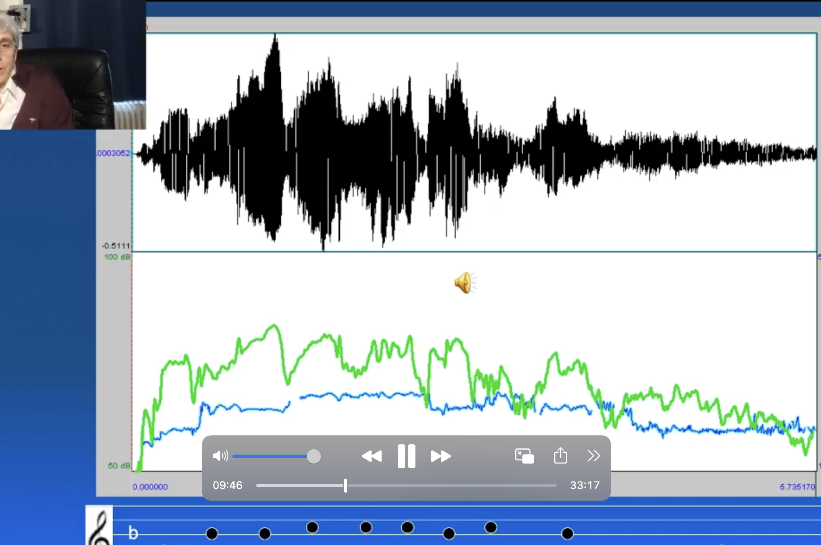
Notes:
I referred to it as the "acoustic vowel space" because we can effectively map the articulatory vowel space onto the acoustic plane, using F1 and F2 to represent the first and second formants, respectively. Now, I'd like to give you the opportunity to listen to these three vowels, and I invite you to discern whether you can distinguish one from the others.
Now i ll let you hear three other sounds and you will tell me if you are also able to distinguish them as three different sounds. Yes , you can … well the three sounds you have just heard are the three vowels you previously heard but with the exception that I neutralized all spectral information but one… this means that in those sounds there was no F2 information there was no F1 information but still you could distinguish them because one thing was still different and that thing was the fundamental frequency …. In other words the pitch quality inherent to each vowel made you able to distinguish those vowels → this is what is called intrinsic vowel pitch.

Slide 10







Definition of a Research Question
2 main features:
- 1 dependent variable = a specific phonetic phenomenon
- At least one independent variable = any “contextual” factor
Linguistic factors
Population factors
Biological factors
…
(language, grammar, word, phoneme, etc)
(SES, regional background, monolingual, etc)
(sexe, age, anatomical differences, etc)

Slide 11

Definition of a Research Question
Data collection
Pre-processing
Acoustic analysis
Post-processing
Stats. Analysis
Interpretation
Sound features:
- Time (When ?)
Amplitude (How strong?) Structure
Frequency (How high?)

Slide 12
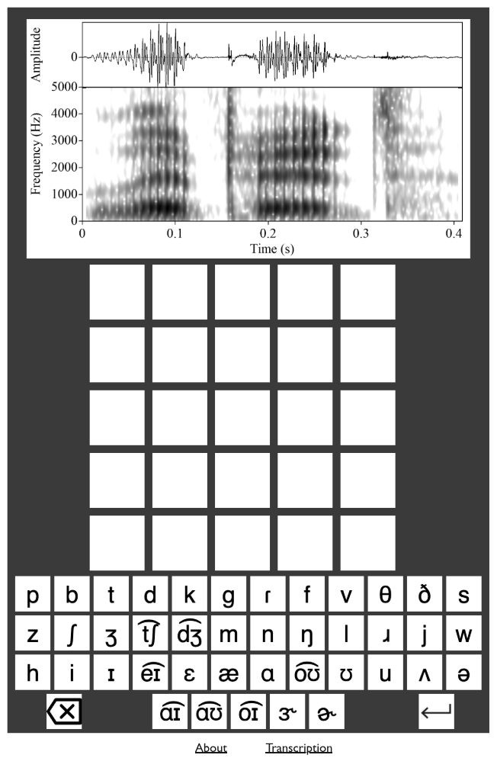
Definition of a Research Question
Data collection
Pre-processing
Acoustic analysis
Post-processing
Stats. Analysis
Interpretation
PRAAT: All information in one picture
GRAMLE
≃wordle
https://nascl.rc.nau.edu/about-gramle/
“READ A SPECTROGRAM”
Notes:
/laiped/
lipid

Slide 13
Definition of a Research Question
Data collection
Pre-processing
Acoustic analysis
Post-processing
Stats. Analysis
Interpretation
Amplitude
Time
Frequency
Notes:
/laiped/
lipid

Slide 14
Definition of a Research Question
Data collection
Pre-processing
Acoustic analysis
Post-processing
Stats. Analysis
Interpretation
Amplitude
Time
Frequency
Notes:
Good frequency resolution narrow wide band

Slide 15
Definition of a Research Question
Data collection
Pre-processing
Acoustic analysis
Post-processing
Stats. Analysis
Interpretation
Sound features:
- Time (When ?) -> Centre of vowels
Amplitude (How strong?) -> First frequency
Frequency (How high?) amplified

Slide 16

Definition of a Research Question
Data collection
Pre-processing
Acoustic analysis
Post-processing
Stats. Analysis
Interpretation
Centre of vowels (1)
Automatic
- Fast
- Error prone
- No human bias
Manual
Slow
Less error prone
Human bias
A combination of both

Slide 17
Definition of a Research Question
Data collection
Pre-processing
Acoustic analysis
Post-processing
Stats. Analysis
Interpretation

Slide 18
Definition of a Research Question
Data collection
Pre-processing
Acoustic analysis
Post-processing
Stats. Analysis
Interpretation

Slide 19
Definition of a Research Question
Data collection
Pre-processing
Acoustic analysis
Post-processing
Stats. Analysis
Interpretation
Is F0 different in high and low vowels produced by monolingual children acquiring Dutch? And is there a development?
Development in children?
Age?

Slide 20
Definition of a Research Question
Data collection
Is F0 different in high and low vowels produced by monolingual children acquiring Dutch?
- Select participants

Slide 21

Definition of a Research Question
Is F0 different in high and low vowels produced by monolingual children acquiring Dutch?
Linguistic factors
Population factors
Biological factors
…
(language, grammar, word, phoneme, etc)
(SES, regional background, monolingual, etc)
(sexe, age, anatomical differences, etc)

Slide 22


Good luck !!!

