Slide 1
Shogi Board
By Jarod Owen

Slide 2
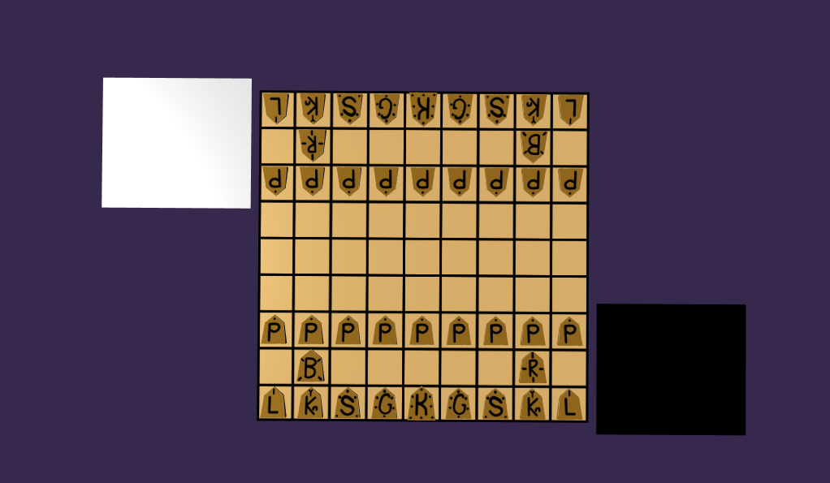
What is it?
The thing I made is a virtual Shogi board. It lets you play the game as if you had a real bord (i.e. it does not force you to play by the rules).
If you don’t know what this Shogi non-sense I'm talking about is, it's basically Japanese chess. Any relevant rules will be explained as needed.

Slide 3
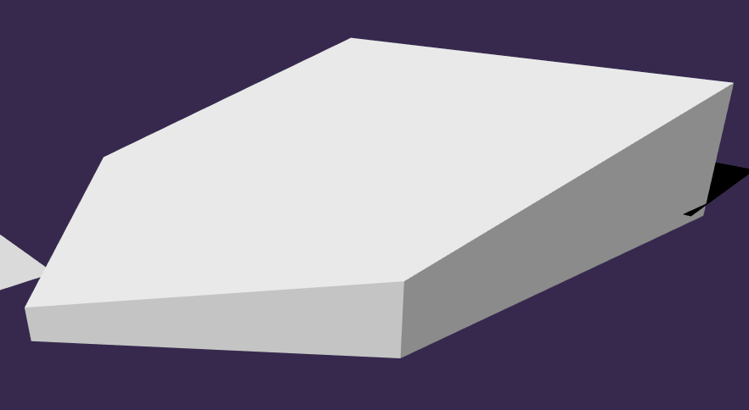
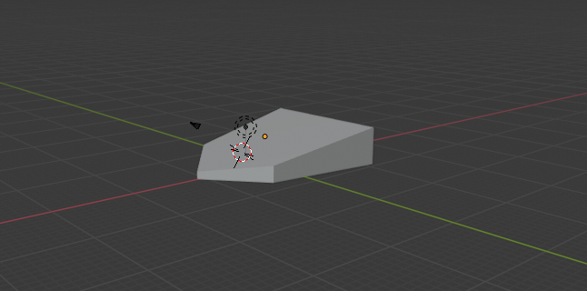
Features: Mesh Imports
The mesh that was used for all the pieces was not made in Babylon.js, but instead in Blender.
Technical difficulties ensued, mostly because I couldn't figure out how to edit imported meshes.
Fun fact: Babylon.js and Blender use very different default measurement units.

Slide 4

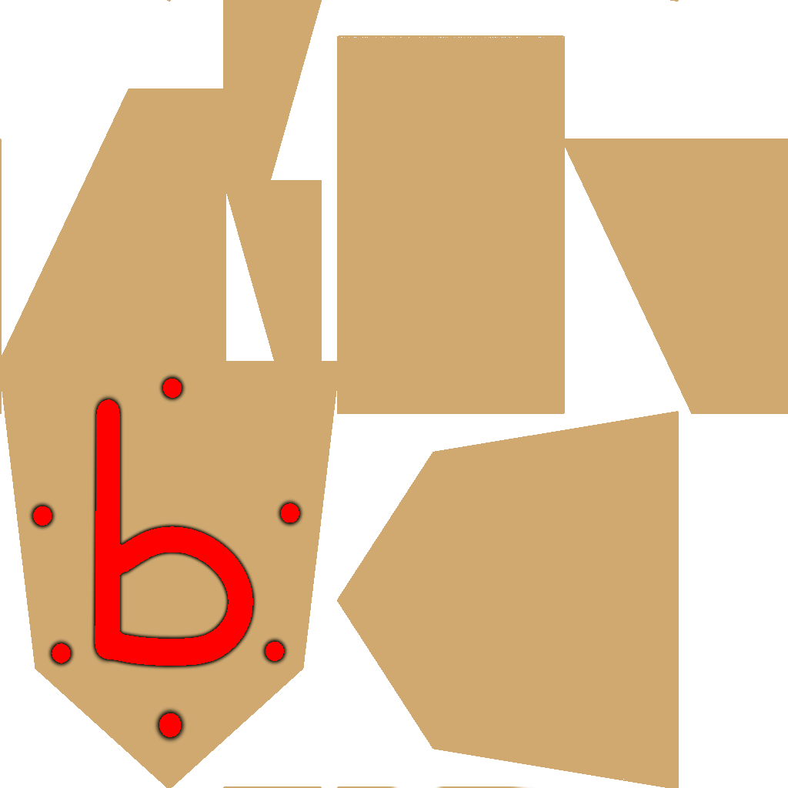
Features: Textures
Textures were also kind of weird.
Most were raster, but the board was vector.
The raster textures had to be drawn backwards for reasons still yet to be discovered.
These textures also had to be swapped instead of flipping the pieces because the pieces were not at all cooperating when being flipped.

Slide 5
Features: UV maps
The piece textures were only acting like a solid color applied to the model. This was because the meshes had no UV maps and thus had no idea what to do with the texture.
After trying and failing to import a UV map made in Blender, re-exporting the mesh in a different format somehow also attached the UV map to the model.
Unfortunately, the textures were still backwards, and this is probably why.

Slide 6
Features: Event Listener
An event listener was used to move pieces, detecting clicks on the pieces and hidden meshes on top of the board's squares. This feature turned out to help correct a problem from the model import.
Even after the method of editing the imported models was pinned down, the edits still seemingly had to take place in the same function that was called as a part of the importation because of a delay between the importation and the execution of other code.
As it turned out the event listener's functions had the same sort of delay, and as a result a lot of the code could be moved inside. The only drawback being that it looks a bit messy.

Slide 7
Demonstration Time
Now to show the actual thing and the source code. Please wait while I screw up a few times before showing it off.

