Slide 1

WindWalker: Using Wind as an Orientation Tool in Virtual Environments
XI Symposium on Virtual and Augmented Reality SVR 2009
May 25 - 28
PUCRS Campus at Porto Alegre, RS, Brazil
Henrique G. Debarba, Jerônimo G. Grandi, Adriano Oliveski, Diana Domingues
Laboratório NTAV – Universidade de Caxias do Sul (UCS)
fhgdebarb, jggrandi, aolives1, ddomingg@ucs.br
Anderson Maciel, Luciana P. Nedel
Instituto de Informática – Universidade Federal do Rio Grande do Sul (UFRGS)
famaciel,nedelg@inf.ufrgs.br

Slide 2

Problem
Human skin is the largest human organ
Haptics (tactile perception) is important for self orientation in the real world
How could we use wind as an alternative way to communicate spatial information in virtual environments?

Slide 3
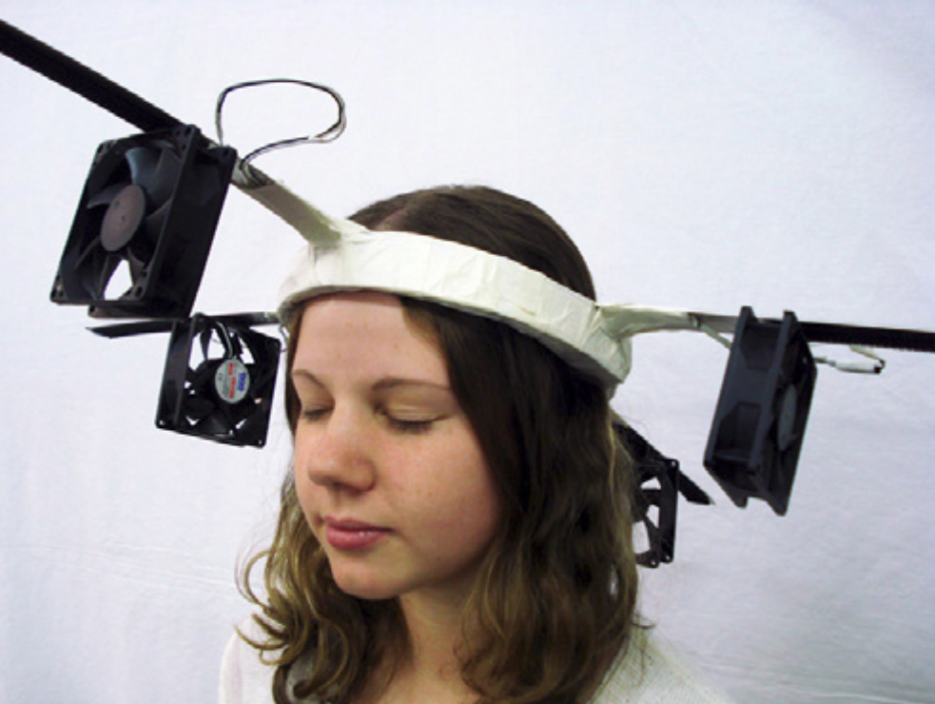
Contents
Related work
Goal
Approach
  Hardware
  Software
Application
  Maze
Interaction evaluation
Results
Future works

Slide 4
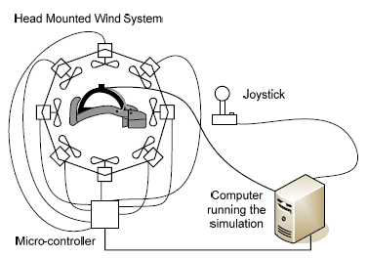
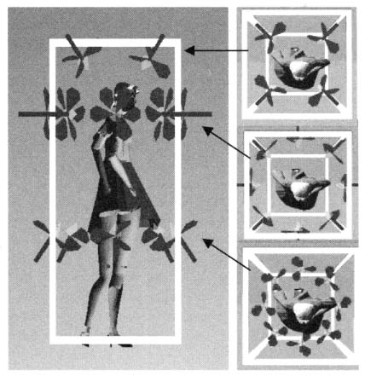
Related Work
Head Mounted Wind
  S. Cardin,
  D. Thalman,
  F. Vexo
  2007
Wind Cube
  T. Moon,
  G. J. Kim
  2004

Slide 5
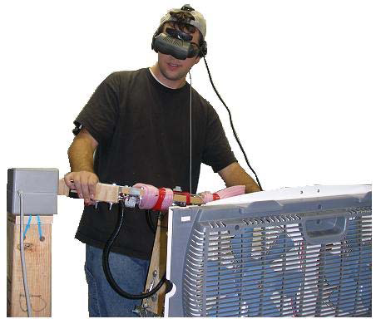
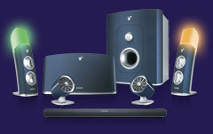
Related Work
VR Scooter
  L. Deligiannidis,
  R. J. K. Deligiannidis
  2006
Ambient Experience
  PHILIPS

Slide 6
Goal
Evaluate possibilities for the wind to act as a major transsensorial interface in a VE.

Slide 7
Approach
Hardware and Software Development
Tests and Evaluation

Slide 8
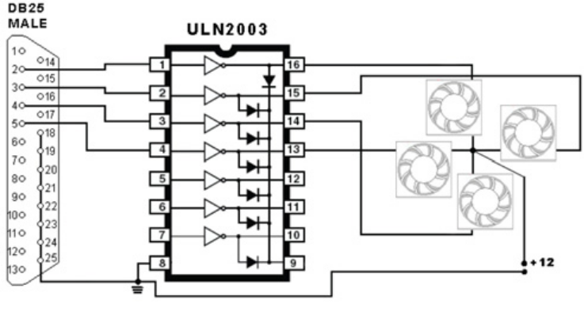

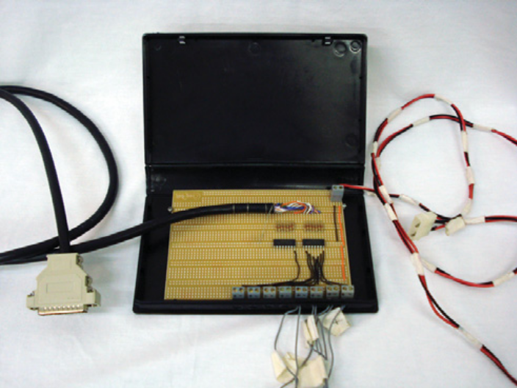
Hardware
Construction
Operation
Lowcost / off-the-shelf

Slide 9
Software
Board Control
Simple software to control the io library, delivering binary signals to the board through the parallel port.
Binary signals are interpreted as pulse/no pulse, setting the fan on/off.

Slide 10
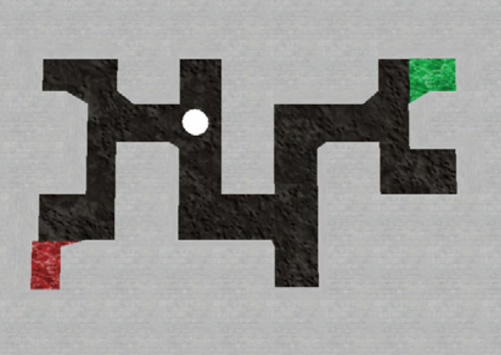
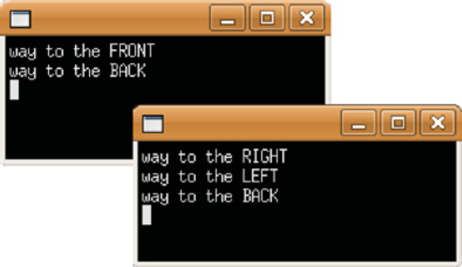
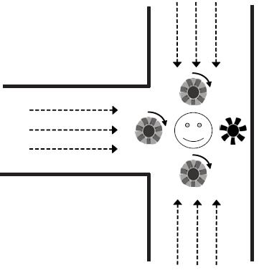
Application
Game: Find your way out of the maze
  Three independent interaction modes
Visual (map) Text Windwalker

Slide 11
Interaction Evaluation
User tests (12 volunteers)
Task: find the way out of the maze
Independent variable: interface mode
  WIND vs. TEXT
Constraints:
  Eyes covered (opaque glasses)
  Ears covered (playing music or talking)

Slide 12
Hypothesis
The common user is able to orient himself in the environment using only wind feedback.

Slide 13
Tests
Isolated Text and Isolated WindWalker
  Cognitive overload test
    Simple mathematical questions asked while interacting (with either interface)
Procedure:
  Select a random maze pattern
  Free practice with all interfaces
  For each interface
    Select a different random maze pattern
    Perform the test
  Fill up a questionnaire

Slide 14
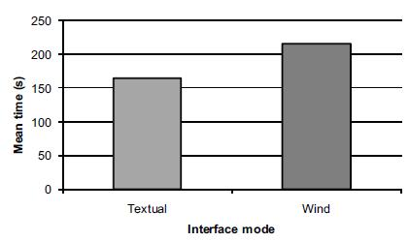
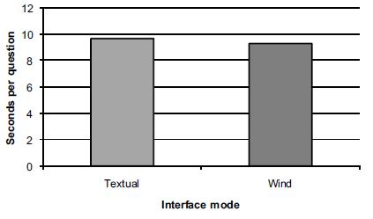
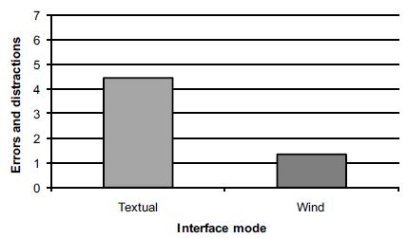
Results
Mean Time to complete the task Mean time for each mathematical question
Average cognitive errors while performing the task

Slide 15
Future works
System improvements (H/S accuracy)
Combine with other non-conventional interaction modes
  Motion tracking (instead of keyboard)
Applications for visually impaired people
Explore other accessibility issues

Slide 16
References
”amBX Philips”. Ambient experience home page. Online at: http://www.ambx.com. Acesso em Feb. 2009.
M. T. Atkinson, S. Gucukoglu, C. H. C. Machin, and A. E. Lawrence. Making the mainstream accessible: redefining the game. In Sandbox ’06: Proceedings of the 2006 ACM. SIGGRAPH symposium on Videogames, pages 21–28, New York, NY, USA, 2006. ACM.
[S. Cardin, D. Thalmann, and F. Vexo. Head Mounted Wind. In Computer Animation and Social Agents (CASA2007), pages 101–108, 2007.
M. Chion. Audio-vision: sound on screen. Columbia University Press, 1994.
L. Deligiannidis and R. J. K. Deligiannidis. The vr scooter: Wind and tactile feedback improve user performance. In 3DUI ’06: Proceedings of the 3D User Interfaces, pages 143-150, Washington, DC, USA, 2006. IEEE Computer Society.
M. L. Heilig. Sensorama simulator, August 1962.
S. M. Kosslyn and D. N. Osherson. Visual Cognition. MIT Press, 1995.
V. B. Mountcastle. Perceptual Neuroscience: The Cerebral Cortex. Harvard University Press, 1998.
M. Zhou, D. Jones, and S. S. C. Cao. Role of haptic feedback and cognitive load in surgical skill acquisition. In PROCEEDINGS of the HUMAN FACTORS AND ERGONOMICS SOCIETY, pages 631–635, 2007.
T. Moon and G. J. Kim. Design and evaluation of a wind display for virtual reality. In VRST ’04: Proceedings of the ACM symposium on Virtual reality software and technology, pages 122–128, New York, NY, USA, 2004. ACM.
“TopSpeed”. Playing in the dark. Online at: http://www.playinginthedark.net. Acesso em: Feb. 2009.
“Audio Games”. Em: http://www.audiogames.net, Acesso em: Feb. 2009.

Slide 17





Acknowledgements
Thanks are due to the volunteers for their participation
in the tests, especially the fellows at NTAV. Thanks
to Gelson Cardoso Reinaldo for the technical support in
the lab and to Luiz Carlos Stevanatto Filho for his help
with the hardware interface. Thanks are also due to
CNPq for the support through grants PDJ 151820/2007-4,
PIBIC/CNPq and IC/CNPq, and to Propesq/UFRGS for the
grant BIC/UFRGS.

