Slide 1
Cascaded Integrator-Comb Filters
James Gibbard

Slide 2
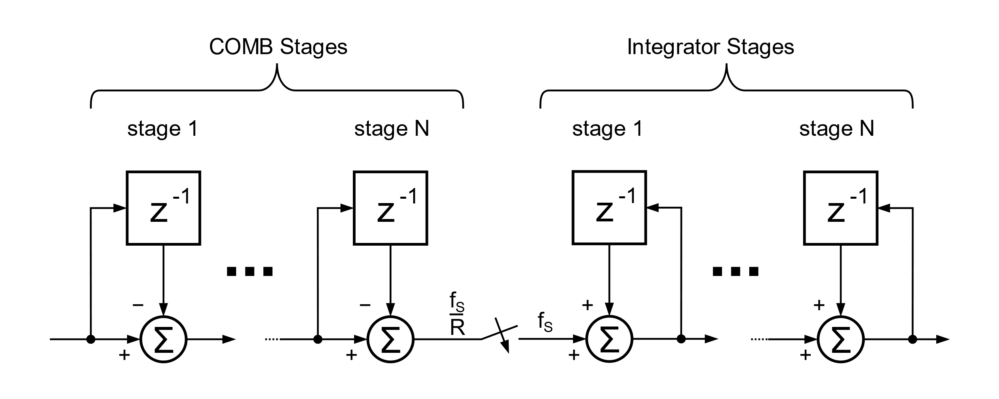
What are CIC Filters?
CICs are an optimised combination of an FIR filter and an interpolator or decimator
Require no multiply operations, only addition and subtraction
Typically used when the sample rate changes by a factor of 10 or more
Sample rate can be changed dynamically
Only work with fixed point maths
Notes:
Image is of an interpolator
CICs filters can be used to interpolate or decimate a signal. I.e. increase or decrease the sample rate
Often called CIC decimator or CIC interpolator
No multipliers – particularly of use in FPGAs and ASICs (Multipliers take up much more silicon than adders)
For large rate changes a CIC has a significant computational advantage over an FIR filter
But there are negatives –
CIC filters do not work with floating point numbers due to rounding errors
CIC filters have pass band attenuation

Slide 3
How Do CIC Filters work?
[Using only diagrams and graphs]

Slide 4
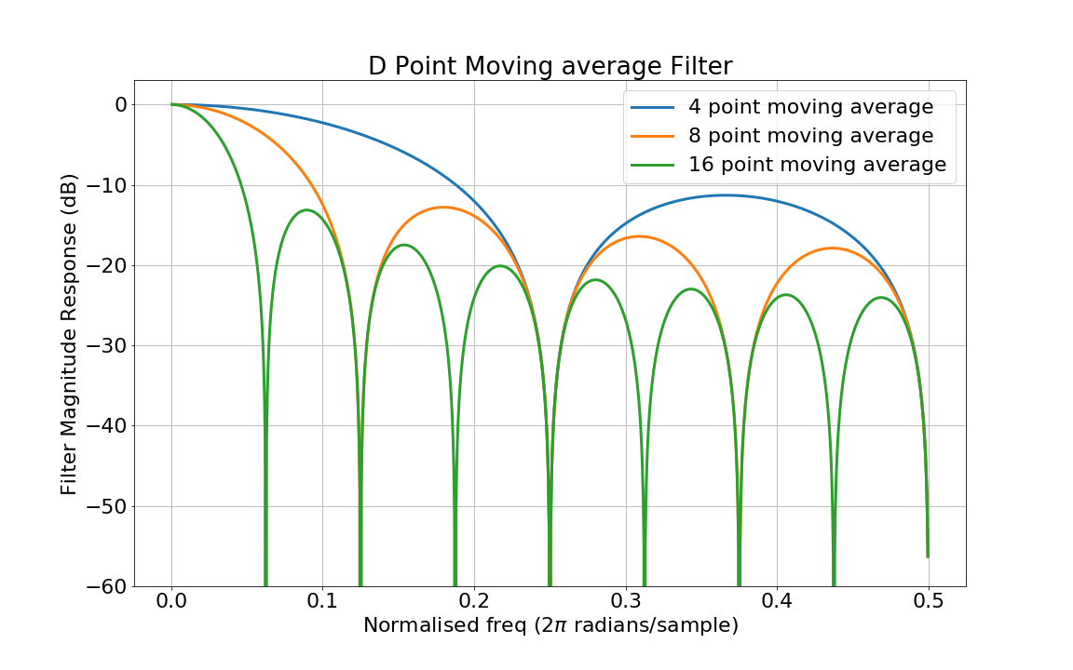
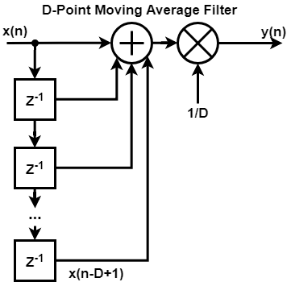
Moving Average Filter
Notes:
Requires D-1 additions
Low pass characteristics
Greater D is the tighter the low pass response
Roll off is not very good

Slide 5
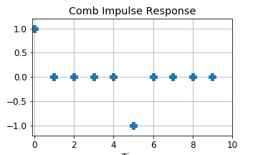
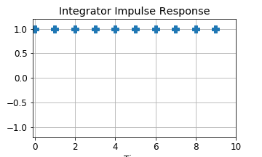
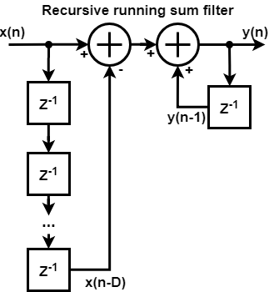
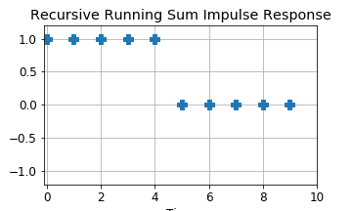
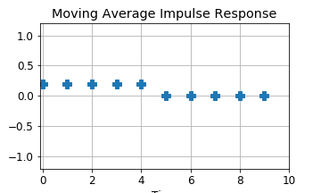
Recursive Running Sum Filter
Time
Time
Notes:
Explain how block diagram is the same as moving average
Left part = Comb
Right part = integrator
D = 5
Convolve the comb and integrator response to get combined response
Same as moving average filter. But there is gain as we have got rid of the multiplier
Talks about floating point – rounding errors and the integrator

Slide 6
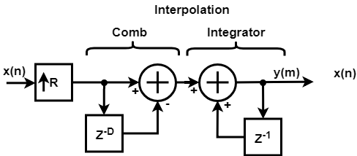
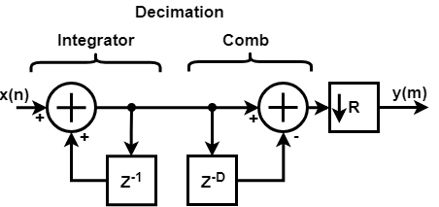
CIC Filter (Non-Optimised)
Notes:
Running sum filter is the same as CIC filter with order 1.
Doesn’t matter which way round we have the comb and integrator. Linear time invariant operations
However later for optimisation reasons it makes sense to have the comb on the side nearest the resampling element.
Currently the down-sample or up-sample takes place before or after the filter. This is non-optimal.
We can see that we are either doing lots of operations on zero values (Interpolator) or we are doing calculations that are then thrown away (decimator)
Going to stay with the non-optimised form for the moment as it is easier to plot

Slide 7
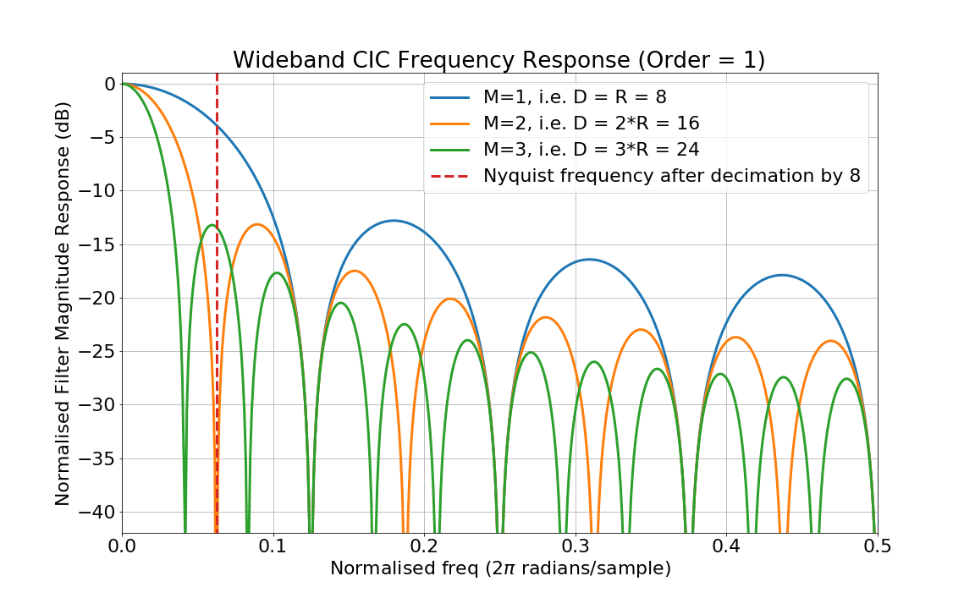
Setting the Delay Value
D is set to an integer multiple of R
This allows for optimisation later on
Normally denoted as D = M*R
M is typically 1 or 2
Larger values of M have too much attenuation in the pass band for most applications
Notes:
Might be able to get away with higher M values if your lower sample rate is much larger than the bandwidth of your signal
Note that the magnitude has been normalised. There is gain which needs to be removed as well.
Rejection is still bad. We haven’t fixed that yet.

Slide 8
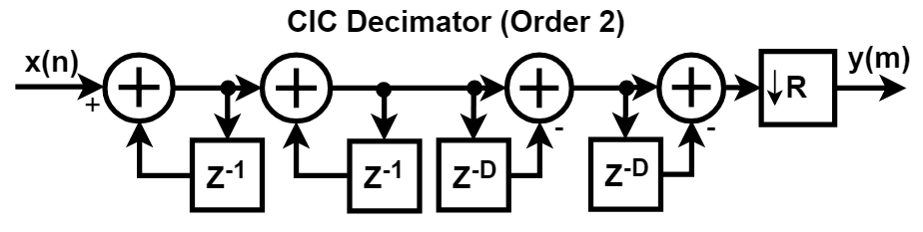
Improving Out-of-Band Rejection
Cascading multiple comb and integrator sections together greatly improves out-of-band attenuation
Number of combs sections must equal number of integrators
More stages mean the gain of the CIC filter increases
Need wider adders
Filter order typically denoted by N
Notes:
Cascading stages increases attenuation
Number of Integrator and comb stages must be equal
LTI operations, but order is important when we get to optimising the filter

Slide 9
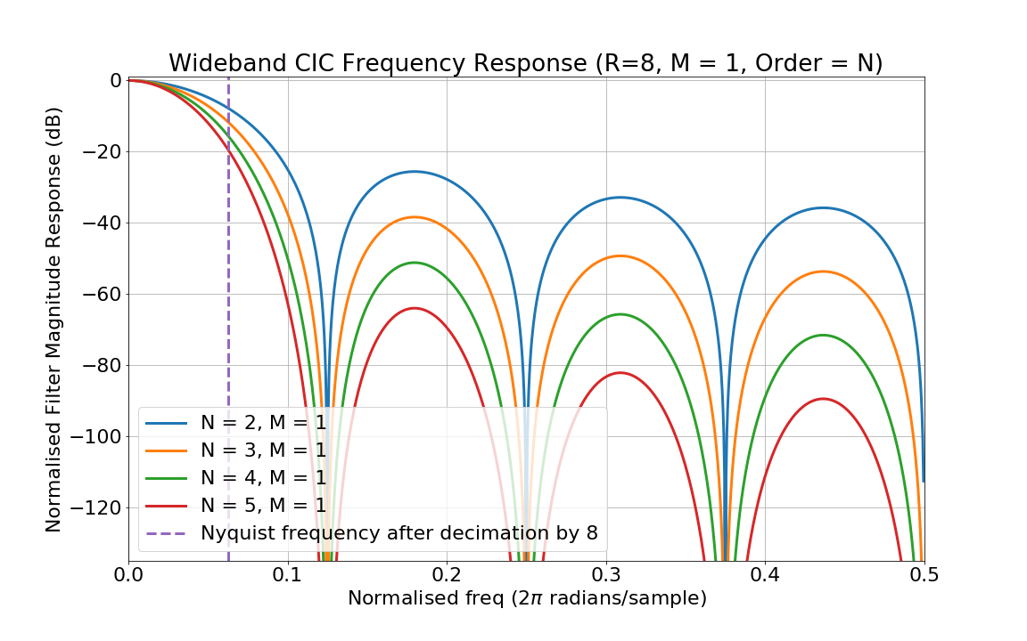
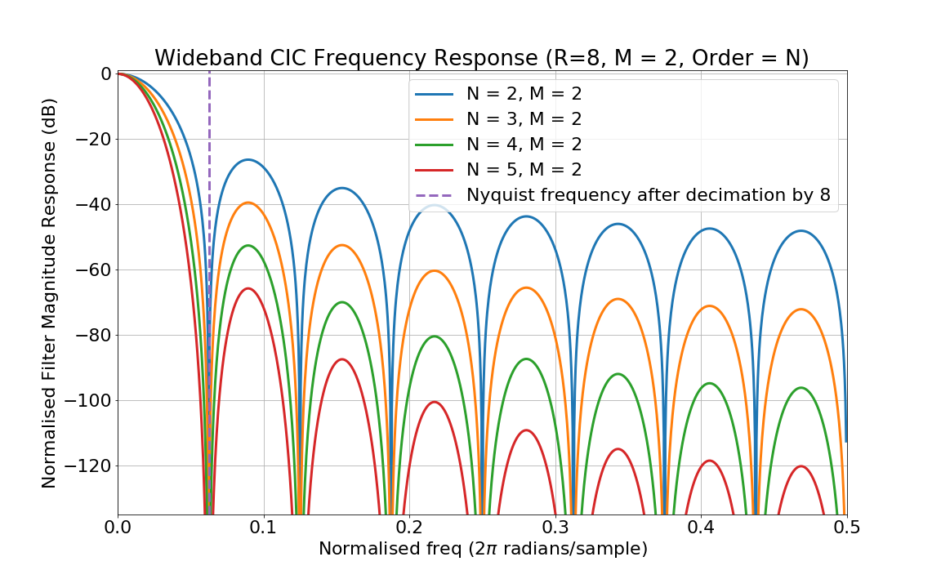
CIC Wideband Frequency Response
Notes:
Can achieve good rejection by cascading stages

Slide 10
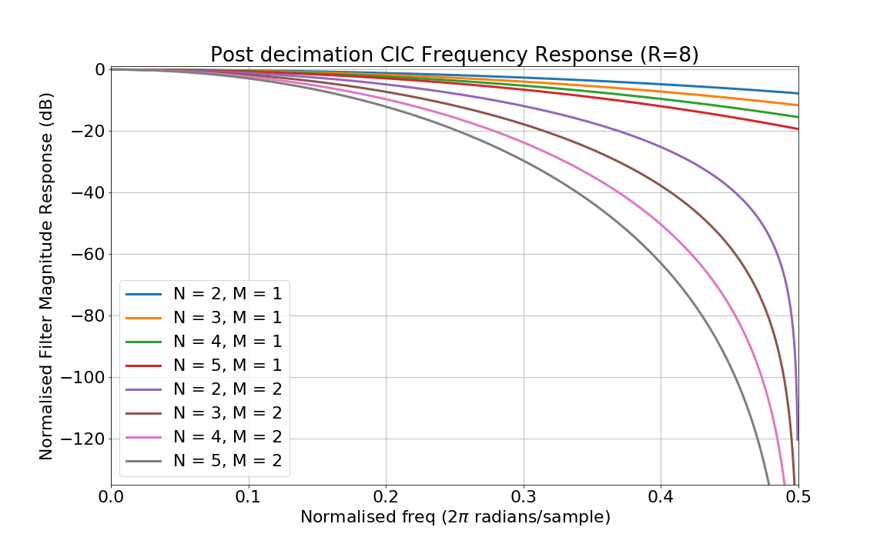
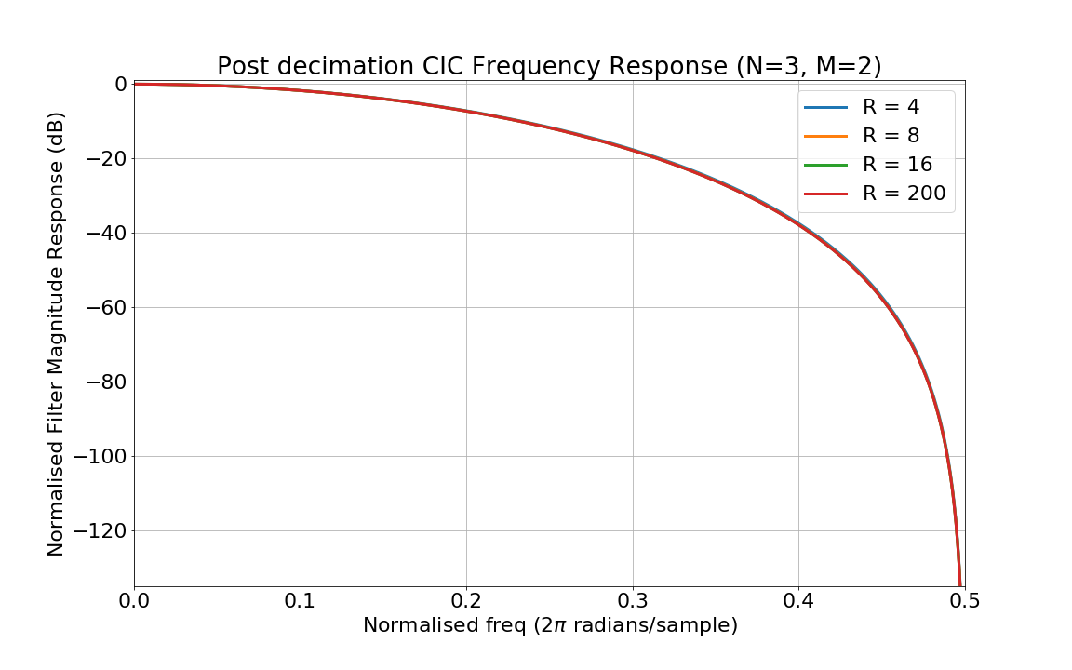
CIC Narrowband Frequency Response
Notes:
Attenuation in passband can be quite significant especially when M>=2
Almost no difference in response based on change in sample rate
Can use a FIR filter to compensate for passband attenuation

Slide 11
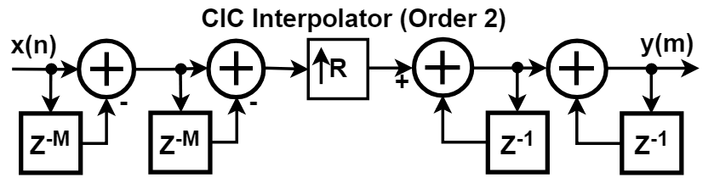
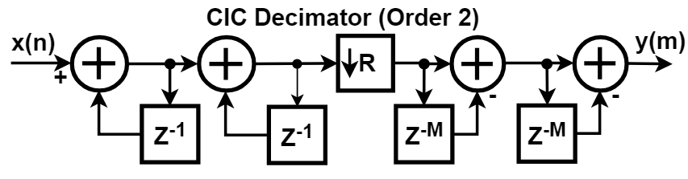
Optimised CIC Filter
Notes:
Shift up/down-sampler through the comb section
Delay now M instead of D. Far less memory required
Comb section operates at lower data rate. Added can be timeshared
Design no longer dependant on R – Can be changed dynamically
Actual output exactly the same as before

Slide 12
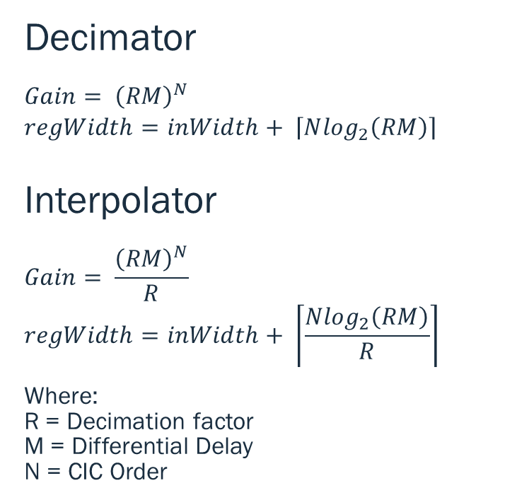
CIC Filter Gain
Decimator
$$Gain= {\left(RM\right)}^{N}$$
$$regWidth=inWidth+ \left\lceil N\log_{2}\left(RM\right)\right\rceil$$
Interpolator
$$Gain= \frac{{\left(RM\right)}^{N}}{R}$$
$$regWidth=inWidth+ \left\lceil \frac{N\log_{2}\left(RM\right)}{R}\right\rceil$$
Where: R = Decimation factor M = Differential Delay N = CIC Order
Notes:
All graphs so far have been normalised to a gain of 1, but CICs actually have a lot of gain
Gain of CIC increases with larger sample rate change, more stages, and higher differential delay
Large sample rate changes can require very wide adders
48 bit for typical FPGA DSP block
Designing to have a power of 2 gain can simplify truncation / rounding of

Slide 13
CIC Compensation Filters
What are they and how do you design them?

Slide 14
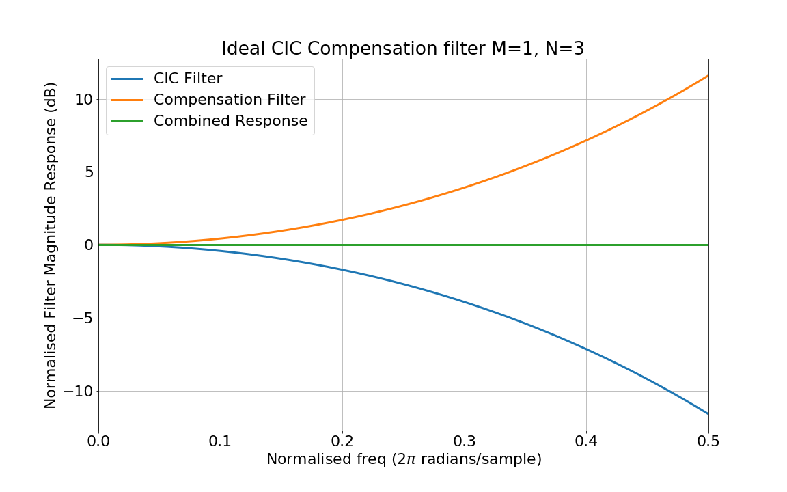
CIC Compensation Filters
F_{s [high]}
F_{s [low]}
F_{s [low]}
CIC Decimator
FIR Compensation Filter
CIC filters have passband attenuation
This can be corrected using a compensation filter
FIR compensation filters are typically used
Compensation filters operate at the lower sample rate
This allows for hardware efficient implementations
FIR Compensation Filter
CIC Interpolator
F_{s [low]}
F_{s [low]}
F_{s [high]}
Notes:
Compensation filters are designed with the opposite frequency response to a CIC (but without the gain)

Slide 15
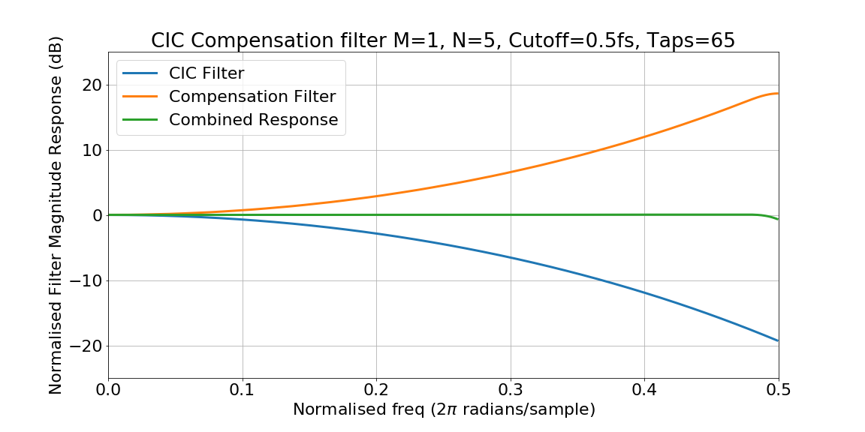
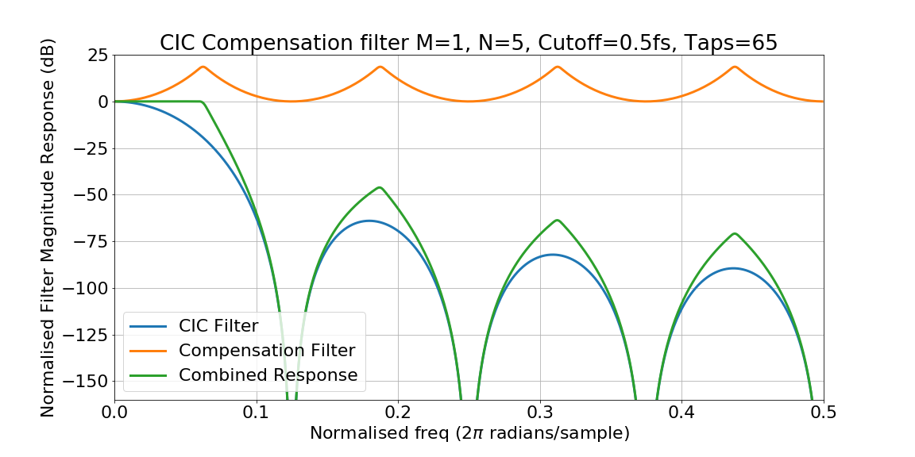
Wideband Compensation Filters
Flat across the entire passband
Can cause a significant reduction in performance of the CIC filter
Transition bandwidth uncontrolled
Rarely used
f_{s}/(2R)
f_{s}/2

Slide 16
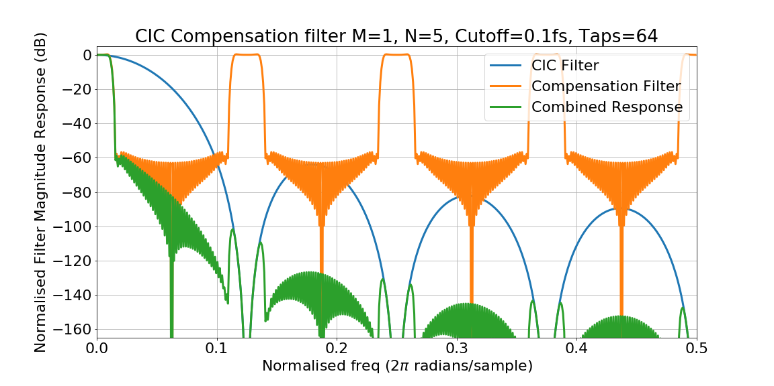
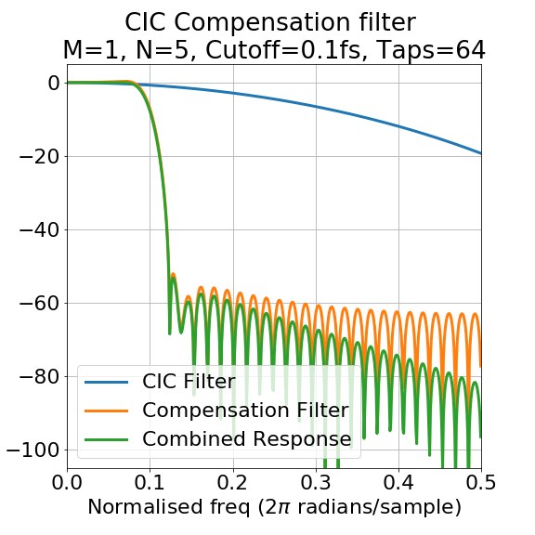
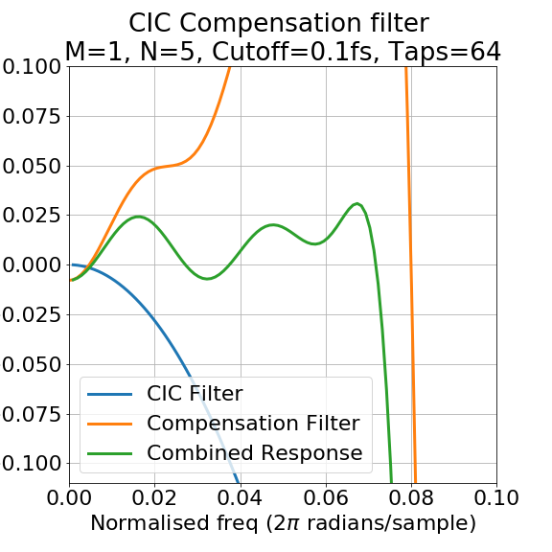
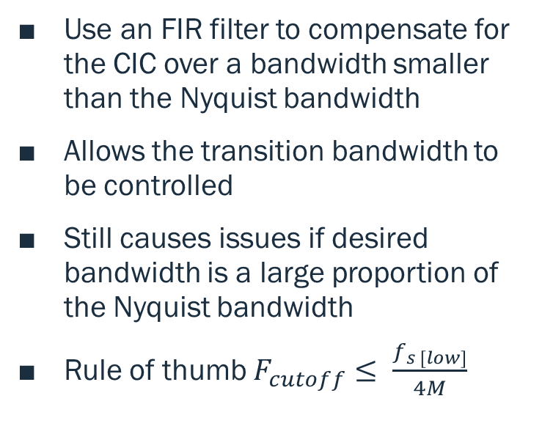
Narrowband Compensation Filters
Use an FIR filter to compensate for the CIC over a bandwidth smaller than the Nyquist bandwidth
Allows the transition bandwidth to be controlled
Still causes issues if desired bandwidth is a large proportion of the Nyquist bandwidth
Rule of thumb $F_{cutoff}≤ \frac{f_{s [low]}}{4M}$
Notes:
If you need to break the rule of thumb do the sample rate change in two stages with FIR compensation filter performing an interpolation or decimation by 2. This will give a much better wideband response.

Slide 17
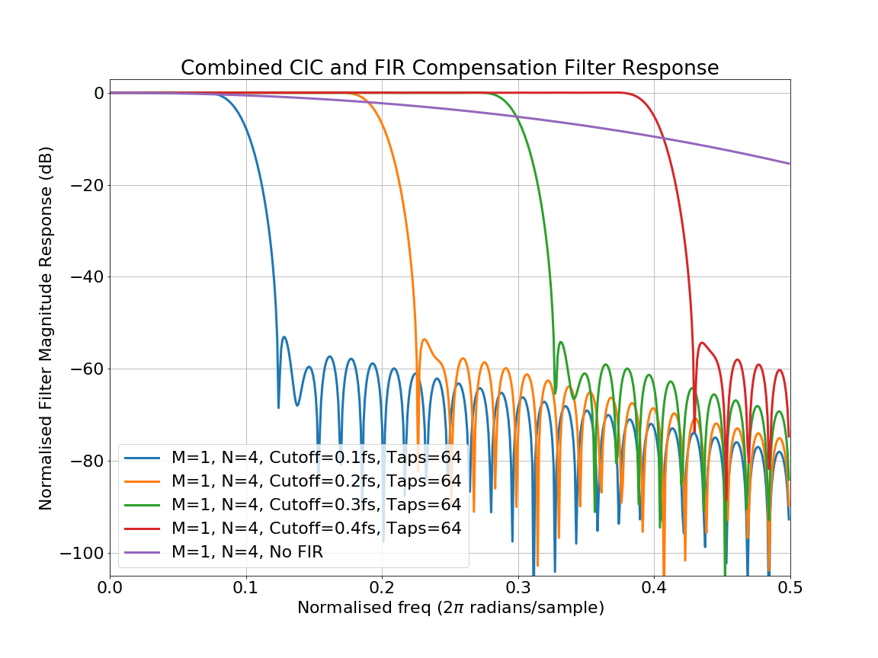
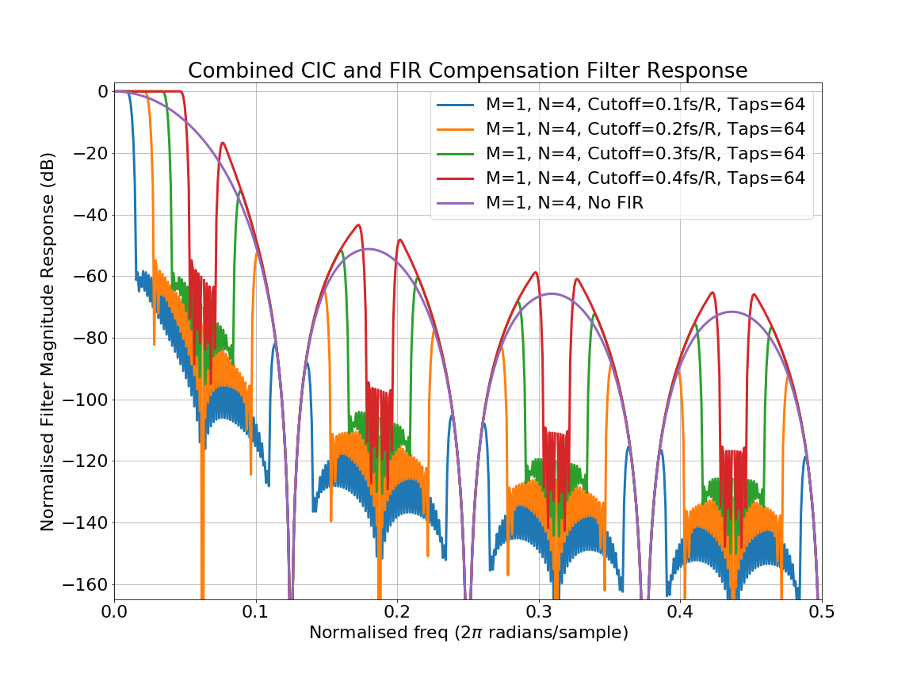
Narrowband Compensation Filters
Notes:
In the narrowband plots everything looks good
In the wideband plots it is clear that once the cut-off frequency is > 0.25fs[low] the FIR compensation filter starts to negatively affect performance.

Slide 18
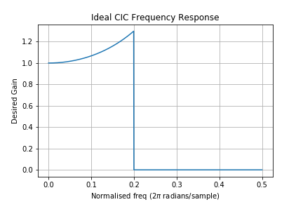

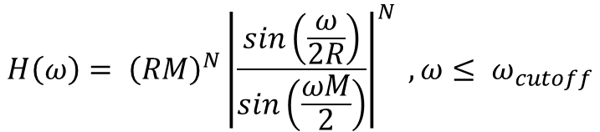
Calculating FIR Coefficients
from scipy.signal import firwin2
from scipy.signal import freqz
import numpy as np
import matplotlib.pyplot as plt
np.seterr(divide='ignore', invalid='ignore');
# cutOff is the cut off freq as a fraction of the lower sample rate
# i.e 0.5 = Nyquist frequency
def getFIRCompensationFilter(R,M,N,cutOff,numTaps,calcRes=1024):
w = np.arange(calcRes) * np.pi/(calcRes - 1)
Hcomp = lambda w : ((M*R)**N)*(np.abs((np.sin(w/(2.*R))) /
(np.sin((w*M)/2.)) ) **N)
cicCompResponse = np.array(list(map(Hcomp, w)))
# Set DC response to 1 as it is calculated as 'nan' by Hcomp
cicCompResponse[0] = 1
# Set stopband response to 0
cicCompResponse[int(calcRes*cutOff*2):] = 0
normFreq = np.arange(calcRes) / (calcRes - 1)
taps = firwin2(numTaps, normFreq, cicCompResponse)
return taps
Ideal CIC Compensation Filter Response
$${{H\left(ω\right)= \left(RM\right)}^{N}\left|\frac{sin\left(\frac{ω}{2R}\right)}{sin\left(\frac{ωM}{2}\right)}\right|}^{N} , ω≤ ω_{cutoff}$$
H($ω)=0 , ω> ω_{cutoff}$

Slide 19

Plotting CIC Compensation Filters
def plotFIRCompFilter(R,M,N,taps,wideband=False):
if wideband: # Interpolate FIR filter to higher sample rate
interp = np.zeros(len(taps)*R)
interp[::R] = taps
freqs,compResponse = freqz(interp)
w = np.arange(len(freqs)) * np.pi/len(freqs) * R
else:
freqs,compResponse = freqz(taps)
w = np.arange(len(freqs)) * np.pi/len(freqs)
Hcic = lambda w : (1/((M*R)**N))*np.abs( (np.sin((w*M)/2.)) / (np.sin(w/(2.*R))) )**N
cicMagResponse = np.array(list(map(Hcic, w)))
combinedResponse = cicMagResponse * compResponse
plt.plot(freqs/(2*np.pi),20*np.log10(abs(cicMagResponse)), label="CIC Filter")
plt.plot(freqs/(2*np.pi),20*np.log10(abs(compResponse)), label="Compensation Filter")
plt.plot(freqs/(2*np.pi),20*np.log10(abs(combinedResponse)), label="Combined Response")
plt.grid(); plt.legend();
axes = plt.gca(); axes.set_ylim([-200,25])
plt.show()
CIC Frequency Response
$${H\left(ω\right)=\left|\frac{sin\left(\frac{ωM}{2}\right)}{sin\left(\frac{ω}{2R}\right)}\right|}^{N}$$

Slide 20
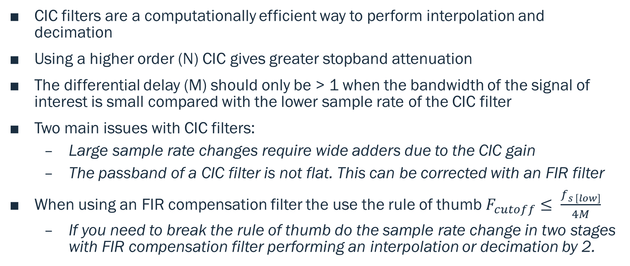
Summary
CIC filters are a computationally efficient way to perform interpolation and decimation
Using a higher order (N) CIC gives greater stopband attenuation
The differential delay (M) should only be > 1 when the bandwidth of the signal of interest is small compared with the lower sample rate of the CIC filter
Two main issues with CIC filters:
Large sample rate changes require wide adders due to the CIC gain
The passband of a CIC filter is not flat. This can be corrected with an FIR filter
When using an FIR compensation filter the use the rule of thumb $F_{cutoff}≤ \frac{f_{s \left[low\right]}}{4M}$
If you need to break the rule of thumb do the sample rate change in two stages with FIR compensation filter performing an interpolation or decimation by 2.

Slide 21
Further reading
?
Additional information and Python code for all examples in this presentation https://www.gibbard.me/cic-filters
Additional information on deriving frequency response and CIC compensation filters
https://dspguru.com/files/cic.pdf
https://www.intel.com/content/dam/www/programmable/us/en/pdfs/literature/an/an455.pdf
https://www.embedded.com/design/configurable-systems/4006446/Understanding-cascaded-integrator-comb-filters
Original paper on CIC filters E. Hogenauer, "An Economical Class of Digital Filters For Decimation and Interpolation," IEEE Trans. Acoust. Speech and Signal Proc., Vol. ASSP–29, pp. 155–162, April 1981.

