Slide 1
All sorts of sort.
Matthew, Orion, Andre and Joseph
Tutor: Erik Vanwyk

Slide 2
Introduction
We implemented sorting algorithms in:
Assembly
Verilog
Python
C

Slide 3
Quick Sort
Takes O(n log(n)) time
Picks a “pivot” from the list, and partitions the list into things bigger and smaller than the pivot.
The bigger and smaller lists are both sorted.

Slide 4
Bubble Sort
Human psedo - code:
Loop until it is sorted
{
Loop through list
{
If list [next one] < list [current one]
{swap list[next one] with list[current one]}
}
}

Slide 5
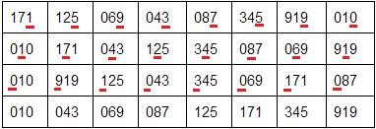
Radix Sort
Sorts numbers by sorting each digit of the numbers
Example:

Slide 6
Selection Sort

Slide 7
Merge Sort

Slide 8
Caching and sorts

Slide 9
Assembly

Slide 10
Verilog

Slide 11
Results

Slide 12
References

