Slide 1
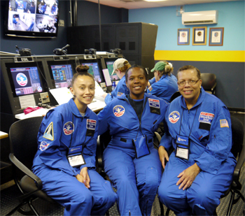
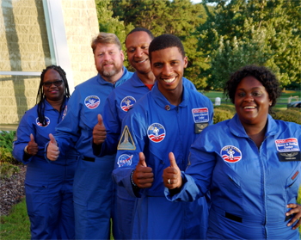

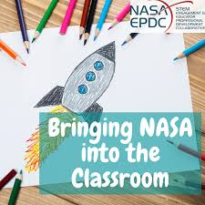
NASA Resources for STEM Educators
Space Academy in Huntsville, AL Classroom Content and Lesson Plans
Weekly Webinars
Educator Resource Centers

Slide 2
linkslinkslinkslinkslinkslinks
Explore STEM Resources for K-12 Educators https://www.nasa.gov/stem/foreducators/k-12/index.html
NASA Classroom Content & Lesson Plans https://www.nasa.gov/langley/education/classroom
NASA Jet Propulsion Lab - Educator Resources https://www.jpl.nasa.gov/edu/teach/resources
NASA Goddard Educator Resource Center https://www.nasa.gov/centers/goddard/visitor/home/erc.html
The INSPIRE Project, Inc. - SPACE ACADEMY FOR DC STEM Teachers - Huntsville, Al https://theinspireproject.org/default.asp?contentID=7
NASA EPDC Webinars https://www.txstate-epdc.net/webinars/
NNASA GISS CCRI Educator Recruitment Notice
https://www.giss.nasa.gov/edu/ccri/

Slide 3
Contacts
Nate Harshman
Director, NASA DC Space Grant Consortium
harshman@american.edu
Eric Day
Program manager, NASA DC Space Grant Consortium
eday@american.edu
Facebook!

