Slide 1
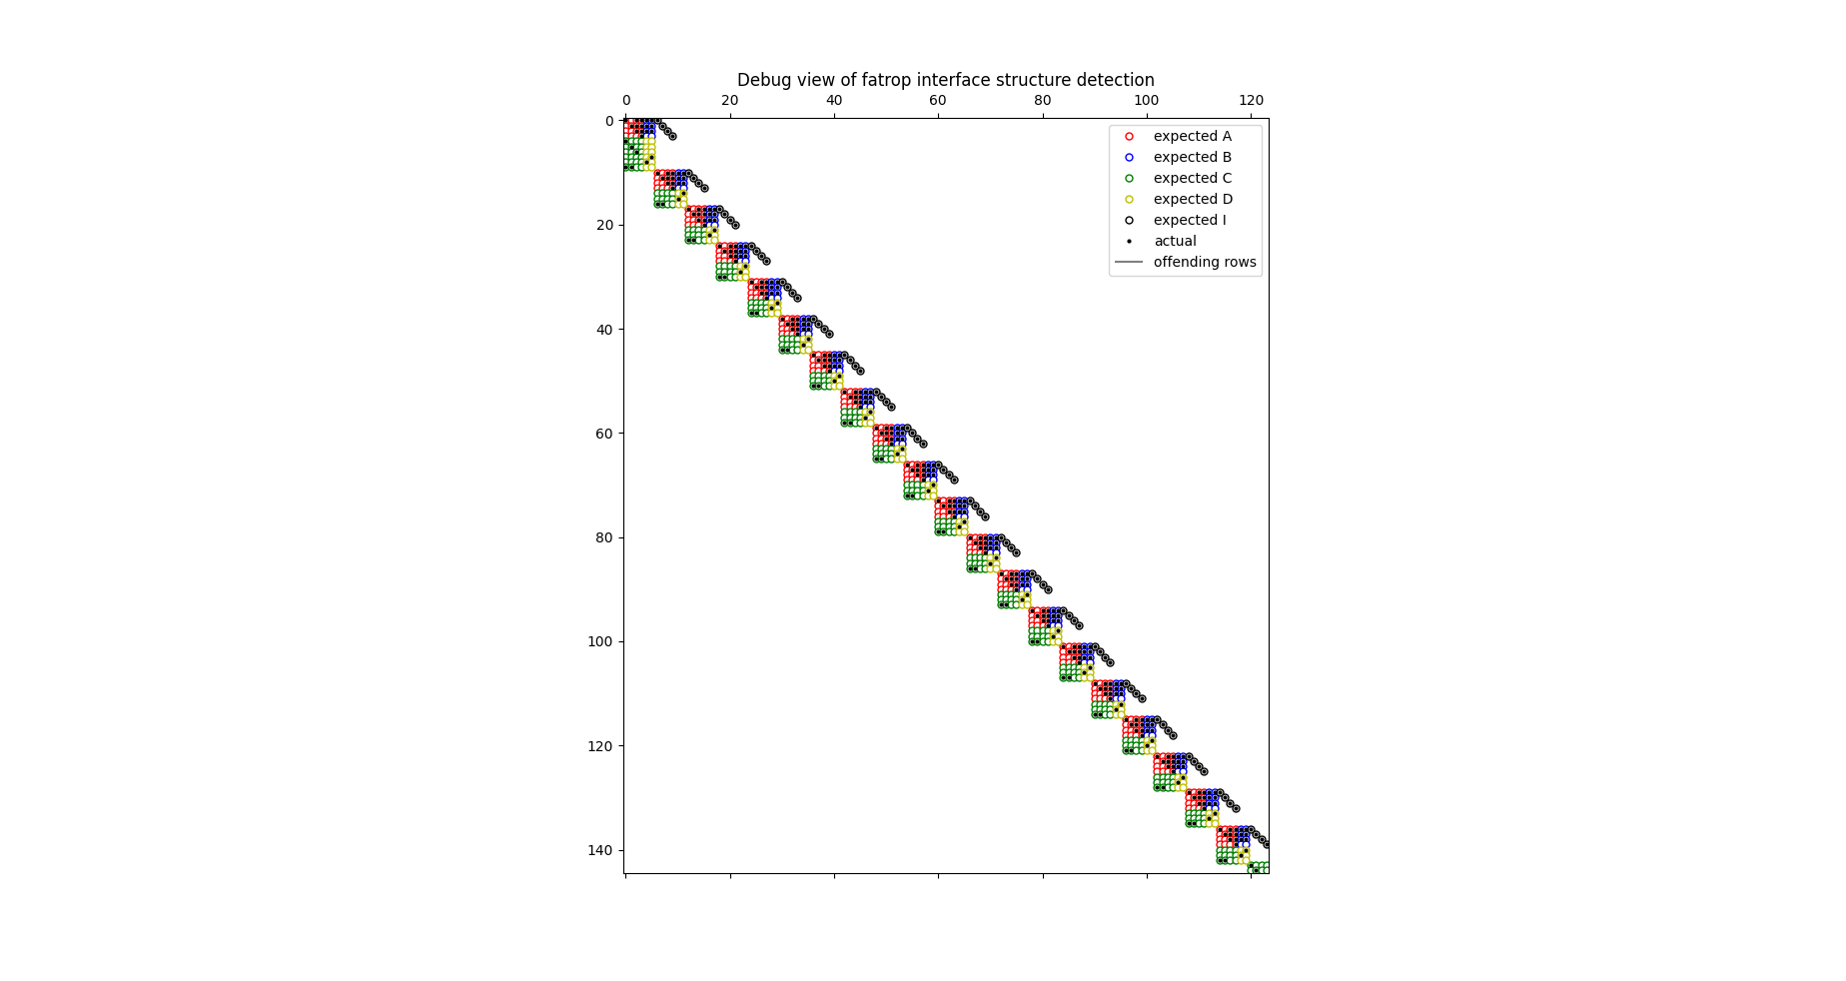


IPOPT
40ms
1.2ms
iter objective inf_pr inf_du lg(mu) ||d|| lg(rg) alpha_du alpha_pr ls
0 2.1000000e+02 9.60e-01 9.85e-01 -1.0 0.00e+00 - 0.00e+00 0.00e+00 0
1 2.1008400e+02 9.15e-01 1.38e+00 -1.0 1.91e+00 - 9.23e-02 4.79e-02h 1
2 2.1154581e+02 6.17e-01 7.29e+00 -1.0 1.61e+00 - 8.27e-02 2.03e-01h 1
3 2.1306548e+02 4.60e-01 7.09e+00 -1.0 5.12e-01 - 8.60e-01 2.27e-01h 1
4 2.1918566e+02 6.40e-03 1.64e+00 -1.0 3.46e-01 - 7.14e-01 1.00e+00h 1
5 2.1879202e+02 4.89e-04 2.48e-01 -1.0 4.93e-02 - 1.00e+00 1.00e+00h 1
6 2.1702108e+02 7.97e-04 1.27e-02 -1.7 7.26e-02 - 1.00e+00 1.00e+00f 1
7 2.1660653e+02 4.43e-04 3.83e-03 -2.5 4.94e-02 - 1.00e+00 1.00e+00f 1
8 2.1654682e+02 1.14e-05 1.13e-04 -3.8 1.55e-02 - 1.00e+00 1.00e+00f 1
9 2.1654367e+02 4.23e-08 6.66e-07 -5.7 1.25e-03 - 1.00e+00 1.00e+00h 1
iter objective inf_pr inf_du lg(mu) ||d|| lg(rg) alpha_du alpha_pr ls
10 2.1654363e+02 2.79e-12 3.60e-11 -8.6 9.13e-06 - 1.00e+00 1.00e+00h 1
EXIT: Optimal Solution Found.
solver : t_proc (avg) t_wall (avg) n_eval
nlp_f | 300.00us ( 27.27us) 18.08us ( 1.64us) 11
nlp_g | 5.18ms (471.00us) 319.41us ( 29.04us) 11
nlp_grad_f | 508.00us ( 42.33us) 30.76us ( 2.56us) 12
nlp_hess_l | 35.20ms ( 3.52ms) 2.23ms (222.79us) 10
nlp_jac_g | 23.28ms ( 1.94ms) 1.47ms (122.25us) 12
total | 638.01ms (638.01ms) 40.91ms ( 40.91ms) 1
it obj cv du lg(mu) reg alpha_du alpha_pr ls
0, 2.1000000e+02, 9.70e-01, 9.85e-01, -1.0, -.-, 0.00e+00, 0.00e+00, 0x
1, 2.1008400e+02, 9.15e-01, 1.38e+00, -1.0, -.-, 9.23e-02, 4.79e-02, 1h
2, 2.1154581e+02, 6.23e-01, 7.29e+00, -1.0, -.-, 8.27e-02, 2.03e-01, 1h
3, 2.1306548e+02, 4.68e-01, 7.09e+00, -1.0, -.-, 8.60e-01, 2.27e-01, 1h
4, 2.1918566e+02, 1.04e-01, 1.64e+00, -1.0, -.-, 7.14e-01, 1.00e+00, 1h
5, 2.1879202e+02, 2.43e-03, 2.48e-01, -1.0, -.-, 1.00e+00, 1.00e+00, 1h
6, 2.1702108e+02, 8.36e-04, 1.27e-02, -1.7, -.-, 1.00e+00, 1.00e+00, 1h
7, 2.1660653e+02, 4.43e-04, 3.83e-03, -2.5, -.-, 1.00e+00, 1.00e+00, 1h
8, 2.1654682e+02, 1.14e-05, 1.13e-04, -3.8, -.-, 1.00e+00, 1.00e+00, 1h
9, 2.1654367e+02, 4.23e-08, 6.66e-07, -5.7, -.-, 1.00e+00, 1.00e+00, 1h
10, 2.1654363e+02, 2.79e-12, 3.60e-11, -8.6, -.-, 1.00e+00, 1.00e+00, 1h
solver : t_proc (avg) t_wall (avg) n_eval
nlp_f | 16.00us (500.00ns) 13.95us (435.88ns) 32
nlp_g | 60.00us ( 5.45us) 59.76us ( 5.43us) 11
nlp_grad_f | 8.00us (666.67ns) 5.76us (479.67ns) 12
nlp_hess_l | 193.00us ( 19.30us) 193.48us ( 19.35us) 10
nlp_jac_g | 121.00us ( 10.08us) 119.94us ( 10.00us) 12
total | 1.21ms ( 1.21ms) 1.21ms ( 1.21ms) 1
New development by Lander Vanroye
at the KU Leuven Robotics Research Group
under supervision of Wilm Decre
Same iterates
Block-structure exploiting linear algebra
Solving a nonlinear optimal control problem

