Slide 1
Flour Frontier
Identifying the largest markets for flour growth
Jake Gilstein · NAF Sales · FSI

Slide 2













Jake Gilstein
Internship Info:
NAF Sales, FSI
Education:
University of South Florida - Fall ‘26
B.S. in Business Management & Minor in Marketing
Hometown:
From Park Slope, Brooklyn, NY & Philadelphia, PA
Live in St. Augustine, FL
Sonny
Milo
Kol
FAVORITE GMI PRODUCTS:
Notes:
CSNM, insurance, dist sales, 3pl, internship has tied nicely to pair things full circle
Some of my hobbies include weightlifting and boxing
But, if there’s one thing you need to know about me, it’s that I’m a huge Knicks fan
Now that you know a little more about me, let’s get into my project, Flour Frontier

Slide 3
The Landscape
Background: Flour faces declining demand and excess industry capacity
Ask: Identify the geographical pockets and growth for flour
Deliverable: A map ranked by metro using data to accelerate flour growth
Notes:
Flour consumption overall declining, excess industry capacity makes growth harder
For flour to be successful in NAF, continue delivering at least 1% growth annually
Asked to identify which metros represent the strongest opportunities for flour growth
Deliverable ask - create data-backed map showing those metros
SUPER excited to show two main things today
If you’re a numbers person/love tech you’ll love to see
Quantifiable impact of top true 5 metros reaching 30% national share which is our average
Also VERY excited about website I built that stores interactive map & so much more
I cannot wait to show you all BOTH
Landscape mapped out, let me talk to you all about my methodology for ranking these metros

Slide 4
Methodology
Market Opportunity – 30%
Population Movement – 30%
Circana & Nielsen DMA
Current GMI share, under/over penetrated areas & the size of market.
Stability
Growth or contraction, and population projection based on migration momentum.
GMI Performance – 20%
Volume YoY
Measurers whether GMI is growing or losing ground. Volume YoY growth, volume trend, distributor performance, and whether loses are market-driven or execution driven.
HQ Inflow – 10%
Cost-to-serve – 10%
Company Movement
How industries will have impact on flour demand and what companies are moving or leaving that metro.
Network Efficiency
Proximity to mills and warehouses, truck vs intermodal freight.
Notes:
You may be asking yourself, out of every city in the US how do you decide what cities are best to sell flour in the future
I ended up with 5 factors to help categorize all 50 cities
Explain lens then say weighting of category
Population movement – Census data & where other flour-heavy operators will expand
GMI Performance – 1:1s w AEs & sales immersion gave insight behind numbers beyond YoY because it shows whether we are gaining or losing momentum
HQ inflow - impacts foodservice density and long-term demand
Cost-to-serve - market is best served by truck or intermodal freight
Goal - find metros under 30% share, pinpoint growing ones and how we get there

Slide 5

Order of the True 5
Houston
4.35
Dallas
3.95
Atlanta
3.50
Tampa
3.30
Phoenix
2.80
Notes:
These scores are not simply five largest flour markets
They match up best with the 5 methodologies created
That is why they are known as the True 5 rather than the Top 5
Starting with Houston at 1, Dallas second, Atlanta in third, my city Tampa in fourth and rounding out the True 5 is Phoenix

Slide 6





What Connects the True 5
Opportunities
& Next Steps
Hispanic market
Proximity to competition
Competitive pricing strategy
Product assortment
Reevaluate go-to-market strategy
Continue to win through DSR accessibility
Notes:
True 5 commonalties
Houston growing, Gus NSM, Hispanic market, largest accessible gap, comp pricing strategy due to local mills
Dallas similar, branded sack, distributor overlap, stay with Hispanic operators, TX AEs work together
Atlanta in SE troubled with freight economics, pricing strategy only works if the service model supports it, reevaluate go to market, pizza chains sized 1 to 19
Tampa growth, product assortment matches operators creating growth, tourism & pizza
Phoenix distributor led, follow Shamrock’s momentum into Hispanic foodservice, DSR accessibility
If we use parallels, can hit national average of 30% flour share in each metro
Now that we’ve seen the qualitative, let’s see the quantitative

Slide 7
Quantifying the Gap to 30% Flour Share
Metro | GMI flour share* | Volume YoY** | 30% share impact in CWT² | 30% share impact RNS @ $28/CWT²
Houston | 20.4% | +1.5% | 60,000 | $1,680,000
Dallas | 14.5% | +5.3% | 75,000 | $2,100,000
Atlanta | 23.8% | -1.5% | 22,000 | $616,000
Tampa | 28.9% | +13.9% | 3,500 | $98,000
Phoenix | ~15.6%¹ | -0.7% | ~28,000 | ~$784,000
True 5 combined | — | — | ~188,500 | ~$5,278,000
¹ No regional DMA data was available for Phoenix, so share was back-calculated using ZIP-level invoice volume benchmarked against the West Region Circana total, making it a directional estimate rather than a direct DMA read. CWT and RNS for Phoenix are similarly back-calculated from GMI's own volume against this estimated share.
² Total category volume sourced from Circana Optika. CWT reflects each metro's own DMA-level total flour category volume divided by 100 to isolate one share point in pounds, then converted to CWT and priced at $28/CWT. Optika represents less than 50% of total market coverage, so actual total category volume and therefore the true value of one share point is likely somewhat larger than shown here; these figures should be read as a conservative, directional floor rather than an exact total.
*Flour Total Market by DMA February ‘25-’26*
**FSI Territory Invoice Volume April ’26**
Notes:
So, continuing the True 5, I’m going to talk over what we’re seeing here while you all read through these quantitative stats
Houston walk through
If we hit national average of 30% flour share within each True 5 metro
188,500 CWT or $5,278,000 in RNS @$28/CWT

Slide 8
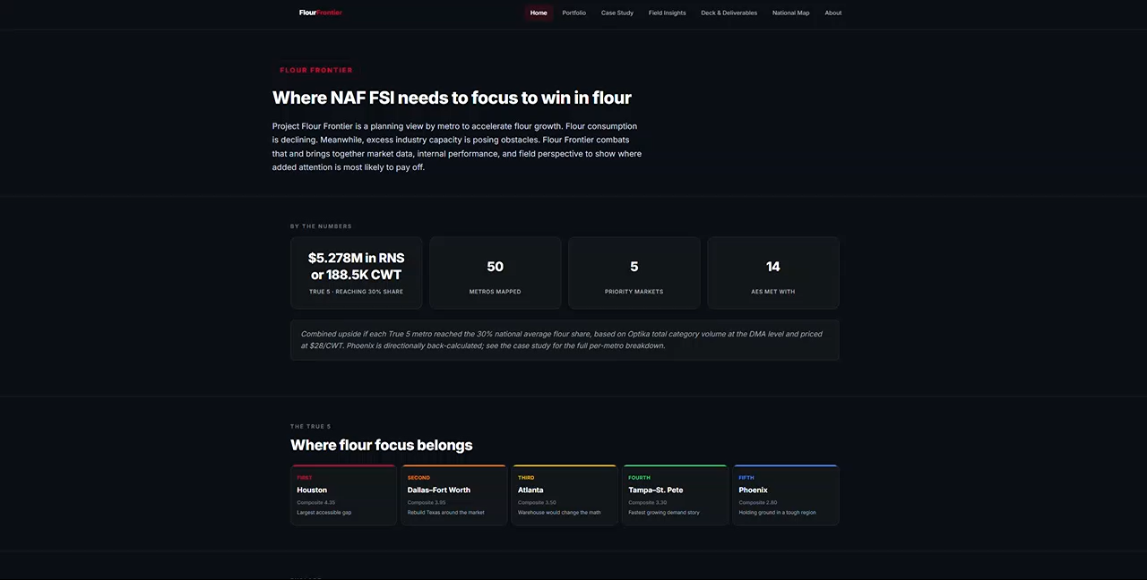
Introducing the Website

Slide 9
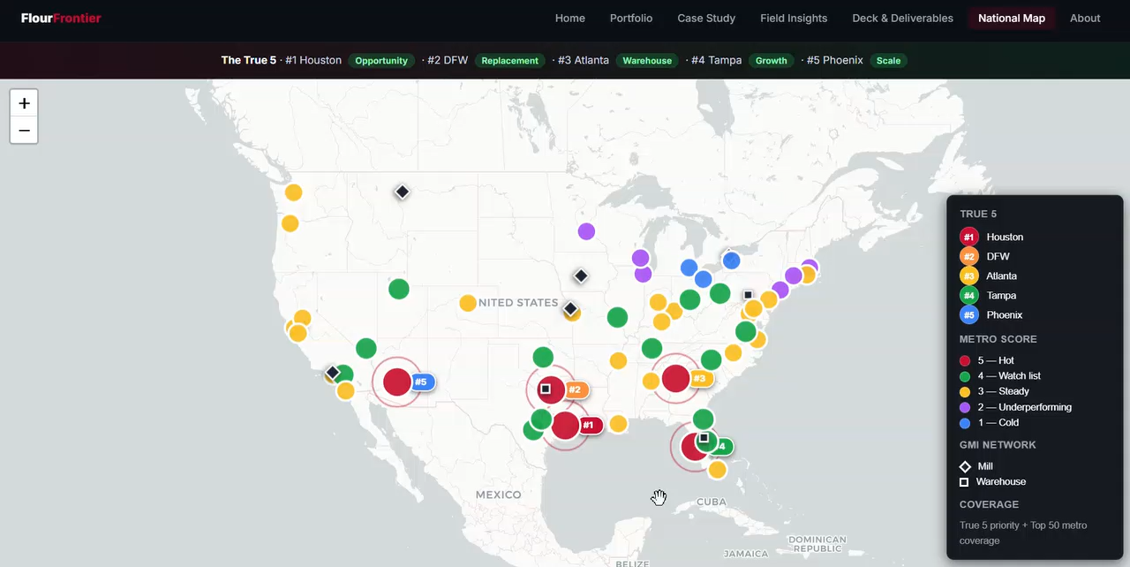
Map & Legend

Slide 10
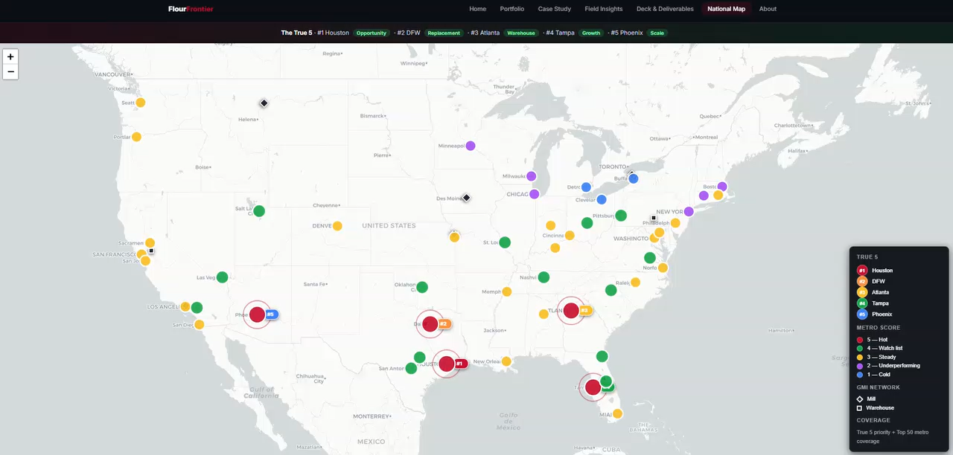
Utilizing the Tooltip
Notes:
ZM see how the AEs I manage were doing
Catherine, our Sr Sales Ops Mngr, measure market cost-to-serve and profitability I would simply locate any metro & click into it
Tooltip gives a deeper read on that market, including volume, companies in the area, cost-to-serve notes, and other metro-specific context
FSI compare markets quickly and pressure test future decisions as new data comes in

Slide 11

What I’m Leaving Behind
Notes:
All of my work has been put into SharePoint
NAF Systems Flourverse
Website is already linked to a go link - backslash flourfrontier

Slide 12
Turning the True 5 Into Action
Recommendation | What it means | Why it matters
Prioritize the True 5 | Focus first on Houston, Dallas, Atlanta, Tampa, and Phoenix as separate market playbooks | Hitting national 30% flour share threshold across the True 5 equals 188,500 CWT or $5,278,000 RNS
Highlight commonalities | Align each metro to the operators most likely to drive flour growth | Hispanic market, pizza, regional bakeries, manufacturers, tourism accounts, and distributor-led independents prove to be winnable
Leverage toolkit | AE, ZM and distributor action plans the team can keep using | The website, map and workbook all follow market-specific steps to create a guide
Notes:
True 5 clearest, most actionable growth opportunities in market where flour consumption declining & excess industry capacity makes growth challenging
Connect market size, share headroom, operator relevance, and commercial practicality.
Upside measurable, 188,500 CWT or $5,278,000 in RNS utilizing $28/CWT
Target True 5 commonalities such as Hispanic market,
The next step is turning these markets into AE, ZM and distributor action plans, supported by the website, map, workbook, and field insights I’m leaving behind

Slide 13

Thank you!
Q/A & Feedback?
Notes:
Thank yous’
Before I open it up for questions, I’ll end where I started, with the Knicks
53-year drought, seeing them finally win the championship was a reminder that loyalty, patience, and belief can pay off
General Mills value of Champion Belonging exactly what I felt here: a team that invested in me, challenged me, and made me feel like I could contribute
Incredibly grateful for the opportunity to return to General Mills, continue seeing the impact of Flour Frontier carry forward, and become a champion
Thank you

