Slide 1
DevOps

Slide 2
What is DevOps?
DevOps is an approach to bridge the gap between software development and operations
Stresses collaboration between development and operations
Aims to deliver software and services quicker
DevOps is more than just tools; it’s a practice of Dev an Ops Engineers participating together in the entire service lifecycle (SDLC).

Slide 3
Tools can Help with DevOps
Cloud Computing ( AWS, Azure, Google Cloud)
Infrastructure as code (Chef, Puppet, Ansible, SaltStack)
Build & Test using Continuous Integration (Jenkins)
Containerization (Docker)

Slide 4
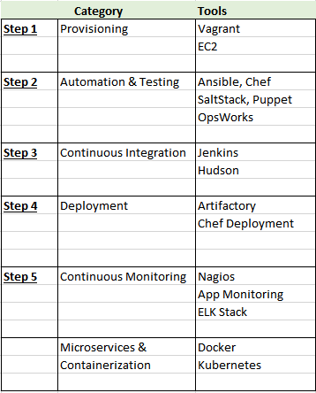
Delivery Process

Slide 5
Version Control
Version Control is the management of changes to documents, computer programs, large web sites, and other collections of information.
Used by:
Software Developers
Ops
Scripts
Tools
Software Configuration
Example: GIT - Free, Open Source and distributed.
Handles small to large projects
Free and Open Source
Distributed Version Control
Saved locally and centrally

Slide 6
Configuration Management and Automation
CM is maintaining consistency of our software configuration
Why Automation
Infrastructure becomes unmanageable
Too much change to Manage
Outdated documentation
No easy way to recreate the environment
The Answer: Automation and config management
Tools: Chef, Ansible, SaltStack, Puppet

Slide 7
Benefits
Automation Tools will help us deliver and maintain software on our servers as code
Infrastructure becomes code
It becomes maintainable
Version controlled
Testable
Collaborative

Slide 8
Guidelines
Use Version Control (GIT)
Understand your infrastructure, you cant automate what you don’t understand
Make use of automated testing before deploying

Slide 9
Step 1: Provisioning
Vagrant can create and configure virtual machine environments
Reproduceable
Portable
Wrapper around VirtualBox, AWS, Docker, VMWare, etc
Create identical environments for operations
No more “Works on my machine”
Do a quick test for Scripts, Chef Configs and isolated deployments of your software products

Slide 10
Step 2: Automation and Configuration Management
Chef
Client – Server
2009
Ruby, ERB & JSON
Keeps state
AWS uses chef in Opsworks
Flexible, code driven and can be more complex
Puppet
Oldest one: 2005
Client – Server
Keeps state
Ansible
Deploys over SSH
Python & YAML
Easy learning curve
Need to buy Ansible Tower to keep state
Aquired by Redhat in 2015
Saltstack
Client – Server
Keeps state
Open Source

Slide 11

Chef
Chef is an automation platform for Developers & System Administrators to define/build/manage infrastructure
Infrastructure as Code
Programmatically provision and configure
Treat like any other codebase
Reconstruct business from code repository, the data backup and bare metal resources
Learning curve is a bit steeper than the other products
Keeps configuration state
Chef has a free version – Open Source Version
Opsworks AWS uses Chef
Free if using to provision EC2 instances

Slide 12
Step 3: Continuous Integration
Tools
Jenkins
Altassian Bamboo
JetBrains Team City
AWS Code Pipeline

Slide 13
Jenkins
Open Source CI Tool written in Java
Jenkins is open source and free
Building and packaging Apps
Building and packaging tool used and depends on language
Ex. Pip or easy_install for Python
Ex. Ant or Maven for Java

Slide 14
Common Tests
Automate Testing
Point of automating the build is to automate testing as well
CI can inform you of failure and it is up to the developers to write tests or nothing will be tested
Unit Tests – tests individual units of source code
Integration Tests – done after unit tests, this is where groups of code and modules are tested
Regression Tests – is a test written when a bug was fixed
UAT Tests – feature or use case was correctly implemented, can be done automatically (then called acceptance test) or by user (user acceptance test – manual test)

Slide 15
Jenkins Packaging
To make deployments easier, we should package our newly created website
Example: Java apps are .zip or .war (.jar files for libraries)

Slide 16
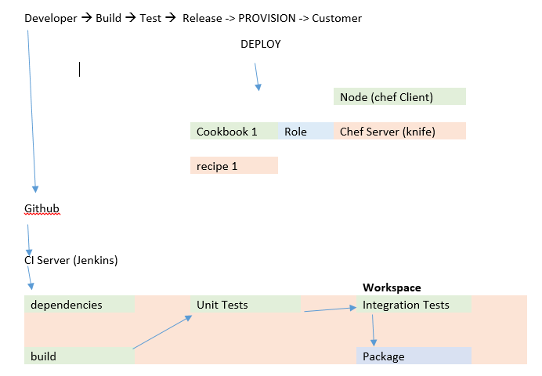
Step 4: Deployments (SDLC Deployment)

Slide 17
Deployments (con’t)
Developer writes code and pushes to Git
It gets picked up by Jenkins
Jenkins downloads dependencies, builds the source code, unit tests, integration tests,
and if all goes well Jenkins will package in a archive for us
During Provision and Deploy phase, we can install it on the nodes
We can use chef to install packages on the nodes
Chef client will retrieve the roles from Chef Server and roles contain cookbooks then recipes
They contain the installation code for our software package
This way we can contain the software in the recipe and have chef client intall it on
the node
Chef client retrieves the package from the artifact storage

Slide 18
Artifact Storage
Want to store artifacts generated by our build process
Jar (java archive) used as libraries
Deb/rpm files to install on servers
Zip/tar files
Tools
Nexus
Artifactory
etc

Slide 19
Continuous Monitoring
Nagios
Often used for monitoring
Very old but mature, not the best for cloud
CloudWatch
Sensu
Made for Cloud Architectures and more modern architectures

Slide 20
Application Monitoring
Application Performance Monitoring
New Relic is more popular one
Application specific so need to check what is offered with each vendor
Can give alerts when the application slows down

Slide 21
Log File Aggregation
Log files are good insight to what is happening on the servers
Tools
ELK stack (Elasticsearch LogStash Kibana) can scale over thousands of servers
Its more work to setup
Complex algorithms can be ran over log output
Visualization can give you good insights
Also can be used for IDS and cybersecurity
Splunk (cost based on amount of data ingested)

Slide 22
Containerization (Docker)
Open Platform for sysadmins to build, ship and run distributed applications
Enables apps to be quickly assembled from components
Should be able to run the same app unchanged on laptops, data center VMs and cloud
Docker uses LXC (linux containers) for OS level virtualization

Slide 23
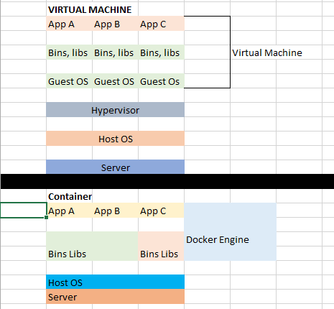
Virtual Machines vs Containers

Slide 24
Virtual Machines vs Containers (con’t)
Virtual Machines
-will need a host OS - ie vmware esxi
-Hypervisor will manage virtual machines
-Runs guest OS, isolated OS
Containers
- physical server and host os
- no hypervisor and guest os
- docker engine manages containers
- docker engine doesnt sit between the containers and OS, only manages
the containers
- containers are using the linux kernel for isolation
- not necessary anymore to launch a separate OS for every container
- possible for containers to share libaries
- docker is written in the language GO
- Namespaces: Every container has its own pid(process id), net (network namespace),
mnt(mountpoints), uts (unix timeshareing sys, kernels) namespace
- Control Groups: limitation and prioritization of resources like CPU, memory, I/O,
network, etc
i.e. limit that a container can use 1 out of 4 cpu's

Slide 25
Container Orchestration
Tools to run the managing of containers for you, orchestration
Tools
Docker swarm – native clustering for docker
Docker compose – 1 container depend on another one; link containers together to depend on each other using componse
Container managers (orchestrators)
Kubernetes – software to manage the clusters of linux containers as a single system
Platform as a Service (like heroku)

