Slide 1
Linear correlation and linear regression

Slide 2
Correlation
Measures the relative strength of the linear relationship between two variables
Unit-less
Ranges between –1 and 1
The closer to –1, the stronger the negative linear relationship
The closer to 1, the stronger the positive linear relationship
The closer to 0, the weaker any positive linear relationship

Slide 3
Scatter Plots of Data with Various Correlation Coefficients
Y
Y
Y
X
X
X
r = -1
r = -.6
r = 0
Y
Y
Y
X
X
X
r = +1
r = +.3
r = 0
Slide from: Statistics for Managers Using Microsoft® Excel 4th Edition, 2004 Prentice-Hall

Slide 4
Linear Correlation
Linear relationships
Curvilinear relationships
Y
Y
X
X
Y
Y
X
X
Slide from: Statistics for Managers Using Microsoft® Excel 4th Edition, 2004 Prentice-Hall

Slide 5
What is “Linear”?
Remember this:
Y=mX+b?
m
b

Slide 6
What’s Slope?
A slope of 2 means that every 1-unit change in X yields a 2-unit change in Y.

Slide 7
Prediction
If you know something about X, this knowledge helps you predict something about Y. (Sound familiar?…sound like conditional probabilities?)

Slide 8
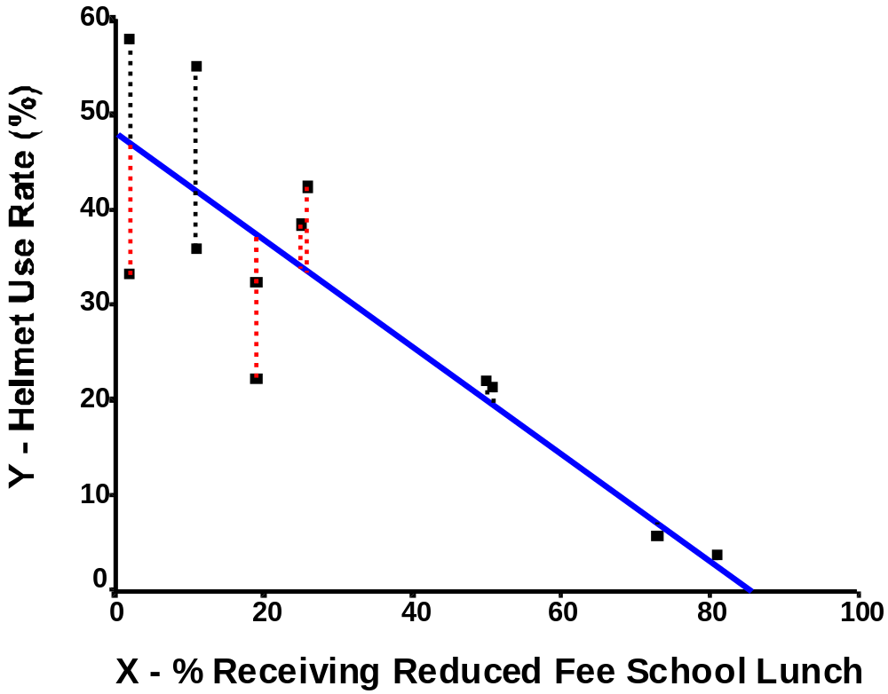
Residuals

Slide 9
Predicted value for an individual…
y_{i}= b + m*x_{i} + random error_{i}
Fixed – exactly on the line
Follows a normal distribution

Slide 10
What is the Goal of LR?
Y=mX+b
Lets be clear:
In the equation above, Y and X are KNOWN…. The goal of regression is to compute m and b in which the ‘guessed’ line has the smallest mean error!

Slide 11
Multiple Linear Regression
What if there are multiple input parameters?
Y=m₁X₁+ m₂X₂ ₊ m₃X₃ + B
Where
X1,X2,X3 are the different input streams

