Slide 1
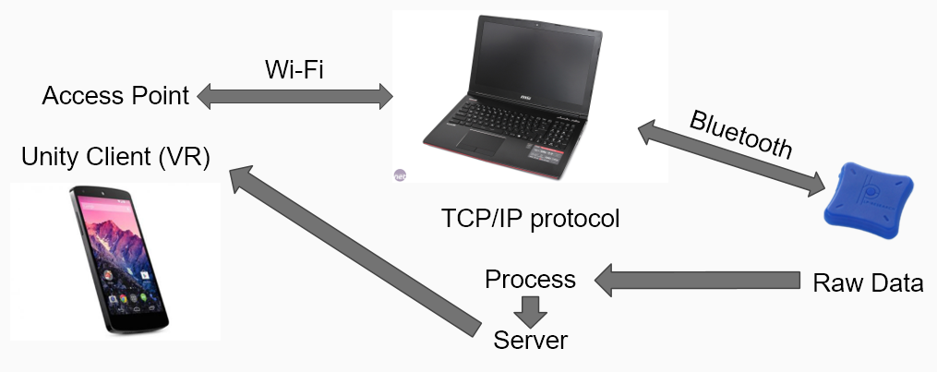
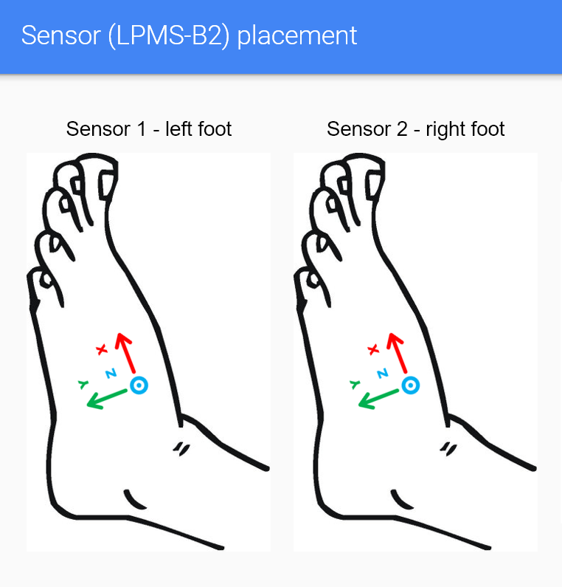

Slide 2
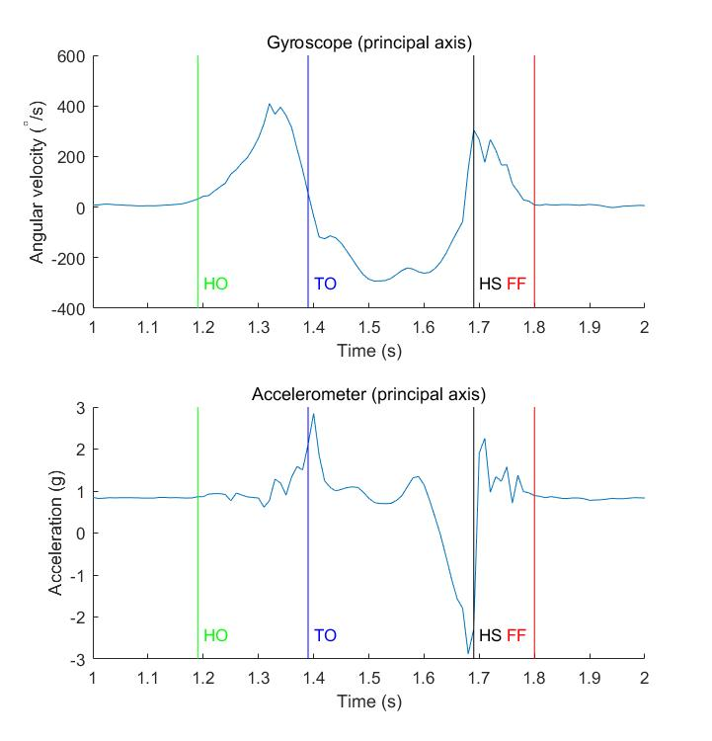
state 0
state 1
state 2
state 3
Foot Flat
Heel Off
False positive
Heel Strike
Toe Off

Slide 4
stationary
state_vv
state 0
state 1
state 2
state 3
state 4
stationary false
above threshold
stationary true
true
false
maxUp
maxDown
below threshold
zeroPass

Slide 6
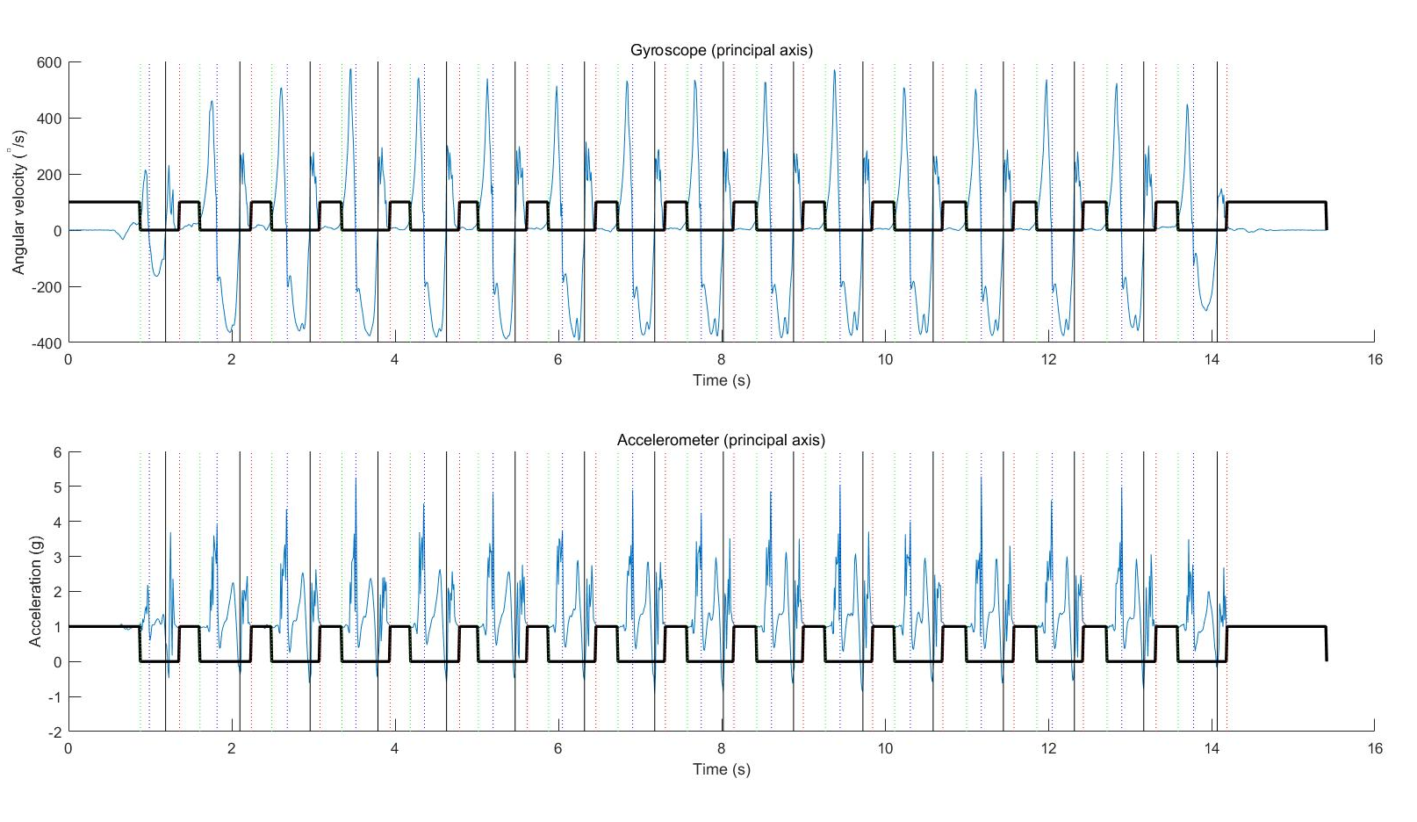

Slide 8
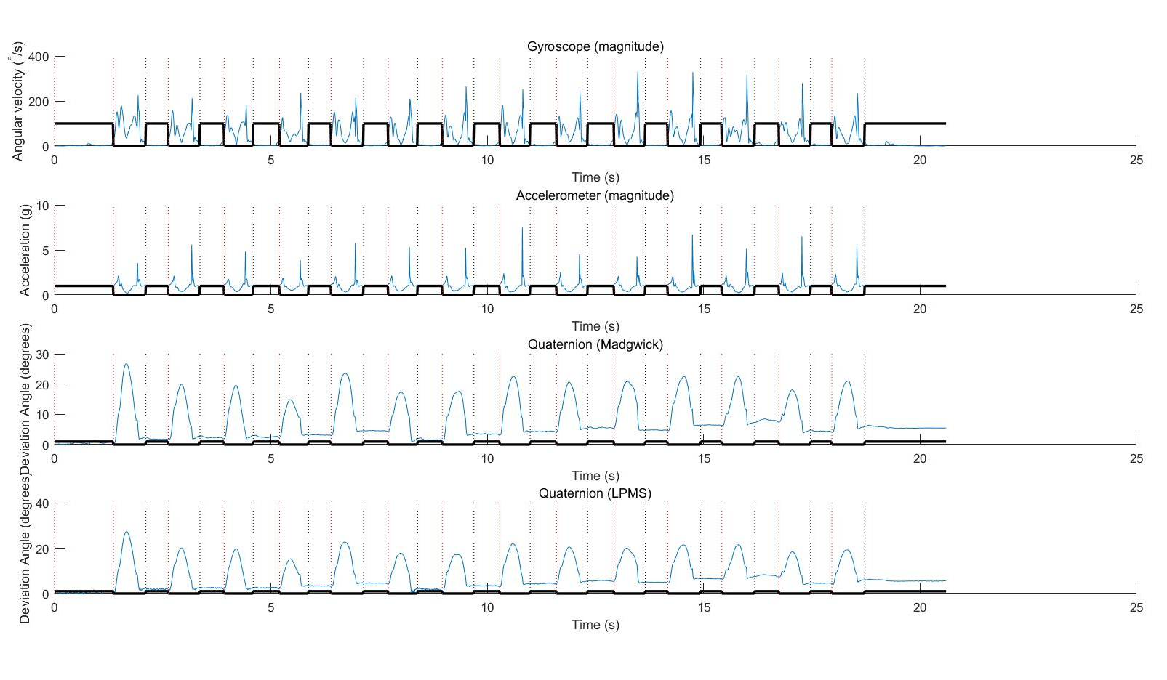

Slide 9
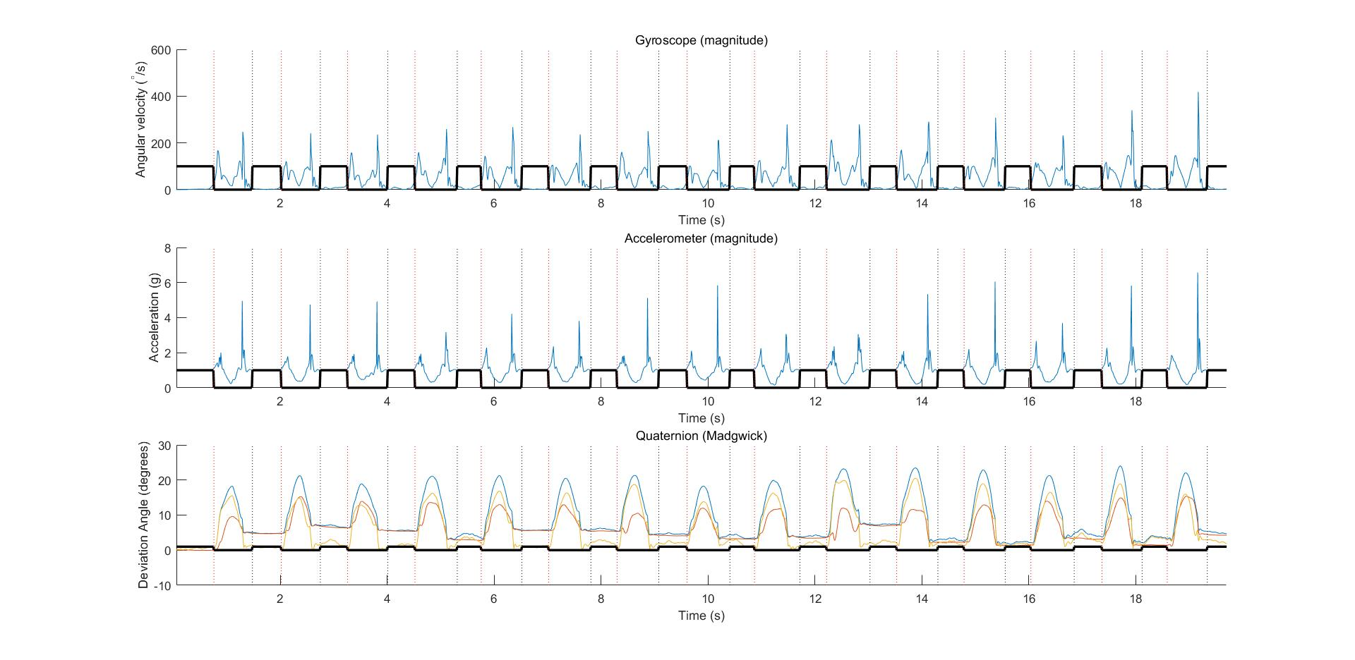
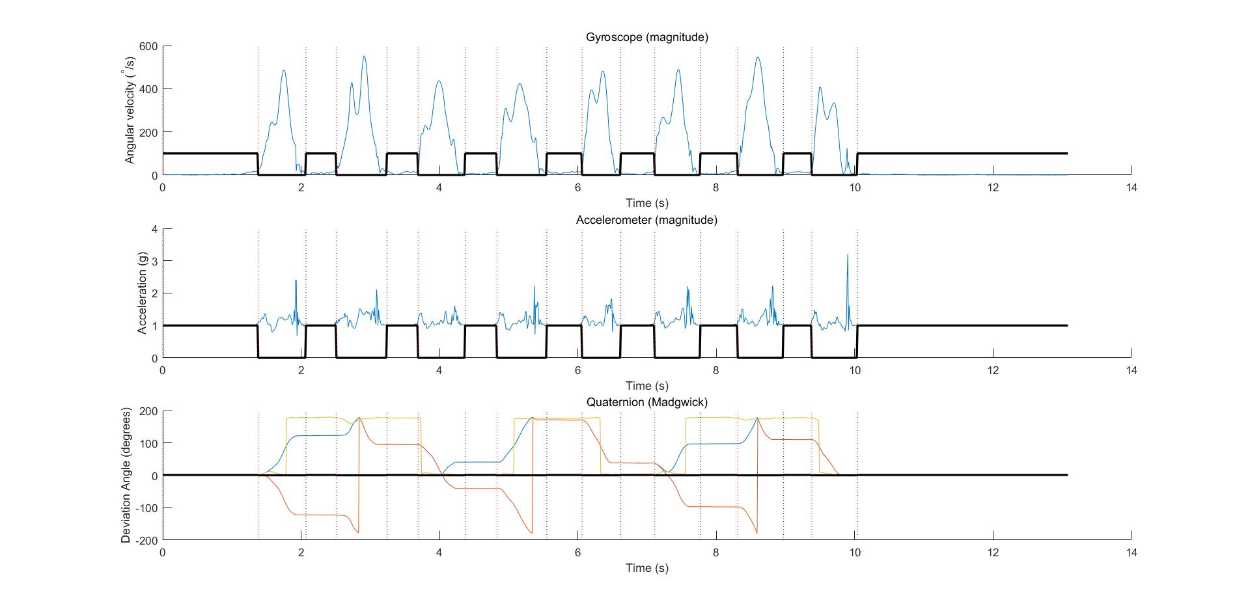
A
B

