Slide 1
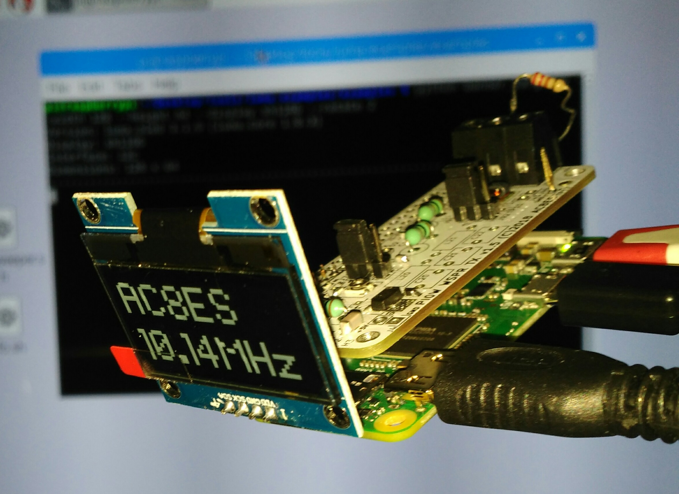
RPi Zero W WSPR Amplifier
ARROW (w8rp.org) Build Sessions Aug 2019
A 100mW+ HF transmit amplifier daughterboard for the Raspberry Pi Zero W
Direct connection of dipole antenna
Select one of two HF band low-pass filters via jumper. 30M LPF built-in; 2nd LPF user-supplied.
OLED direct plug-in
©2019 AC8ES
jglandorf at gmail dot com

Slide 2
What's Needed
What's Optional
safety glasses
soldering iron, solder, flux
voltmeter
HDMI monitor, mini-HDMI to HDMI cable
USB keyboard+mouse (trackpad) combo or separate devices with powered USB hub
magnifying glasses
tape measure
WiFi internet access
needle-nose pliers
a Linux/MAC/Windows PC with built-in or USB SD card reader
USB volt/current meter
Oscilloscope, 50MHz+
VNA

Slide 3

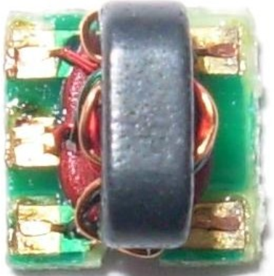
Warnings
Use caution around the balun area, as its fragile wires are easily damaged
Do not remove or insert the uSD card, amplifier
board, or cables while the RPi is powered
Use care when inserting/removing the
easily-damaged uSD card; do not bend or twist it
When inserting or removing a cable, grasp the board connector in one hand, and insert/remove the cable with the other; this will reduce stress on the connector's solder joints
Avoid powering down by simply turning power off; use the Pi menu (X-Windows) or the sudo shutdown now command
When running the WSPR or other transmitting programs in X-Windows, moving any window around on the screen will lock up the operating system (run these from the console)

Slide 4
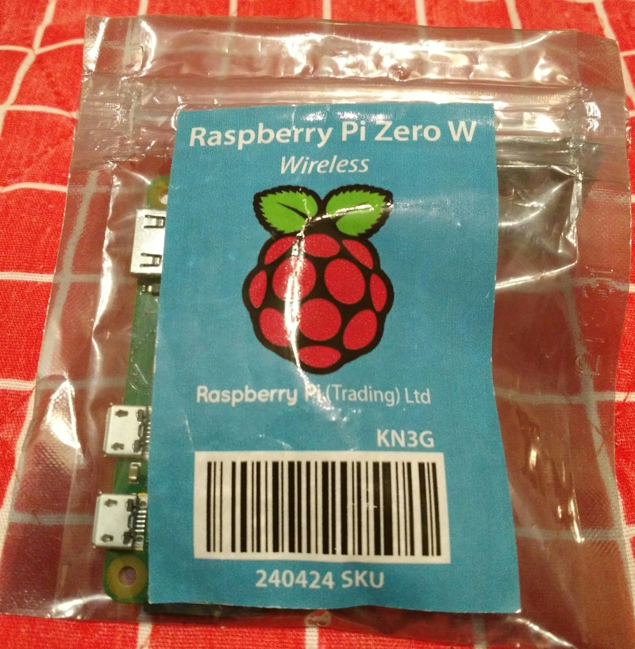
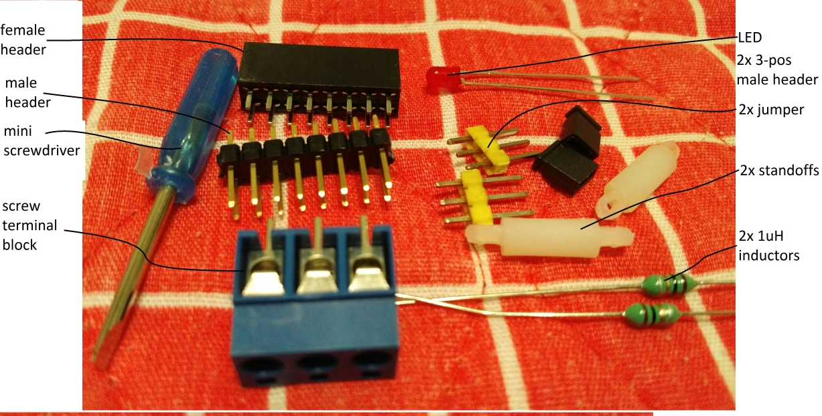
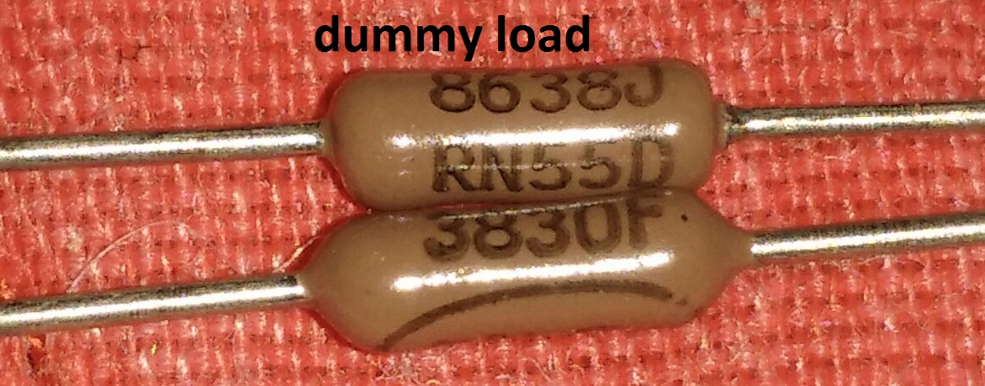
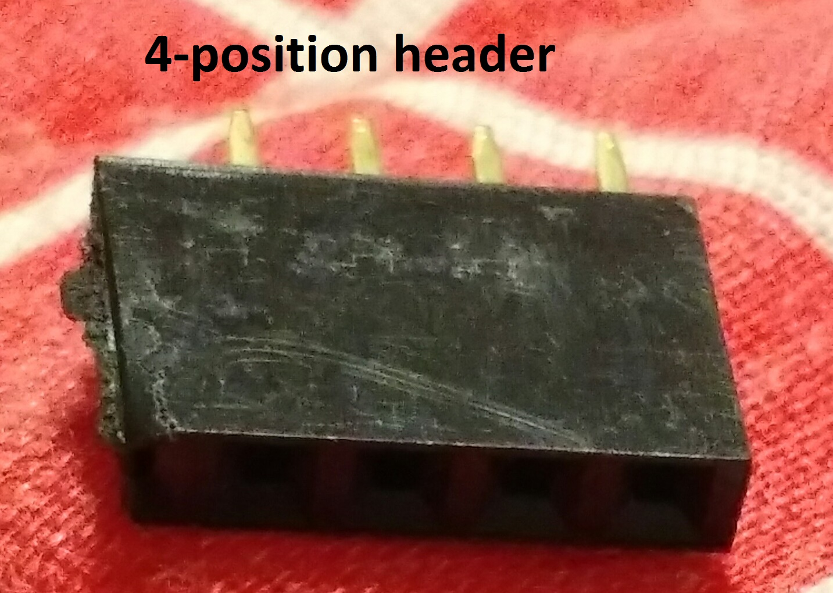
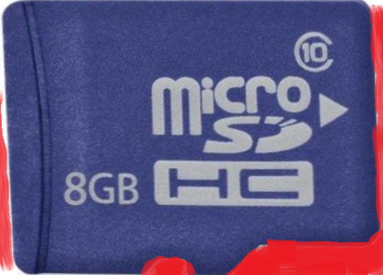
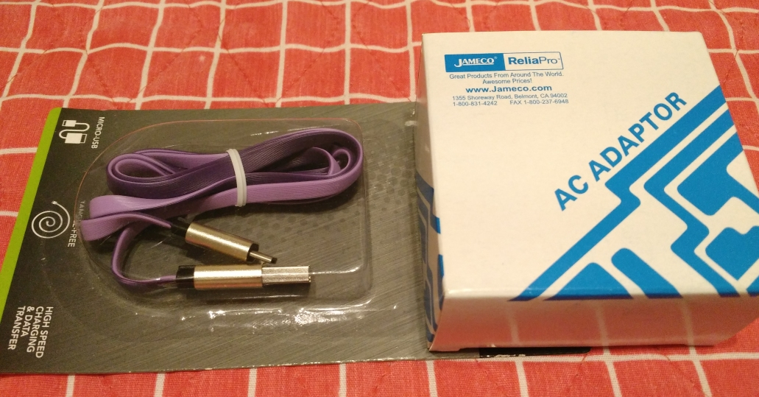
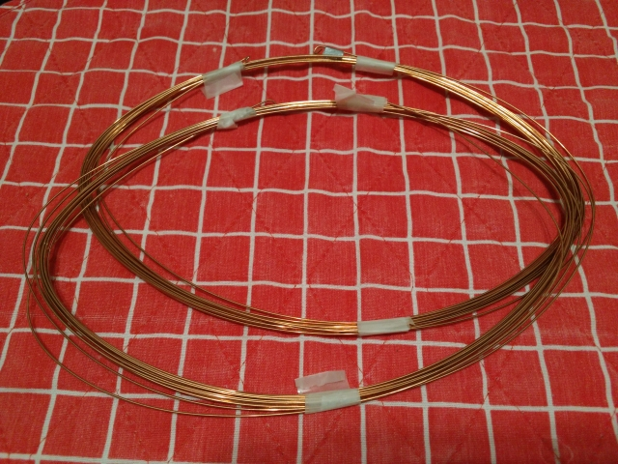
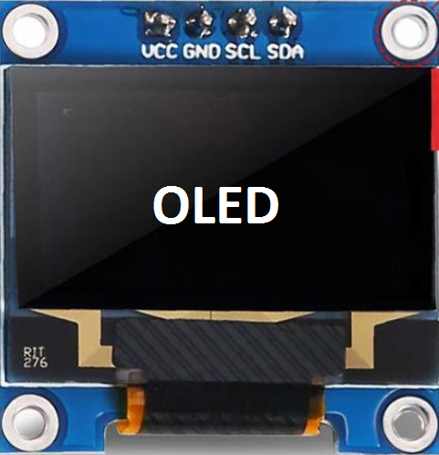
Kit Contents

Slide 5
Block Diagram
Raspberry Pi
Zero W
WSPR Amplifier PCB
5V
11MHz
Low Pass
Filter
CPU
timer
3 → 5V
Buffer
100mW
FET
Amplifier
Balun
Dipole
User
Low Pass
Filter
I2C
OLED
display
5V AC
adapter
Schematic is in separate document

Slide 6
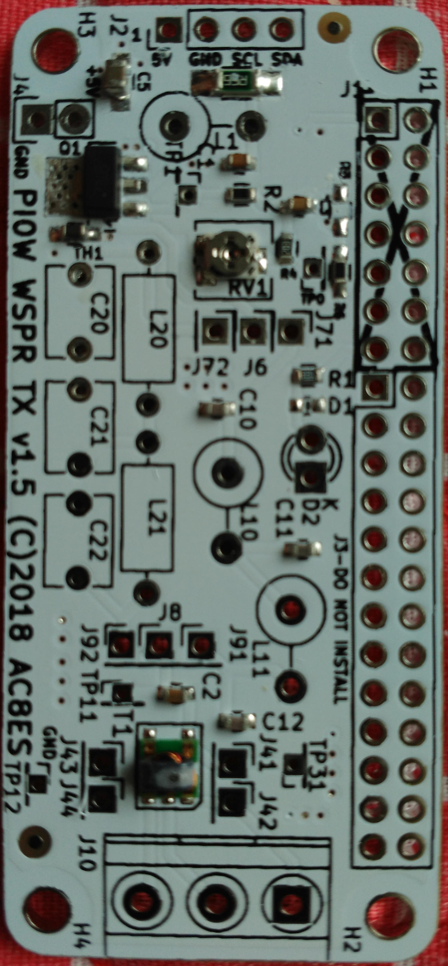
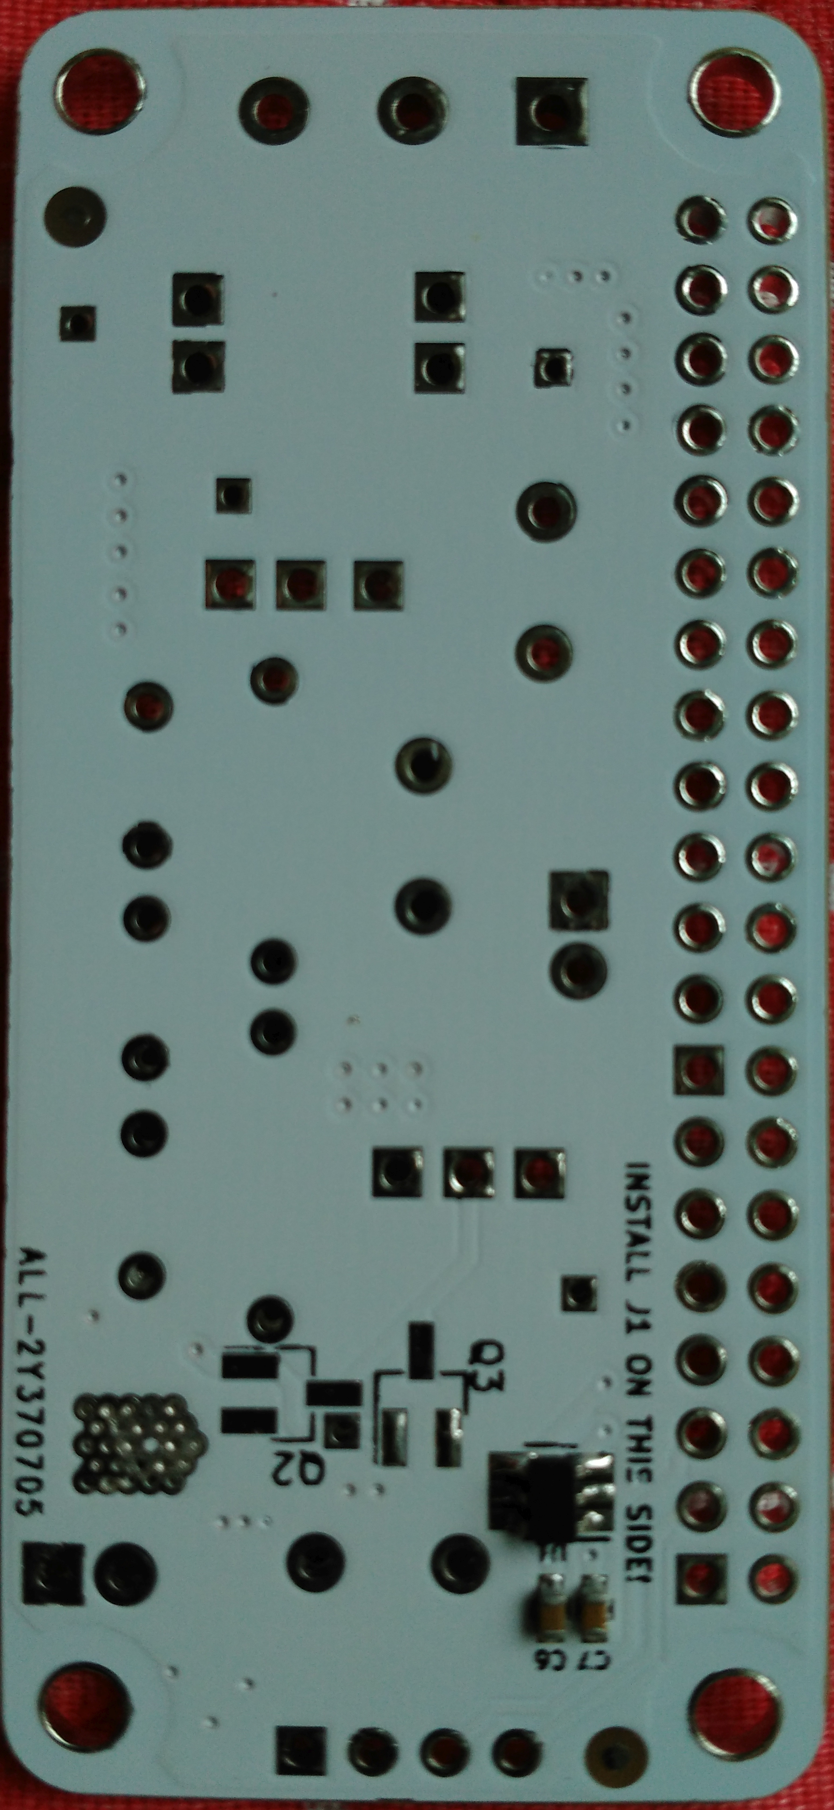
Surface-Mount Components Installed
 | FRONT
C2, C3 | 0.1uF
C10, C12 | 430pF
C1 | 10-18nF
C11 | 680pF
C5 | 10uF
R1 | 270-330Ω
R2, R6 | 47-51Ω
R4 | 20kΩ
R55 | 0.56Ω
RV1 | 50kΩ
TH1 | 10kΩ 4250K
T1 | MABA-009488-61HWCA
Q1 | ZXMN6A07Z
 | BACK
C6, C7 | 0.1uF
U1 | 74LVC1T45

Slide 7
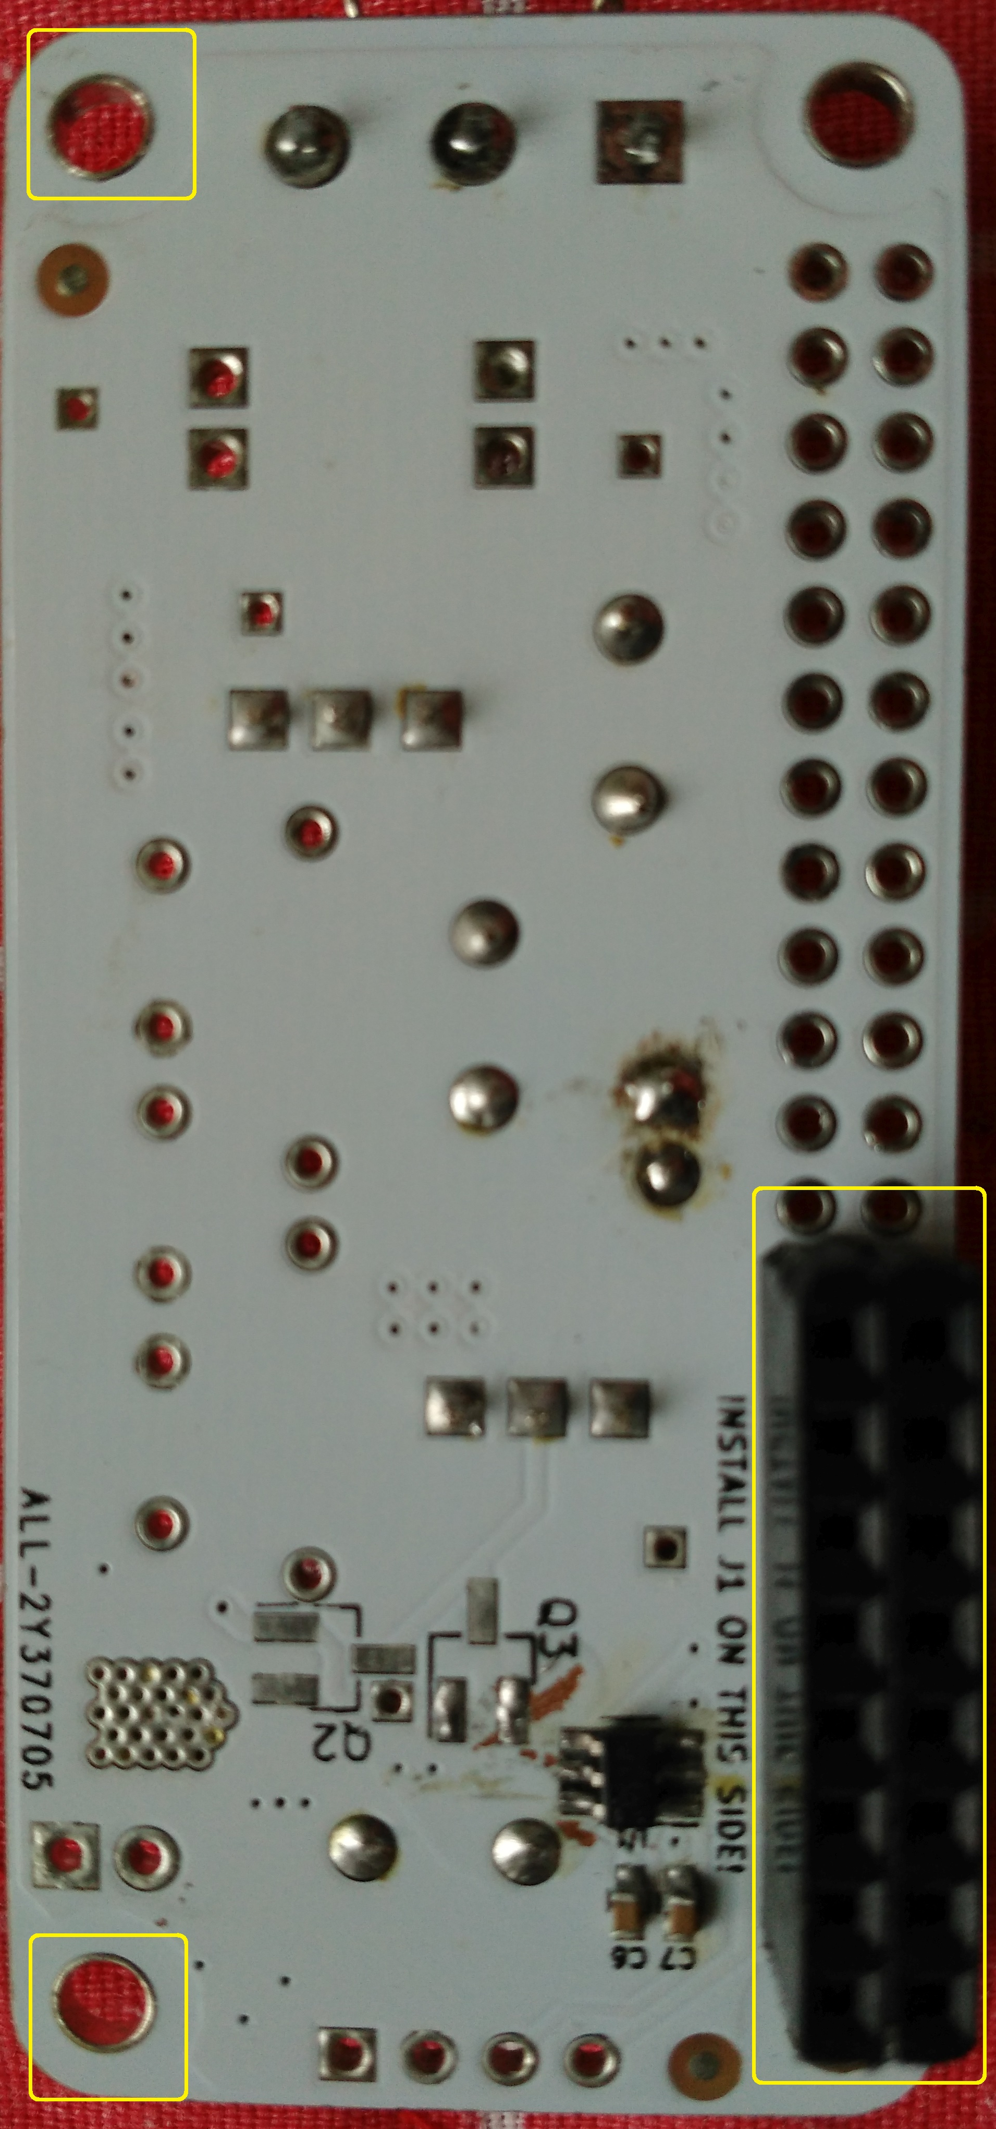
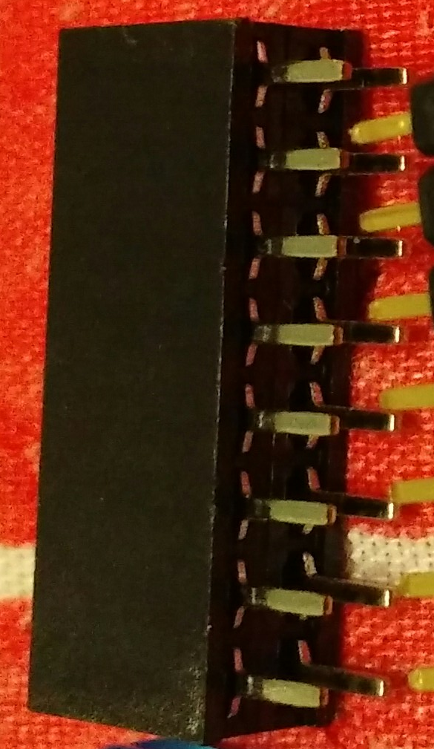
Back Installation
☑completed |  | BACK
□ | J1 | 2x7 or 2x8 female header socket

Slide 8
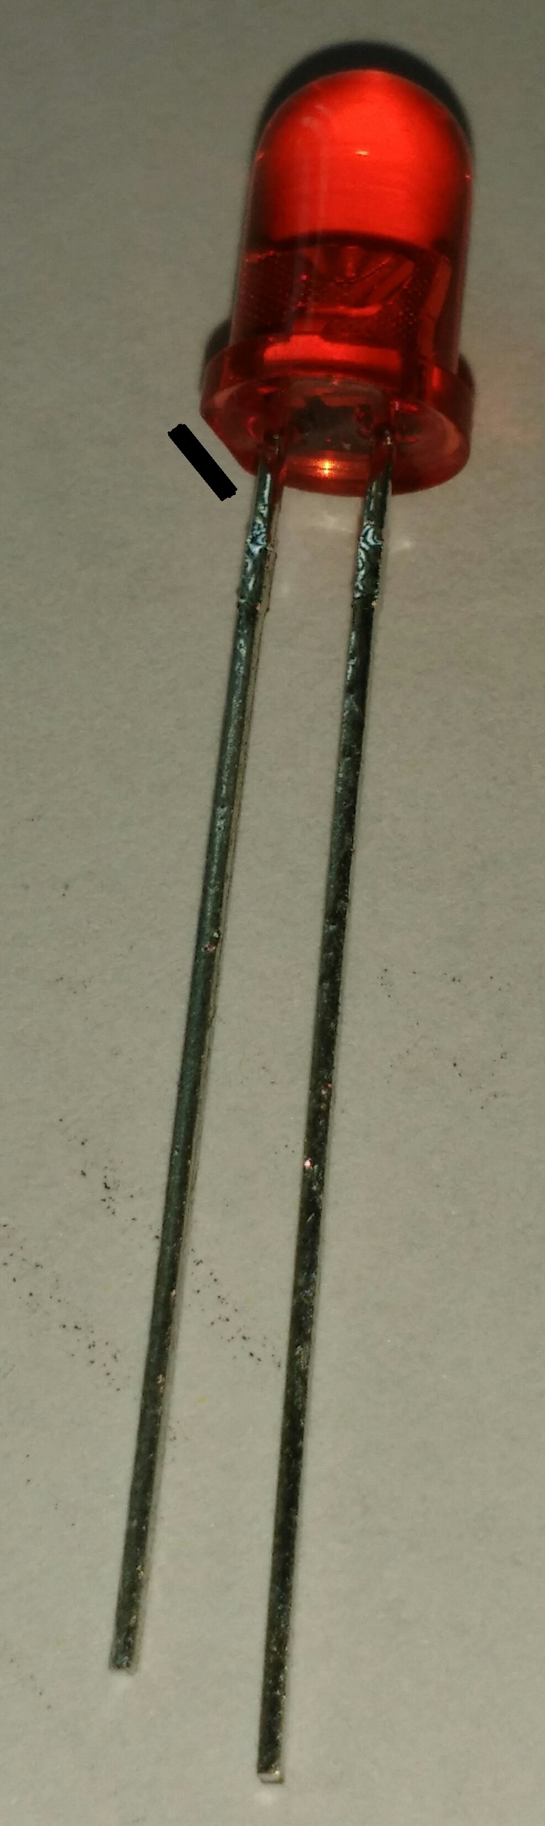
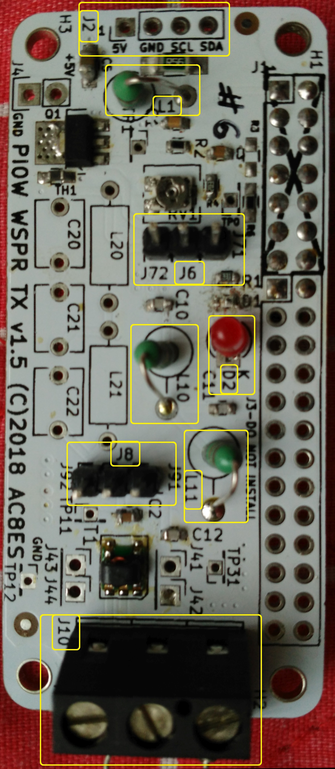
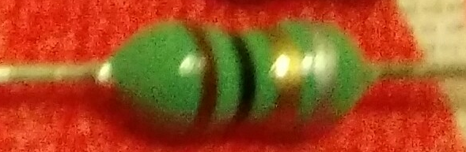
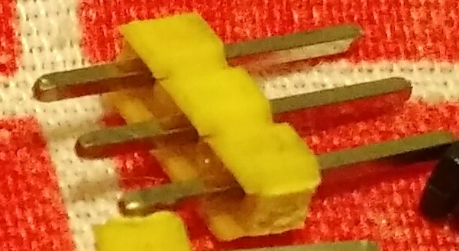
Front Installation
☑completed |  | FRONT
□ | D2 | LED – short lead at flat
 |  | is cathode [K]
□ | L1 | 1uH
□ | L10 | 1uH
□ | L11 | 1uH
□ | J6 | 3-position header
□ | J8 | 3-position header
 | J10 | See next page!
K

Slide 9
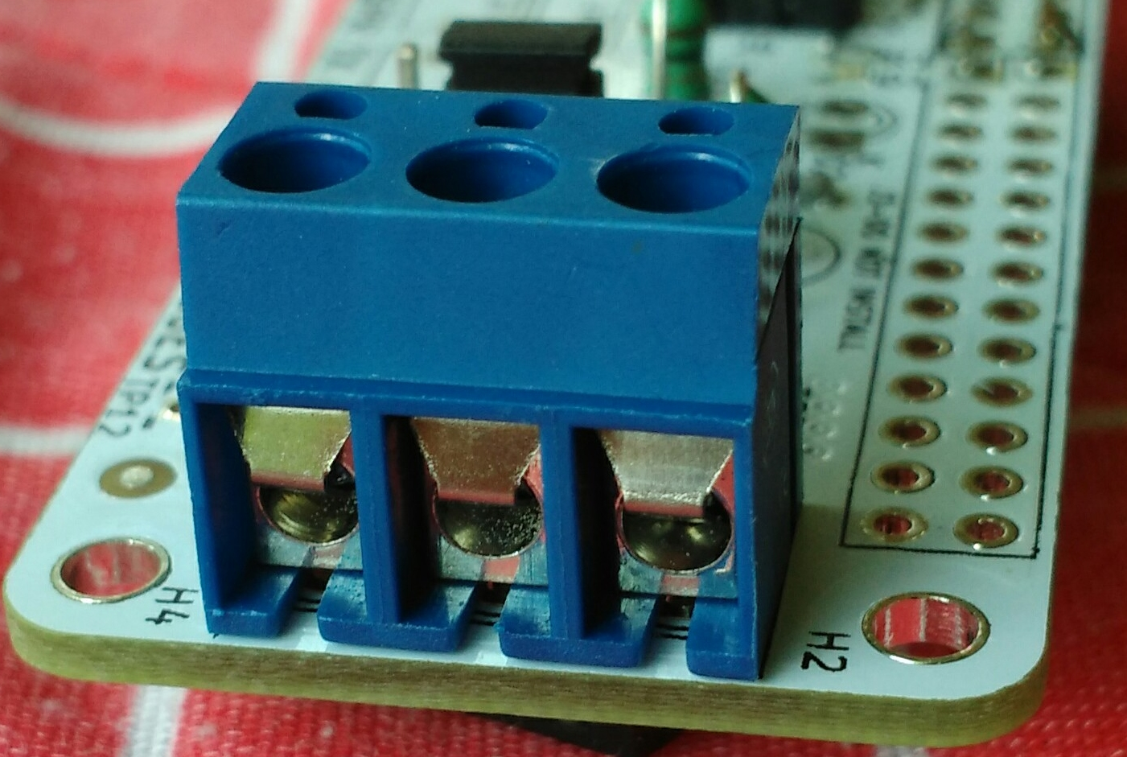

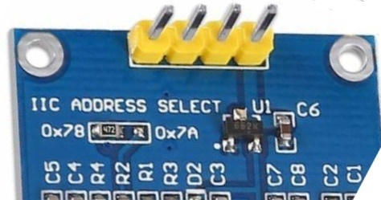
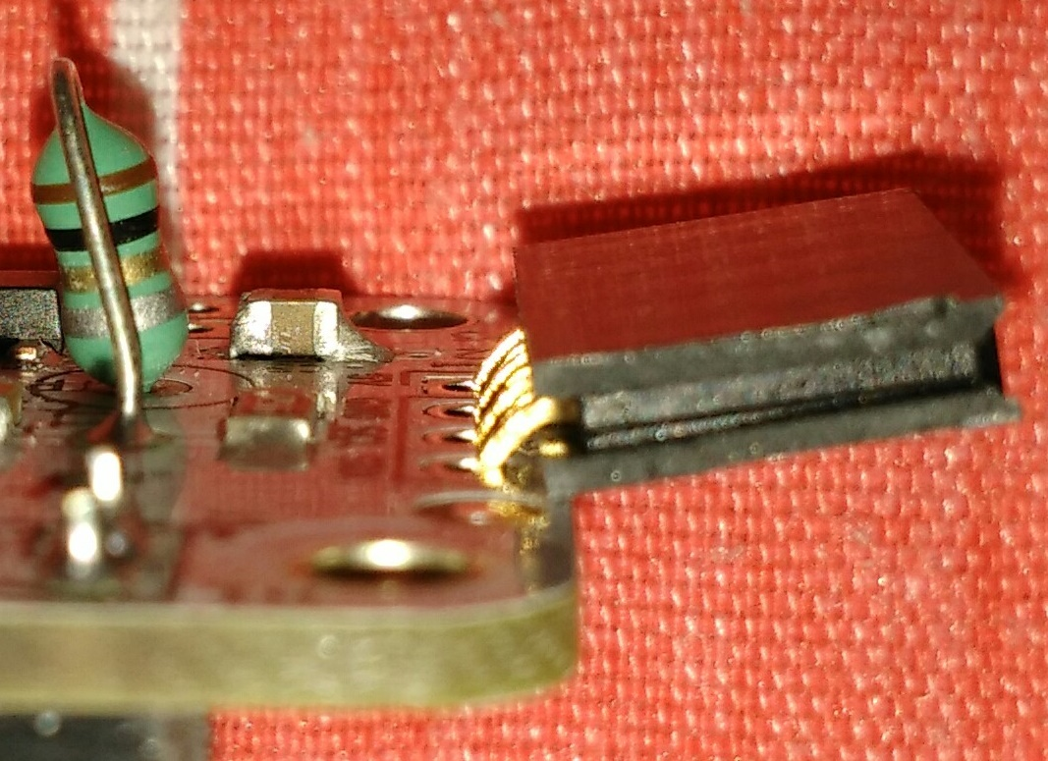
Front Installation
☑completed |  | FRONT
□ | J10 | 3-position screw terminal
□ | J2 | 4-position OLED header
 |  | Insert header from top until pins are flush back side
 |  | Bend header to be nearly parallel to PCB
 |  | Adjust header as needed after soldering each pin
 |  | Do not plug OLED in yet.

Slide 10
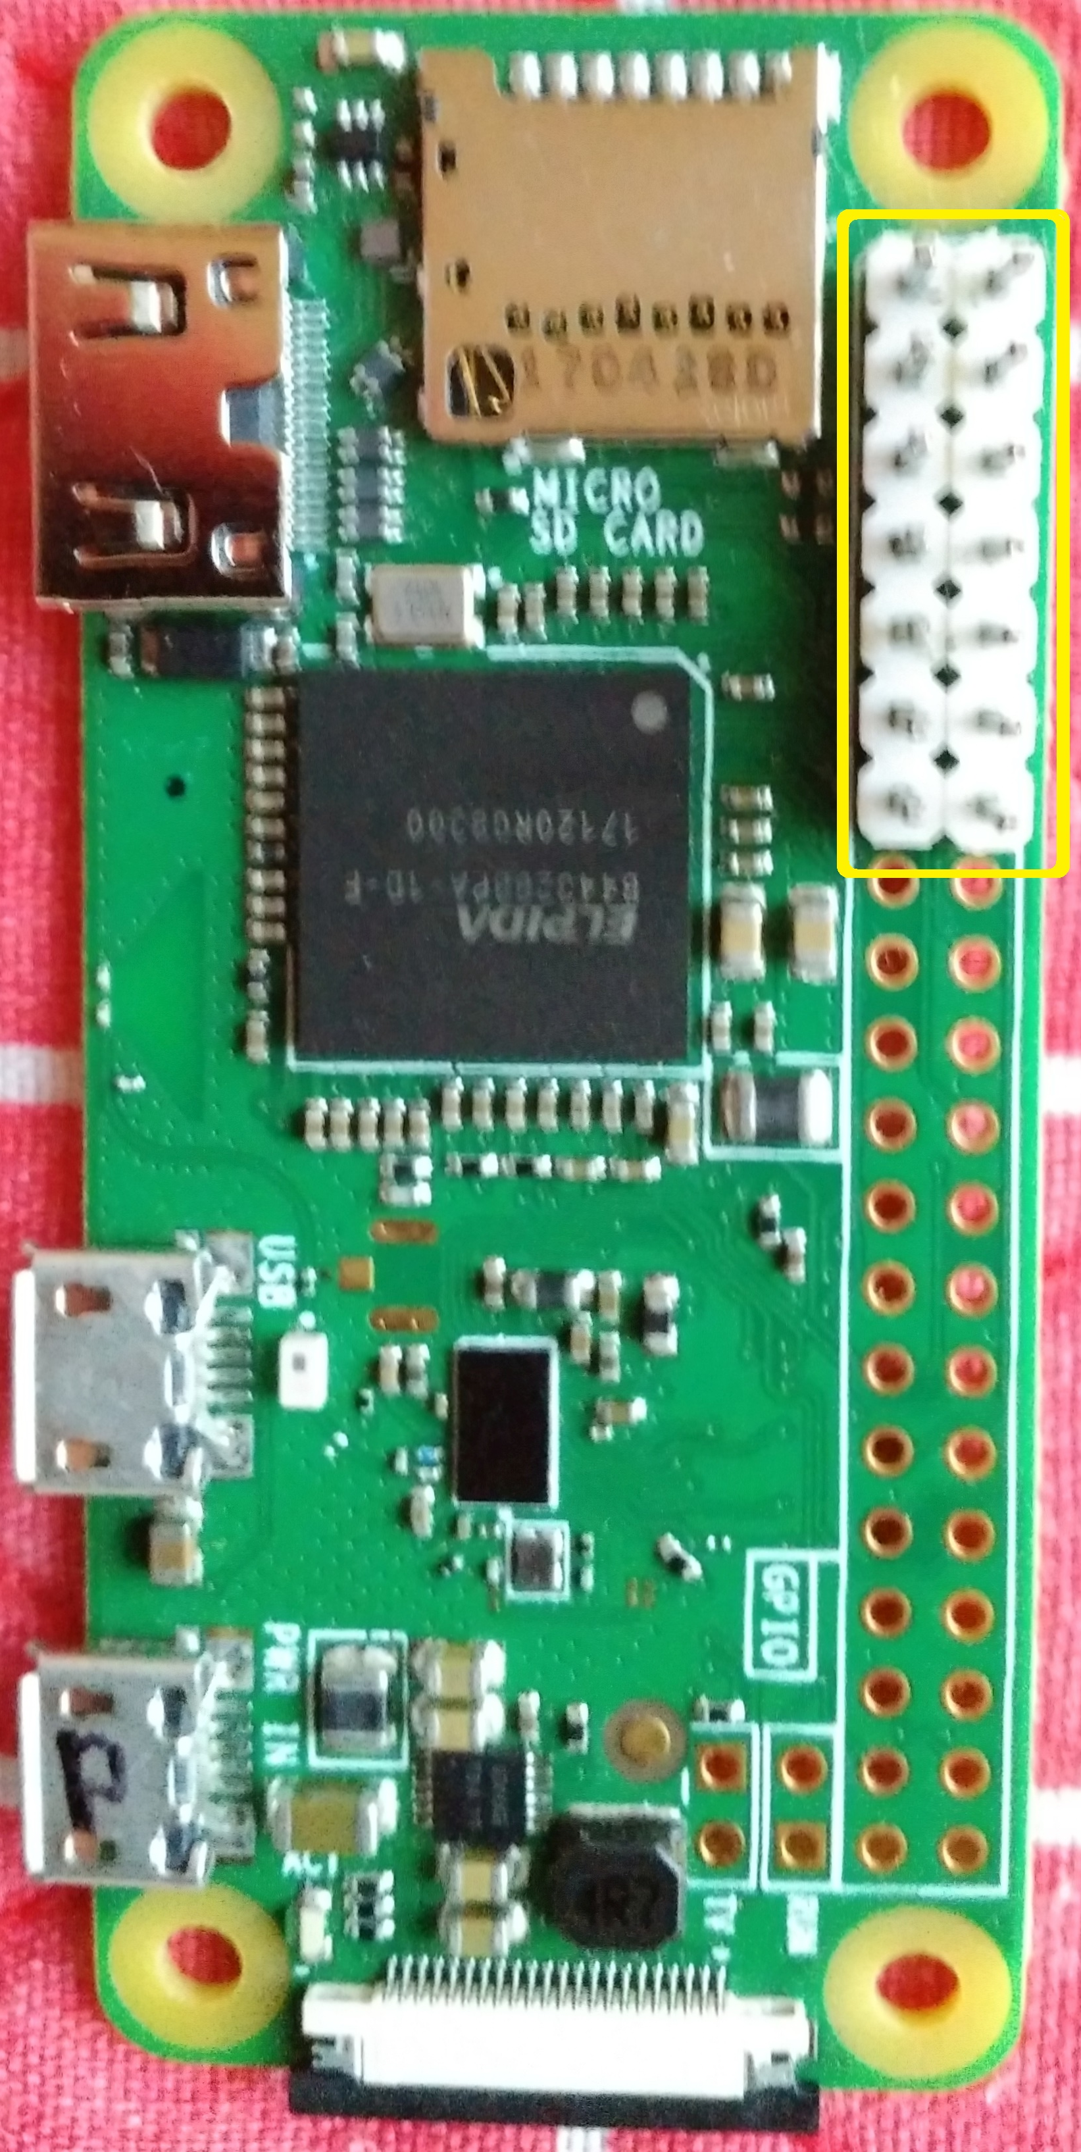
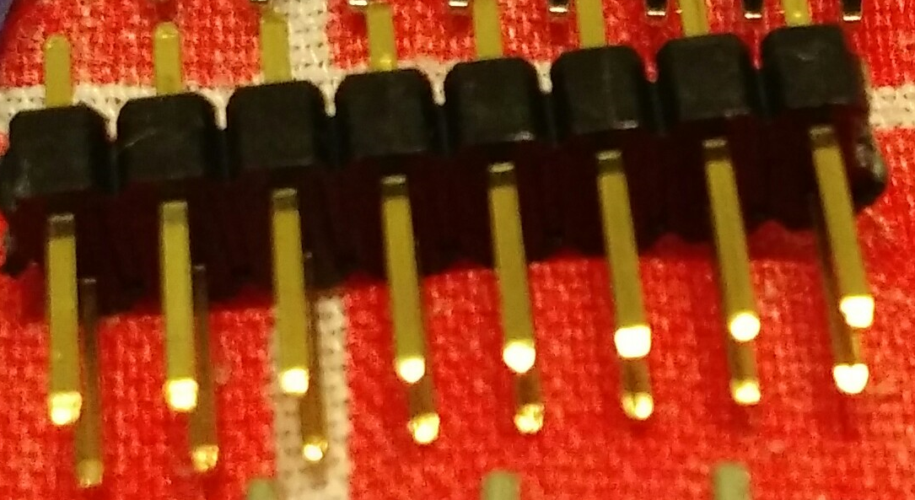
Rpi Zero W Installation
☑completed |  | BACK
□ | J0 | 2x7 or 2x8 male header
 |  | (only 14 pins are used)
 |  | align with RPi pin 1

Slide 11
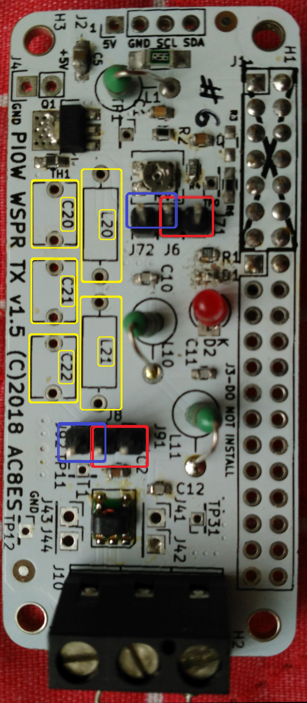
Low Pass Filter
☑completed
□ | Place jumpers here for the 30m LPF
After project completion, you can populate an alternate LPF, per the chart below, and move the jumpers here :
 | λ_{target} | 80m | 40m | 30m | 20m | 14m | 10m
☑completed | F_{cutoff} MHz | 4 | 8 | 11 | 16 | 22 | 33
□ | C20, pF | 1200 | 560 | 430 | 300 | 220 | 150
□ | C21, pF | 1200 | 560 | 430 | 300 | 220 | 150
□ | C22, pF | 1800 | 910 | 680 | 470 | 330 | 220
□ | L20, μH | 2.7 | 1.5 | 1 | 0.68 | 0.56 | 0.33
□ | L21, μH | 2.7 | 1.5 | 1 | 0.68 | 0.56 | 0.33

Slide 12
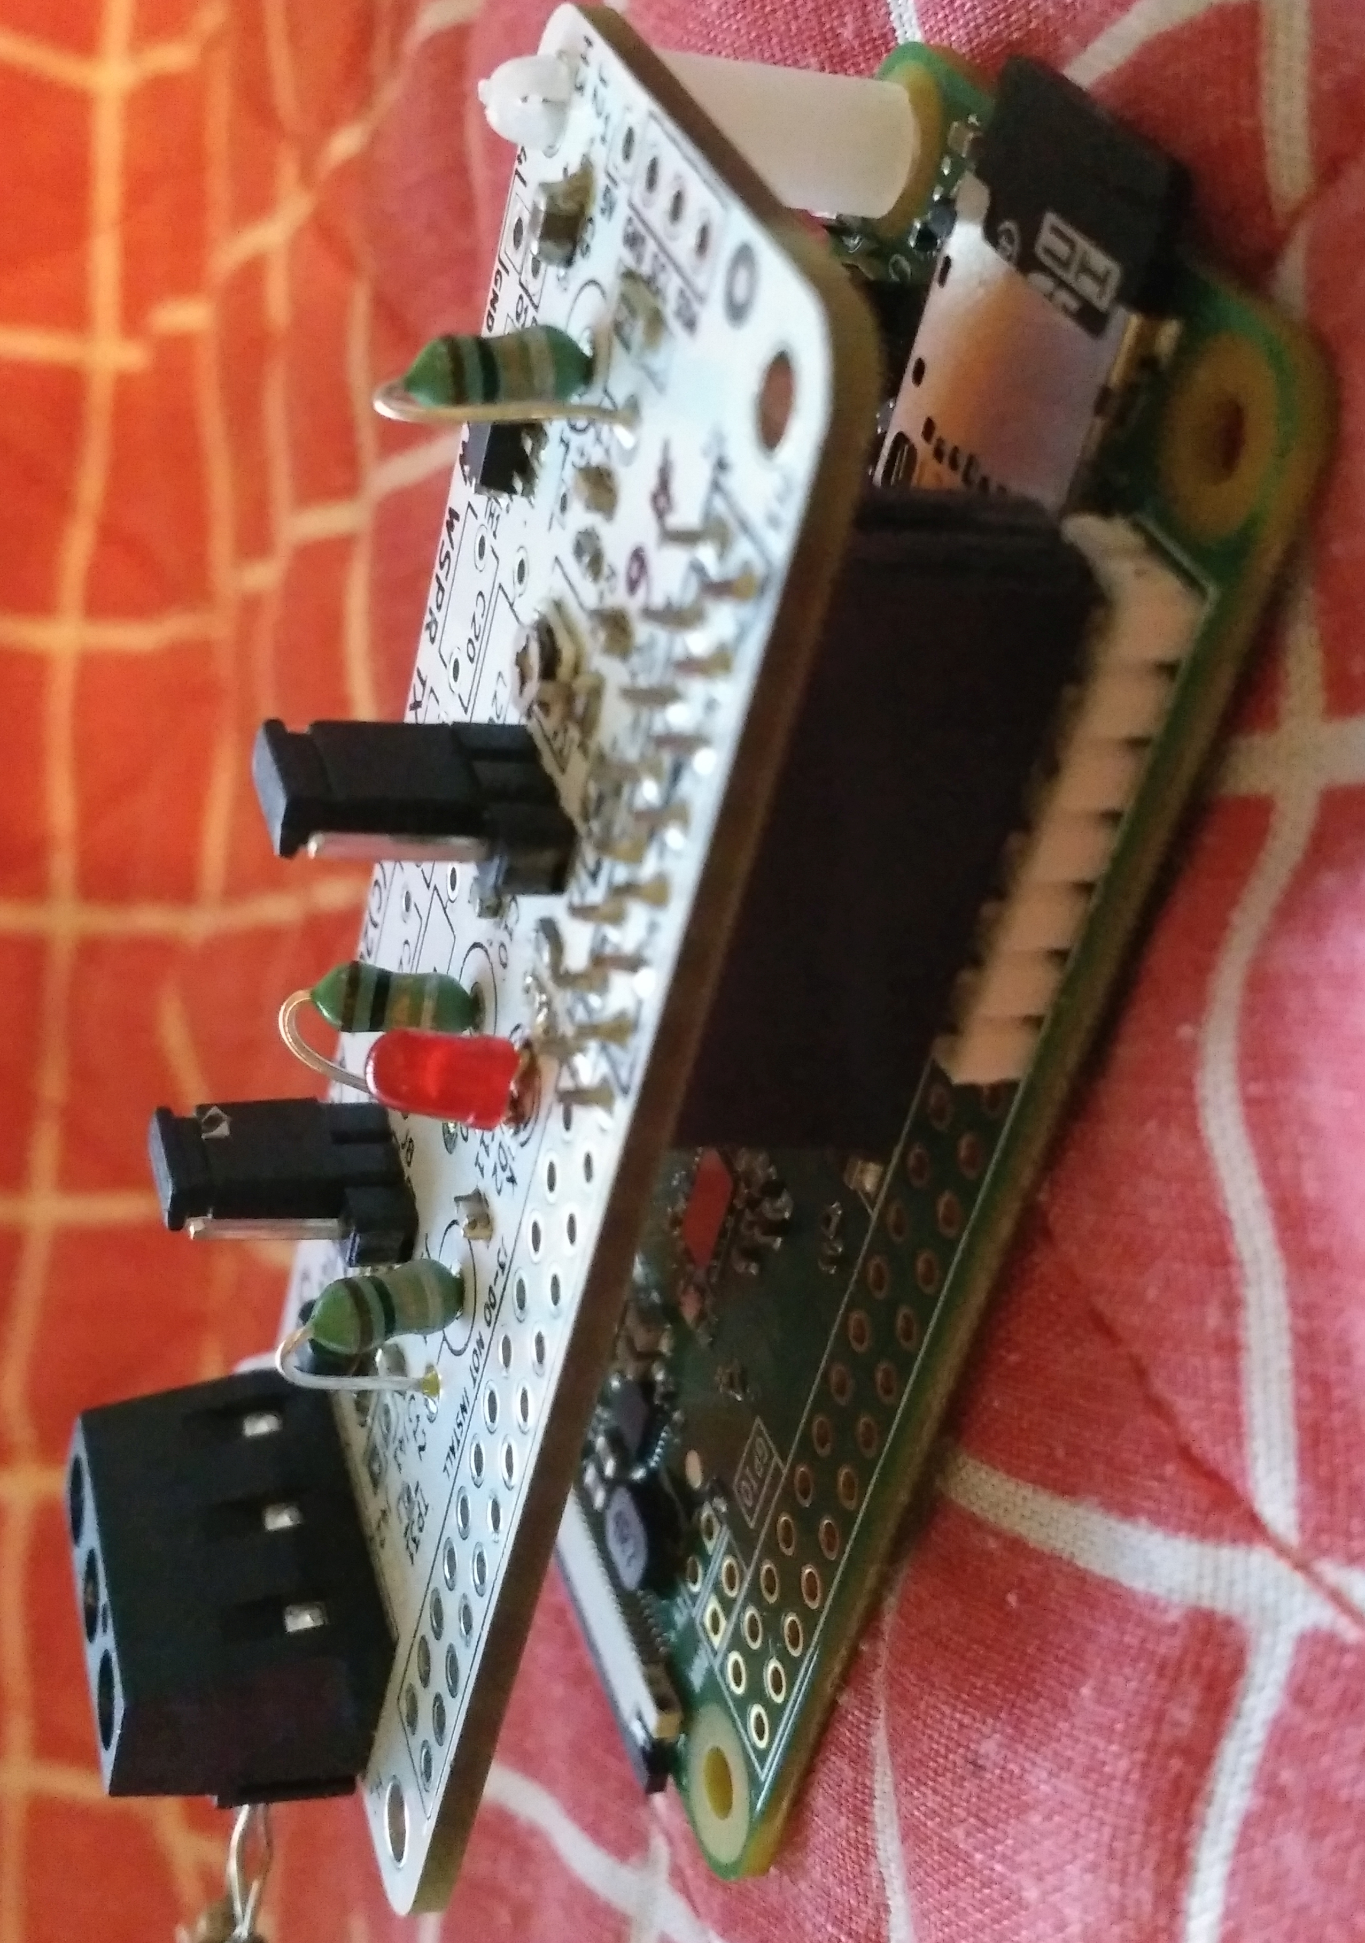
Assembly with RPi
☑completed
□ | Snap the two standoffs onto the Pi Zero, on long-edge corner holes opposite header
□ | Carefully align the WSPR socket onto the RPi header pins and push the WSPR board straight down
□ | Snap the two nylon standoffs into the RPi mounting holes
□

Slide 13
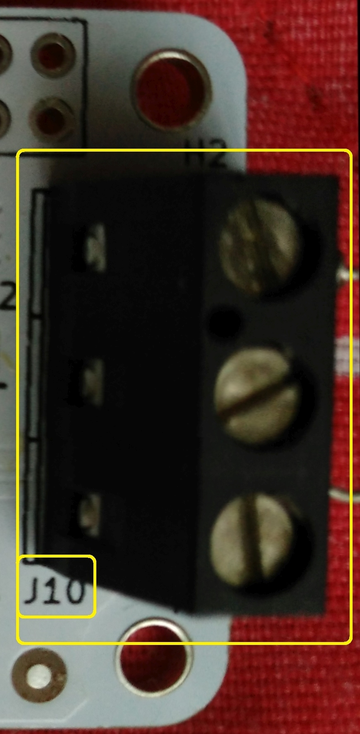
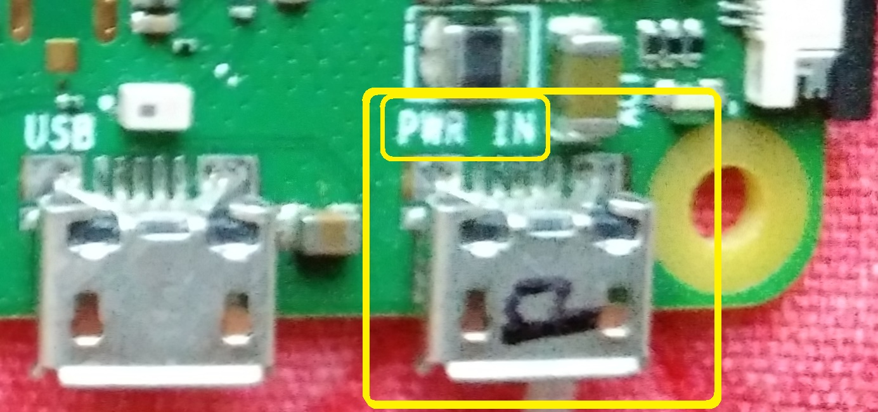
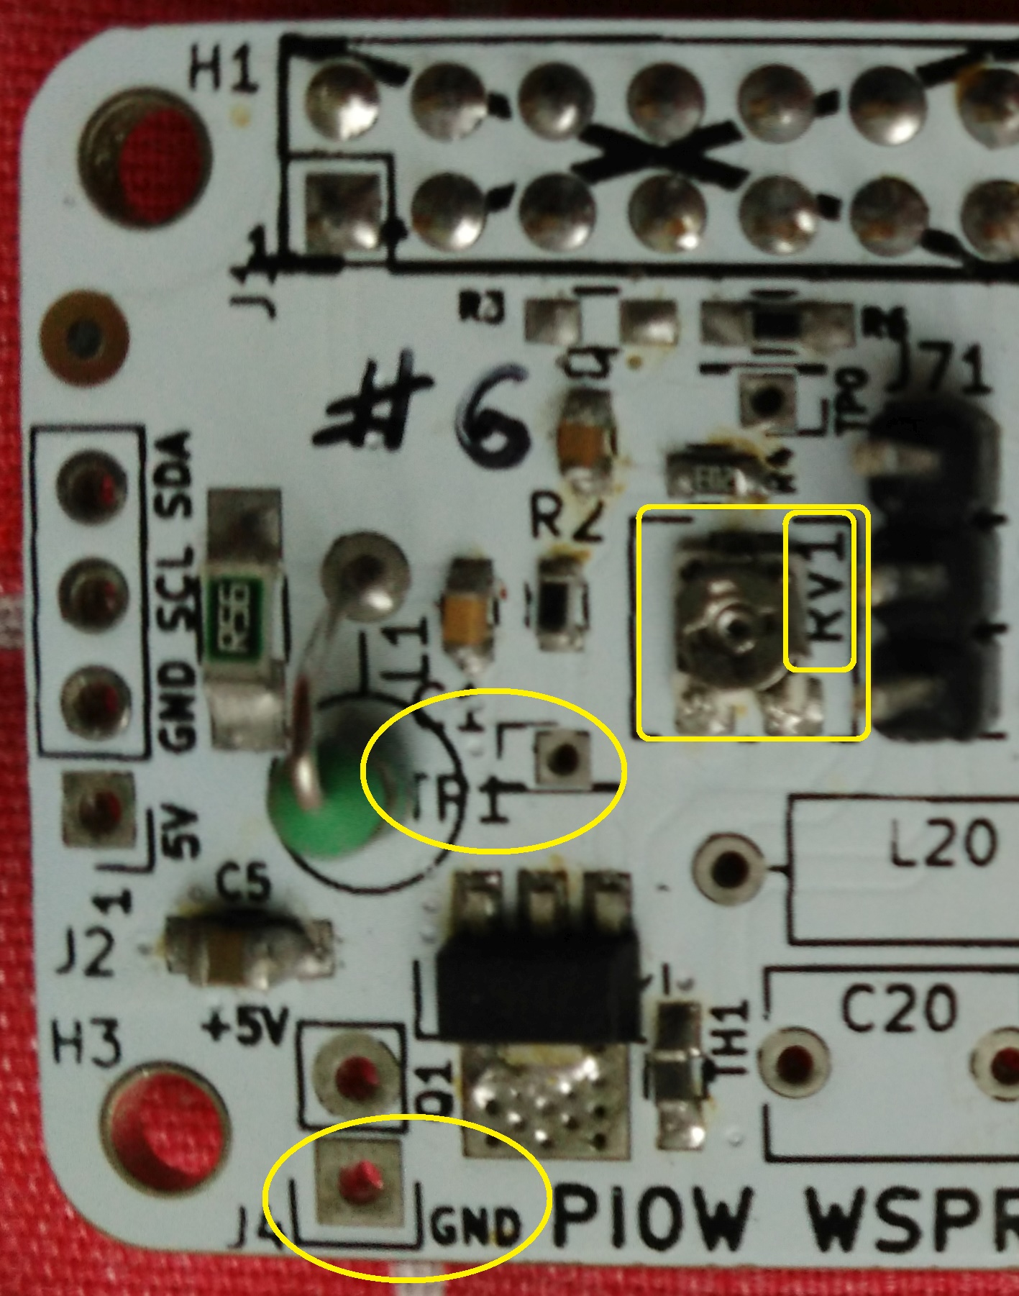
Bias Adjustment
1
2
3
USB Power
☑completed
□ | Connect two 383Ω resistors in parallel to J10-1 and J10-3.
 | Keep the resistors installed until ready to connect an antenna.
□ | Turn VR1 fully clockwise, using the mini-screwdriver
□ | Be prepared to unplug power if anything is hot or if there’s smoke! Apply 5V power [see photo top-right]; do not plug in HDMI cable or USB peripherals yet.
□ | Connect a voltmeter between TP1 and GND
□ | Slowly adjust VR1 for 0.9 to 1.0 V between TP1 and GND
□ | Disconnect 5V power

Slide 14
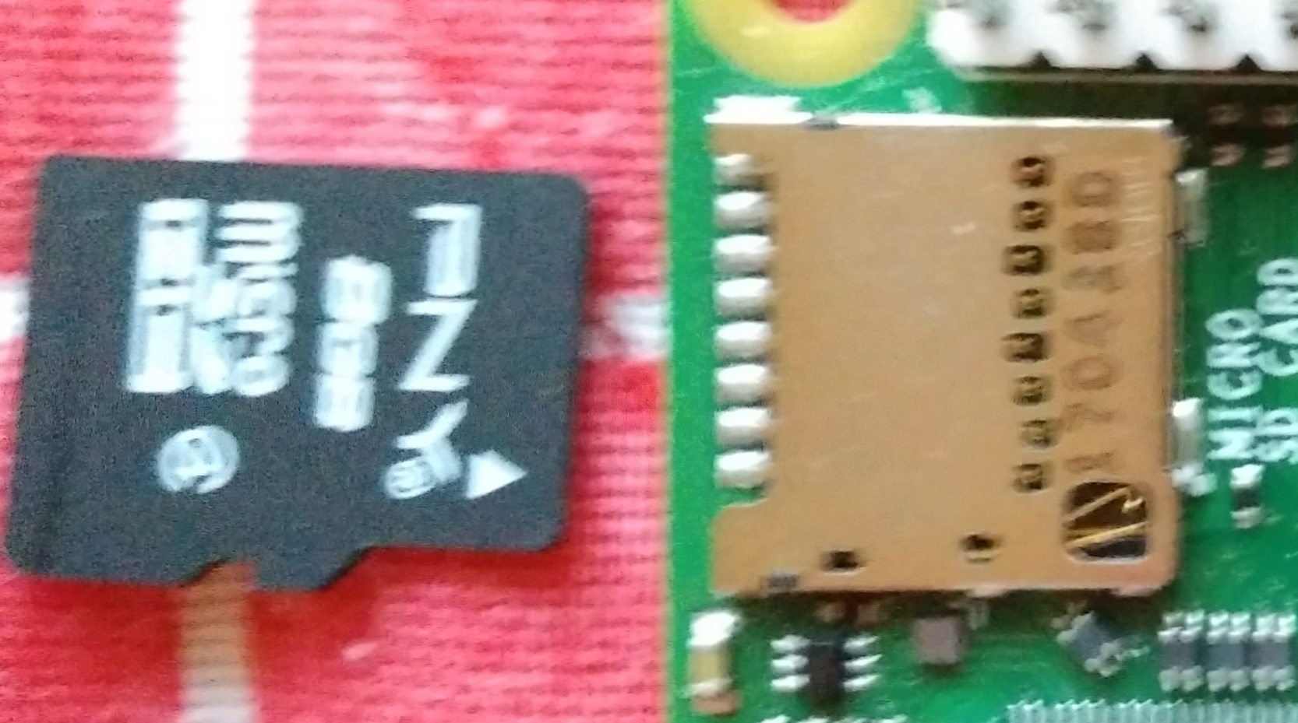
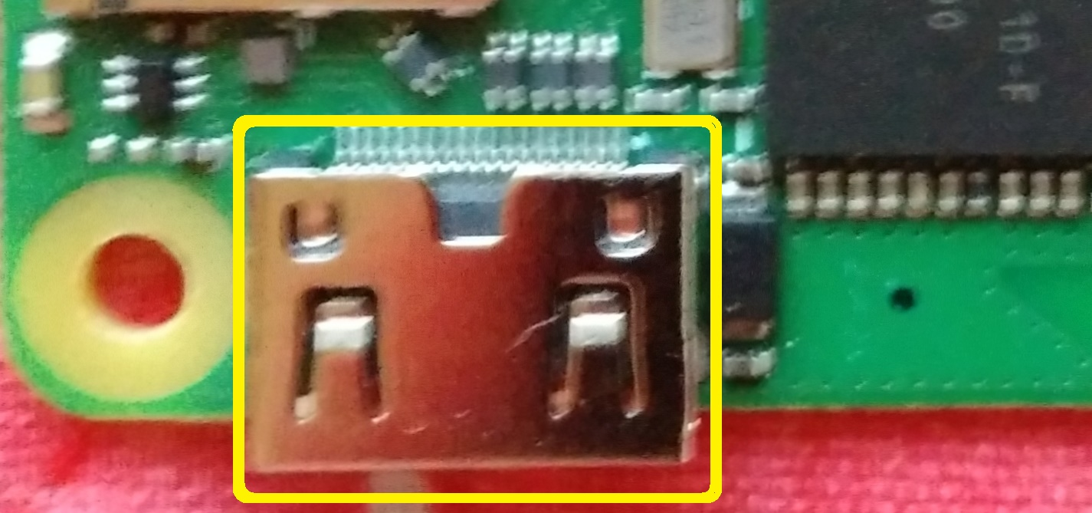
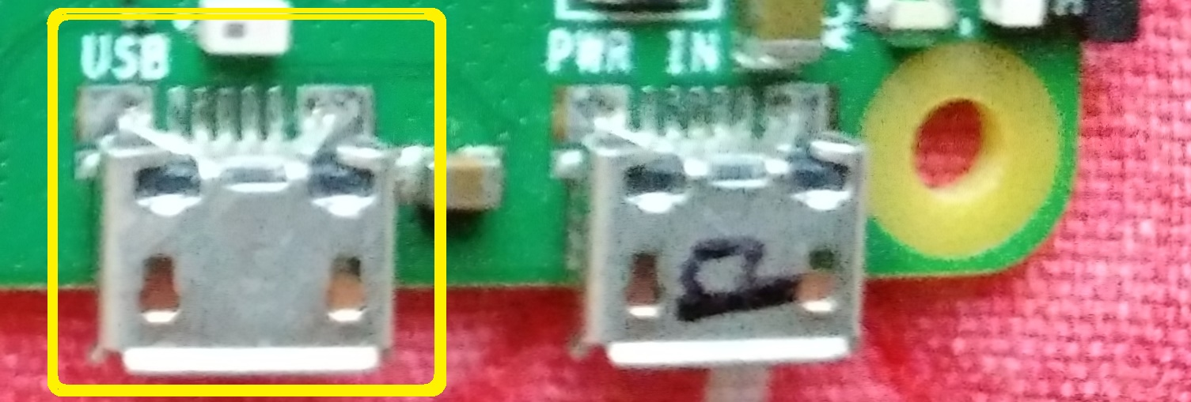
RPi Zero W Startup
☑completed
□ |  | Install the uSD card into the slot. uSD card contacts are facing the PCB. Install carefully!! Card is fragile
□ | miniHDMI port | Connect an HDMI monitor
□ | USB port | Connect a keyboard and mouse via USB hub
□ | USB power | Connect 5V USB power
□ | login as | username: pi password: raspberry
□ | enter | startx

Slide 15
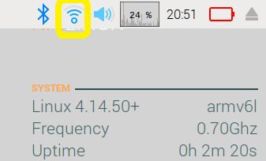



RPi Zero W Startup
☑completed
□ | WiFi connect | Click WiFi icon, follow prompts to connect to a network
□ |  | If using UM guest network, open web browser, agree to terms
□ | NTP check | Allow a minute or two for clock time to update
□ | Terminal window | Click to open a command terminal
□ | enter | cd /home/pi/Desktop
 |  | Keep the terminal window open for the next step

Slide 16
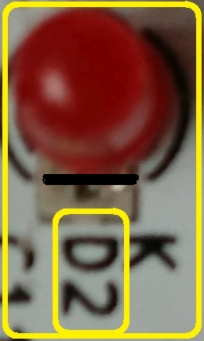
LED Test
☑completed
□ | Terminal window | at /home/pi/Desktop
□ | enter | sudo ./raspi-gpio27.sh
□ | verify | LED should blink for about 1 second

Slide 17
RF Test with Scope
☑completed
□ | Terminal window | at /home/pi/Desktop
□ | dummy load still connected? | Connect two 383Ω resistors in parallel to J10-1 and J10-3.
□ | Connect scope to load | J10-3 (gnd), J10-1 (signal) Set scope for ~10V pk-pk, ~10ns/division
□ | enter | sudo ./wspr.sh
□ | wait | Up to two minutes for transmission to start. WSPR protocol starts TX on the even minute, lasts for just under two minutes.
□ | verify | Power output at resistor
□ | calculate | P= (0.707 * Vpk)^2 / R
□ | stop: enter | <ctrl>C
1
2
3

Slide 18
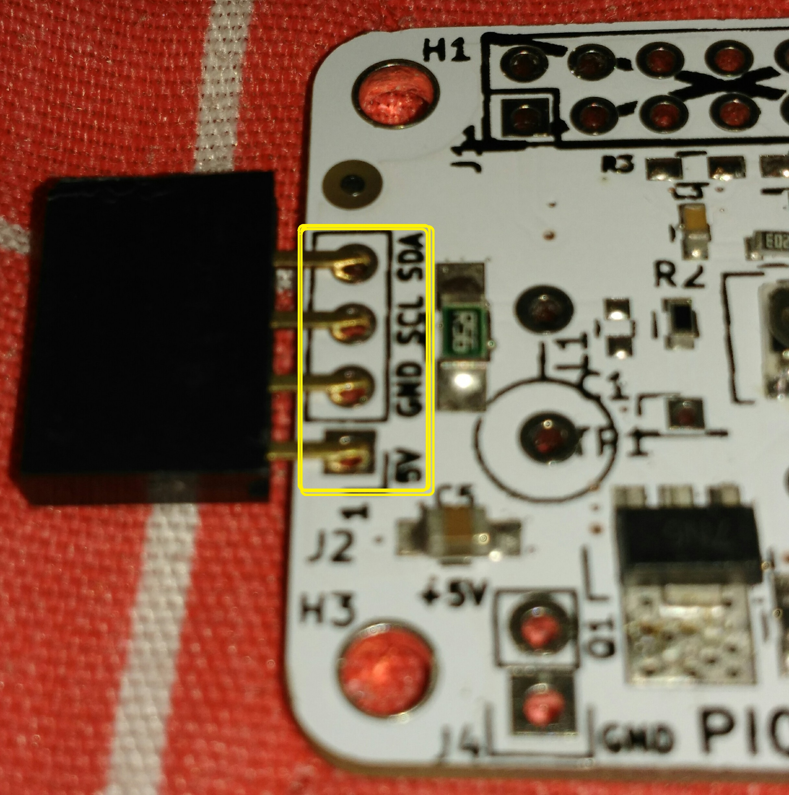
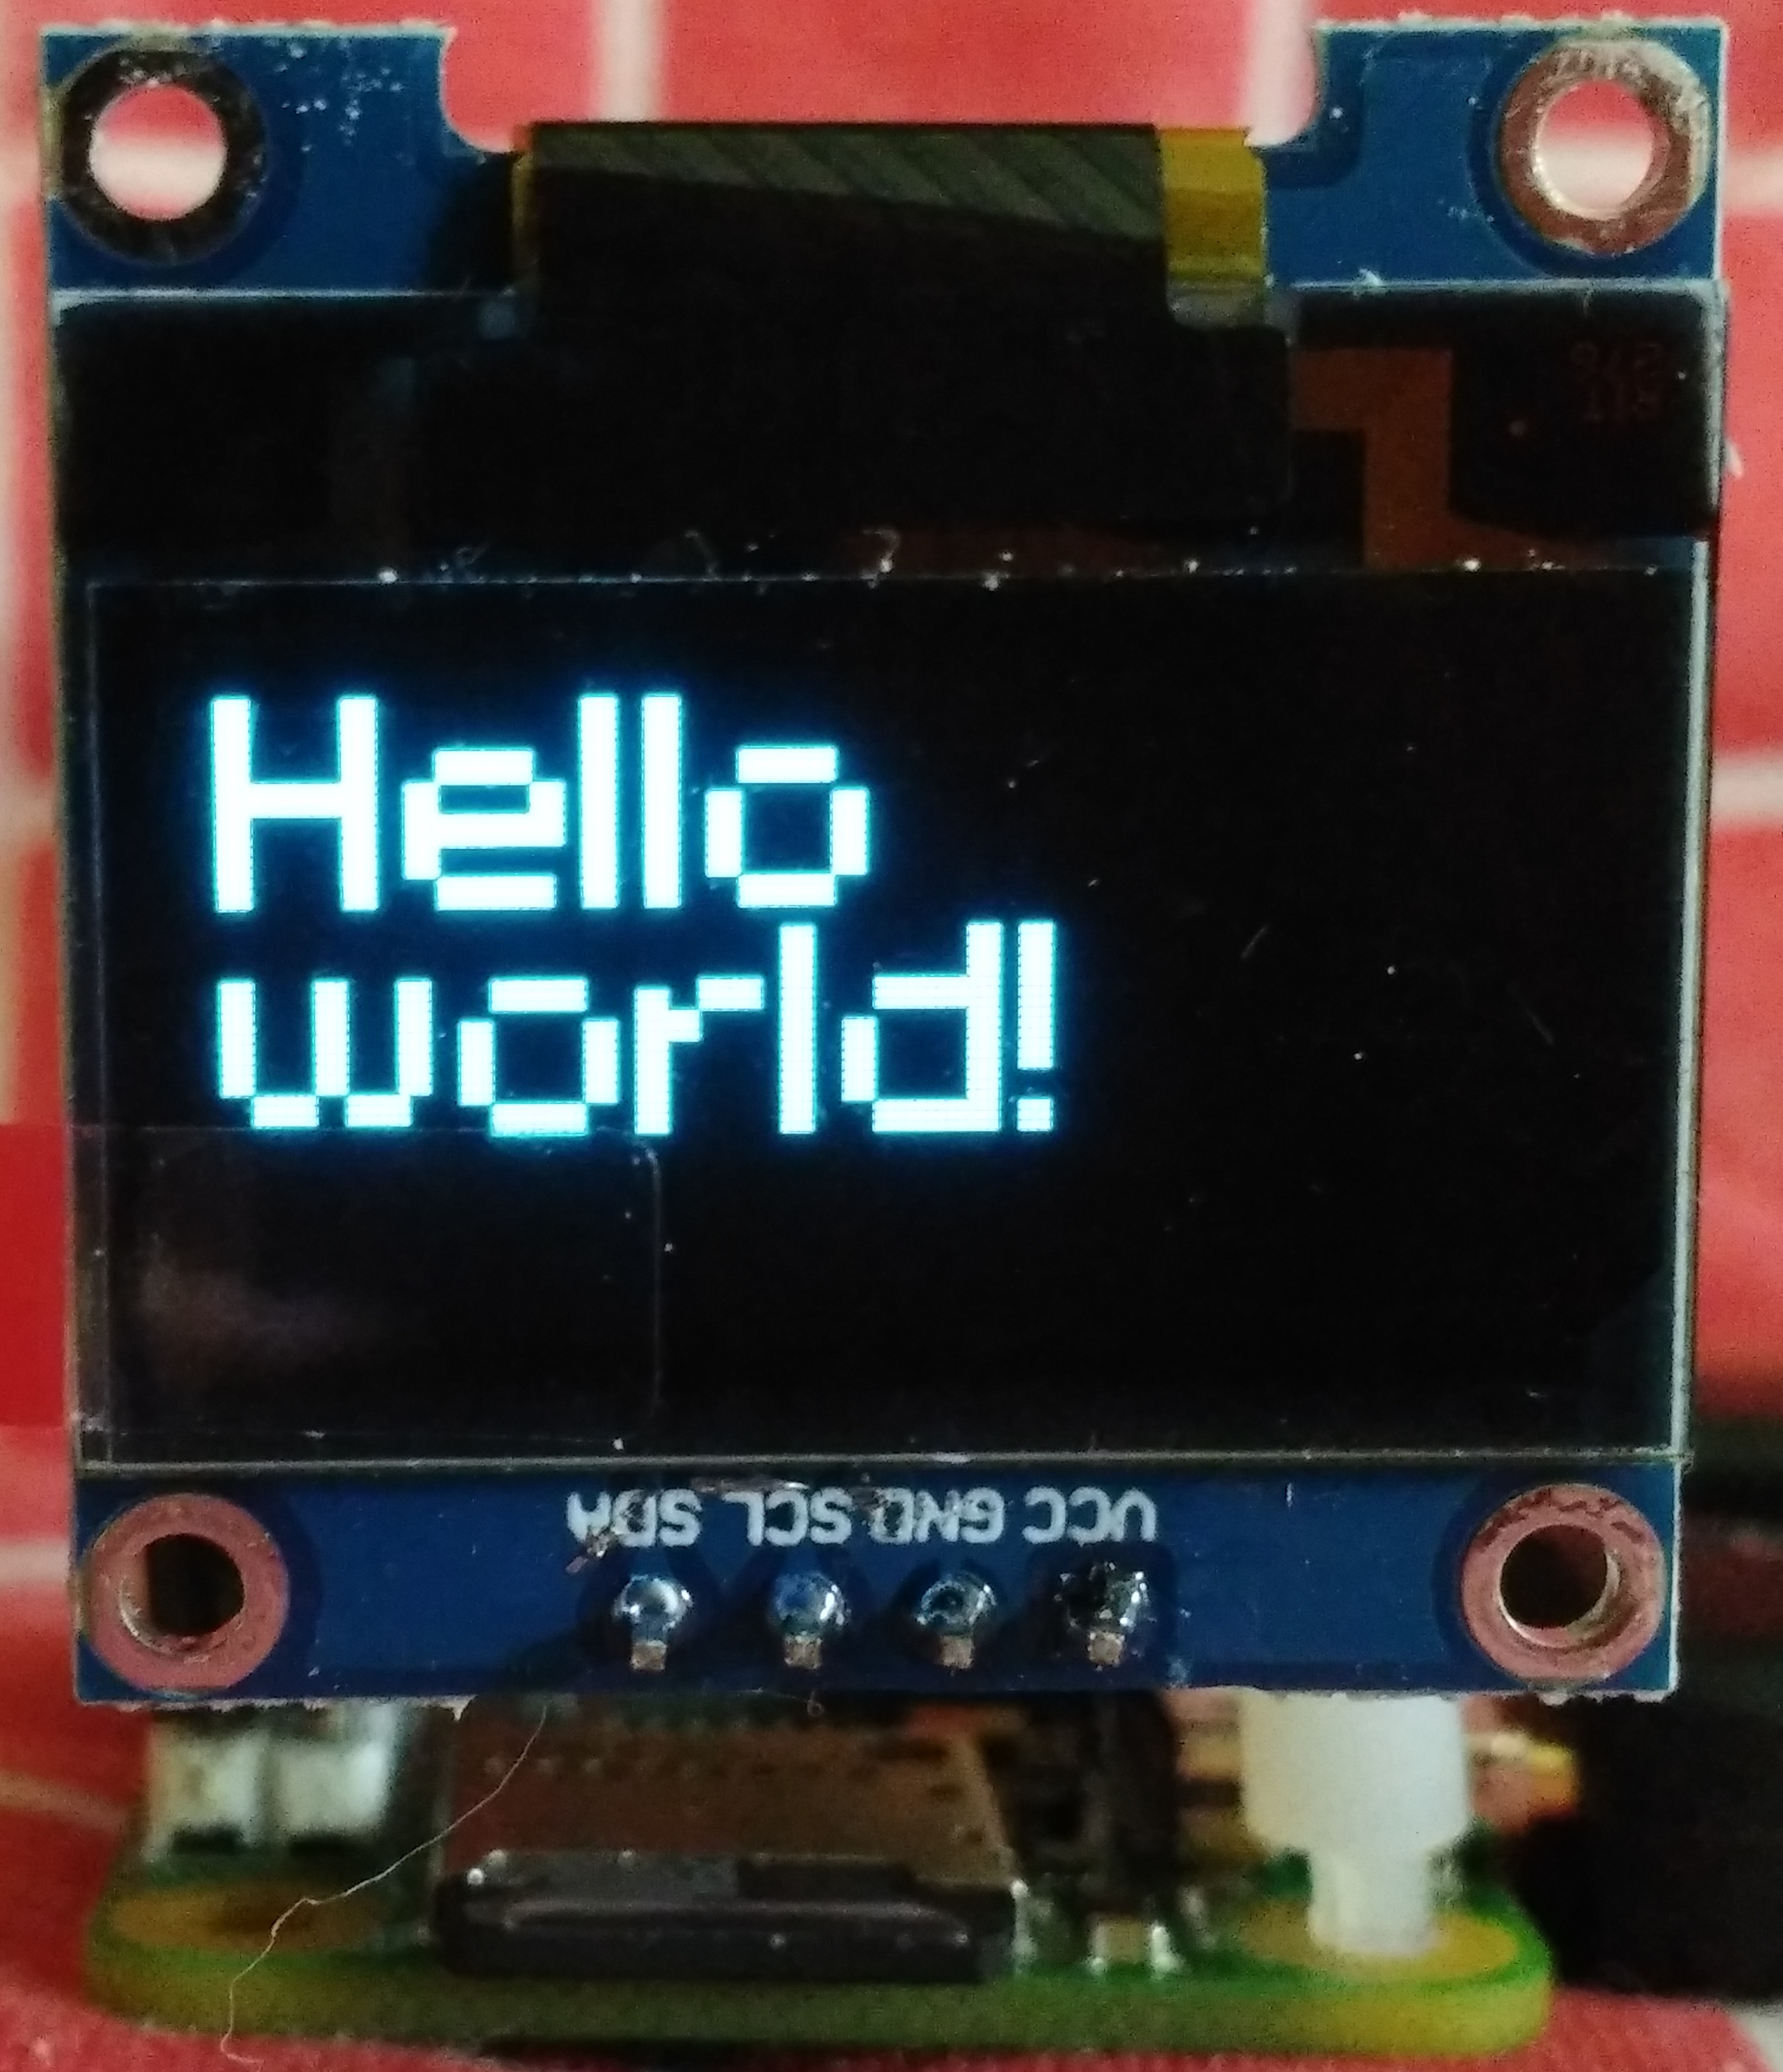
OLED Test
☑completed
□ | Terminal window | Prepare to power down
□ | enter | sudo shutdown now
□ |  | Turn off 5V power
□ | OLED | Plug in display; ensure that the Vcc, GND, SCL, and SDA pins match up
□ |  | Turn on 5V power
□ | At console, enter | cd Desktop
 | enter | ./oled.sh
 | verify | on OLED: Hello world!
 | stop: enter | <ctrl>C

Slide 19
Operational Setup
☑completed
□ | From console, enter | startx
□ | From X-Windows desktop | Right-click, wspr.sh, select edit
□ | In “leafpad” editor | Edit the call sign and grid square
□ |  | Save file and exit editor
□ | Open a file window | Navigate to home/pi/Desktop/tools/luma.examples/examples
□ | Edit OLED banner text | Right-click banner_medium_hello.py, select Thony (simple mode)
□ |  | Edit the “Hello” (line 95) and “world” (line 97) text to, e.g., your call sign and frequency
□ |  | Save file and exit editor

Slide 20
Antenna Connection
☑completed
□ | enter | sudo shutdown now
□ |  | Turn off 5V power
□ | Dummy load | Remove and save 2x 383Ω resistors from J10-1, J10-3 (200Ω connection)
□ | Connect antenna | WARNING: ends of antenna are sharp and could cause injury. Use safety glasses when handling antenna. Connect one antenna lead to J10-1, and the other to J10-2 (50Ω connection)
□ | Cut antenna | Each exposed lead should theorectically be 23’ 1” long (7m 3cm), but you should initially make them a bit longer for tuning 23” 7” (7m18cm)
1
2
3
200Ω
50Ω

Slide 21
Operation
☑completed
□ | Drop down to console | Pi menu...Shutdown...Exit to command line
□ | From console enter | cd home/pi/Desktop
□ | enter | ./oled.sh & (ampersand runs script in background)
□ | enter | ./wspr.sh (no ampersand)
□ | Wait | Up to two minutes for transmission to start
□ | To quit program, enter | <ctrl>C
□ | To shut down, enter | sudo shutdown now
□ |  | Turn off 5V power

Slide 22
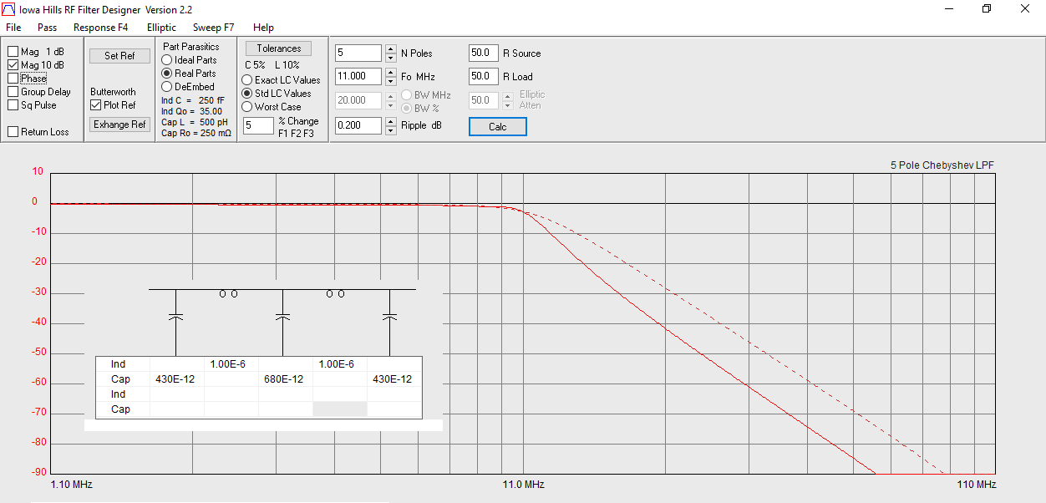
Appendix: 30m LPF Design
http://www.iowahills.com/8DownloadPage.html

Slide 23
Acknowlegements
Thanks to W8ARU for design tips, reviews, and for doing lots of the surface-mount soldering. If you get a board that works, it was probably his; if it doesn't work, I probably soldered that one.
Thanks to my sister for making at least two dozen trips to Micro Center for obtaining the Raspberry Pi Zero Ws. One at a time.
Filter design software from
http://www.iowahills.com/8DownloadPage.html
Thanks to EAE Sales for donating to the Arrow Comm. Association's bus trip. The Edsyn soldering station worked great! https://www.eaesales.com/

Slide 24
Notes
A fork of the WSPR software, with GPIO control for the LED is here:
https://github.com/jglandorf/WsprryPi.git
KiCAD files for this project are here:
https://github.com/jglandorf/wspr_pi0.git
An image of the uSD Card is here:
https://github.com/jglandorf/wspr_pi0.git/RPi0_usdCardImage

