Slide 1
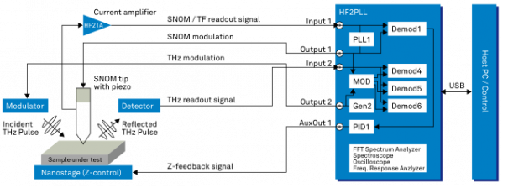

Slide 2
Front Panel
THz Detector
(from pre-amp)
Input 1
Input 2
Output 1
Output 2
Tip oscillation amplitude
(from EasyPLL)
Back Panel
Aux 1 (<20kHz)
Optical
Chopper

Slide 3
Easy PLL Plus Controller
Sensor’s Preamplifier
Signal Input
Excitation Piezo Driving Output
Reference Frequency Input
Output Frequency
DC Output
Detect in
Drive out
Signal out
Ref-In
Amplitude
Easy PLL Plus Detector
Sensor Signal AC-input
Input
Ref
Lock-In Amp’s
Ref-In
Sinusoidal Reference Signal Output
SIM 900 Main Frame
1 2
SIM 960 Analog
PID Controller
3
SIM 965
Analog
Filter
4
SIM 965
Analog
Filter
5
SIM 965
Analog
Filter
6
SIM 983
Scaling
Amp
7
SIM 983
Analog
Amp
8
SIM 965
Analog
Filter
In
In
In
In
In
In
Input
Output
Out
Out
Out
Out
Out
Out
DAQ Board, Nanostage
Tuning Fork
Tuning Fork

