Slide 1
TP-1
THz Time-Domain Spectroscopy (TDS)
TP-1-1 : Semiconductor Characterization
by THz TDS : Theory
TP-1-2 : Semiconductor Characterization
by THz TDS : Experiment
Mentor : M. Lim

Slide 2
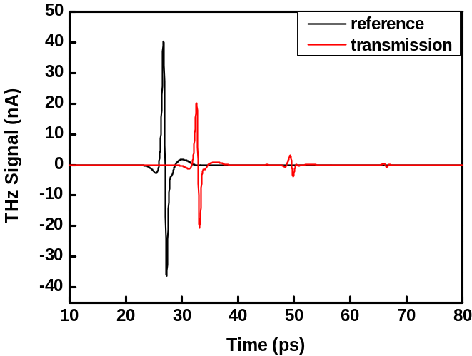

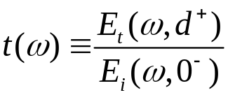









What To Do
1. Find the incident and transmitted THz field
spectra by Fourier transform
2. Find the transmission coefficient defined as
3. Find the complex refractive index
S
D

