Slide 1
2019. 12
THz Photonic Device Design
by Machine Learning
Jonggeon Lee
Nano-Bio THz Photonics
Department of Electrical Engineering
POSTECH, Korea

Slide 2
Contents
Introduction
Distributed Bragg Reflector
1×2 Optical Power Splitter
Additive Reinforcement Learning
Artificial Neural Network
Summary
1
2
3
4
5
6

Slide 3
Introduction

Slide 4
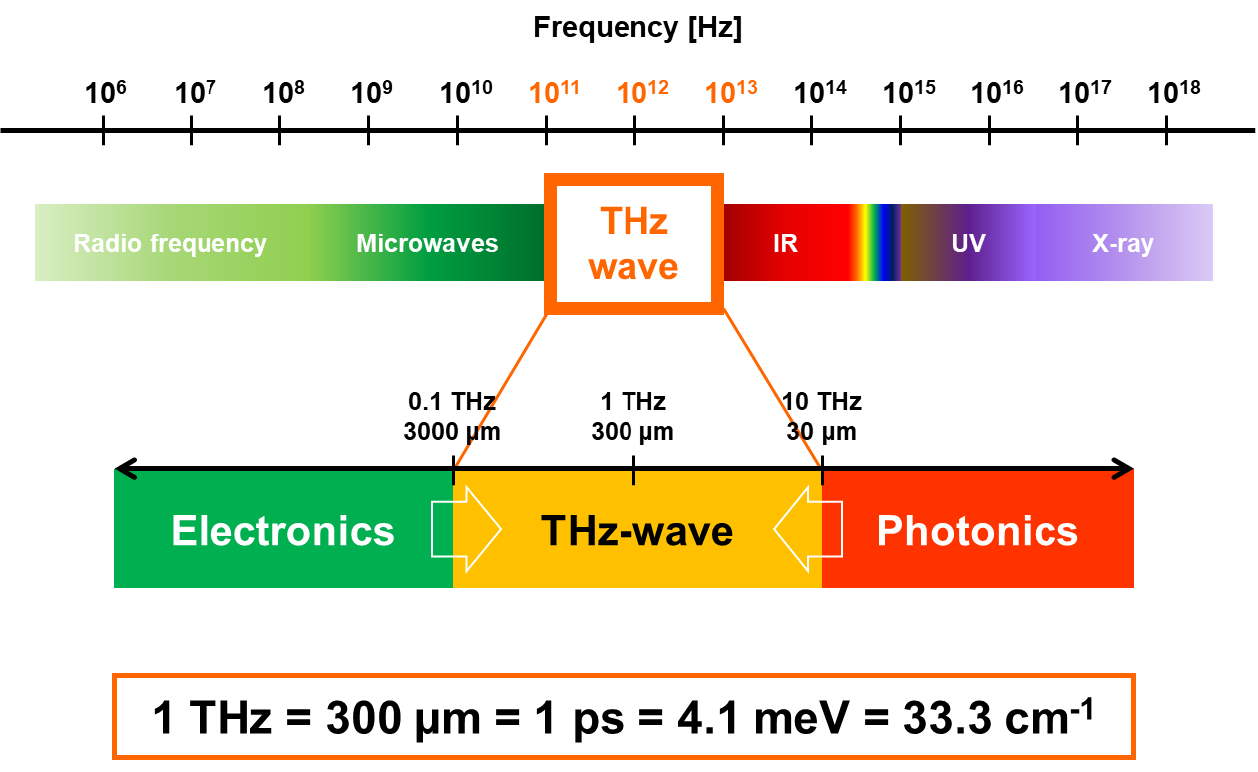
What’s the THz wave

Slide 5
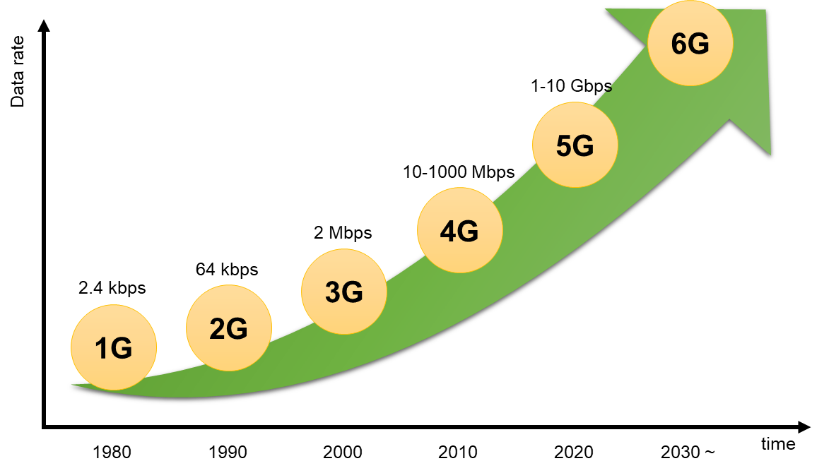
Beyond 5G
Edholm’s law
Required date rates double every 18 months
Need THz band communication
Notes:
Frequencies from 100 GHz to 3 THz are promising bands for the next generation

Slide 6
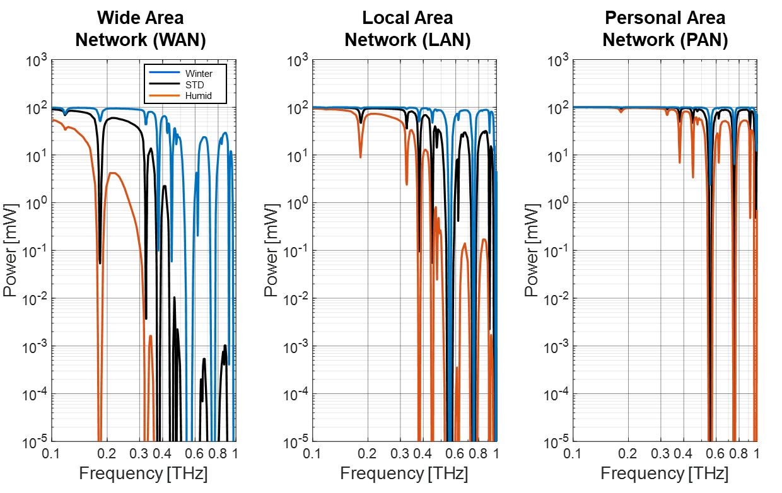
THz Communication
Large THz signal loss
optical fiber communication
Notes:
광통신 소자 개발

Slide 7
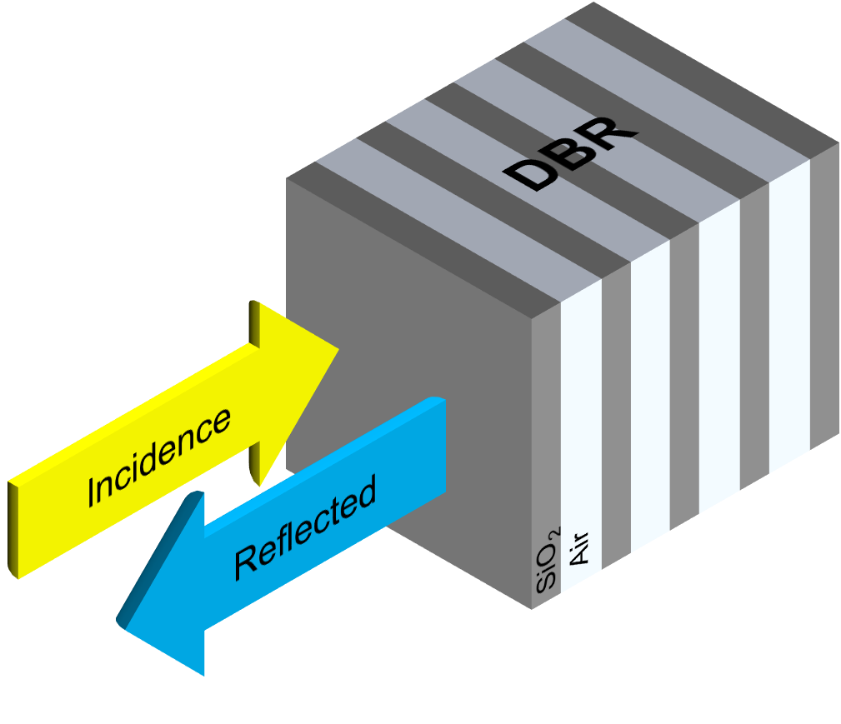
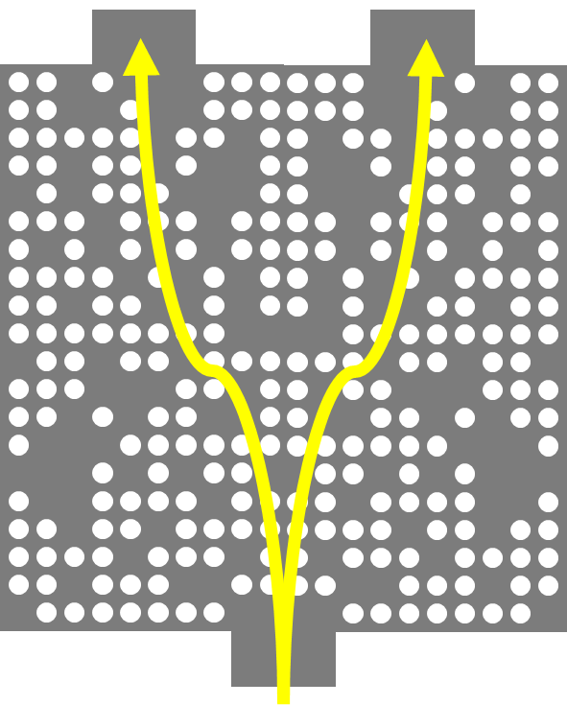
Design Structure
Distributed Bragg Reflector
1x2 Power Splitter
Notes:
대표적인 광소자 THz 대역

Slide 8
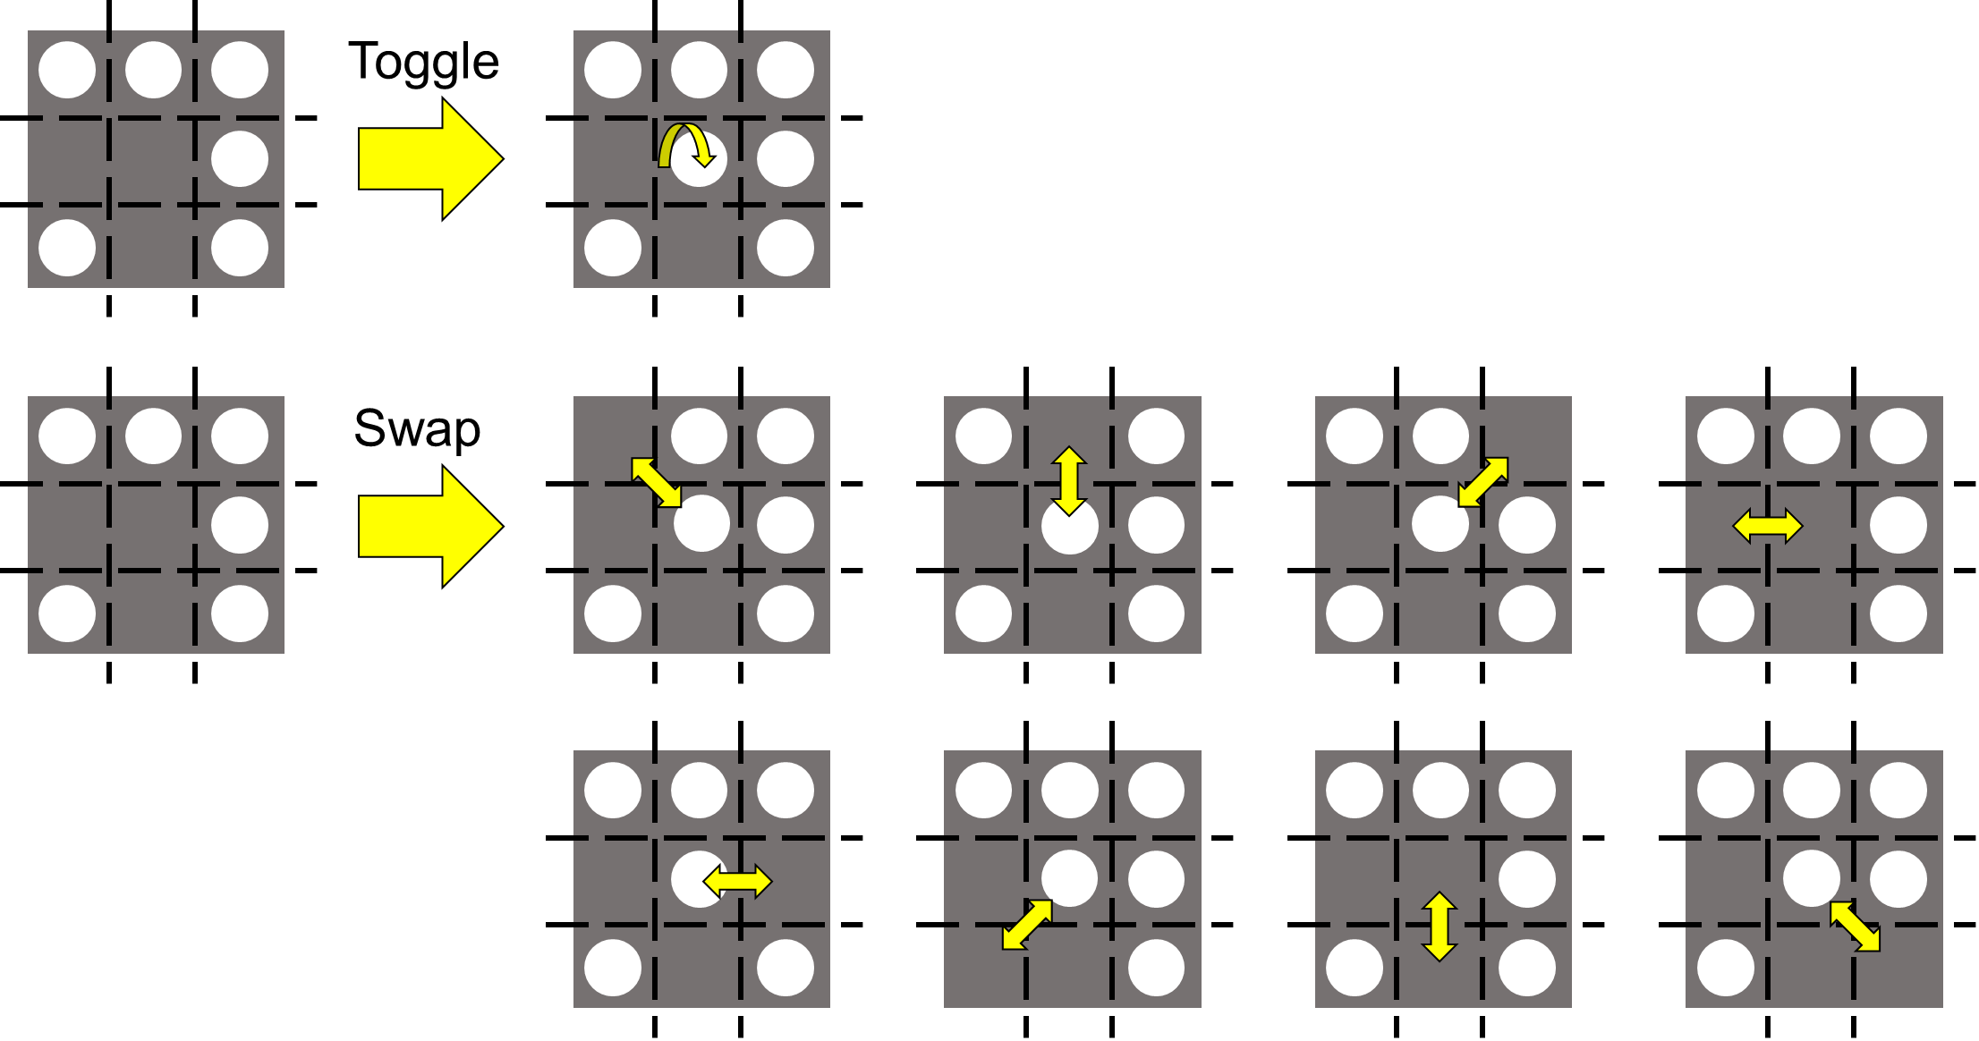
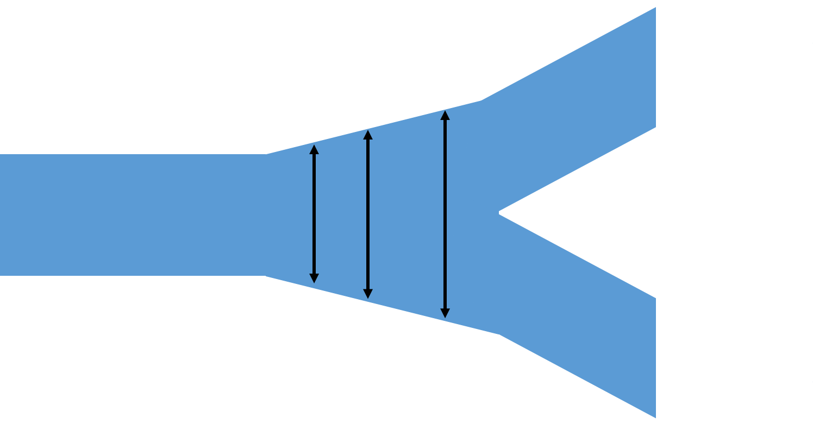
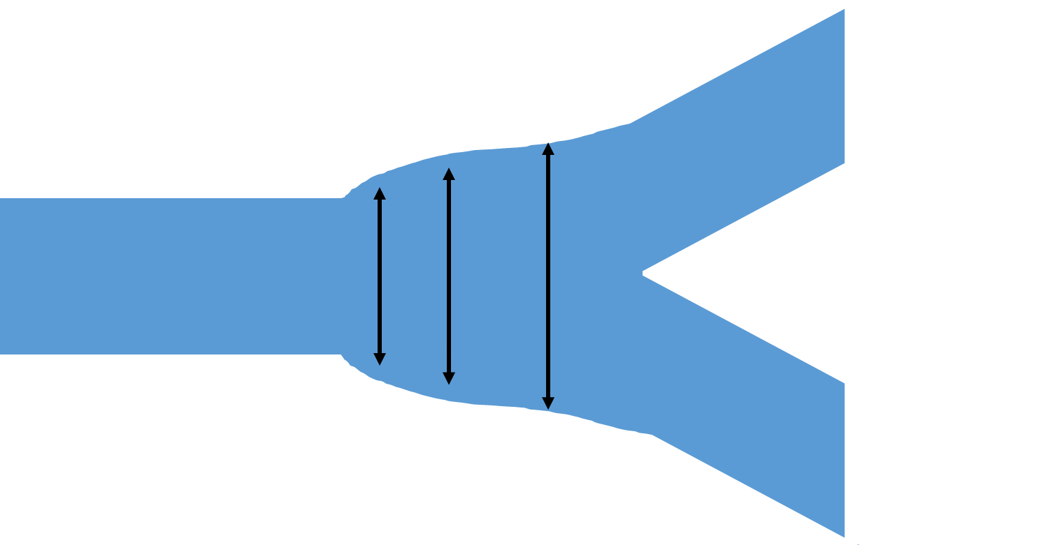
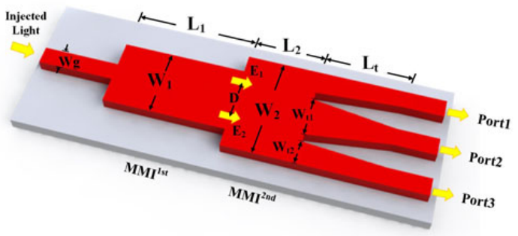
Design Method
Direct Binary Search (DBS)
Sweep parameter based on specific structure
Ye Tian et al., IEEE Photonics Journal, vol. 10, no. 3, June 2018.
Self-Imaging: leads to compact expressions for the positions, amplitudes, and phases of the images, is given for the first time.
Notes:
현소자의 개발방법들

Slide 9
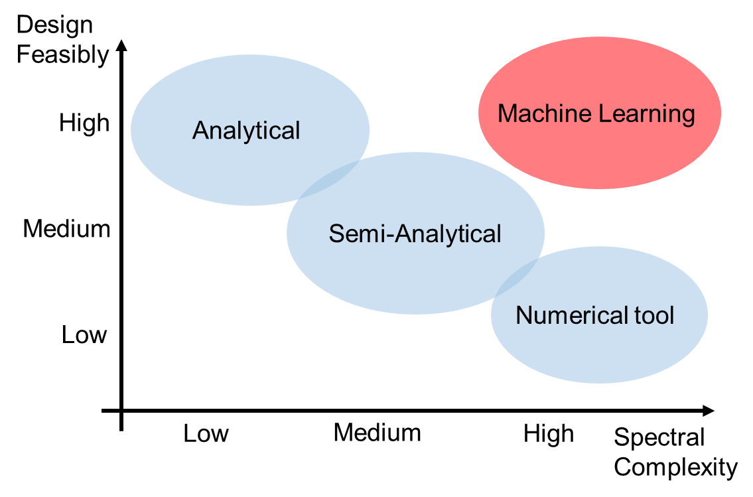
Why Machine Learning?
Machine Learning has
Notes:
머신러닝 딥러닝 합쳐서 소개

Slide 10
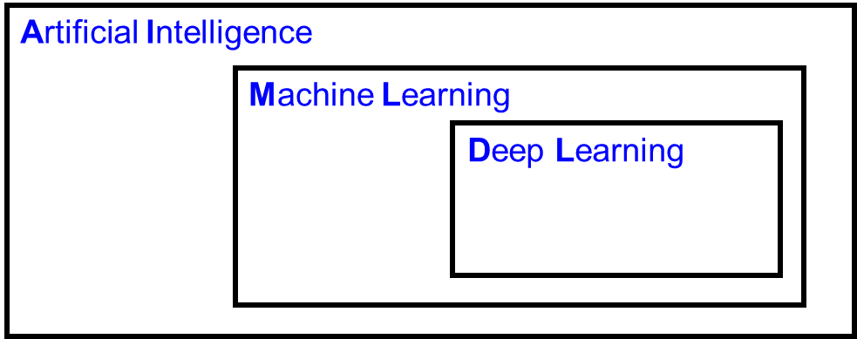
What’s the Machine Learning
Machine Learning:
A computer program is said to learn from experience E with respect to some class of tasks T and performance measure P.
Deep Learning:
Deep learning is a particular kind of machine learning that achieves great power and flexibility by learning to represent the world as nested hierarchy of concepts, with each concept defined in relation to simpler concepts, and more abstract representations computed in terms of less abstract ones

Slide 11





What’s the Machine Learning
Cat or Dog
Give Features (Ex. Ears, face shape, hair)
depends on breeds
Complicate to implement

Slide 12

What’s the Deep Learning
Cat or Dog
Cat
Cat
Dog
???
Dog
Cat!!
Dog
Give labeled data → Find features itself
Notes:
다음으로 이어지는 내용

Slide 13
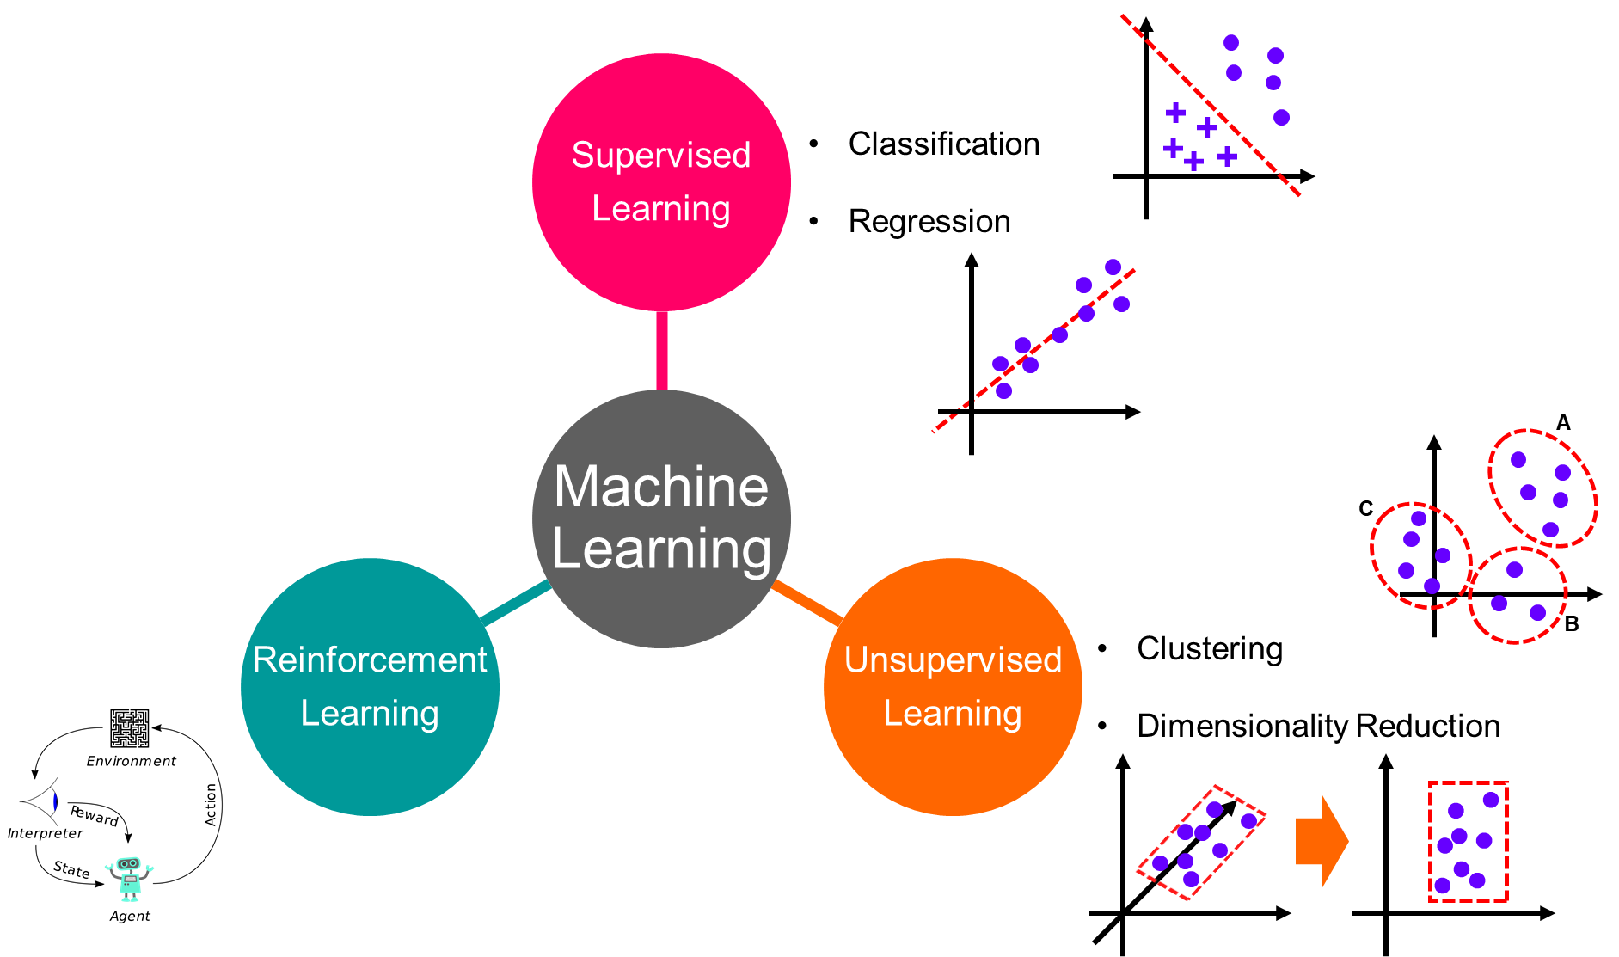
Machine Learning

Slide 14
Distributed Bragg Reflector

Slide 15
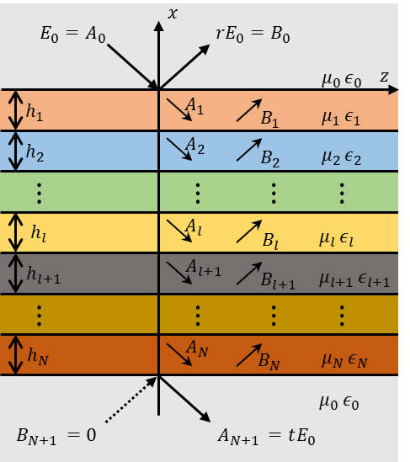





Transfer Matrix in Multilayered Medium
From boundary condition($E_{y}$ and $H_{z}$ are continuous)
$$\left[\begin{aligned}A_{l} \\ B_{l}\end{aligned}\right]={\overset{̿}{B}}_{l\left(l+1\right)}\left[\begin{aligned}A_{l+1} \\ B_{l+1} \end{aligned}\right]$$
Backward-propagation matrix
$${\overset{̿}{B}}_{l\left(l+1\right)}=\frac{1}{2}\left[\begin{matrix}\left(1+P_{l\left(l+1\right)}\right)e^{−jk_{\left(l+1\right)x}h_{l+1}} & \left(1−P_{l\left(l+1\right)}\right)e^{jk_{\left(l+1\right)x}h_{l+1}} \\ \left(1−P_{l\left(l+1\right)}\right)e^{−jk_{\left(l+1\right)x}h_{l+1}} & \left(1+P_{l\left(l+1\right)}\right)e^{jk_{\left(l+1\right)x}h_{l+1}}\end{matrix}\right]$$
Where $P_{l\left(l+1\right)}=\frac{μ_{l}k_{\left(l+1\right)x}}{μ_{l+1}k_{lx}}$
$$\left[\begin{aligned}E_{0} \\ rE_{0}\end{aligned}\right]= {\overset{̿}{B}}_{01}{\overset{̿}{B}}_{12}{\overset{̿}{B}}_{23}⋯{\overset{̿}{B}}_{N\left(N+1\right)}\left[\begin{aligned}A_{N+1} \\ B_{N+1}\end{aligned}\right]=\left[\begin{matrix}b_{11} & b_{12} \\ b_{21} & b_{22}\end{matrix}\right]\left[\begin{aligned}tE_{0} \\ 0\end{aligned}\right]$$
$$t=\frac{1}{b_{11}}, r=\frac{b_{21}}{b_{11}}$$

Slide 16
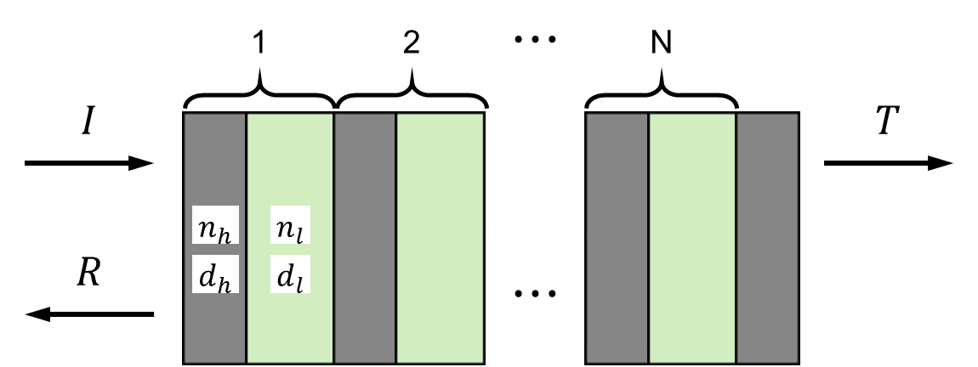


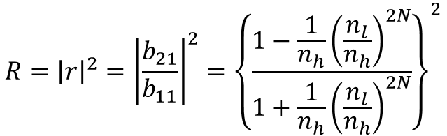
Distributed Bragg Reflector (DBR)
Multilayer structure of pairs of alternating materials with two different refractive index
For resonance, DBR has quarter wave optical thickness at certain design wavelength
$$n_{h}d_{h}=n_{l}d_{l}=λ_{0}/4$$
Transfer Matrix for N+1/2 pairs DBR
$${\overset{̿}{B}}_{DBR}=\left[\begin{matrix}b_{11} & b_{12} \\ b_{21} & b_{22}\end{matrix}\right]={\overset{̿}{B}}_{0h}{\left({\overset{̿}{B}}_{hl}{\overset{̿}{B}}_{lh}\right)}^{N}{\overset{̿}{B}}_{h0}$$
Reflectance at design wavelength
$$R={\left|r\right|}^{2}={\left|\frac{b_{21}}{b_{11}}\right|}^{2}={\left\{\frac{1−\frac{1}{n_{h}}{\left(\frac{n_{l}}{n_{h}}\right)}^{2N}}{1+\frac{1}{n_{h}}{\left(\frac{n_{l}}{n_{h}}\right)}^{2N}}\right\}}^{2}$$
Increasing N (# of pairs) & n_{l}/n_{h} (refractive index ratio), R converges to 1

Slide 17
1×2 Optical Power Splitter

Slide 18
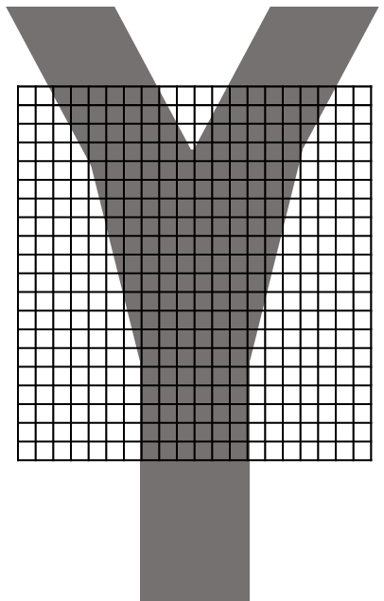


1×2 Optical Power Splitter
1×2 Optical Power Splitter (OPS)?
Equally divide the power into the output ports
Frequently used in fiber and channel waveguide devices
Notes:
FDTD는 Maxwell 방정식을 Time domain 에서 numerical하게 풀이하는 것으로, Lumerical 사의 FDTD Solution을 사용했습니다.

Slide 19
Additive Reinforcement Learning

Slide 20
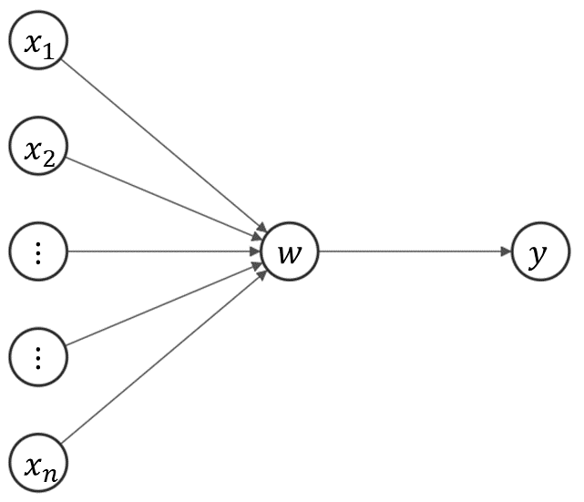
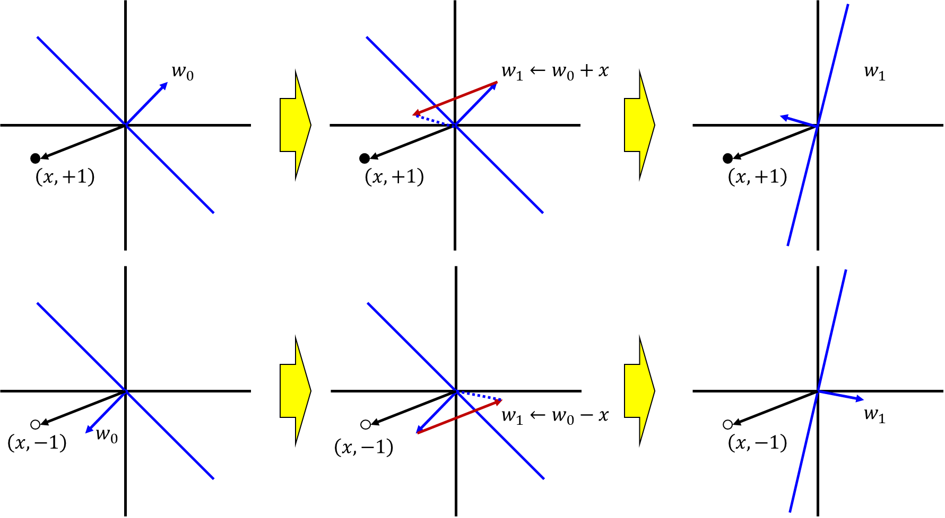
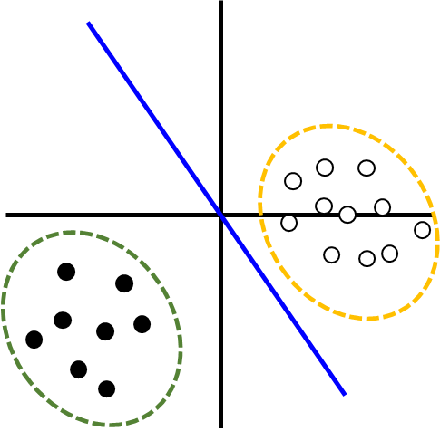
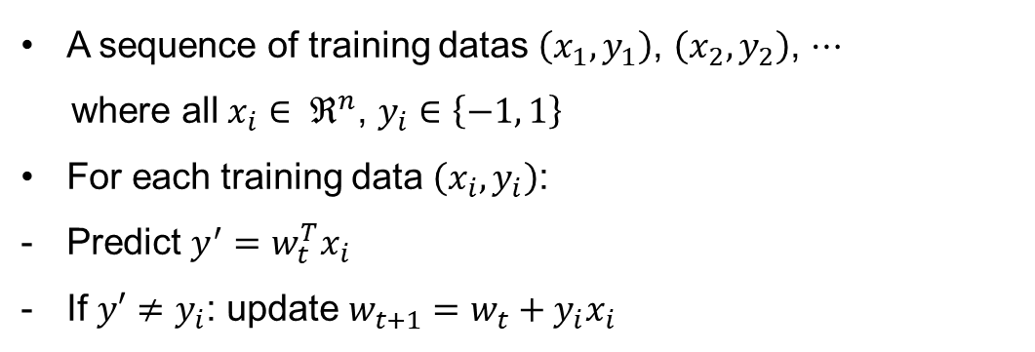
Additive Reinforcement Learning (ARL)
Additive + Reinforcement
< perceptron >
Perceptron: binary classifier
A sequence of training datas $\left(x_{1}, y_{1}\right)$, $\left(x_{2}, y_{2}\right)$, $⋯$
where all $x_{i}∈ ℜ^{n}$, $y_{i}∈\left\{−1, 1\right\}$
For each training data $\left(x_{i}, y_{i}\right)$:
Predict $y^{′}=w_{t}^{T}x_{i}$
If $y′≠y_{i}$: update $w_{t+1}=w_{t}+y_{i}x_{i}$

Slide 21
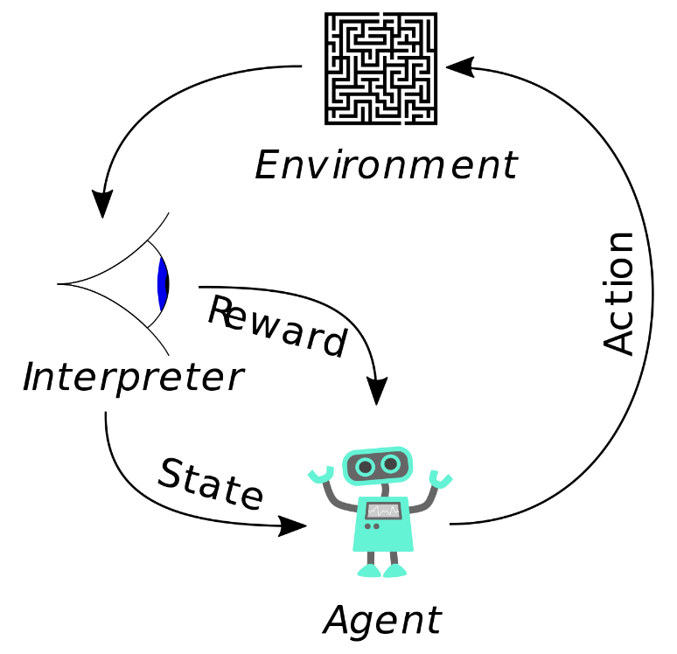
Additive Reinforcement Learning (ARL)
Additive + Reinforcement
Reinforcement: machine learning concerned with how software agents ought to take actions in an environment so as to maximize some notion of cumulative reward.

Slide 22
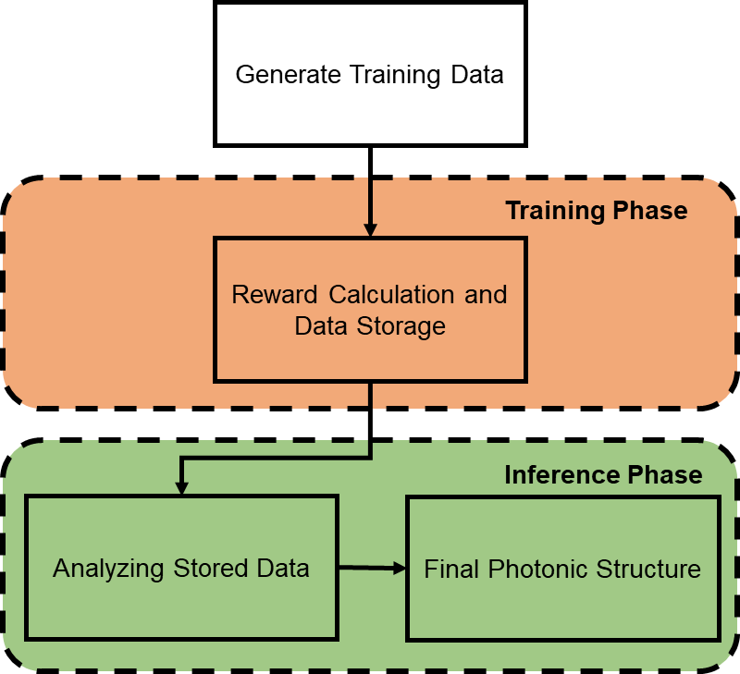
Additive Reinforcement Learning (ARL) Flowchart

Slide 23

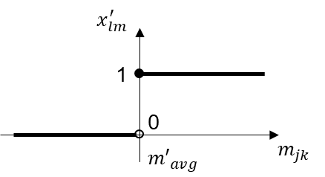
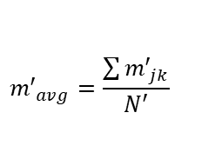


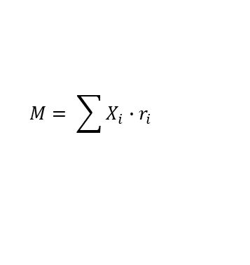

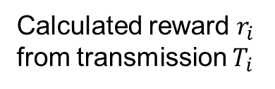

ARL Detail Description
Training Phase
Binary matrix
Calculated reward $r_{i}$
from transmission $T_{i}$
1 for etched (air)
0 for not etched (Si)
$$X_{i}= \left(\begin{aligned}1 1 0 0 ⋯11 \\ 1 1 0 0 ⋯11 \\ ⋮ ⋱ ⋮ \\ 1 1 1 1 ⋯1 1\end{aligned}\right)$$
$$X_{i}, r_{i}$$
Inference Phase
Accumulate the reward in a summation matrix M
$$M= \sum{X_{i}∙r_{i}}$$
Normalizing summation matrix M’
$$m_{min}=\min{m_{jk}}$$
$$m_{jk}^{′}=m_{jk} −m_{min}$$
Activation function
< Activation function >
$${m′}_{avg}=\frac{\sum{{m′}_{jk}}}{N′}$$
$$x_{lm}^{′}=\left\{\begin{aligned}1 if m_{lm}^{′}≥{m′}_{avg} \\ 0 if m_{lm}^{′}<{m′}_{avg}\end{aligned}\right.$$

Slide 24
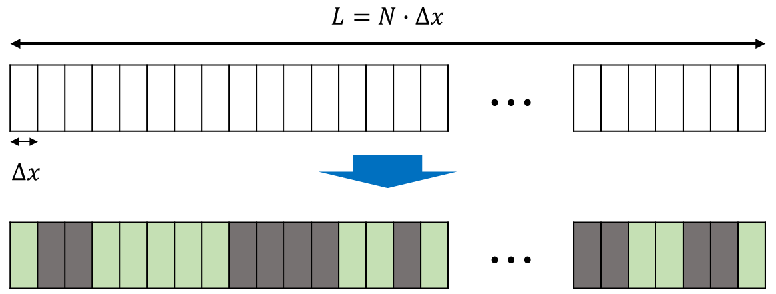
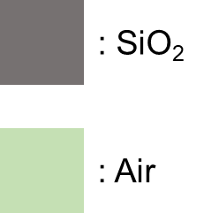

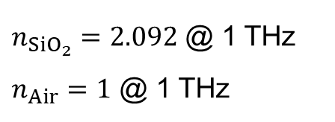
DBR Design Platform
Design wavelength: 300 μm (1 THz)
Wavelength: 150 – 3000 μm (5 um step, 570 points)
TE mode
$n_{{SiO}_{2}}=2.092$ @ 1 THz
$n_{Air}=1$ @ 1 THz
$N=80$, $∆x=5$ μm

Slide 25
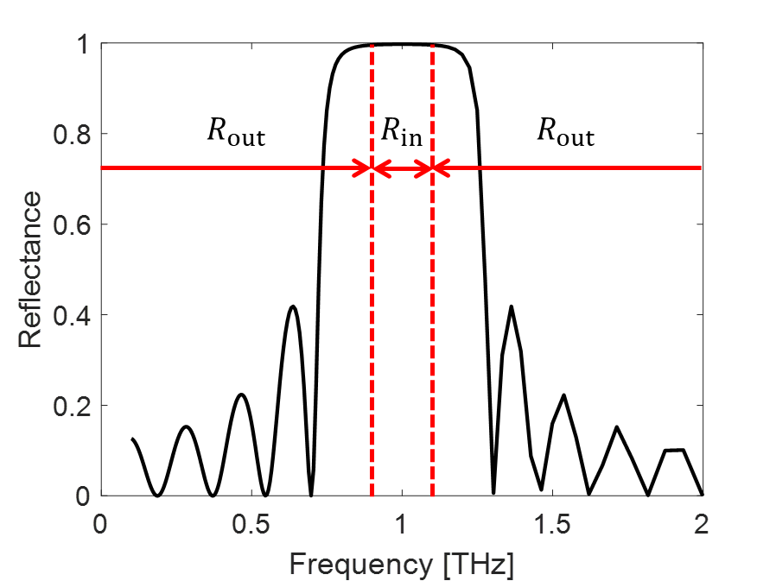
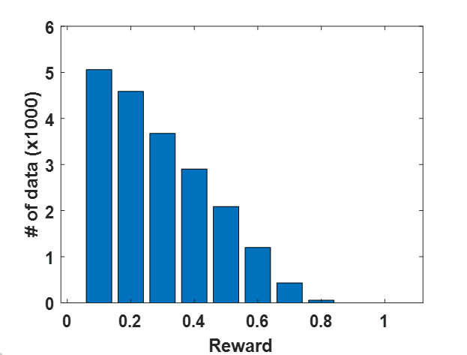

DBR Design Platform
$$reward=mean\left(R_{in}\right)∙\left(1−mean\left(R_{out}\right) \right)$$

Slide 26
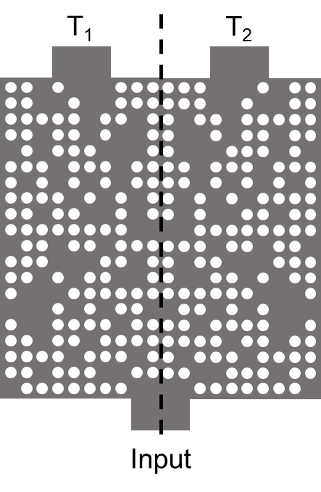

Design Platform
1x2 Power Splitter
Design Band: 275 – 325 μm (2 μm step, 26 points)
TM mode

Slide 27
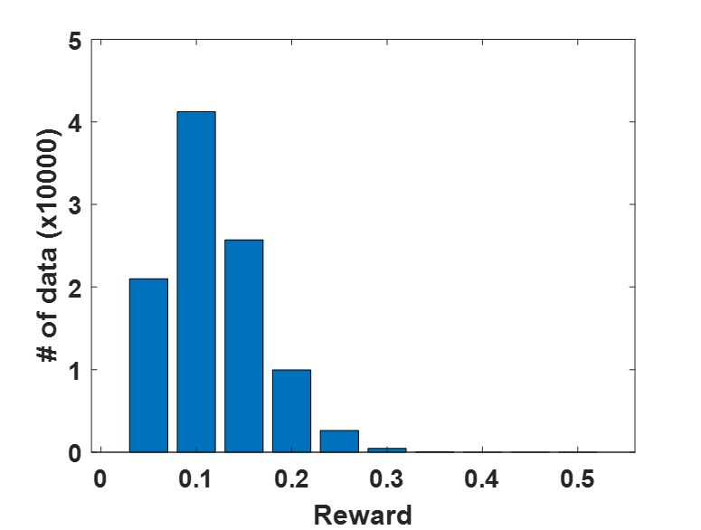

Design Platform - Algorithm
1x2 Power Splitter
$$reward=\min\left(T\right)$$

Slide 28
Reflectance of DBR

Slide 29
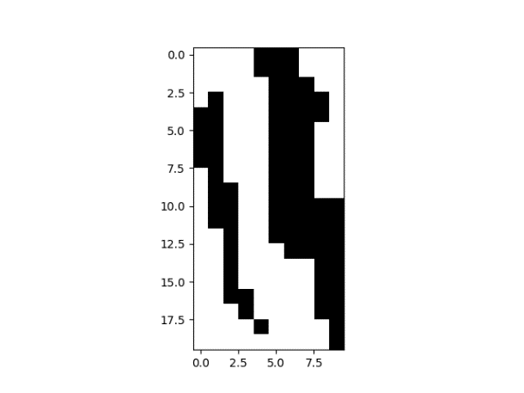
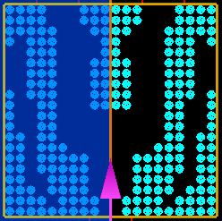
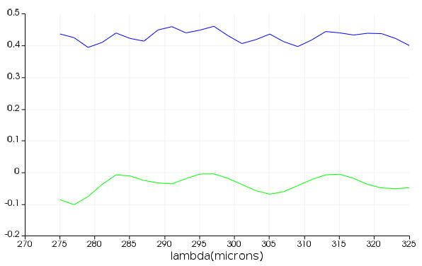
Transmittance of 1x2 Power Splitter
# of data: 40,000
reward = min(T)
1x2 splitter TM
T
T
E
R
T ~0.43
Transmission
R ~0.05
Power uniformity = 0.71 dB

Slide 30
Artificial Neural Network

Slide 31
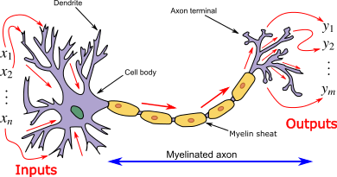
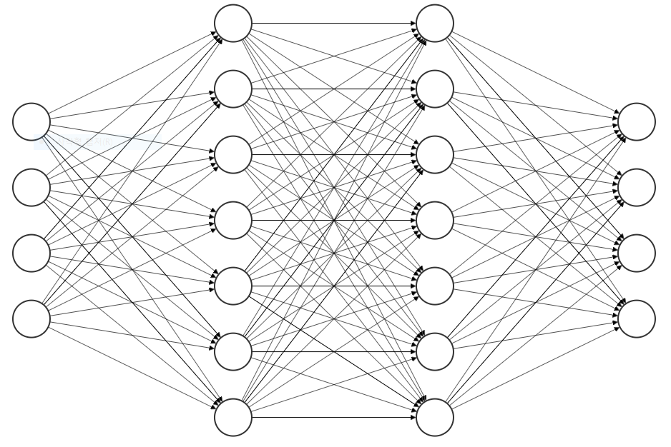
Artificial Neural Network (ANN)
Learning: adjust of nodes variable
layer
node
Input layer
Output layer
hidden layer

Slide 32
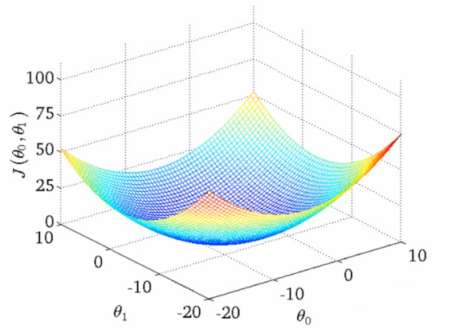


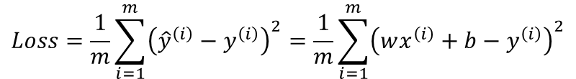


ANN Learning Process #1
bias
Training Data
b
Activation
function
x | y
1 | 2
2 | 3
3 | 4
x
1
2
3
weight
y
2
3
4
:
x
wx+b
ŷ
w
$$\hat{y}=wx^{\left(i\right)}+b$$
$$Loss=\frac{1}{m}\sum_{i=1}^{m}{{\left({\hat{y}}^{\left(i\right)}−y^{\left(i\right)}\right)}^{2}}=\frac{1}{m}\sum_{i=1}^{m}{{\left(wx^{\left(i\right)}+b−y^{\left(i\right)}\right)}^{2}}$$
Minimize by
gradient descent algorithm
Gradient
$$Loss$$
$$W$$
$$b$$

Slide 33
ANN Learning Process #2
bias
Training Data
b
Activation
function
x | y
1 | 2
2 | 3
3 | 4
x
1
2
3
weight
y
2
3
4
:
x
wx+b
ŷ
w
b = 1
w = 1
by Gradient descent method
bias
1
Activation
function
weight
x
4
x
1
wx+b
y
y
5

Slide 34

Inverse Design
T
Forward Design
T
Inverse Design

Slide 35
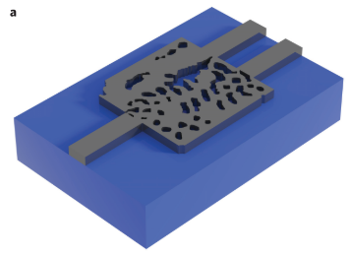




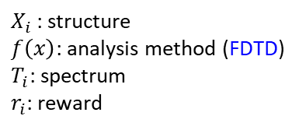



Normal Inverse Design
Cost
function
$X_{i}$
$$f\left(x\right)$$
$$T_{i}$$
$$r_{i}$$
$$\frac{1}{r_{i}}, Const.−r_{i}$$
$X_{i}$: structure
$f\left(x\right)$: analysis method (FDTD)
$T_{i}$: spectrum
$r_{i}$: reward
minimize
Gradient
$$Cost$$
$x_{i, jk}$
A. Y. Piggott et al., Nature Photonics, vol. 9, no. 6, pp. 374–377, Nov. 2015.
FDTD is too complex and heavy to calculate gradient

Slide 36
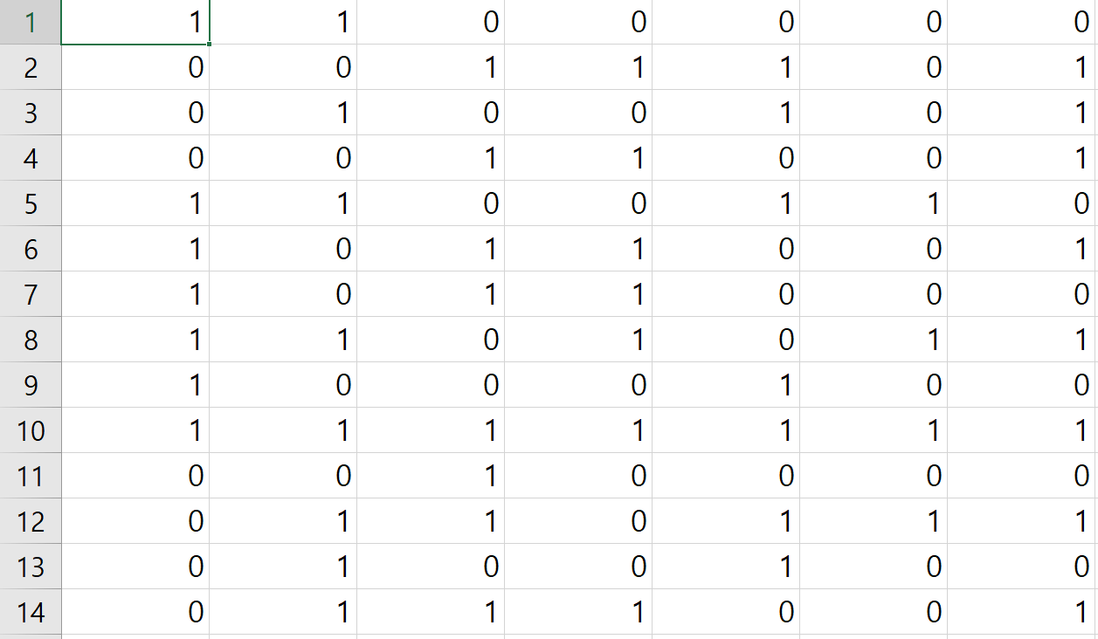
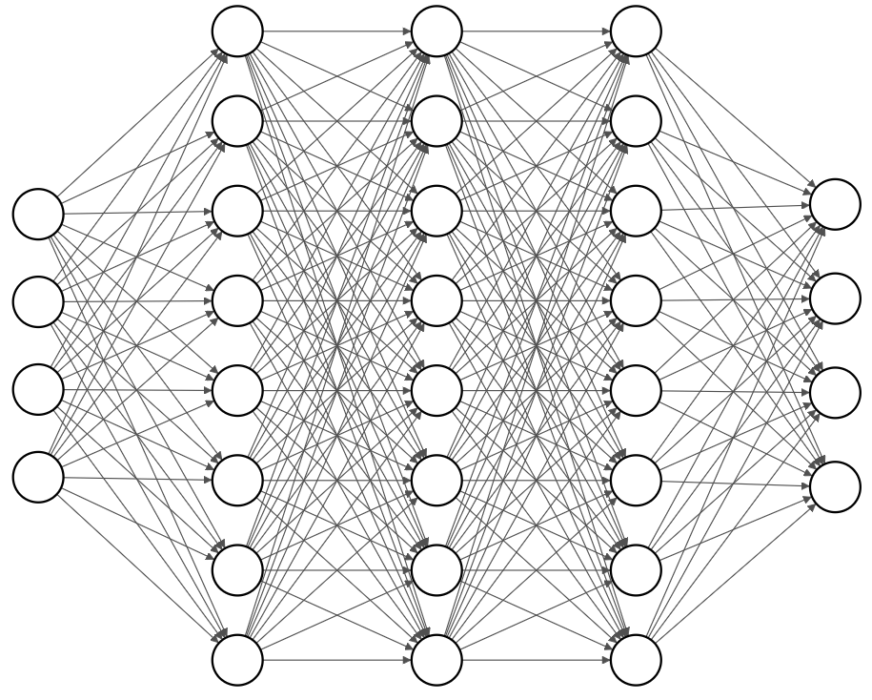
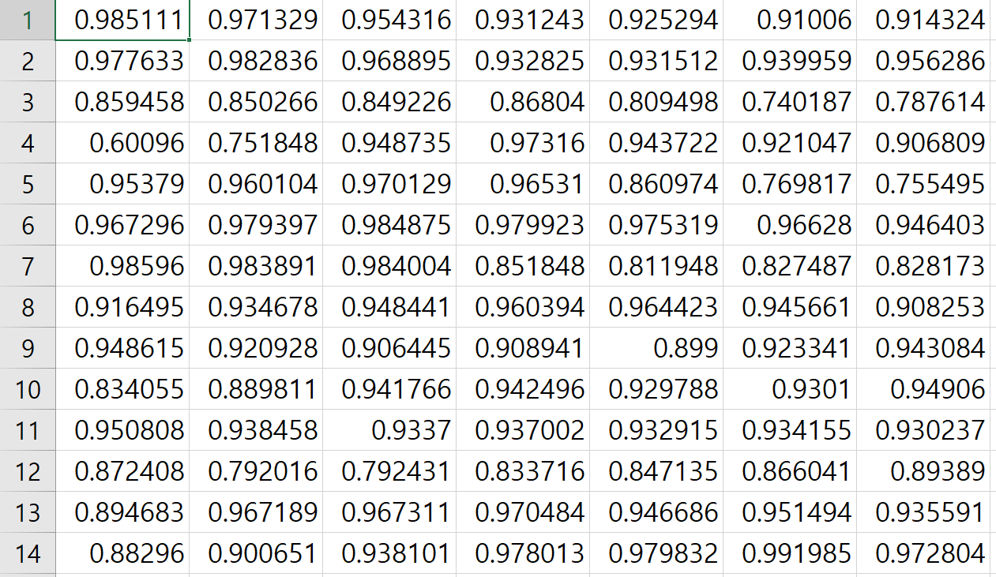

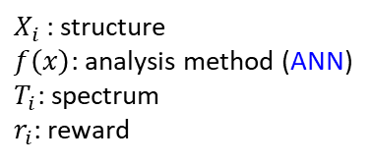



Inverse Design with ANN
FDTD → Artificial Neural Network
Learning
Neural
Network
$X_{i}$
$$f\left(x\right)$$
$$T_{i}$$
$$r_{i}$$
$X_{i}$: structure
$f\left(x\right)$: analysis method (ANN)
$T_{i}$: spectrum
$r_{i}$: reward
Artificial Neural Network
(ANN)
structures
spectrums

Slide 37
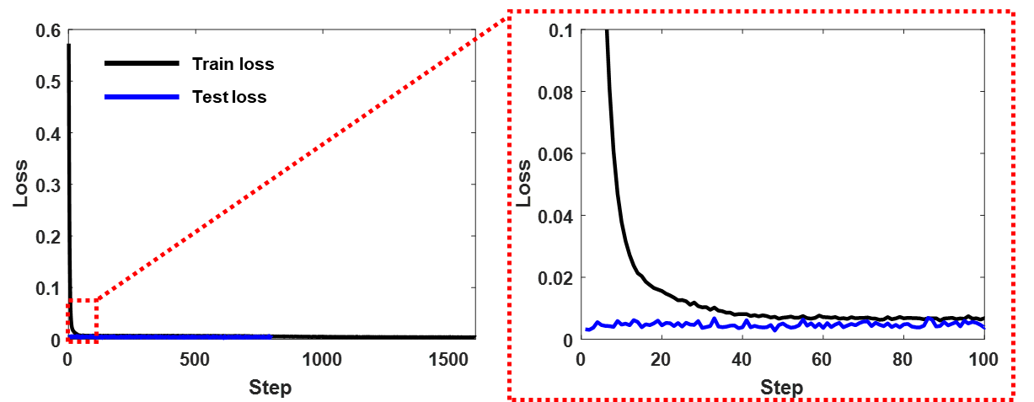


Design Platform - Algorithm
DBR
Input layer: 80 node
Output layer: 570 node
Hidden layer: 3 layer, 200 node
$$Loss=mean\left\{{\left(\hat{y}−y\right)}^{2}\right\}$$
$$Cost=mean\left(R_{out}\right)∙\left(1−mean\left(R_{in}\right)\right)$$

Slide 38

Design Platform - Algorithm
1x2 Power Splitter
Input layer: 80 node
Output layer: 570 node
Hidden layer: 3 layer, 200 node
$$Loss=mean\left\{{\left(\hat{y}−y\right)}^{2}\right\}$$
$$Cost=1/mean\left(T\right)$$

Slide 39
Summary

