Slide 1
6G
Data rate
1-10 Gbps
5G
10-1000 Mbps
4G
2 Mbps
64 kbps
3G
2.4 kbps
2G
1G
1980
1990
2000
2010
2020
2030 ~
time

Slide 2
Frequency [Hz]
10⁶
10⁷
10⁸
10⁹
10¹⁰
10¹¹
10¹²
10¹³
10¹⁴
10¹⁵
10¹⁶
10¹⁷
10¹⁸
THz wave
Radio frequency
Microwaves
IR
UV
X-ray
0.1 THz
3000 μm
1 THz
300 μm
10 THz
30 μm
Electronics
THz-wave
Photonics
1 THz = 300 µm = 1 ps = 4.1 meV = 33.3 cm⁻¹

Slide 3
Artificial Intelligence
Machine Learning
Deep Learning

Slide 4
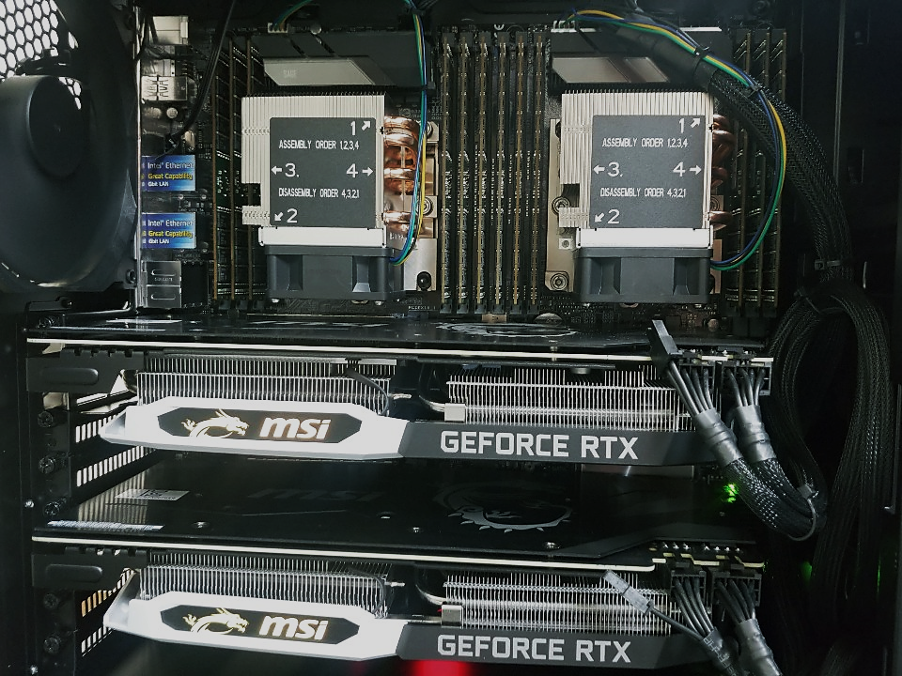
Name | Workstation-NBTP
CPU | Intel Xeon Scalable Silver 4114 (2.2 GHz)
CPU # (core # / thread #) | 2 (20 / 40)
RAM | 32 GB (DDR4)
RAM (Total) | 384 GB
FDTD Software | FDTD Solutions (Lumerical Inc.)

Slide 5
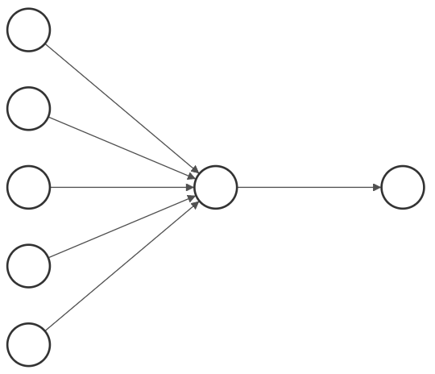










$$x_{1}$$
Generate Training Data
$$x_{2}$$
$$⋮$$
$$w$$
$$y$$
Training Phase
Reward Calculation and
Data Storage
$$⋮$$
$$x_{n}$$
Inference Phase
$$x_{lm}^{′}$$
Analyzing Stored Data
Final Photonic Structure
1
0
$${m′}_{avg}$$
$$m_{jk}$$

Slide 7












$$w_{0}$$
$$w_{1}←w_{0}+x$$
$$w_{1}$$
$$\left(x, +1\right)$$
$$\left(x, +1\right)$$
$$\left(x, +1\right)$$
$$w_{1}←w_{0}−x$$
$$w_{1}$$
$$\left(x, −1\right)$$
$$w_{0}$$
$$\left(x, −1\right)$$
$$\left(x, −1\right)$$

Slide 8
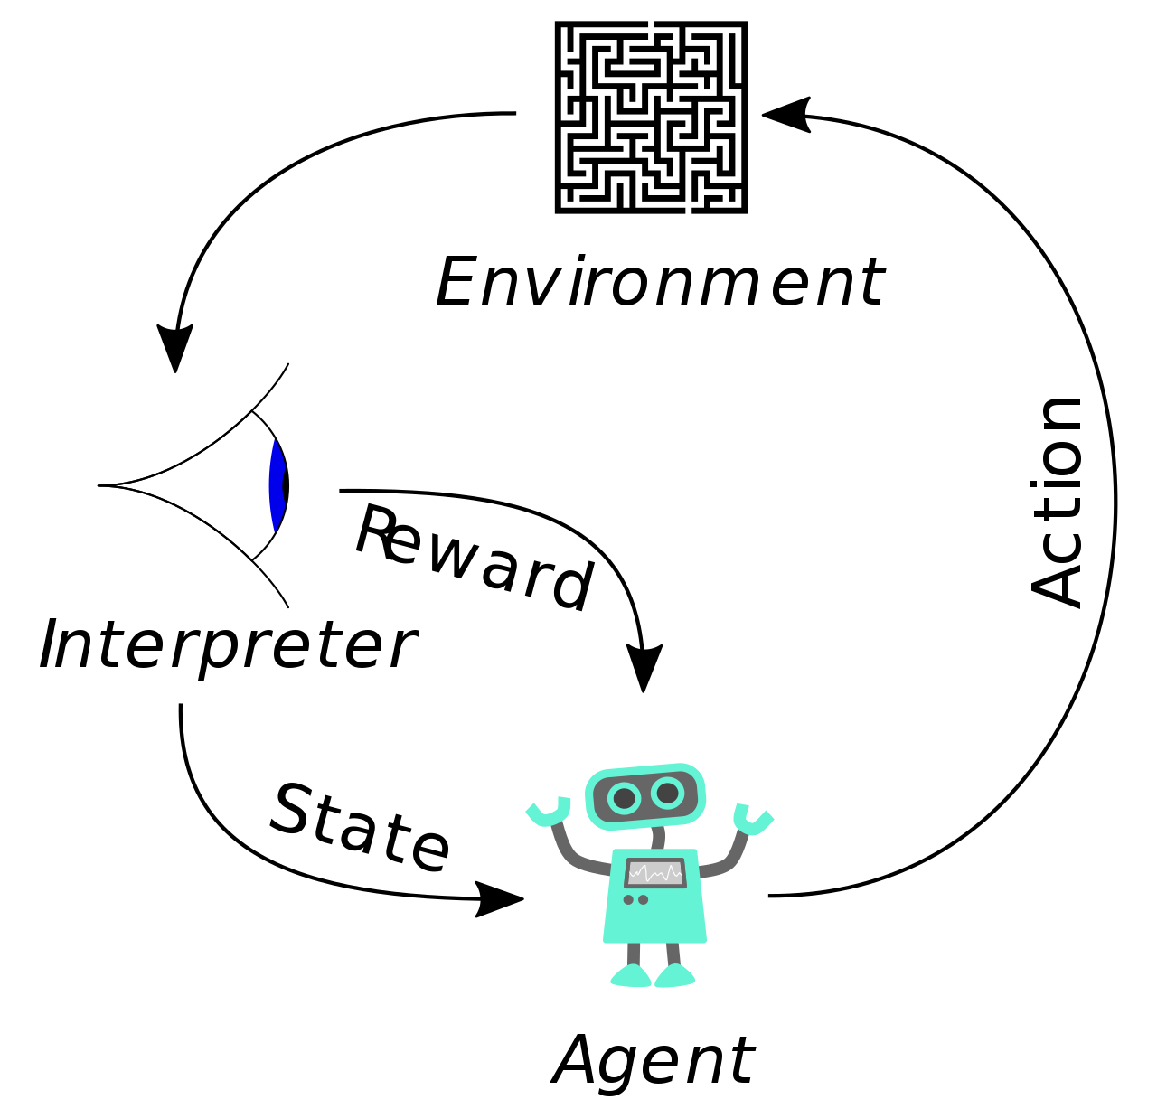

Slide 9


Supervised
Learning
Classification
Regression
Machine Learning
A
C
Reinforcement
Learning
Unsupervised
Learning
Clustering
Dimensionality Reduction
B

Slide 10


































































$$x$$
$$x$$
$$E_{0}=A_{0}$$
$${rE}_{0}=B_{0}$$
$$E_{0}=A_{0}$$
$${rE}_{0}=B_{0}$$
$$μ_{0 }ε_{0}$$
$$z$$
$$x=0$$
$$μ_{0 }ε_{0}$$
$$z$$
$$h_{1}$$
$$A_{1}$$
$$B_{1}$$
$$μ_{1 }ε_{1}$$
$$x_{1}=−d_{1}$$
$$h_{1}$$
$$A_{1}$$
$$B_{1}$$
$$μ_{1 }ε_{1}$$
$$h_{2}$$
$$A_{2}$$
$$B_{2}$$
$$μ_{2 }ε_{2}$$
$$x_{2}=−d_{2}$$
$$h_{2}$$
$$A_{2}$$
$$B_{2}$$
$$μ_{2 }ε_{2}$$
$$⋮$$
$$⋮$$
$$⋮$$
$$⋮$$
$$x_{l−1}=−d_{l−1}$$
$$⋮$$
$$⋮$$
$$⋮$$
$$⋮$$
$$h_{l}$$
$$A_{l}$$
$$B_{l}$$
$$μ_{l }ε_{l}$$
$$x_{l}=−d_{l}$$
$$h_{l}$$
$$A_{l}$$
$$B_{l}$$
$$μ_{l }ε_{l}$$
$$h_{l+1}$$
$$A_{l+1}$$
$$B_{l+1}$$
$$μ_{l+1 }ε_{l+1}$$
$$x_{l+1}=−d_{l+1}$$
$$h_{l+1}$$
$$A_{l+1}$$
$$B_{l+1}$$
$$μ_{l+1 }ε_{l+1}$$
$$⋮$$
$$⋮$$
$$⋮$$
$$⋮$$
$$⋮$$
$$⋮$$
$$⋮$$
$$⋮$$
$$h_{N}$$
$$A_{N}$$
$$B_{N}$$
$$μ_{N }ε_{N}$$
$$x_{N}=−d_{N}$$
$$h_{N}$$
$$A_{N}$$
$$B_{N}$$
$$μ_{N }ε_{N}$$
$$μ_{0 }ε_{0}$$
$$μ_{0 }ε_{0}$$
$$B_{N+1 }=0$$
$$A_{N+1 }=tE_{0}$$
$$B_{N+1 }=0$$
$$A_{N+1 }=tE_{0}$$

Slide 11



















DBR
1
2
$$⋯$$
N
$$I$$
$$T$$
Incidence
$$n_{h}$$
$$n_{l}$$
Reflected
$$R$$
$$d_{h}$$
$$d_{l}$$
$$⋯$$
Air
SiO₂
1
2
$$⋯$$
N
$$E_{0}^{+}$$
$$E_{s}^{+}$$
$$n_{h}$$
$$n_{l}$$
$$E_{0}^{−}$$
$$d_{h}$$
$$d_{l}$$
$$⋯$$
$$E_{s}^{−}$$

Slide 13
(a)-1
(a)-2
(b)-1
(b)-2

Slide 15


$L$: branch distance
$θ$: branch angle

Slide 16
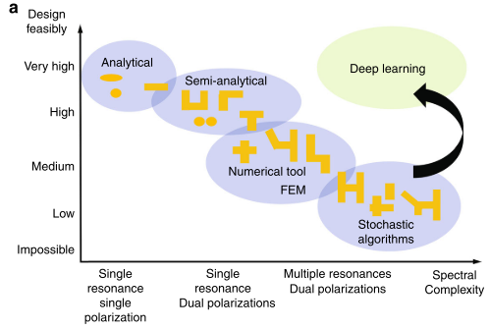
Design
Feasibly
High
Machine Learning
Analytical
Medium
Semi-Analytical
Numerical tool
Low
Low
Medium
High
Spectral
Complexity

Slide 17
Wide Area Network (WAN)
Local Area Network (LAN)
Personal Area Network (PAN)
Winter
STD
Humid

Slide 18
: Etched
: Not Etched
T₁
T₂
T₁
Input
port
W
T₂
L
Input

Slide 19




$$L=N∙∆x$$
$$⋯$$
: SiO₂
$$∆x$$
: Air
$$⋯$$

Slide 20
35.8 -> 35.8*0.05
Theory
DBR
Quartz
ARL
DBR
Air gap
35.8 μm
40 μm
75.0 μm
50 μm
35.8 μm
45 μm
75.0 μm
40 μm
479 μm
35.8 μm
45 μm
390 μm
40 μm
75.0 μm
45 μm
35.8 μm
40 μm
75.0 μm
45 μm
35.8 μm

Slide 21



$$R_{out}$$
$$R_{in}$$
$$R_{out}$$

Slide 23
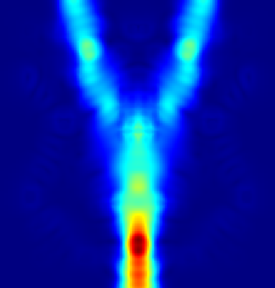
(a)
(b)
300
150
y [um]
0
-150
-300
-300
-150
0
150
300
(c)
x [um]
T
R

Slide 24
Toggle
Swap

Slide 26
ARL
ANN
Theory
Theory

Slide 27
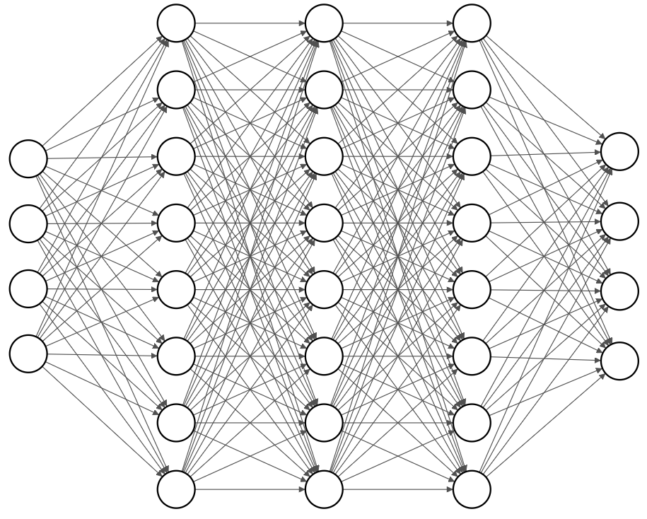
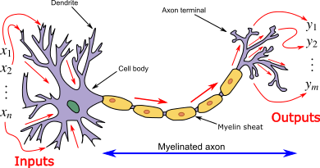
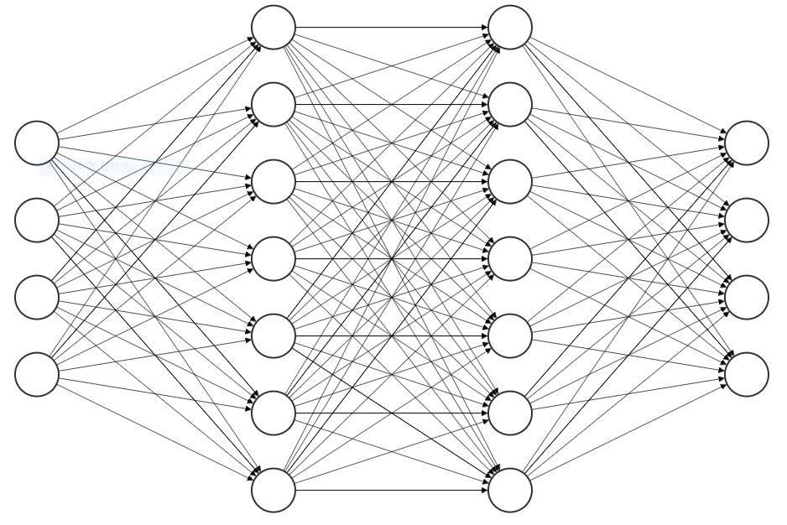

layer
node
Input layer
Output layer
hidden layer

Slide 28
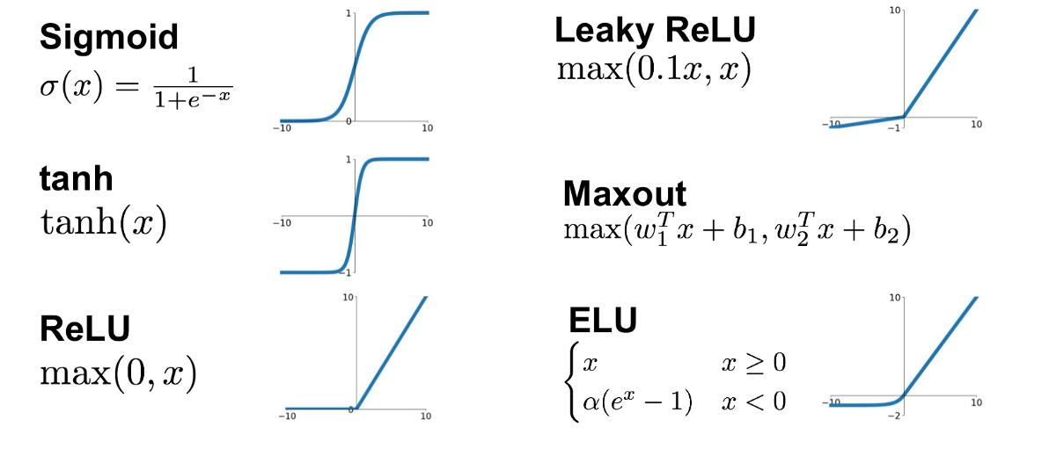
(a)
(b)
(c)

Slide 29
big r
Gradient
small r
Initial
point
Loss
Learning
step
Loss
Minimum loss
θ
θ

Slide 30
(a)
(b)
(c)

Slide 31
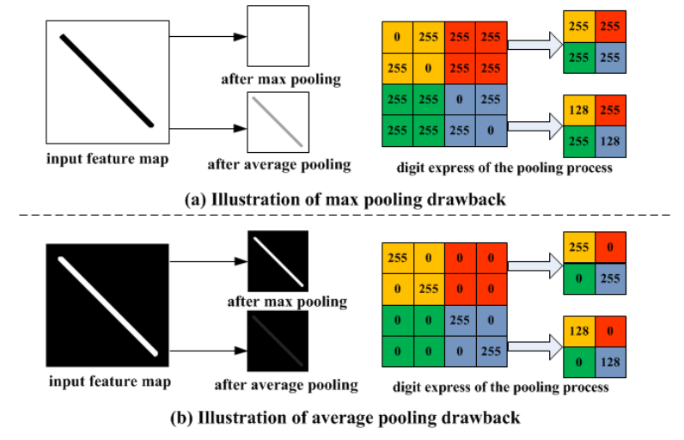
(a)
(b)

Slide 32
(a)
(b)
x
x
Hidden layer
Hidden layer
F(x)
F(x)
x
Hidden layer
Hidden layer
F(x)
+
F(x) + x
Skip connection

Slide 33
Train loss
Test loss
0.005
0.005

Slide 34
35.8 -> 35.8*0.05
Theory
DBR
Quartz
ANN
DBR
Air gap
35.8 μm
35 μm
75.0 μm
60 μm
35.8 μm
35 μm
75.0 μm
50 μm
479 μm
35.8 μm
40 μm
400 μm
50 μm
75.0 μm
45 μm
35.8 μm
50 μm
75.0 μm
35 μm
35.8 μm

Slide 35
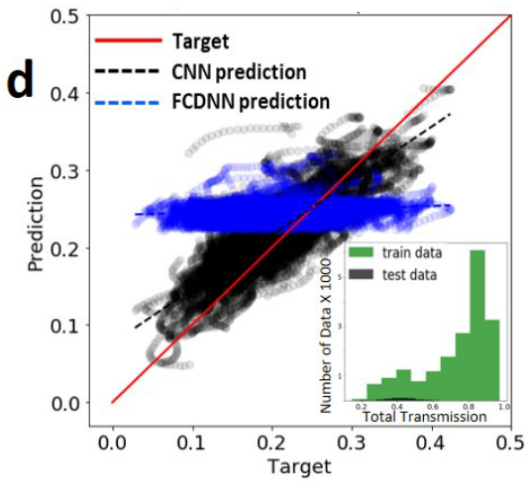

Slide 36
(a)
Train loss
Test loss
(b)

Slide 37
(a)
(b)
Target
Prediction

