Slide 1
6G
Data rate
1-10 Gbps
5G
10-1000 Mbps
4G
2 Mbps
64 kbps
3G
2.4 kbps
2G
1G
1980
1990
2000
2010
2020
2030 ~
time

Slide 2
Frequency [Hz]
10⁶
10⁷
10⁸
10⁹
10¹⁰
10¹¹
10¹²
10¹³
10¹⁴
10¹⁵
10¹⁶
10¹⁷
10¹⁸
THz wave
Radio frequency
Microwaves
IR
UV
X-ray
0.1 THz
3000 μm
1 THz
300 μm
10 THz
30 μm
Electronics
THz-wave
Photonics
1 THz = 300 µm = 1 ps = 4.1 meV = 33.3 cm⁻¹

Slide 3
Artificial Intelligence
Machine Learning
Deep Learning

Slide 4
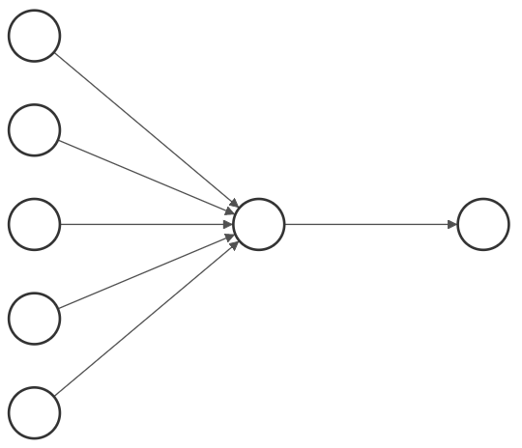










$$x_{1}$$
Generate Training Data
$$x_{2}$$
$$⋮$$
$$w$$
$$y$$
Training Phase
Reward Calculation and
Data Storage
$$⋮$$
$$x_{n}$$
Inference Phase
$$x_{lm}^{′}$$
Analyzing Stored Data
Final Photonic Structure
1
0
$${m′}_{avg}$$
$$m_{jk}$$

Slide 6












$$w_{0}$$
$$w_{1}←w_{0}+x$$
$$w_{1}$$
$$\left(x, +1\right)$$
$$\left(x, +1\right)$$
$$\left(x, +1\right)$$
$$w_{1}←w_{0}−x$$
$$w_{1}$$
$$\left(x, −1\right)$$
$$w_{0}$$
$$\left(x, −1\right)$$
$$\left(x, −1\right)$$

Slide 7
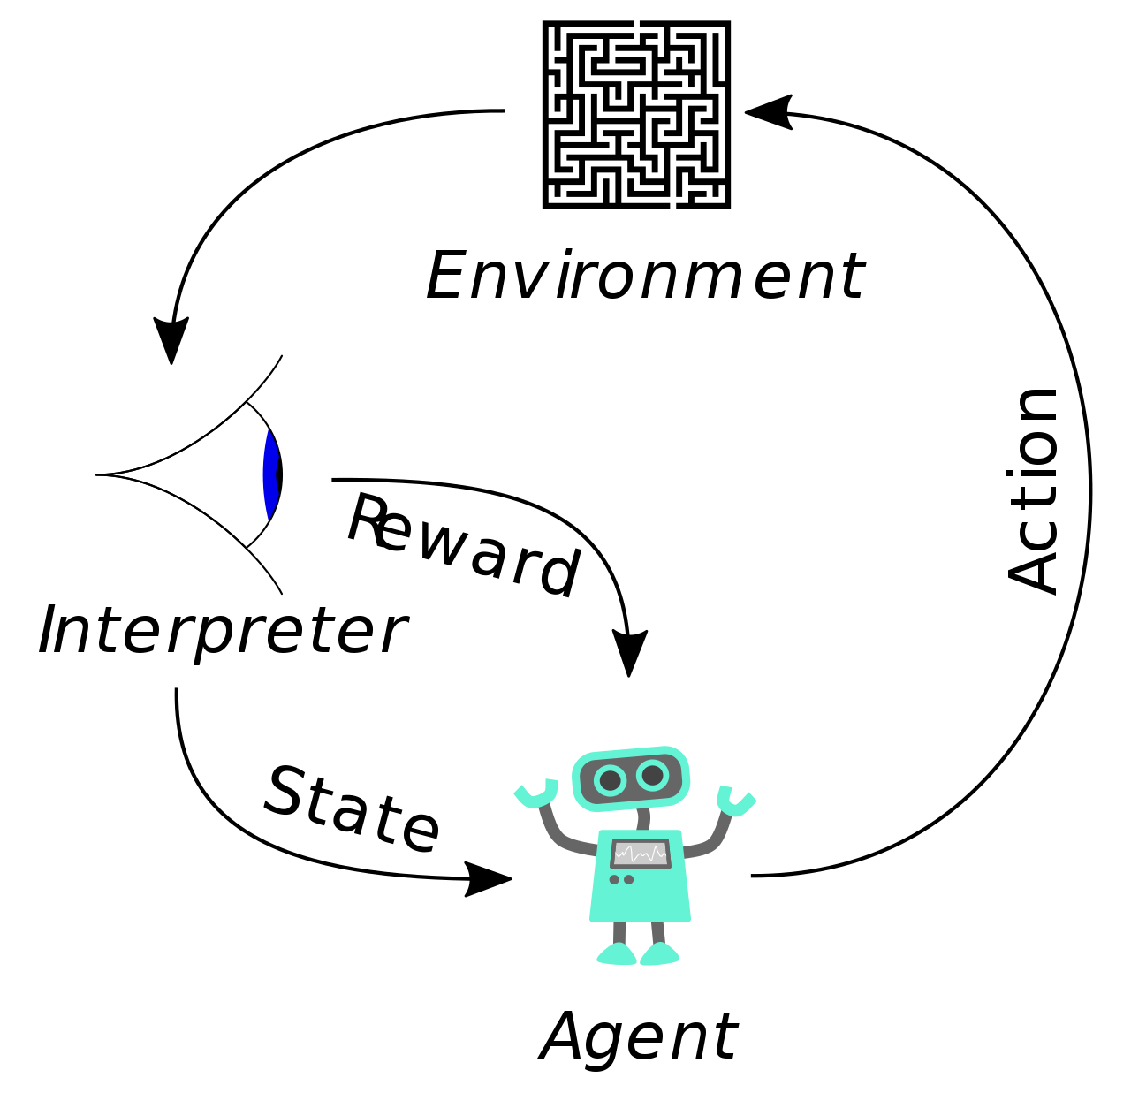

Slide 8


Supervised
Learning
Classification
Regression
Machine Learning
A
C
Reinforcement
Learning
Unsupervised
Learning
Clustering
Dimensionality Reduction
B

Slide 9


































































$$x$$
$$x$$
$$E_{0}=A_{0}$$
$${rE}_{0}=B_{0}$$
$$E_{0}=A_{0}$$
$${rE}_{0}=B_{0}$$
$$μ_{0 }ε_{0}$$
$$z$$
$$x=0$$
$$μ_{0 }ε_{0}$$
$$z$$
$$h_{1}$$
$$A_{1}$$
$$B_{1}$$
$$μ_{1 }ε_{1}$$
$$x_{1}=−d_{1}$$
$$h_{1}$$
$$A_{1}$$
$$B_{1}$$
$$μ_{1 }ε_{1}$$
$$h_{2}$$
$$A_{2}$$
$$B_{2}$$
$$μ_{2 }ε_{2}$$
$$x_{2}=−d_{2}$$
$$h_{2}$$
$$A_{2}$$
$$B_{2}$$
$$μ_{2 }ε_{2}$$
$$⋮$$
$$⋮$$
$$⋮$$
$$⋮$$
$$x_{l−1}=−d_{l−1}$$
$$⋮$$
$$⋮$$
$$⋮$$
$$⋮$$
$$h_{l}$$
$$A_{l}$$
$$B_{l}$$
$$μ_{l }ε_{l}$$
$$x_{l}=−d_{l}$$
$$h_{l}$$
$$A_{l}$$
$$B_{l}$$
$$μ_{l }ε_{l}$$
$$h_{l+1}$$
$$A_{l+1}$$
$$B_{l+1}$$
$$μ_{l+1 }ε_{l+1}$$
$$x_{l+1}=−d_{l+1}$$
$$h_{l+1}$$
$$A_{l+1}$$
$$B_{l+1}$$
$$μ_{l+1 }ε_{l+1}$$
$$⋮$$
$$⋮$$
$$⋮$$
$$⋮$$
$$⋮$$
$$⋮$$
$$⋮$$
$$⋮$$
$$h_{N}$$
$$A_{N}$$
$$B_{N}$$
$$μ_{N }ε_{N}$$
$$x_{N}=−d_{N}$$
$$h_{N}$$
$$A_{N}$$
$$B_{N}$$
$$μ_{N }ε_{N}$$
$$μ_{0 }ε_{0}$$
$$μ_{0 }ε_{0}$$
$$B_{N+1 }=0$$
$$A_{N+1 }=tE_{0}$$
$$B_{N+1 }=0$$
$$A_{N+1 }=tE_{0}$$

Slide 10



















DBR
1
2
$$⋯$$
N
$$I$$
$$T$$
Incidence
$$n_{h}$$
$$n_{l}$$
Reflected
$$R$$
$$d_{h}$$
$$d_{l}$$
$$⋯$$
Air
SiO₂
1
2
$$⋯$$
N
$$E_{0}^{+}$$
$$E_{s}^{+}$$
$$n_{h}$$
$$n_{l}$$
$$E_{0}^{−}$$
$$d_{h}$$
$$d_{l}$$
$$⋯$$
$$E_{s}^{−}$$

Slide 12
(a)-1
(a)-2
(b)-1
(b)-2

Slide 14


$L$: branch distance
$θ$: branch angle

Slide 15
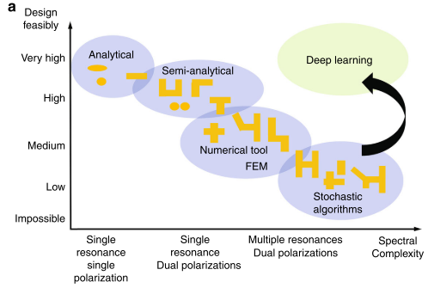
Design
Feasibly
High
Machine Learning
Analytical
Medium
Semi-Analytical
Numerical tool
Low
Low
Medium
High
Spectral
Complexity

Slide 16
Wide Area Network (WAN)
Local Area Network (LAN)
Personal Area Network (PAN)
Winter
STD
Humid

Slide 17
T₁
T₂
: Etched
: Not Etched
Input

Slide 18




$$L=N∙∆x$$
$$⋯$$
: SiO₂
$$∆x$$
: Air
$$⋯$$

Slide 19



$$R_{out}$$
$$R_{in}$$
$$R_{out}$$

Slide 20
Toggle
Swap

Slide 22
ARL
ANN
Theory
Theory

Slide 23
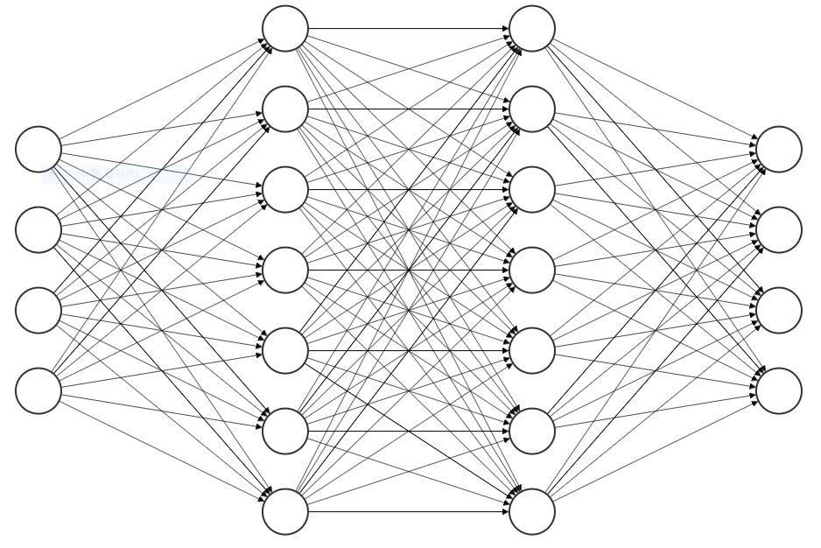
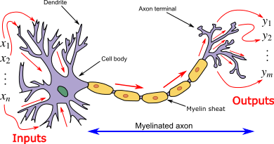
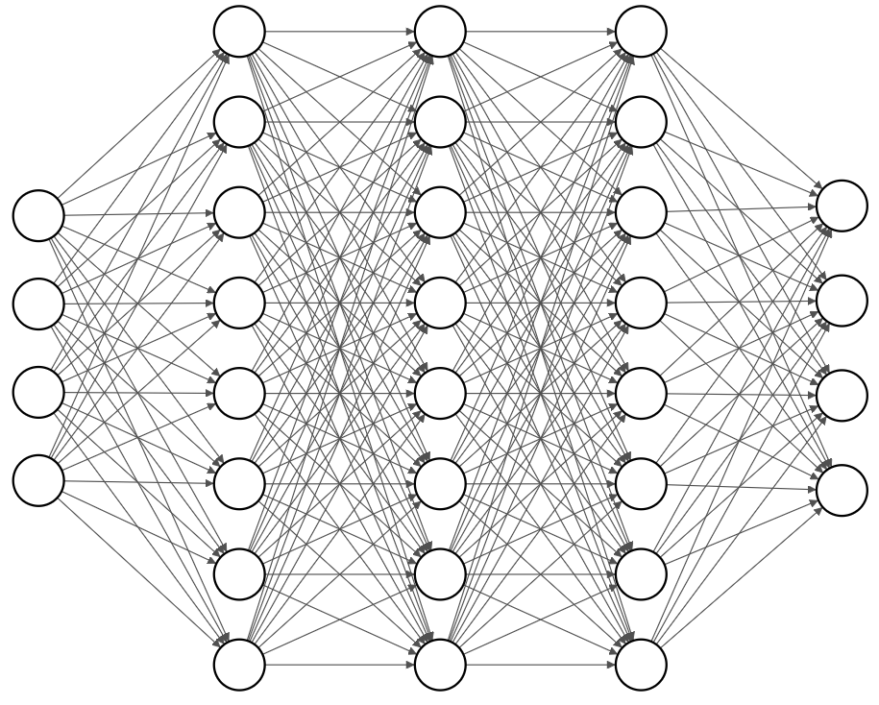

Slide 24
0.005
0.005

