Slide 1
3-level (a)
(Λ system)
3-level (b)
(V system)
4-level
E₂
E₂
E₃
(2) Non-radiative
emission
(2) Non-radiative
emission
(2) Spontaneous
emission
E₁
E₂
(3) Spontaneous
emission
E₁
(3) Spontaneous
emission
E₁
(3) Non-radiative
emission
(4) Non-radiative
emission
(1) Pumping
(1) Pumping
(1) Pumping
E₀
E₀
E₀
 | 3-level (a) | 3-level (b) | 4-level
Fast decay range | E₁ → E₀ | E₂ → E₁ | E₃ → E₂ , E₁ → E₀
Population inversion | X | O | O
Conversion efficiency | Low | Mid | High
Threshold pump power | High | Mid | Low
Application | Yb:YAG | Ruby | Nd:YAG

Slide 2
3-level (a)
(Λ system)
E₂
Rate equations
At steady state
(2) Spontaneous
emission
E₁
For good laser :
(3) Non-radiative
emission
(1) Pumping
Atom conservation
E₀
3-level (b)
(V system)
E₂
(2) Non-radiative
emission
Requirements for population inversion
E₁
(3) Spontaneous
emission
(1) Pumping
E₀

Slide 3
Rate equations
Fluorescent quantum efficiency
4-level
Population inversion
E₃
Atom conservation
(2) Non-radiative
emission
For a good laser
:
E₂
(3) Spontaneous
emission
Optical approximation
E₁
(4) Non-radiative
emission
(1) Pumping
At steady state
E₀
For good laser :

Slide 4
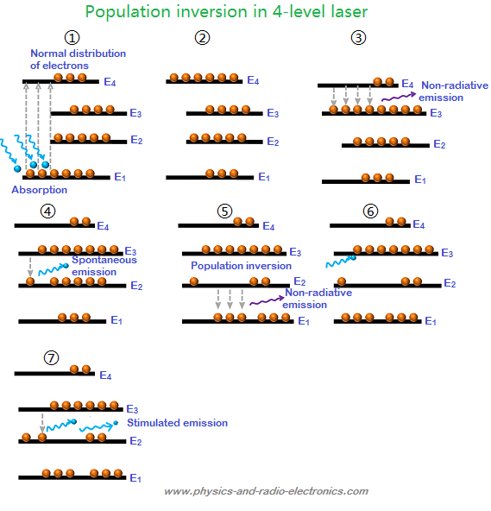
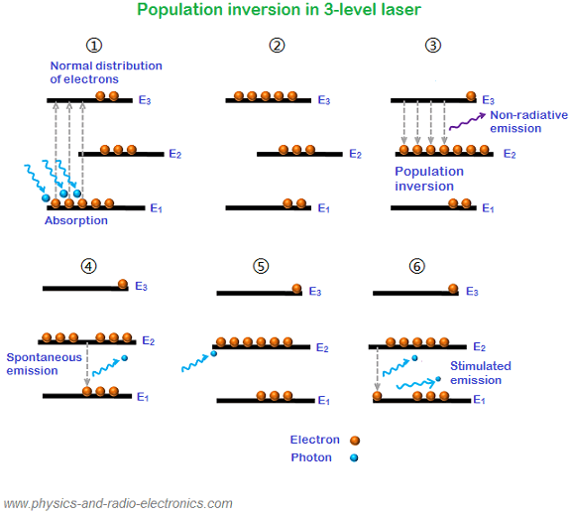
3-level laser
4-level laser

Slide 5
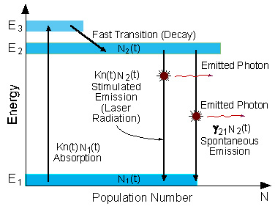
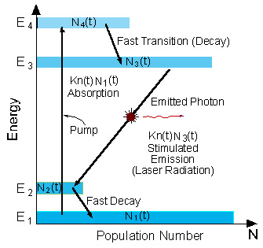
3-level laser
4-level laser

Slide 6
3-level laser (a)
3-level laser (b)
4-level laser
Non-radiative
emission
Non-radiative
emission
spontaneous
emission
spontaneous
emission
spontaneous
emission
Non-radiative
emission
Non-radiative
emission
 | 3-level (a) | 3-level (b) | 4-level
Pop

