Slide 1
3-level (a)
(Λ system)
3-level (b)
(V system)
4-level
E₂
E₂
E₃
(2) Non-radiative
emission
(2) Non-radiative
emission
(2) Stimulated
emission
E₁
E₂
(3) Stimulated
emission
E₁
(3) Stimulated
emission
E₁
(3) Non-radiative
emission
(4) Non-radiative
emission
(1) Pumping
(1) Pumping
(1) Pumping
E₀
E₀
E₀
 | 3-level (a) | 3-level (b) | 4-level
Fast decay range | E₁ → E₀ | E₂ → E₁ | E₃ → E₂ , E₁ → E₀
Population inversion | X | O | O
Conversion efficiency | Low | Mid | High
Threshold pump power | High | Mid | Low
Application | Yb:YAG | Ruby | Nd:YAG

Slide 2
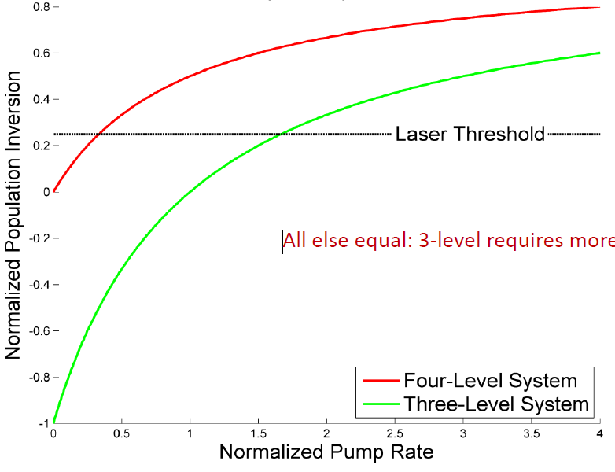
3-level
4-level
Pumping efficiency
E₂,N₂
E₃,N₃
(2) Non-radiative
emission
(2) Non-radiative
emission
E₁,N₁
E₂,N₂
(3) Stimulated
emission
(3) Stimulated
emission
E₁,N₁
Pumping
(W_{p})
(4) Non-radiative
emission
Pumping
(W_{p})
E₀,N₀
E₀,N₀
Rate equations
Rate equations
3 level
Atom conservation
4 level
Atom conservation

Slide 3
references
[slide # 1]
[1] Brauch, U.; Bammer, F. Disk Lasers. In Advanced Laser Materials Processing; Schuocker, D., Schuöcker, G., Eds.; OMICS International: Foster, CA, 2014.
https://www.esciencecentral.org/ebooks/ebookchapter/disk-lasers-10/4
[2] Spectroscopic systems used to create a laser http://www.optique-ingenieur.org/en/courses/OPI_ang_M01_C01/co/Contenu_08.html (accessed Aug 16, 2018).
[slide # 2]
[1] Lindgren, G. Pumping and Population Inversion - Laser Amplification, 2012.
https://www.aphys.kth.se/polopoly_fs/1.551652!/Presentation%2C%20March%2012th%2C%20Gustav%20Lindgren.pdf
[2] Section 2.4: Rate Equations and Population Inversion http://www.aml.engineering.columbia.edu/ntm/level2/ch02/html/l2c02s04.html (accessed Aug 16, 2018).

Slide 4
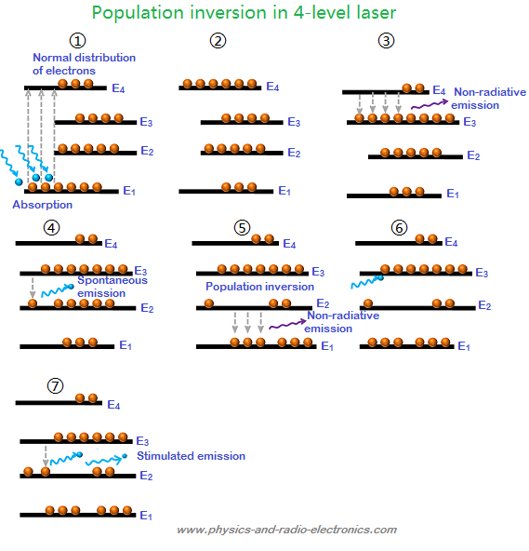
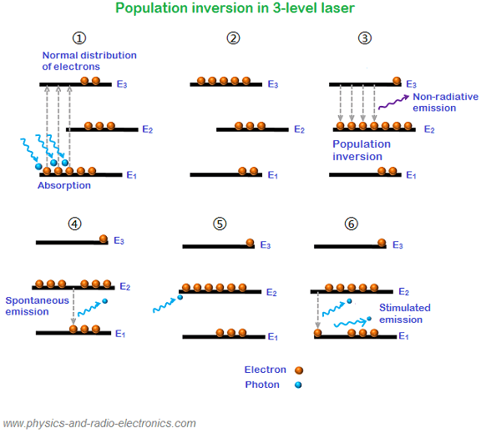
3-level laser
4-level laser

Slide 5
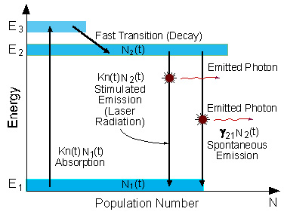
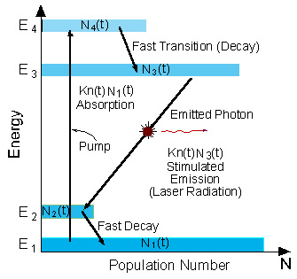
3-level laser
4-level laser

Slide 6
3-level laser (a)
3-level laser (b)
4-level laser
Non-radiative
emission
Non-radiative
emission
spontaneous
emission
spontaneous
emission
spontaneous
emission
Non-radiative
emission
Non-radiative
emission
 | 3-level (a) | 3-level (b) | 4-level
Pop

