Slide 1
TP-1 THz Time-Domain Spectroscopy (TDS)
TP-1-1 : Semiconductor Characterization
by THz TDS : Theory
TP-1-2 : Semiconductor Characterization
by THz TDS : Experiment
Lee Jong Geon

Slide 2
What To Do
1. Find the incident and transmitted THz field
spectra by Fourier transform
2. Find the transmission coefficient defined as
3. Find the complex refractive index
S
D

Slide 3
Find the incident and transmitted THz field spectra
FFT

Slide 4





Cause of fluctuation
$$r_{12}, t_{12}$$
$$r_{23}, t_{23}$$
$$t_{12}t_{23}E_{i}(ω,z)$$
S
D
$$t_{12}r_{23}^{2}t_{23}E_{i}(ω,z)$$
$$t_{12}r_{23}^{4}t_{23}E_{i}(ω,z)$$

Slide 5
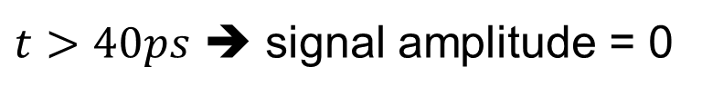
Find the incident and transmitted THz field spectra
$t>40ps$ ➔ signal amplitude = 0

Slide 6
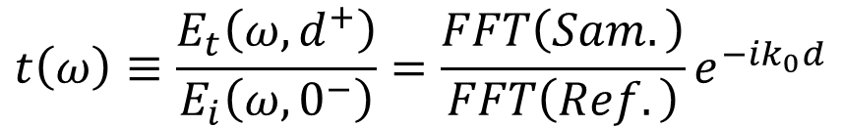
Find the transmission coefficient
$$t\left(ω\right)≡\frac{E_{t}\left(ω,d^{+}\right)}{E_{i}\left(ω,0^{−}\right)}=\frac{FFT\left(Sam.\right)}{FFT\left(Ref.\right)}e^{−ik_{0}d}$$

Slide 7

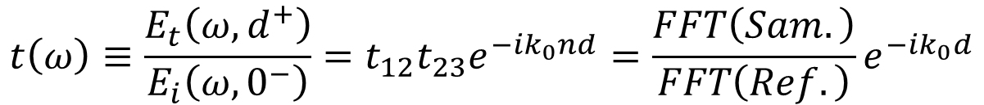


Find the complex refractive index
$$n\left(ω\right)=n^{′}\left(ω\right)+in^{′′}(ω)$$
$$r_{12}, t_{12}$$
$$r_{23}, t_{23}$$
S
D
$$t\left(ω\right)≡\frac{E_{t}\left(ω,d^{+}\right)}{E_{i}\left(ω,0^{−}\right)}=t_{12}t_{23}e^{−ik_{0}nd}=\frac{FFT\left(Sam.\right)}{FFT\left(Ref.\right)}e^{−ik_{0}d}$$
Theory
Experiment

Slide 8



Find the complex refractive index
Use Newton’s method
$$f=T_{th} −T_{ex}$$
$$Initial index=3.4$$
$$error<1e−10$$

Slide 9


Find the complex refractive index
$$n\sim 3.40−0.0i$$
$$n\sim 3.6−0.0i$$

Slide 10




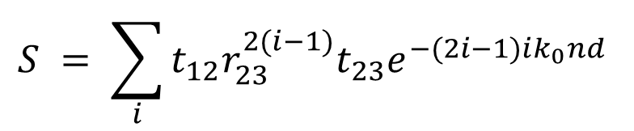


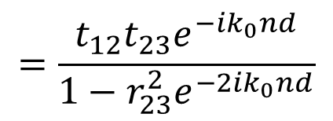
Find the complex refractive index
2nd, 3rd signal을 고려한 Transmission coefficient
$$s_{1}= t_{12}t_{23}e^{−ik_{0}nd}$$
$$n\sim 3.40−0.0i$$
$$s_{2}= t_{12}r_{23}^{2}t_{23}e^{−3ik_{0}nd}$$
$$s_{3}= t_{12}r_{23}^{4}t_{23}e^{−5ik_{0}nd}$$
$$→S =s_{1}+s_{2}+s_{3}$$
$$S = \sum_{i}{t_{12}r_{23}^{2(i−1)}t_{23}e^{−(2i−1)ik_{0}nd} }$$
$$n\sim 3.40−0.0i$$
$$=\frac{t_{12}t_{23}e^{−ik_{0}nd}}{1−r_{23}^{2}e^{−2ik_{0}nd}}$$

