Slide 1
Intro
머신러닝과 딥러닝
나노 소자 설계 방법
기존 설계 방법
딥러닝의 필요성
Additive Reinforcement Learning Algorithm
Inverse Design with Neural Network
Result
References

Slide 2
Intro
Machine Learning과 Deep Learning의 관계
Artificial Intelligence
Machine Learning
Deep Learning

Slide 3
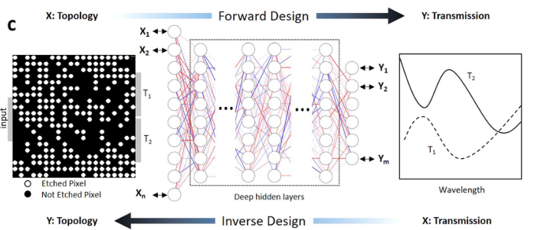
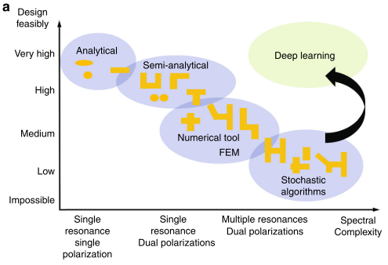
나노 소자 설계 방법
Forward Design & Inverse Design 설명
M. H. Tahersima, K. Kojima, T. Koike-Akino, D. Jha, B. Wang, C. Lin, and K. Parsons, “Deep Neural Network Inverse Design of Integrated Photonic Power Splitters,” Scientific Reports, vol. 9, no. 1, 2019.
Nano-photonic structure 설계에 Deep Learning의 필요성
I. Malkiel, M. Mrejen, A. Nagler, U. Arieli, L. Wolf, and H. Suchowski, “Plasmonic nanostructure design and characterization via Deep Learning,” Light: Science & Applications, vol. 7, no. 1, 2018.

