Slide 1

John Glisson / Josh Morris / Daniel McConnell
November 10, 2017

Slide 2
Agenda
1PM – 1:45PM
Overview / Components
1:45PM –3:15PM
Hand On with Azure
3:15PM – 4PM
Roundtable

Slide 3
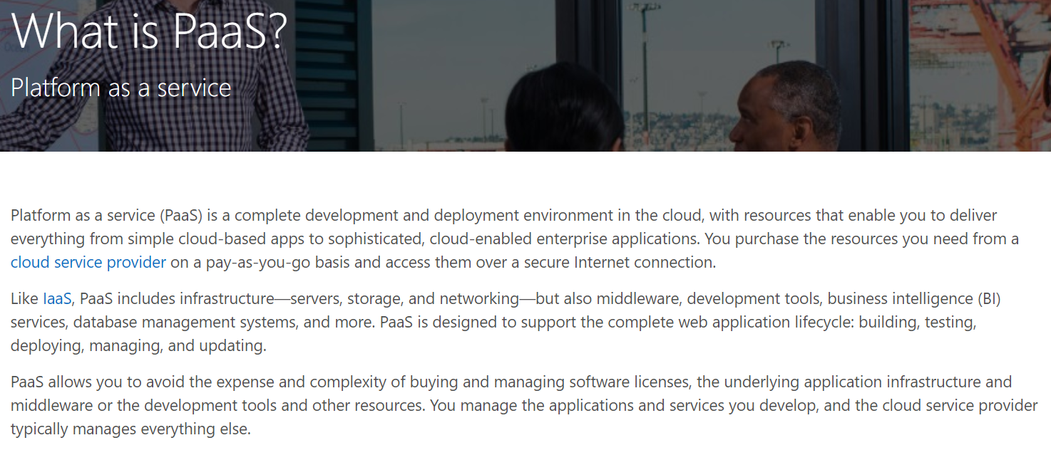
Overview
Platform as a Service (PaaS)

Slide 4
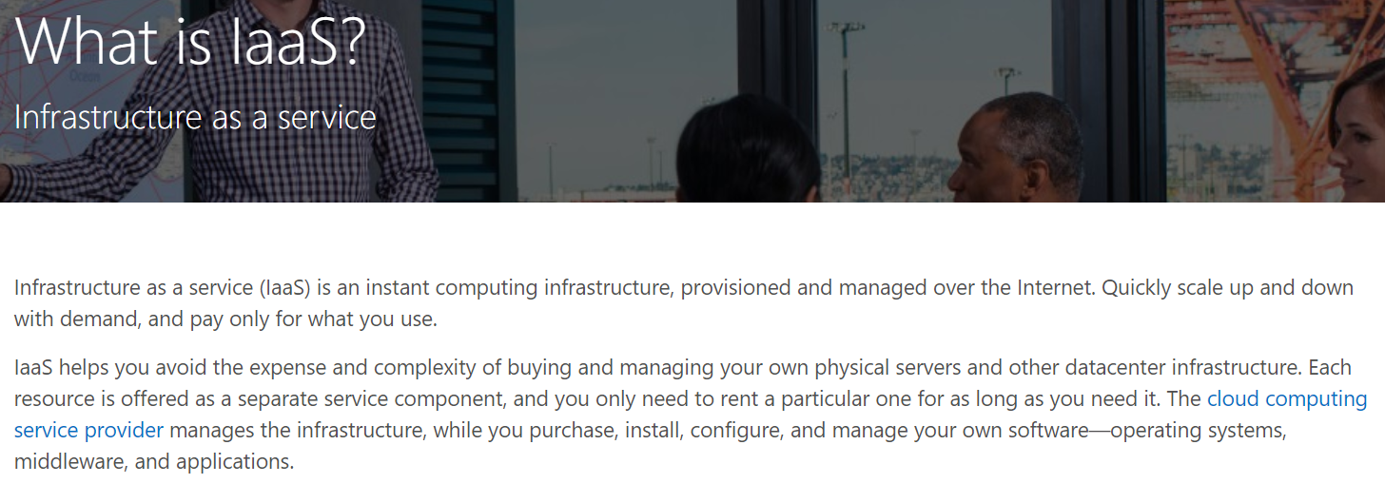
Overview
Infrastructure as a Service (IaaS)
Notes:
Also mention SaaS – Office 365, SharePoint Online

Slide 5
Overview
Azure API / Web App
VSTS
Azure Functions
Azure SQL
Cosmos DB
Event Hubs
Application Insights
Power BI
Notes:
VSTS – VSO, TFS

Slide 6
Overview (cont.)
Why do I care (AKA how do I sell it)?
Rapid development / deployment
Solution can be stood up very quickly
Very attractive for POC development
Solution is elastic (can be scaled up/down and out/in as needed)
Most PaaS solutions can handle this automatically (if configured), however all can be handled via automation scripts
Continuous delivery is fairly straightforward
Push from VSTS
Pull from VSTS, GitHub, BitBucket, or any other hosted Git repository
Eliminates the need for ongoing hardware/software maintenance (patches, version updates, license management, etc)
PaaS is not cloud only, excellent jumping off point for a hybrid solution

Slide 7
Azure API / Web App
Supports multiple languages and frameworks
ASP.NET
Node.js
Java
Python
Continuous Deployment with a source control repository
Scale up or out manually or automatically
Connect to SaaS platforms and on-premises data
Deployment Slots

Slide 8
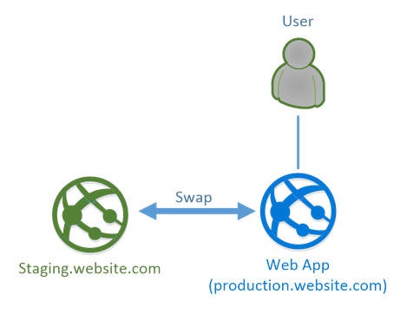
Azure API / Web App (cont.)
Deployment Slots – Separate App Service within the same Service Plan, allows:
Different environments
A/B testing
Hot swap between deployment slots
Features / Limitations
Free to use at Standard tier or higher*
Functions as a full fledged App Service instance, however cannot be independently scaled
Can copy configurations/settings from other deployments slots
Slots have different URLs and require the (re)installation of any custom site extensions
Notes:
https://stackify.com/azure-deployment-slots/

Slide 9
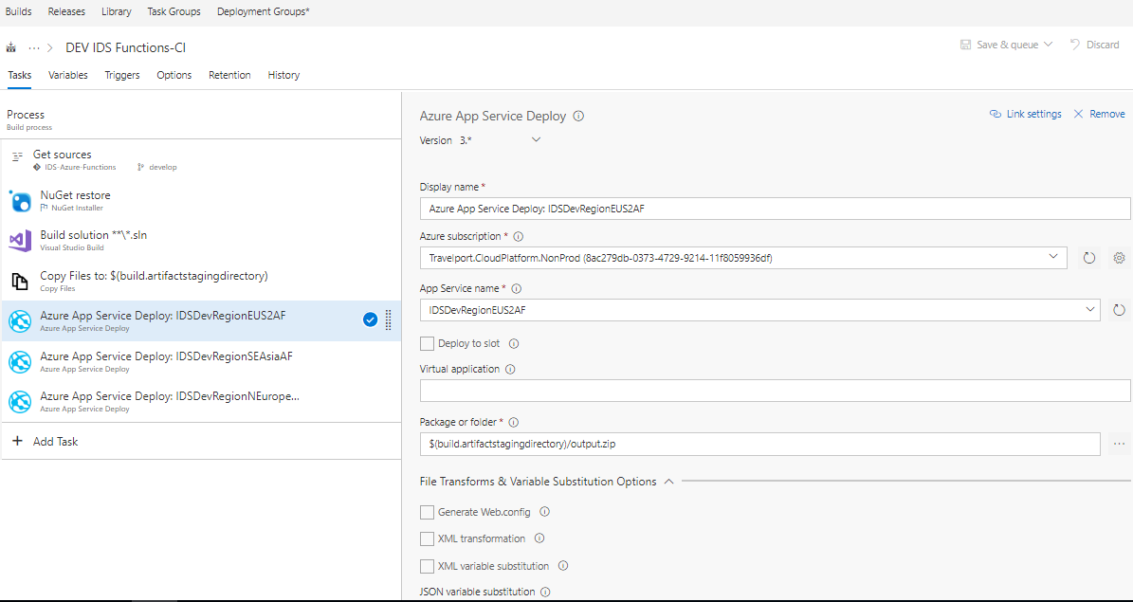
VSTS screenshots of CD setup and deployment

Slide 10
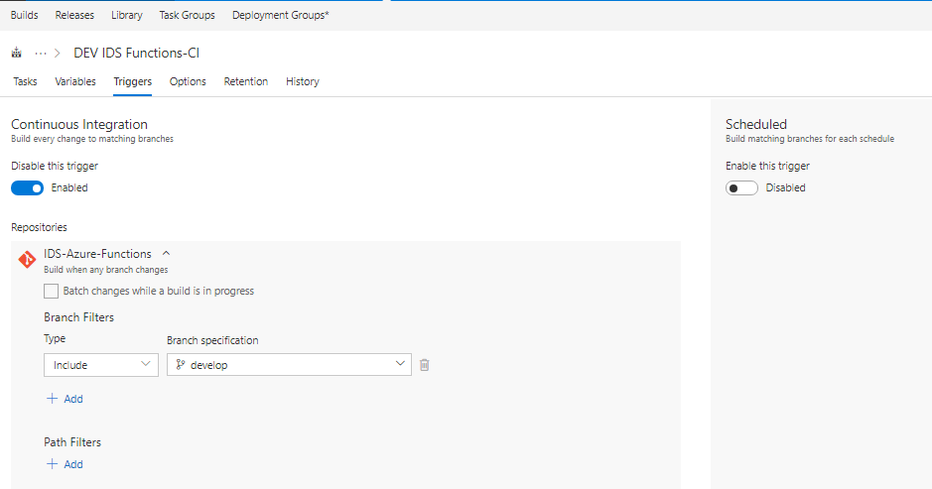
VSTS screenshots of CD setup and deployment

Slide 11
Azure Functions
Azure Functions is a serverless solution for easily running small pieces of code in the cloud
Supports C#, F#, Node.js, Java, PHP, batch, bash, or any executable
Protect HTTP-triggered functions with OAuth providers such as Azure Active Directory, Facebook, Google, Twitter, and Microsoft Account
Pay only for processing time used via Consumption Plan, App Service Plan available as well
Also supports deployment slots and continuous delivery

Slide 12
Azure Functions – Bindings
HTTPTrigger
TimerTrigger
GitHub webhook
Generic webhook
CosmosDBTrigger
BlobTrigger
QueueTrigger
EventHubTrigger
ServiceBusQueueTrigger
ServiceBusTopicTrigger
Notes:
https://docs.microsoft.com/en-us/azure/azure-functions/functions-triggers-bindings

Slide 13
Azure SQL
Dynamic scalability
Built in High Availability (via geo-replication)
Intelligent Optimization
Point in Time Backup and Restore
Built in performance monitoring and alerting
MS – Cloud first development, Azure SQL has new bells and whistles before on premises
Notes:
Don’t really want to spend much time here, more that it is SQL Server in the cloud, and while not everything works the same as SQL on premises it’s not too far off either.
Additional Links:
https://docs.microsoft.com/en-us/azure/sql-database/sql-database-transact-sql-information
https://docs.microsoft.com/en-us/azure/sql-database/sql-database-features

Slide 14
Cosmos DB
Azure’s NOSQL solution
Provides 4 flavors
Table – Key-Value pairs
Graph – Node/Edges (social media data)
Document DB – JSON documents queried via SQL-like syntax
MongoDB – Direct support for most MongoDB API functionality
High Availability through global replication
Elastically scale throughput per minute as well as per second to handle burst traffic
Notes:
Document DB API – extensible via JavaScript also supports stored procs, triggers, and UDFs
MongoDB – Similar to DB, however directly support most (some) features available in native MongoDB
Graph API – High performance searches through relationships

Slide 15
Event Hubs
Streaming queue of events
Message queuing / buffering - Log millions of events per second in near real-time
Limited Message Size - 256 KB
Limited Buffering – 1 - 7 days
Supports automatic message archiving through Azure Event Hubs Capture to Azure Storage or Azure Data Lake Storage
Supports: .NET (Standard & Framework), Java, Node, C
Supports AMQP 1.0 (also used by RabbitMQ and other non-MS queueing options)
Notes:
Size limit: (Fits Claim-Check Pattern)
https://docs.microsoft.com/en-us/azure/event-hubs/event-hubs-capture-overview

Slide 16
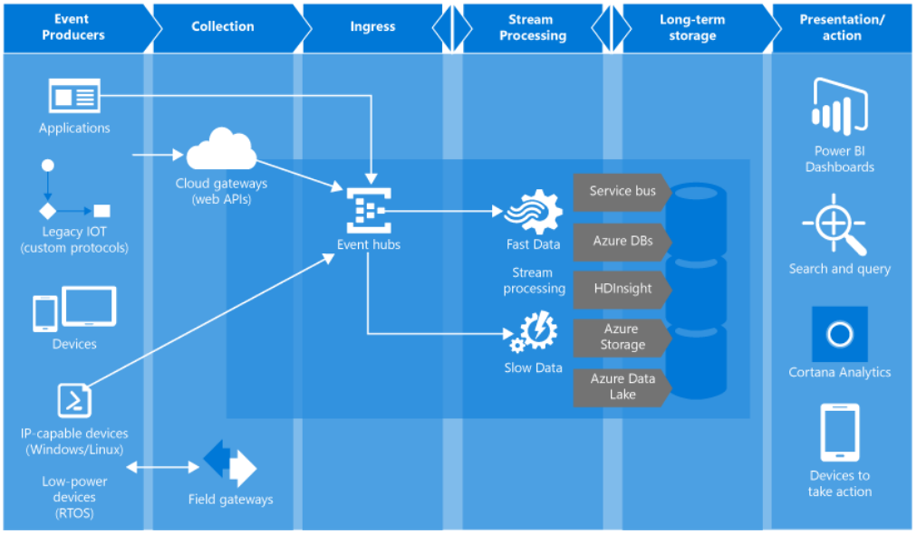
Event Hubs (cont.)

Slide 17
Application Insights
Repository of solution telemetry
Supports .Net, Node.js, Java
Realtime monitoring and alerting with stack traces for exceptions
All metrics are query-able through the analytics portal
Query results can be exported into and visualized with Power BI (more on this in the demo)

Slide 18
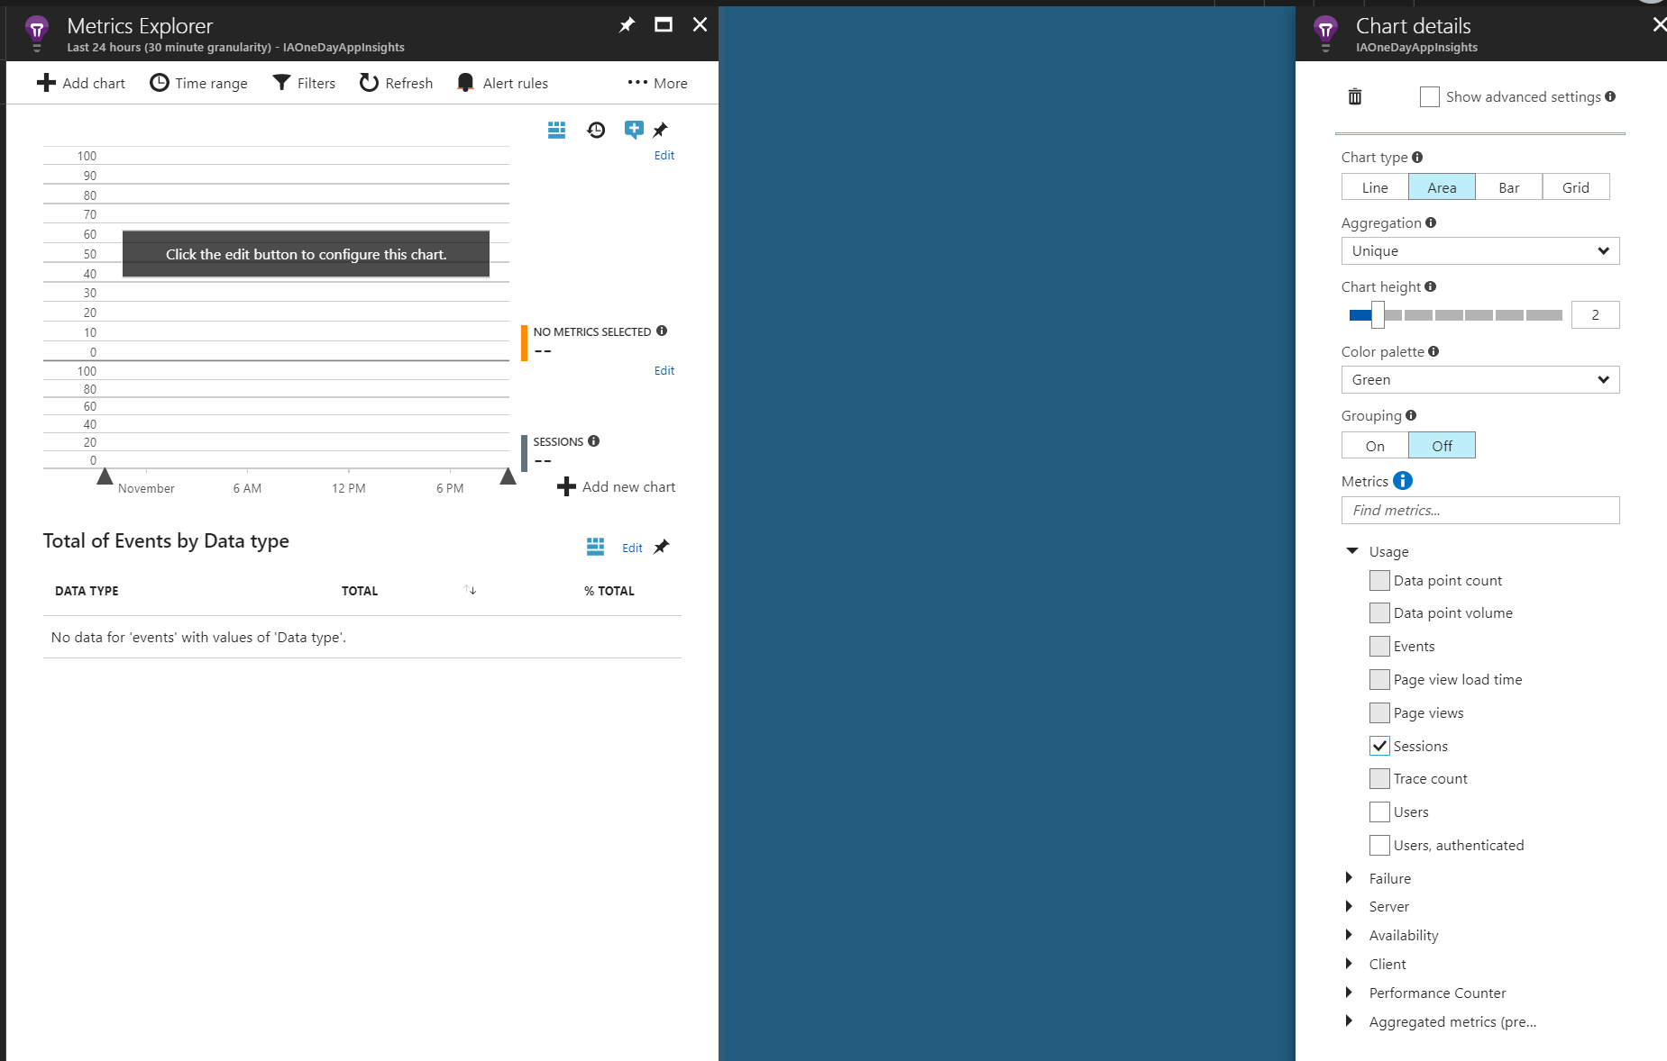
Application Insights (cont.)

Slide 19
Application Insights (cont.)
Sample Query:
traces
| where timestamp > datetime(2017-07-31T00:00:00Z)
and timestamp < datetime(2017-08-01T00:00:00Z)
| extend Method=
tostring(parsejson(customDimensions.MethodName))
| extend Duration=
extract(""([0-9.]+) ms"",1, message, typeof(real))
| extend FuncStepOrder=extract(""^([0-9.]+[A-Z.]?)"",1,message)
| distinct
timestamp, message, client_CountryOrRegion,
Duration, itemId, FuncStepOrder, operation_Id, Method

Slide 20
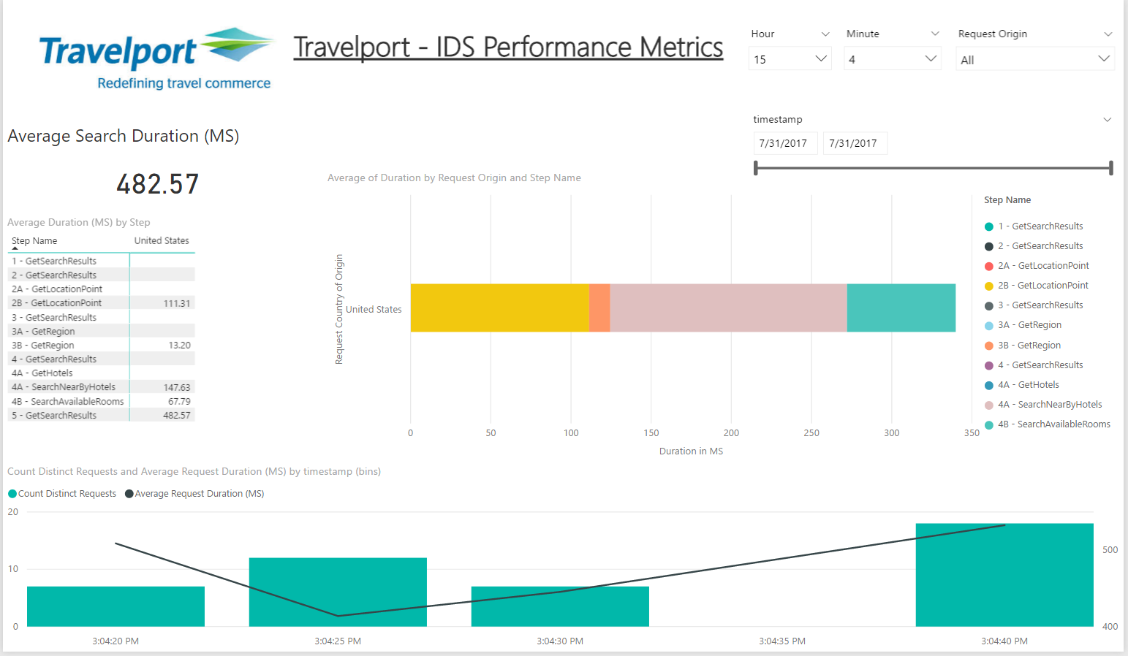
Application Insights (cont.)

Slide 21
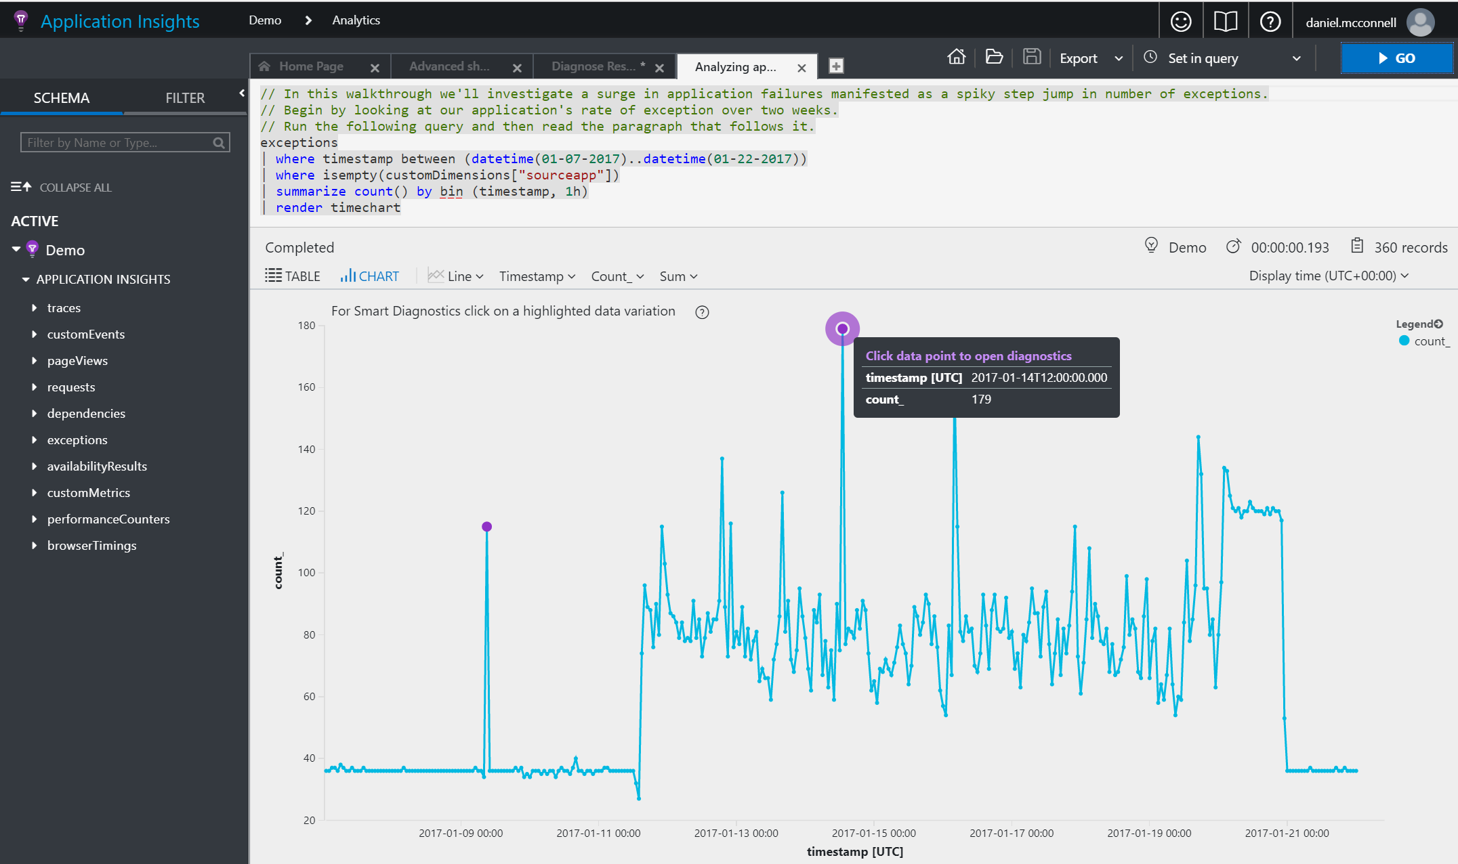
Application Insights (cont.)
Notes:
Custom queries against real time logs, visualize data, auto identification of outliers

Slide 22
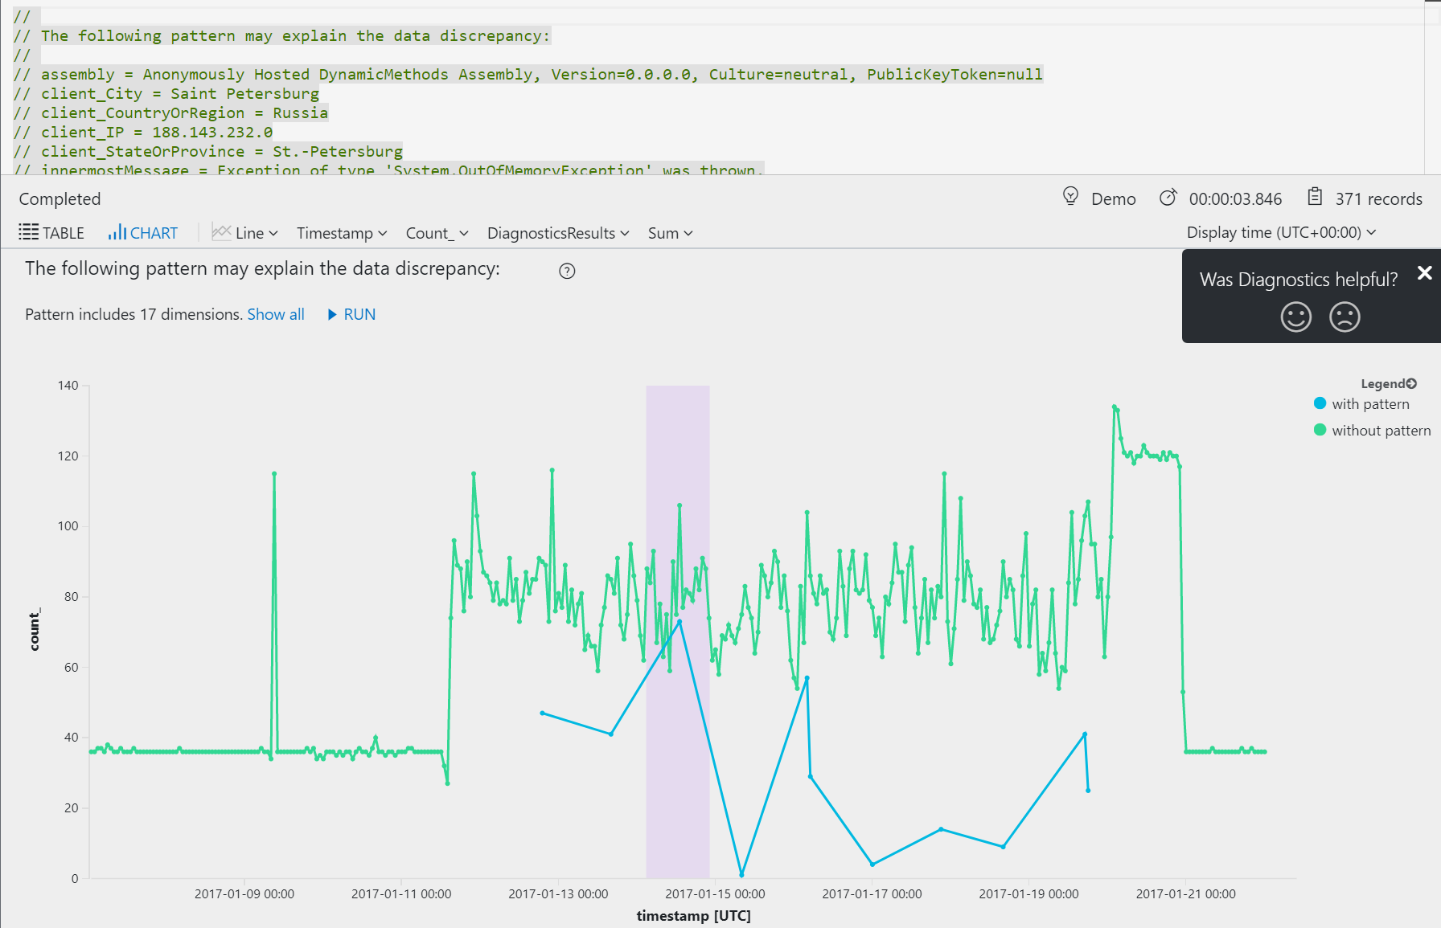
Application Insights (cont.)
Notes:
Automatic investigation into what may have caused the issue

Slide 23
Questions?

Slide 24
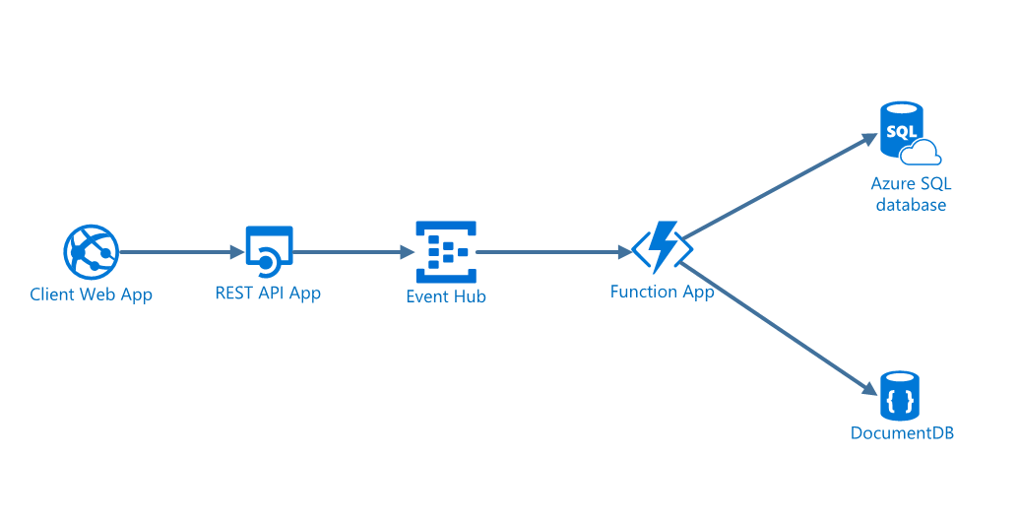
Demo Time!
Repo: https://github.com/johnglisson/IAOneDay

Slide 25
Hands on Demo - Provisioning
Create –
Resource Groups
API App
App Service Plan
Event Hub
Cosmos DB
Function App
Azure SQL Server and Database
Application Insights
Web App

Slide 26
Hands on Demo – Add Data
Create table to store survey results

Slide 27
Hands on Demo – Deploy Code
Update SurveyAPI connection string
Publish code to API App
Verify via Hello World ping test
Deploy Function App
Deploy Survey UI

Slide 28
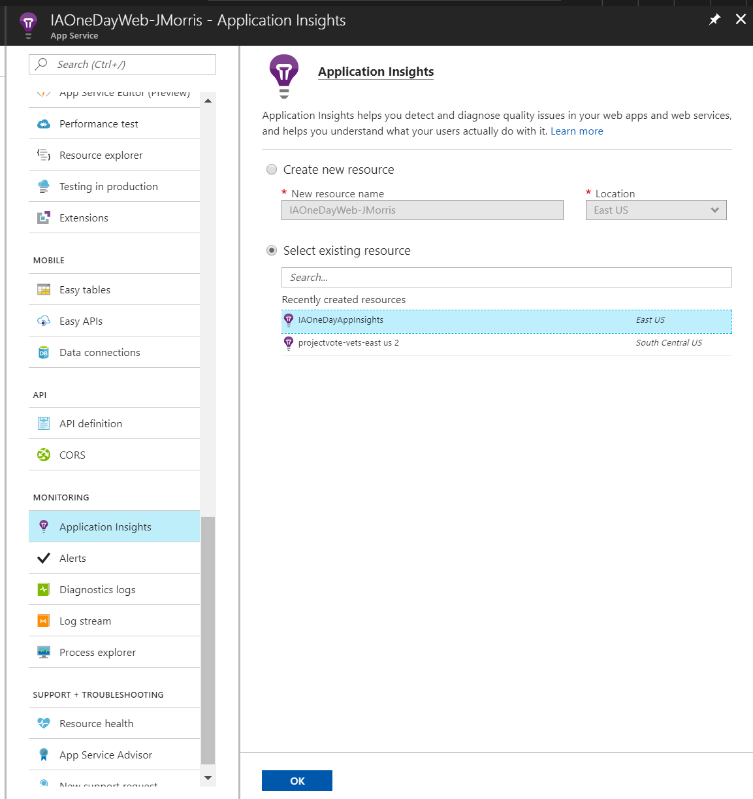
Hands on Demo – Connecting to Application Insights

Slide 29
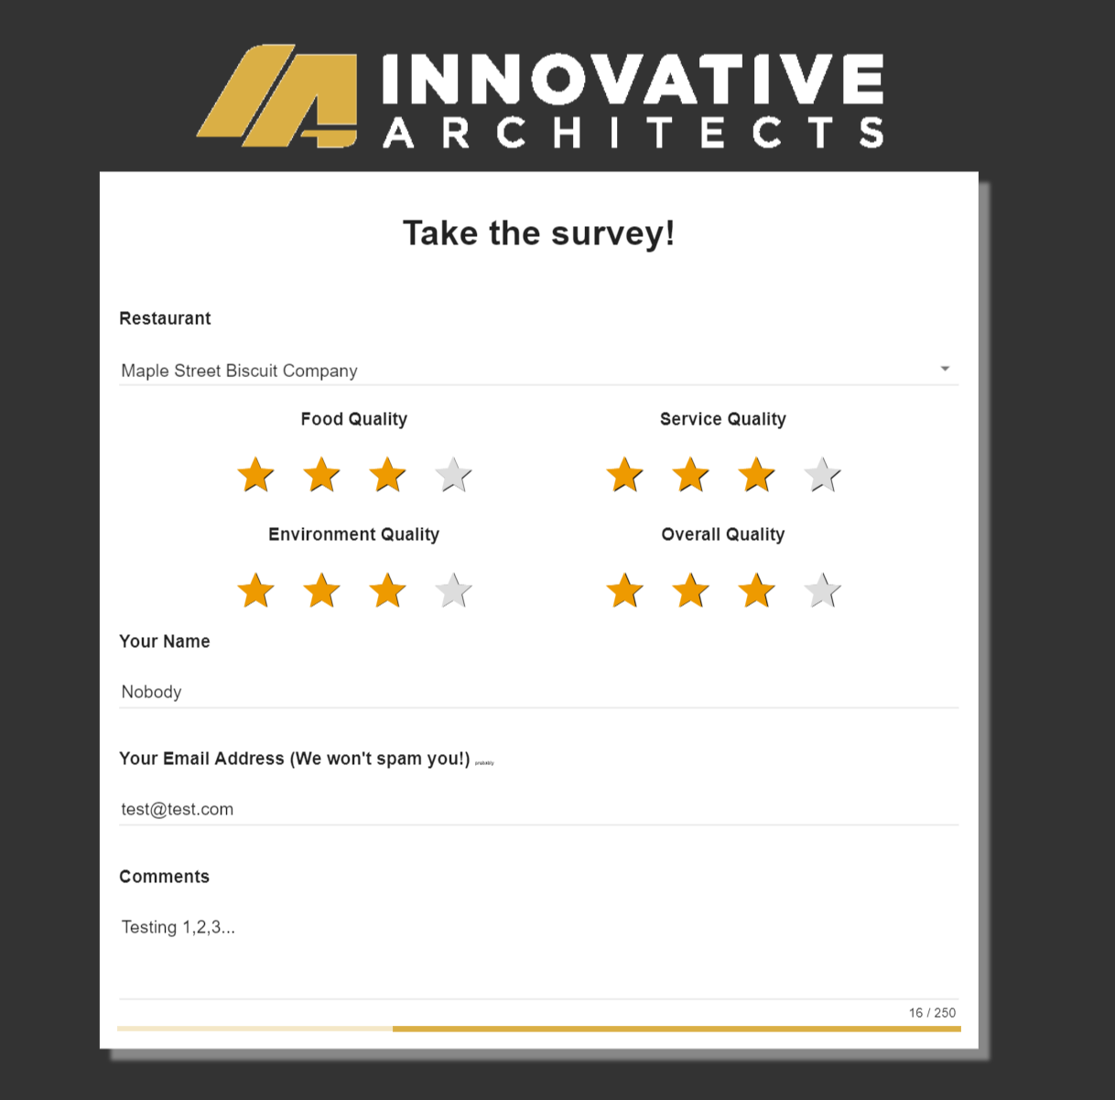
Hands on Demo – Watching the Data Flow Through
Add some data

Slide 30
Hands on Demo – Watching the Data Flow Through
Verify data in CosmosDB
Verify data in SSMS
Connect to App Insights Service
Connect and execute a custom query

Slide 31
Questions?

Slide 32
Round Table
Story Time - Travelport – 15m
Story Time – Integra Connect CI – 15m
Small Group Discussion – Where can you use what you learned today? – 15m

