Slide 1
Iowa .NET User Group

Slide 2
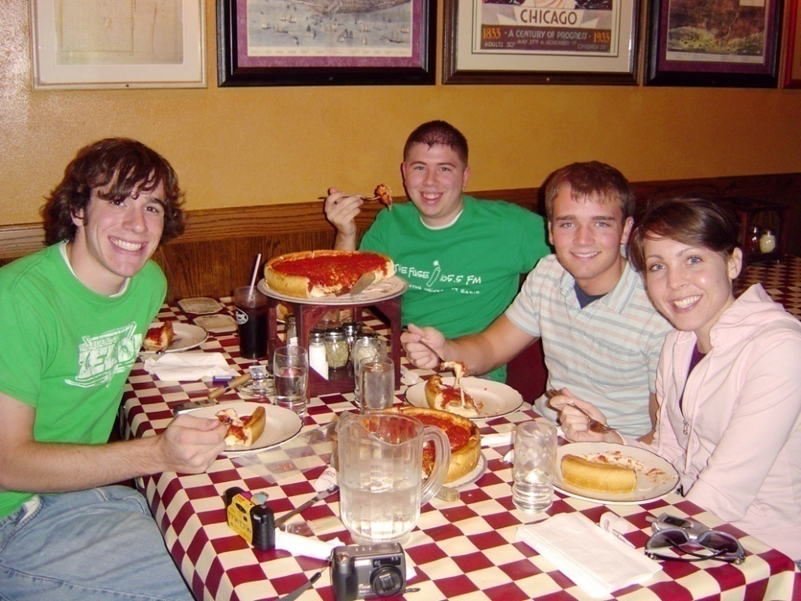

Pizza Provided by .NET User Group
Please thank our sponsors!

Slide 3

Platinum Sponsor:

Slide 4

Platinum Sponsor:

Slide 5
Tonight’s Meeting
Building Rich Web Experiences using Silverlight
By: Javier Lozano
This is an overview presentation of the feature set that both Silverlight v1.0 and v1.1 have to offer to developers.
We will also cover some of the current tools available for both designers and developers to create Silverlight applications.
What is Silverlight?
Microsoft® Silverlight™ is a cross-browser, cross-platform plug-in for delivering the next generation of .NET based media experiences and rich interactive applications for the Web.
Silverlight offers a flexible programming model that supports AJAX, VB, C#, Python, and Ruby, and integrates with existing Web applications.
Silverlight supports fast, cost-effective delivery of high-quality video to all major browsers running on the Mac OS or Windows.

Slide 6

In Memory of
Eric Jacobs

Slide 7


Gold Sponsors:

Slide 8

In Memory of
Josh Trainor

Slide 9
Questions & Answers
HOW DO YOU BECOME A MEMBER?
Answer: Just log into www.iowadnug.org and register on the website.
WHY BECOME A MEMBER?
Answer: Monthly event notifications, free conference passes, networking with other members, free training, and free books.
DOES MEMBERSHIP COST?
Answer: NO, everything is free!
HOW DO WE PAY FOR EVERYTHING I.E. BOOKS, PIZZA, SPEAKER?
Answer: From our sponsors fees, sponsors pay to have a logo on our website. They do NOT have access to our roster.

Slide 10
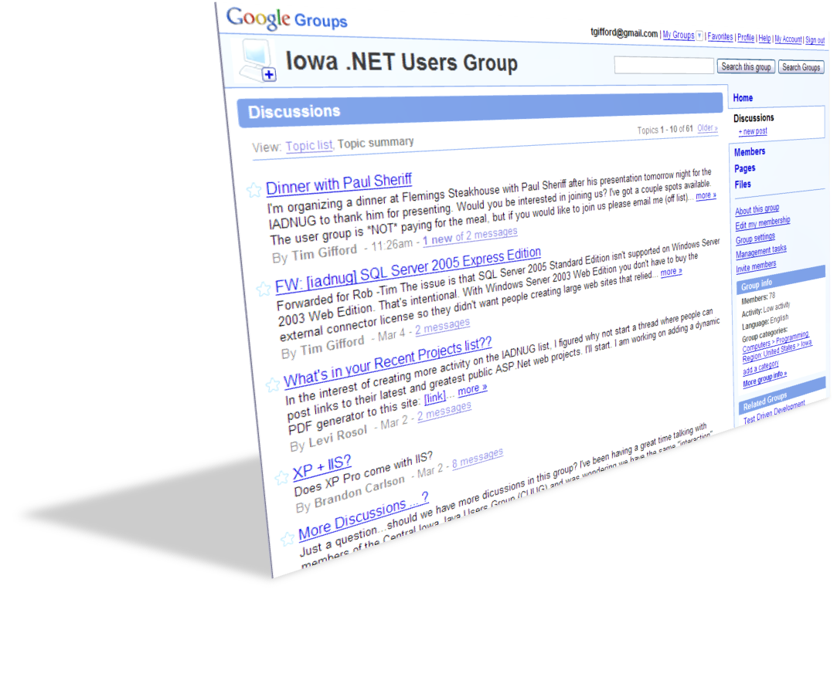

Collaborate: Join the Google Group
http://groups.google.com/group/iadnug

Slide 11
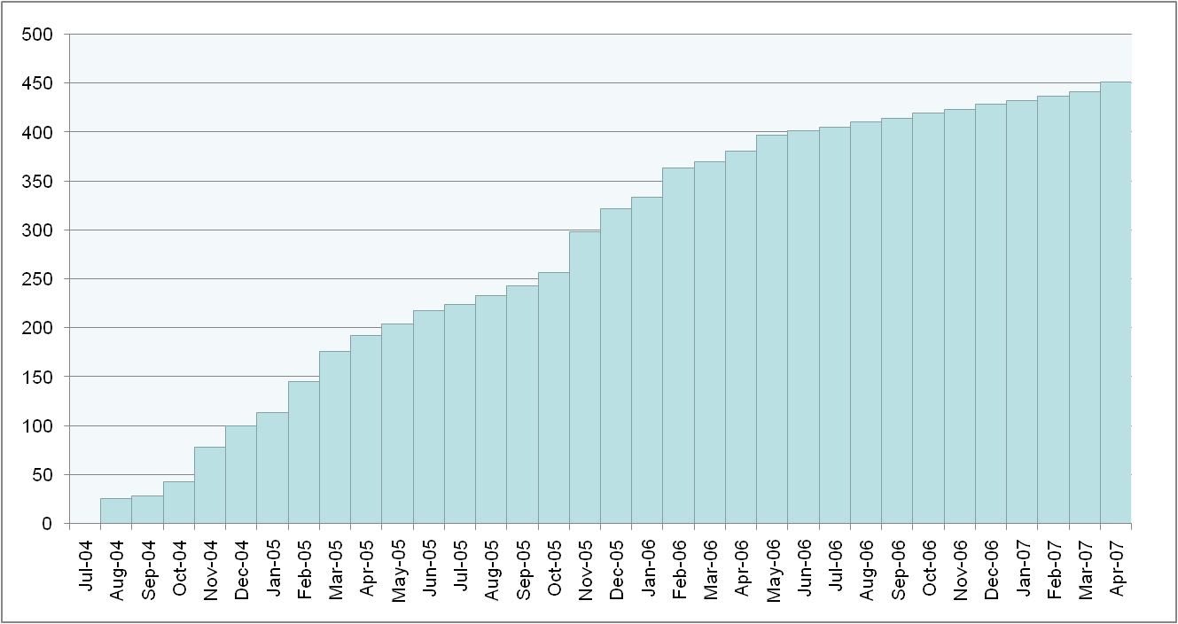
Membership Update
Total: 451 as of 4/2/2007

Slide 12





Our In Kind Sponsors

