Slide 1
ESCape
A VR Escape Game

Slide 2
CONCEPT
You are an earthling chimpanzee in the zoo
You have been captured by extra-dimensional lifeforms that wish to experiment on you, earth’s most evolved species
You have 2 hours before their alien ship returns to the beeblebrox system
You must ESCape!

Slide 3
GAMEPLAY
Minimap tracks player and AI, provides navigation
Line-of-sight AI tracks player when spotted
Mazerunning gameplay
Various object-oriented puzzle solving games

Slide 4
Technologies
Unreal Engine 4 level making engine
C++ with visual studio
Object-oriented UE Blueprint system
Oculus rift + touch controls
Mobile and PC compatible

Slide 5
Challenges
Documenting user-based test cases
Version control with github + unreal engine 4
Minimap
Artificial intelligence
Blueprint design

Slide 6
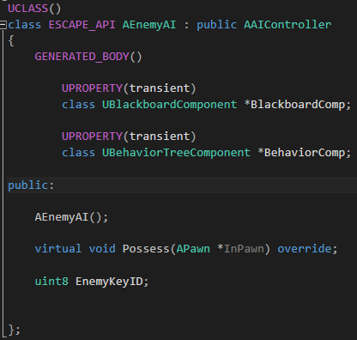
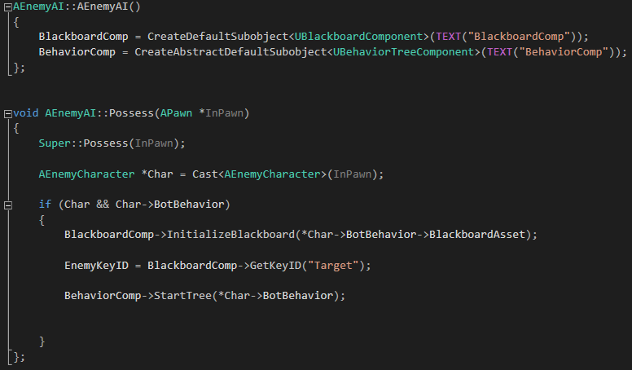
Iteration 1: Enemy Targeting System

Slide 7
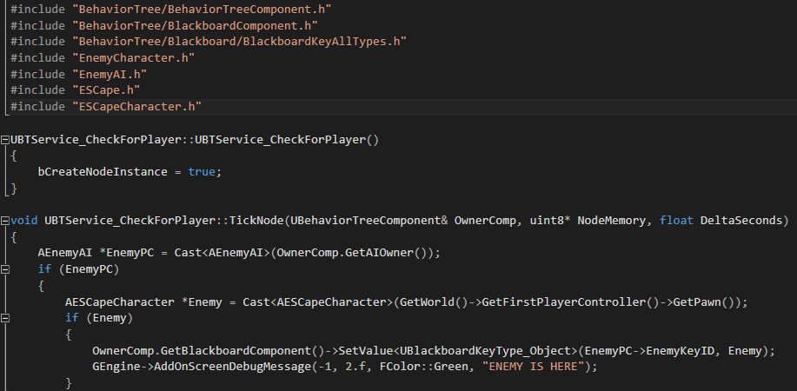
Iteration 2: CheckForPlayer task

Slide 8
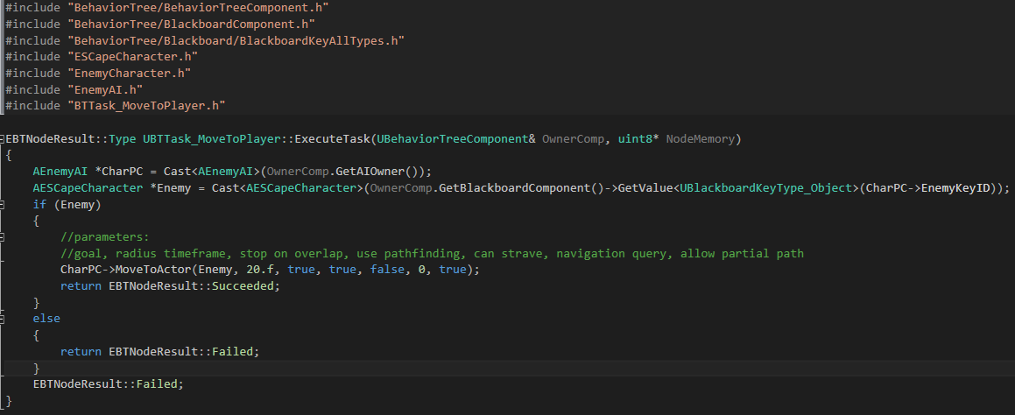
Iteration 2: MoveToPlayer task

Slide 9
Test Cases
TEST CASE | EXPECTED OUTCOME
Enemy Reaches Player | Stop moving
Enemy backs player into corner | Player cannot move
Enemy reaches navmesh | Enemy stops on location
Player leaves navmesh | Enemy stops at border
Enemy collides with static mesh | Enemy navigates around mesh
2 Enemies on board | Both enemies chase player
2 Enemies, no player | Enemies stand still
Enemy sees player | Enemy pursues player
Player not on board | Enemy stands still
Player enters board | Enemy begins pursuit
2 Enemies, player enters board | Both enemies pursue player

Slide 10
Expectations
More realistic AI with intuition and mistakes
C++-designed puzzle challenged
Implemented minimap
Dijkstra pathfinding on minimap

