Slide 1
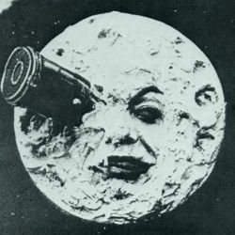
Slide 1
This should use Two Content, not Comparison!
an image

Slide 2
Slide 2
This should also use Two Content
an image

