Slide 1
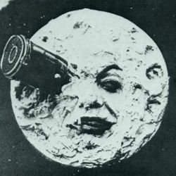

Slide 2
The Moon

Slide 3
One More
The Moon

