Slide 1
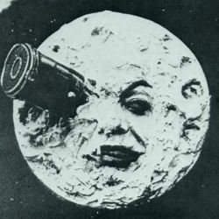
The moon
Notes:
chicken and dumplings

Slide 2
Right | Left | Center | Default
12 | 12 | 12 | 12
123 | 123 | 123 | 123
1 | 1 | 1 | 1
Demonstration of simple table syntax, with alignment
Notes:
foo bar

Slide 3
some stuff
some more stuff
Some other stuff
Notes:
Some notes inside a column
Some notes outside the column

