Slide 1
Neural Tractography Using an
Unscented Kalman Filter
James Malcolm
PhD Defense
21 Oct 2010

Slide 2
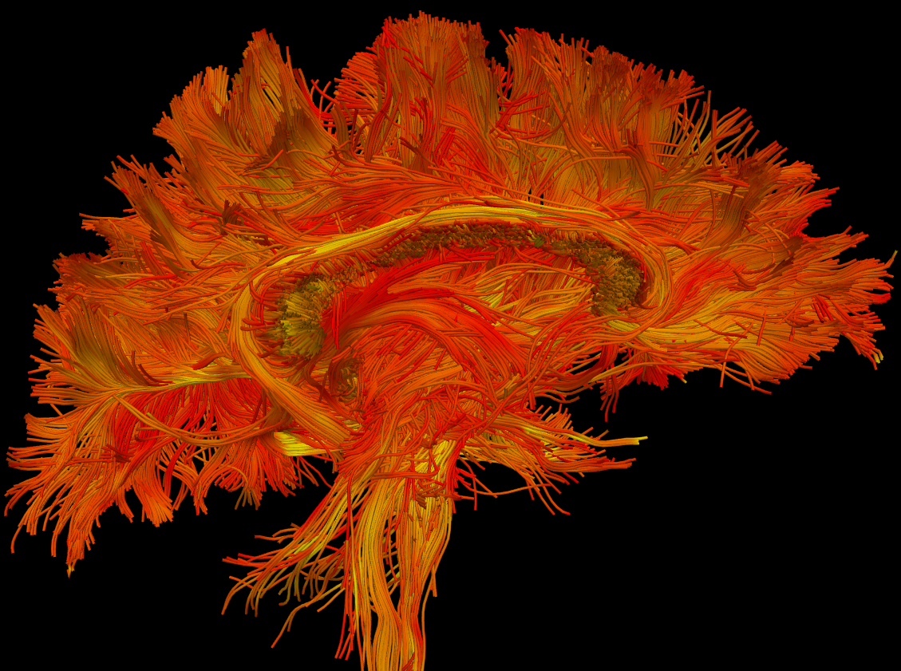
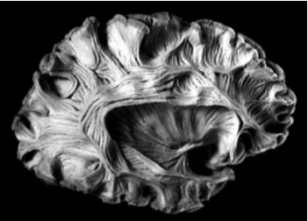

Slide 3
background
J. G. Malcolm, Y. Rathi, and C.-F. Westin. “Processing and visualization of diffusion MRI.” In T. Deserno, editor, Recent Advances in Biomedical Image Processing and Analysis, chapter 16, pages 387–410. Springer, 2011.

Slide 4
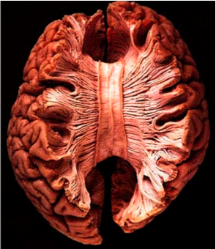
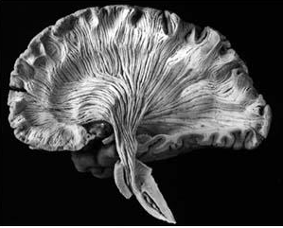
neural fibers
[Williams 97]

Slide 5
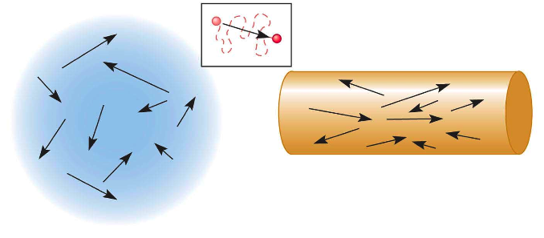
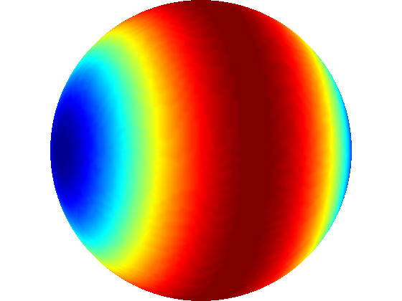
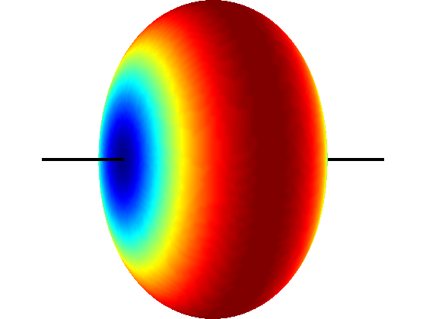
scan directions
[Huettel 2004]
isotropic scanner signal
directed signal

Slide 6
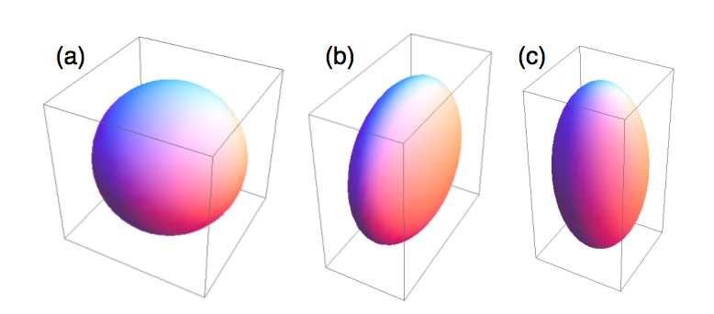
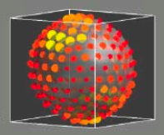
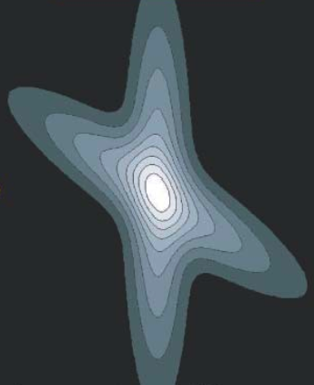
imaging techniques
Diffusion tensor imaging (DTI)
  single-tensor
  [Basser 94]
High Angular Resolution (QBI)
  multi-fiber
  [Tuch 02]
Diffusion Spectrum (DSI)
  radial information
  [Wedeen 05, Hagmann 05]
[Clayden]
[Tuch]
[Hagmann]

Slide 7
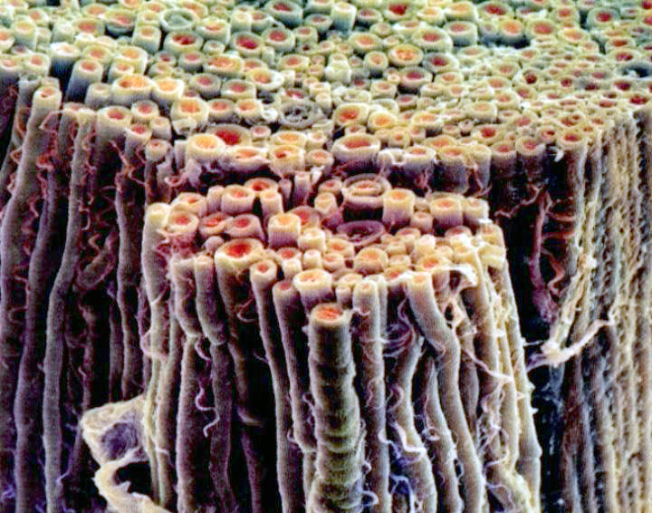
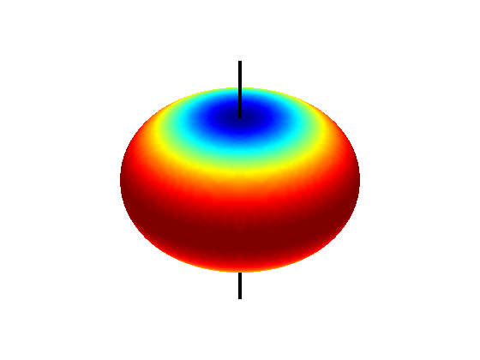
one neural fiber
0.2 to 20 microns
one scanned voxel
1.7 x 1.7 x 1.7 mm
George Bartzokis, UCLA

Slide 8
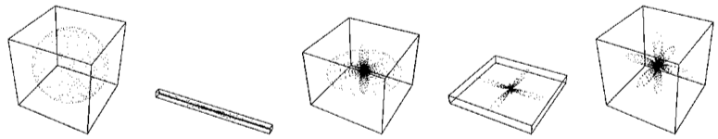
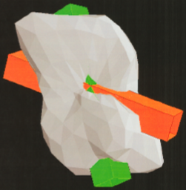
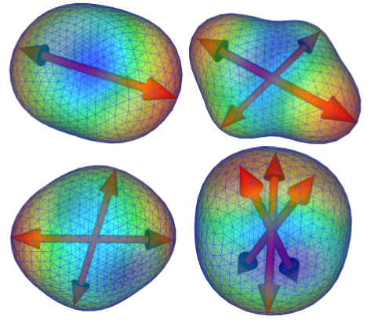
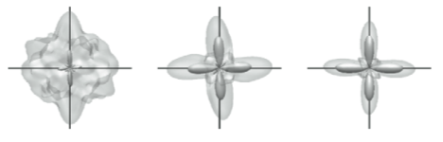
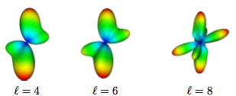
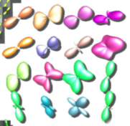

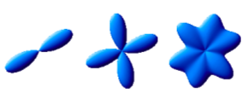
voxel reconstruction
PAS [Jansons 03], MESD [Alexander 05]
tensor mixtures [Tuch 02]
HOT [Hlawitschka 05]
SD [Tournier 04]
spherical harmonics [Descoteaux 07]
DOT [Ozarslan 05]
VMF [Kumar 08]
Wishart [Jian 07]

Slide 9
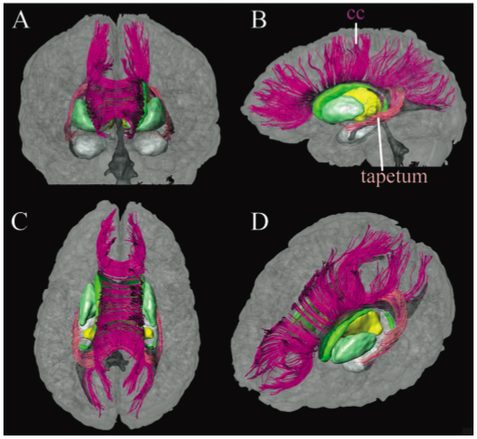
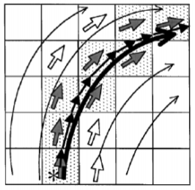
deterministic tractography
streamline
[Mori 99]
[Conturo 99, Basser 00]
[Wakana 03]

Slide 10
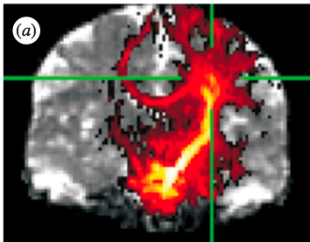
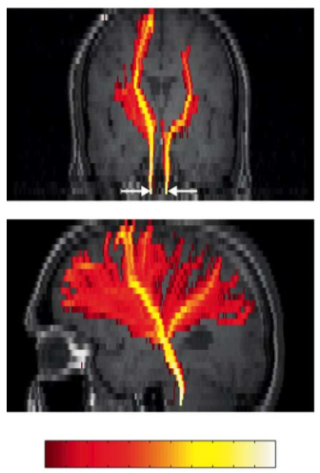
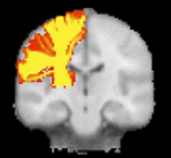
probabilistic tractography
[Parker 05]
[Friman 06]
[Behrens 07]

Slide 11
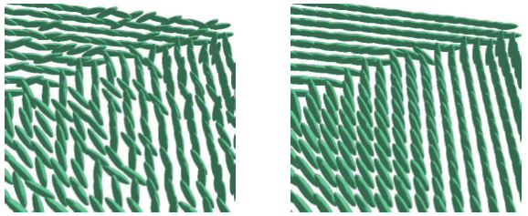
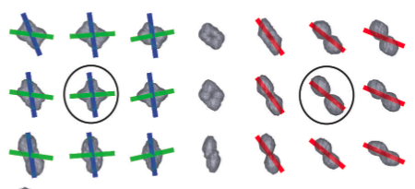
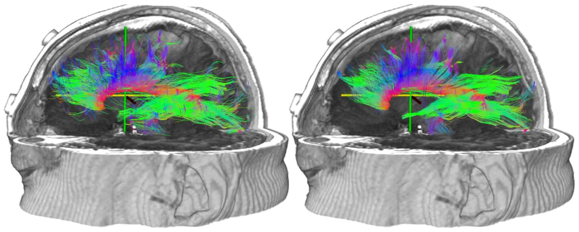
spatial regularization
pre/post-processing
[Tschumperle 03]
[Savadjiev 07]
[Fillard 07]

Slide 12
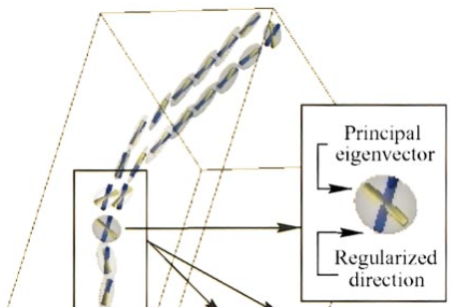

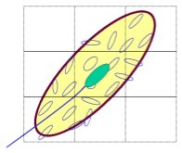
tract regularization
deterministic approaches:
deflection [Lazar 03]
spaghetti [Poupon 00]
single-tensor
path regularization
[Zhukov 02]

Slide 13
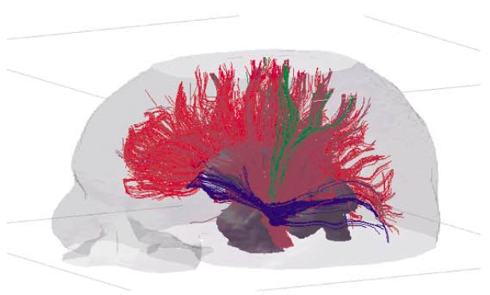
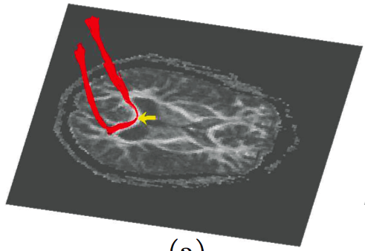
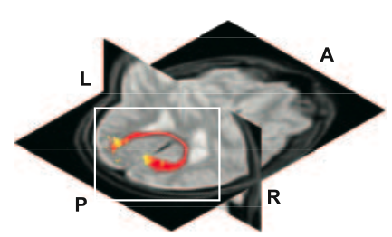
tract regularization
probabilistic approaches:
linear Kalman filter [Gossl 02]
particle filtering [Zhang 07]
single-tensor
path regularization
stochastic [Bjornemo 02]

Slide 14
method:
the model
Y. Rathi, J. G. Malcolm, O. Michailovich, C.-F. Westin, M. E. Shenton, and S. Bouix. Tensor-kernels for simultaneous ﬁber model estimation and tractography. Magnetic Resonance in Medicine, 64(1):138–148, 2010.
J. G. Malcolm, M. E. Shenton, and Y. Rathi. Neural tractography using an unscented Kalman ﬁlter. In Information Processing in Medical Imaging (IPMI), pages 126–138, 2009.

Slide 15
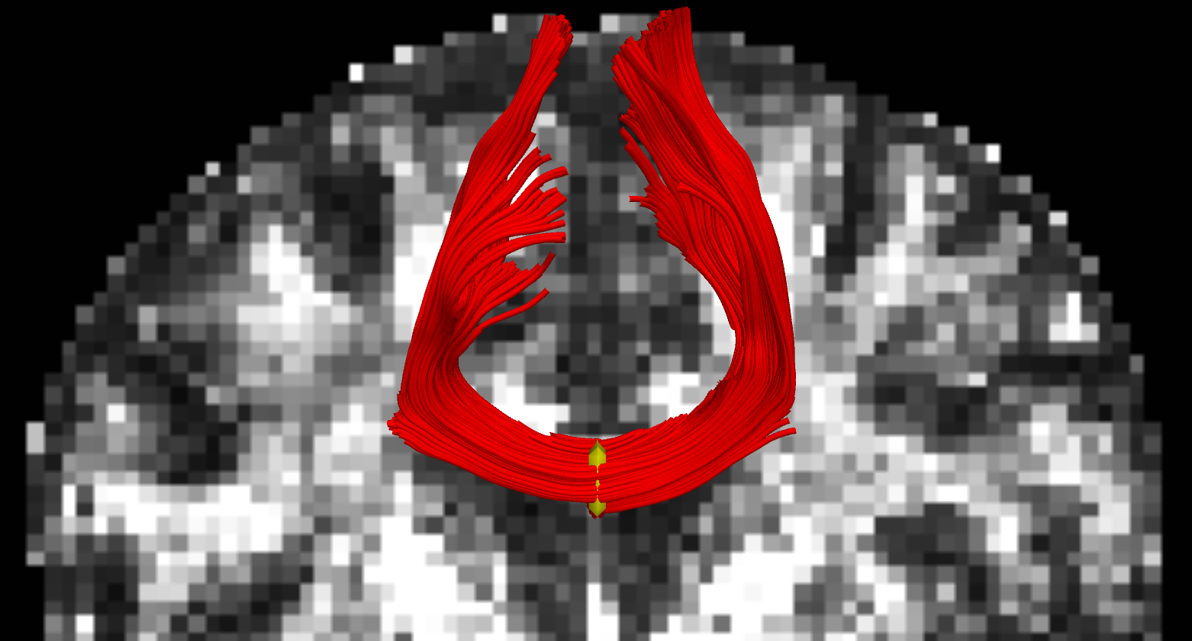
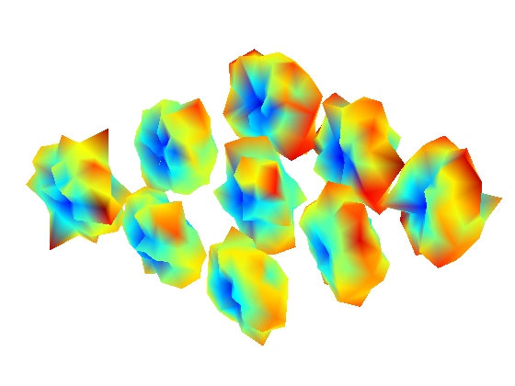
scanner signal
b=900
51 directions
1.7mm isotropic voxel
17 minute scan
[Bartzokis]

Slide 16
DTI
diffusion tensor
6 parameters
unit direction
acquisition constant
null signal (b=0)
[Basser 94]

Slide 17
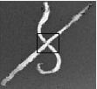
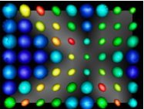
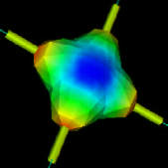
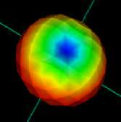
single-tensor limitations
rat spinal nerves
true ODF
single-tensor ODF
[Campbell, Descoteaux]
[Descoteaux]

Slide 18
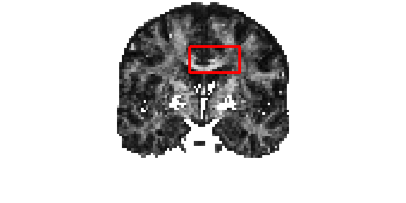

Slide 19
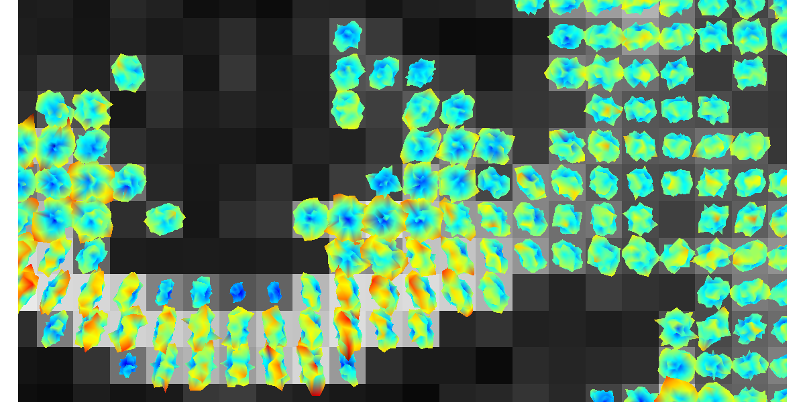
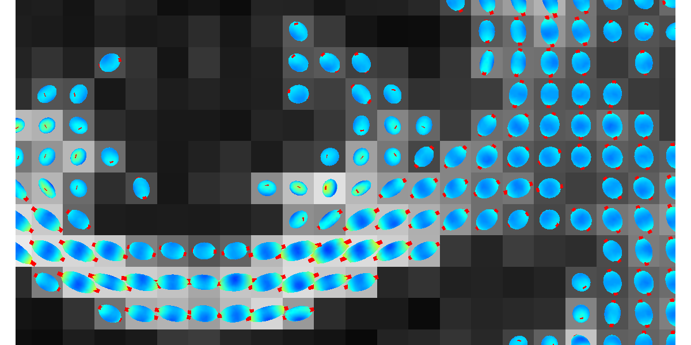
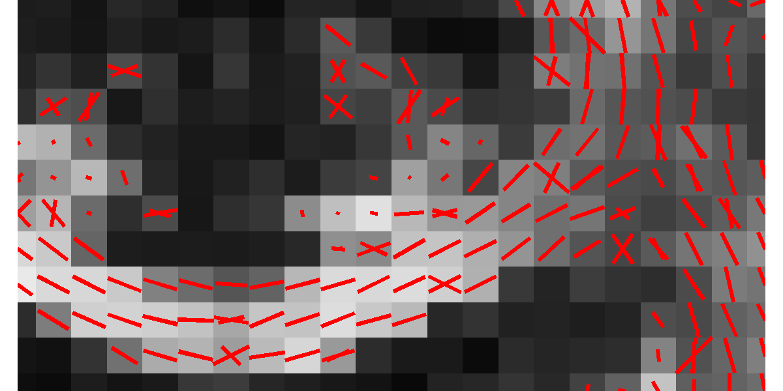
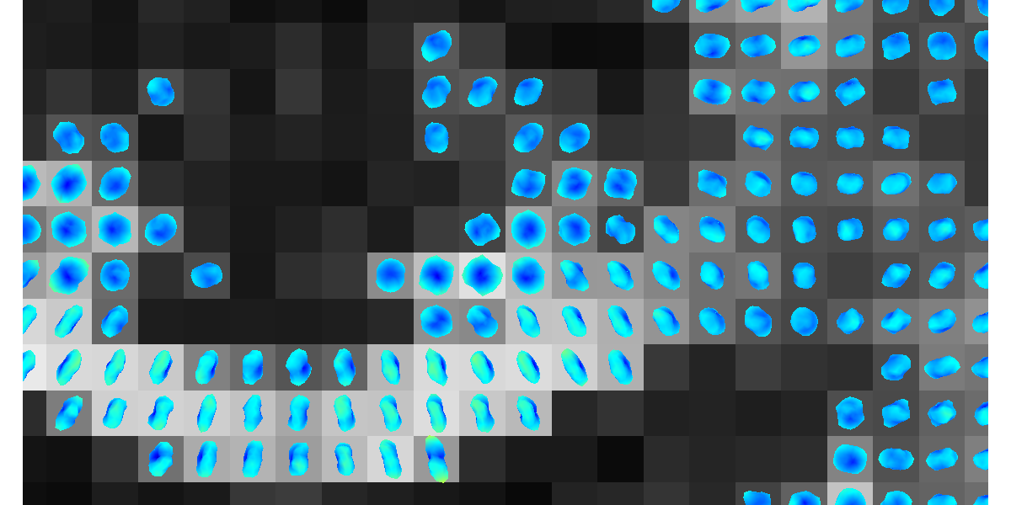
raw dMRI signal
single-tensor ODF
two-tensor axis
spherical harmonic ODF

Slide 20
multi-tensor signal model
diffusion tensor
unit direction
convex weights
acquisition constant
null signal (b=0)

Slide 21
model assumptions
...for now
Two fibers
Fixed volume fractions
Tensors are elliptic or isotropic

Slide 22
model parameters
for two fibers...
...two principal directions m ∈ ℝ³
...two primary eigenvalues λ1 ∈ ℝ
...two minor eigenvalues λ2 ∈ ℝ
5 + 5 = 10 parameters

Slide 23
model parameters
for two fibers...
...two principal directions m ∈ ℝ³
...two primary eigenvalues λ1 ∈ ℝ
...two minor eigenvalues λ2 ∈ ℝ
5 + 5 = 10 parameters
eigenvectors:

Slide 24
method:
estimating the model
J. G. Malcolm, O. Michailovich, S. Bouix, C.-F. Westin, M. E. Shenton, and Y. Rathi. A ﬁltered approach to neural tractography using the Watson directional function. Medical Image Analysis, 14:58–69, 2010.
J. G. Malcolm, M. E. Shenton, and Y. Rathi. Filtered multi-tensor tractography. IEEE Trans. on Medical Imaging, 29:1664–1675, 2010.

Slide 25
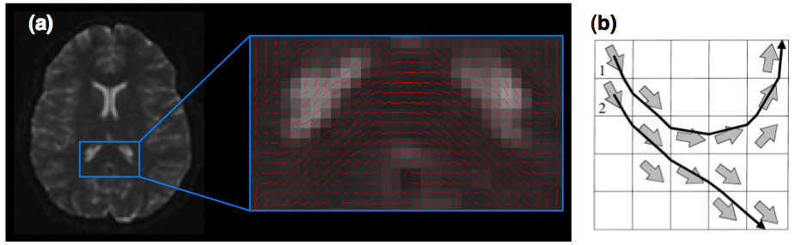
independent estimation
[Xue 99]

Slide 26
the system: a fiber
independent process
causal
process
Notes:
List other indep. methods
“causal estimation” or call it something else?

Slide 27
model-based filtering
scanner measurement
underlying model
objectives:
  estimate model from measurements
  suppress noise

Slide 28
notation
state of system at time t
state = “model parameters”
what you see at time t
observation, measurement
update:
observation:
linear
nonlinear

Slide 29
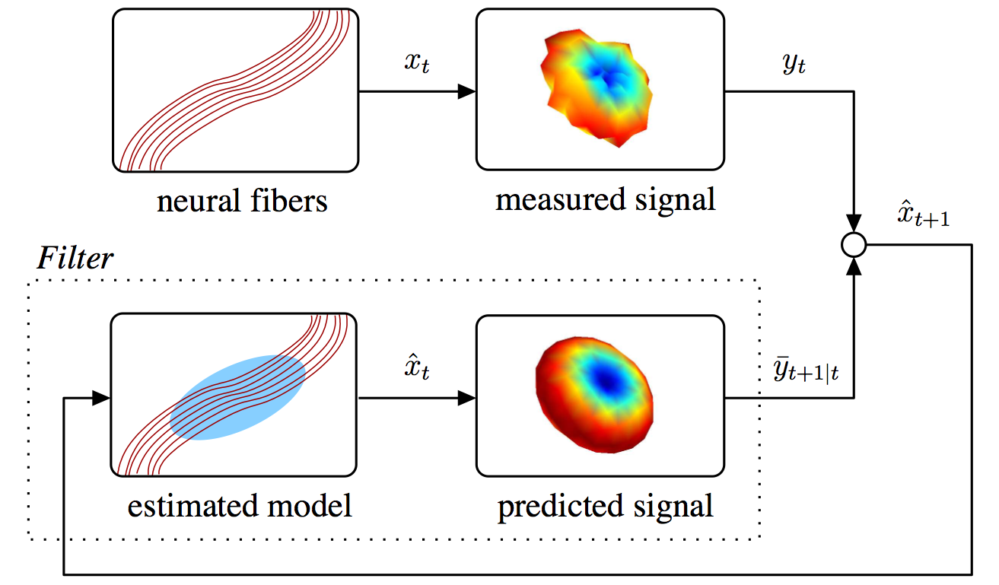
Kalman filtering
predict … measure … reconcile … repeat ...

Slide 30
10 dimensional
state
signal

Slide 31
10 dimensional
state
signal
small steps
slowly varying state

Slide 32
10 dimensional
state
signal
small steps
slowly varying state

Slide 33
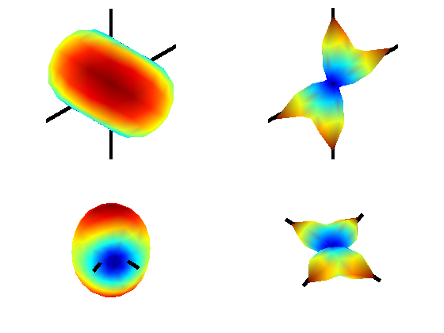
Local fiber model: mixture of two tensors
diffusion MRI signal
orientation distribution
function (ODF)

Slide 34
signal reconstruction is nonlinear
independent optimization
least squares
  linearization
gradient descent
  local minima
Levenberg-Marquardt
  local minima
causal
estimation
extended Kalman filter
  mean + covariance
  linearization
particle filter
  non-parametric
  sampling
unscented Kalman filter
  mean + covariance
  no linearization
  limited sampling
[Julier 04, Merwe 03]
Notes:
List other indep. methods
“causal estimation” or call it something else?

Slide 35
linear Kalman filter
predict … measure … reconcile … repeat ...

Slide 36
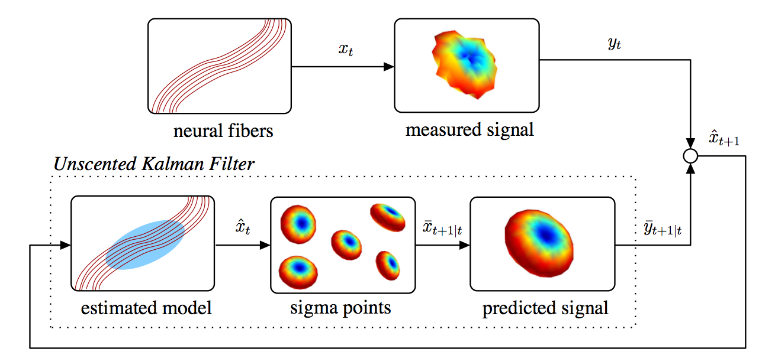
unscented Kalman filter
same update equations
modified prediction step

Slide 37
unscented transform
approximate the statistics...not the function

Slide 38
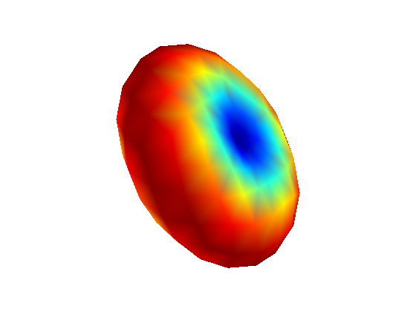
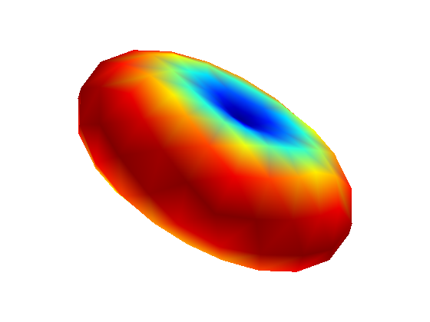
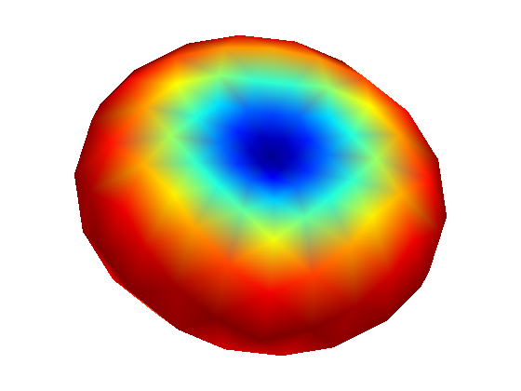


unscented transform
for signal reconstruction...

Slide 39
unscented Kalman filter
predict … measure … reconcile … repeat ...

Slide 40
diffusion tensor results
J. G. Malcolm, M. E. Shenton, and Y. Rathi. Filtered multi-tensor tractography. IEEE Trans. on Medical Imaging, 29:1664–1675, 2010.

Slide 41
synthetic validation

Slide 42


b = 1000
SNR ≈ 10, 5

Slide 43
nonlinear least squares
  Levenberg-Marquart
  two-tensor model
  initialize with ground truth (best possible)
spherical harmonics
  non-parametric
  order eight (8)
  fiber sharpening for peak detection (L=0.006)
filtered tractography
  two-fiber model
  unscented Kalman filter
[Descoteaux 07]
J. G. Malcolm, M. E. Shenton, and Y. Rathi. Neural tractography using an unscented Kalman ﬁlter. In Information Processing in Medical Imaging (IPMI), pages 126–138, 2009.
J. G. Malcolm, M. E. Shenton, and Y. Rathi. Filtered multi-tensor tractography. IEEE Trans. on Medical Imaging, 29:1664–1675, 2010.
Notes:
“projection pursuit” or “matching pursuit”

Slide 44

angular reconstruction error
13°
5°
3°
SNR ≈ 5, b = 1000

Slide 45

unequal signal field: 60/40
13°
7°
4°
SNR ≈ 5, b = 1000

Slide 46

unequal signal field: 70/30
13°
SNR ≈ 5, b = 1000

Slide 47
estimation fidelity
50/50
60/40
70/30
one fiber
(no crossing)
45 degree crossing
90 degree crossing

Slide 48
in vivo
b=900
51 directions
1.7mm isotropic voxel
17 minute scan

Slide 49
algorithm
interpolate scanner signal (measurement)
estimate model parameters with UKF
proceed in most consistent direction
terminate: FA < 0.15

Slide 50




single tensor
spherical harmonics
filtered two-tensor
filtered two-tensor
(b = 900, 1.7mm, 51 directions)

Slide 51

fitting the local fiber model
Independent optimization v. filtered estimation
Nonlinear model: Unscented Kalman filter
single-tensor
filtered two-tensor

Slide 52

single tensor
filtered two-tensor

Slide 53


DSI [Hagmann 05]
filtered two-tensor

Slide 55



single tensor
filtered two-tensor
spherical harmonics

Slide 56
corpus callosum
internal capsule

Slide 57




centrum semiovale

Slide 58



single tensor
spherical harmonics
filtered two-tensor

Slide 60
related work

Slide 61


Deterministic (Descoteaux 2007)
Probabilistic (Descoteaux 2007)
our implementation of spherical harmonics

Slide 62
spherical harmonics, probabilistic tractography
[Descoteaux 2007]
filtered two-tensor, deterministic tractography

Slide 63



DSI [Hagmann 2005]
filtered two-tensor

Slide 64



single tensor streamline
spherical harmonics
filtered two-tensor
single tensor streamline
peak detection
(our “spherical harmonics”)
tensor decomposition
[Schultz 2008]

Slide 65



filtered two-tensor
single tensor
spherical harmonics
tensor decomposition
[Schultz 2008]

Slide 66

[Kreher 08]
~1 month to compute

Slide 67
conclusion
inherent coherence along the fiber
we should exploit it in the estimation

Slide 68
from the proposal...
tensors: IPMI 2009, TMI 2010
weighted mixtures: MICCAI 2009
validation (phantom): DMFC (MICCAI) 2010
Slicer3 module: Slicer 3.6 (?)
population study: DMFC (MICCAI) 2010
local voxel model, global path model: MICCAI 2010

Slide 69


variations
Watson functions
tensors
parametric:
mixture models
non-parametric:
spherical harmonics
higher-order tensors
weighted models
Malcolm, Shenton, Rathi. Two-tensor tractography using a constrained ﬁlter. In MICCAI, p.894–902, 2009.
Rathi, Malcolm, Michailovich, Westin, Shenton,Bouix. Tensor-kernels for simultaneous ﬁber model estimation and tractography. Magnetic Resonance in Medicine, 64(1):138–148, 2010.

Slide 70


streamline
single-tensor
filtered
single-tensor

Slide 71


streamline
single-tensor
filtered
single-tensor

Slide 72
model components
one or two?
a population study
Malcolm, Kubicki, Shenton, Rathi. The effect of local ﬁber model on population studies. In Diffusion Modeling and Fiber Cup (in MICCAI), pages 33–40, 2009.
Rathi, Malcolm, Michailovich, Goldstein, Seidman, McCarley, Westin, Shenton. Biomarkers for identifying ﬁrst-episode schizophrenia patients using diffusion weighted imaging. In MICCAI, volume 6361, pages 657–665, 2010.

Slide 73


Experiment: look at FA superimposed on two-tensor fibers
Result: single-tensor FA drops outside corpus callosum while two-tensor maintains higher FA on out to gray-matter

Slide 74





Slide 75












1T 2T
FA
trace
radial diffusivity

Slide 76


J. G. Malcolm, M. E. Shenton, and Y. Rathi. Filtered tractography: State estimation in a constrained subspace. In Diffusion Modeling and Fiber Cup (in MICCAI), pages 122–133, 2009.

Slide 77
end

Slide 79
extra...

Slide 80
the watson approximation
J. G. Malcolm, O. Michailovich, S. Bouix, C.-F. Westin, M. E. Shenton, and Y. Rathi. A ﬁltered approach to neural tractography using the Watson directional function. Medical Image Analysis, 14:58–69, 2010.

Slide 81
do we need six parameters?
for tractography, care most about direction
  3 parameters
approximate diffusivity with scalar anisotropy
  fractional anisotropy
  1 parameter

Slide 82
Watson approximation
≈
=
=
principal direction m ∈ ℝ³
scaling factor k ∈ ℝ
4 parameters
[Rathi 09, Malcolm 10]

Slide 83
model parameters
for two fibers...
...two principal directions m ∈ ℝ³
...two scaling factors k ∈ ℝ
4 + 4 = 8 parameters

Slide 84
model parameters
for two fibers...
...two principal directions m ∈ ℝ³
...two scaling factors k ∈ ℝ
4 + 4 = 8 parameters

Slide 85



effect of scaling factor k
isotropic
weak
strong

Slide 86
synthetic validation

Slide 87
brute force optimization
  matching pursuit
  parametric dictionary
  noiseless signal
  discretization, noise
spherical harmonics
  non-parametric
  order eight (8)
  fiber sharpening for peak detection (L=0.006)
filtered tractography
  two-fiber model
  unscented Kalman filter
[Descoteaux 07]
Notes:
“projection pursuit” or “matching pursuit”

Slide 88

signal reconstruction error
smoothing
dictionary
predicting
SNR ≈ 5, b = 1000

Slide 89

angular reconstruction error
9°
5°
SNR ≈ 5, b = 1000

Slide 90

angular reconstruction error
15°
5°
SNR ≈ 5, b = 1000

Slide 91
in vivo
b=900
51 directions
1.7mm isotropic voxel
17 minute scan

Slide 92

single tensor
spherical harmonics
filtered two-Watson
filtered two-Watson
(b = 900, 1.7mm, 51 directions)

Slide 93
single tensor
filtered two-Watson
spherical harmonics

Slide 94



single tensor
filtered two-Watson
spherical harmonics

Slide 95



single tensor
spherical harmonics
filtered two-Watson

Slide 96
DSI [Hagmann 05]
filtered two-Watson

Slide 97
spherical harmonics, probabilistic tractography
[Descoteaux 2009]
filtered two-Watson

Slide 98
model assumptions
...in this proposal
Two fibers
single fiber: align
Fixed volume fractions
scaling factor
model selection, non-parametric, ...

Slide 99



Slide 100


Slide 101

volume fractions
SNR ≈ 10, b = 1000

Slide 102



volume fractions
50-50
60-40
10°
70-30
filter
deteriorates
15°
SNR ≈ 10, b = 1000

Slide 103




10•
20•
30•
40•
primary
branches

Slide 104
DSI (Hagmann 2005)
DSI (Hagmann 2005)
filtered two-Watson

Slide 105

ROI-based
to constrain probabilistic
[Jababdi 07]

Slide 106

[Poupon 08,Deriche 09]

Slide 107



Slide 108


Slide 109


Slide 110
false positives?

Slide 111



filtering
[Niethammer 08]

Slide 112
brute force optimization
  matching pursuit
  parametric dictionary
  noiseless signal
  discretization, noise
spherical harmonics
  non-parametric
  order eight (8)
  fiber sharpening for peak detection (L=0.006)
filtered tractography
  two-fiber model
  unscented Kalman filter
[Descoteaux 07]
J. G. Malcolm, M. E. Shenton, and Y. Rathi. Neural tractography using an unscented Kalman ﬁlter. In Information Processing in Medical Imaging (IPMI), pages 126–138, 2009.
Notes:
“projection pursuit” or “matching pursuit”

Slide 113

signal reconstruction error
smoothing
dictionary
predicting
SNR ≈ 5, b = 1000

