Slide 1
Filtering for Closed Curves
Yogesh Rathi
Advisor: Prof. Allen Tannenbaum
Georgia Institute of Technology

Slide 2
Outline
Filtering for Geometric Active Contours
Tracking
Shape Analysis:
Kernel PCA and Pre-image Problem
Locally Linear Embedding (LLE)

Slide 3
Shape in Filtering
Filtering for closed curves has many applications in Computer Vision:
Tracking objects in a movie.
Segmentation of 2-D and 3-D structures in medical images.
Representation of closed curves (shapes) is very important to perform the above tasks.

Slide 4
Shape in Filtering
Various finite dimensional parameterizations of Shape have been proposed, e.g., B-Spline representation.
In the Condensation Algorithm, an object is tracked by applying an Affine Transformation to the B-Spline control points.
Other methods which use Level Sets to implicitly represent a shape (curve) have also been used for tracking.
Notes:
Other representations are angle based, curvature based parametric representations,. Condensation = first application of particle filtering to computer vision.
Level sets allow for infinite dimensional space of curves.

Slide 5
Existing Methods
Isard & Blake – Condensation Algorithm (Active Contours -98)
D. Comaniciu, et al – “Real-time tracking of non-rigid objects using mean shift”, CVPR 2000
J. Jackson et al, – “Tracking deformable moving objects under severe occlusion”, CDC 2004
T. Zhang et al, – “Tracking objects using density matching and shape priors”, ICCV 2003
M. Niethammer et al, – “Dynamic geodesic snakes for visual tracking”, CVPR 2004
N. Paragios et al, – “A PDE based level set approach for detection and tracking of moving objects”, INRIA Tech. Report
Notes:
Many methods exist. I am only listing a few of them here

Slide 6
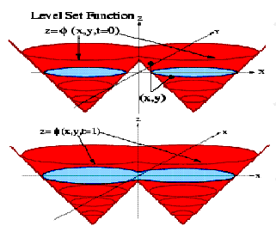
Geometric Active Contours
Active Contours are curves that deform to extract an object from an image by minimizing an image based energy functional.
Parametric Active Contours – curves are parameterized. (Terzopoulos et al, Kalman Snakes)
In Geometric Active Contours – curves are implicitly represented as the zero level set of a higher dimensional function (typically a signed distance function).
Notes:
Kalman Snakes: Kalman filter was used to predict the position and velocity and measurement done using optical flow.

Slide 7
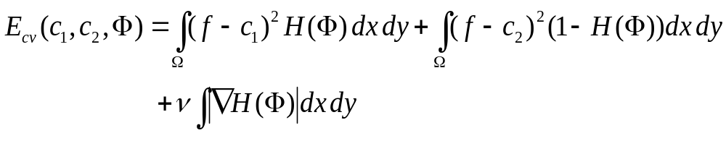
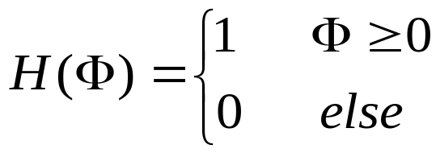
Geometric Active Contours
Minimize Chan-Vese Energy functional:
where, the Heavyside function is given by:
Notes:
Maximize the gray value homogeneity within the 2 regions , inside the contour and outside the contour

Slide 8
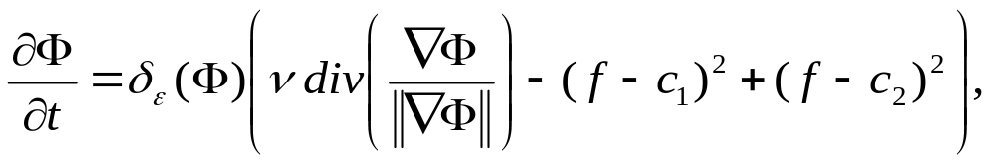
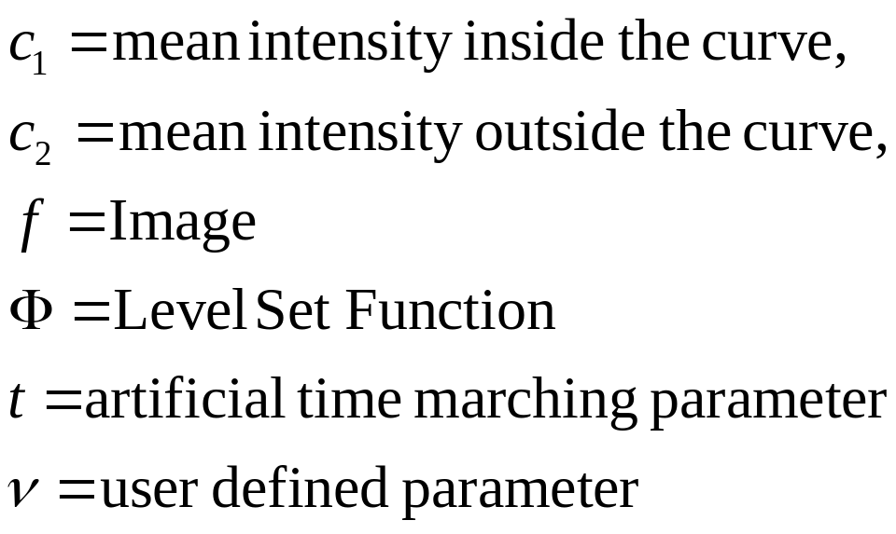
Geometric Active Contours
The corresponding Euler-Lagrange is given by:

Slide 9
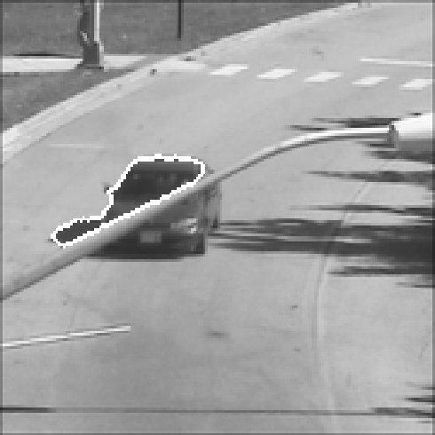
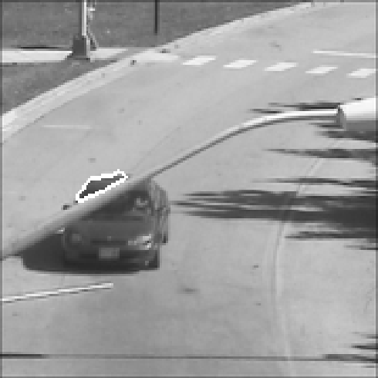
Geometric Active Contours (GAC)
Use GAC for tracking ?
Only a part of the car gets tracked due to occlusion
Notes:
Apart from problems with occlusions, we minimize the energy at each frame and do not utilize the dynamics of the moving object.

Slide 10
Geometric Active Contours
Need to incorporate the motion dynamics of the moving object in order to track using Active Contours.
Perform filtering for the geometric active contours.
Can use Kalman filter, Particle filter etc.

Slide 11
Tracking Deformable Objects
Global motion
Local deformation
A. Yezzi et al, “Deformotion”, IJCV 2003

Slide 12
Why Filtering for GAC (Geometric Active Contours) ?
Global motion
Existing Filters
Existing GAC
Local deformation

Slide 13
Filtering for GAC (Geometric Active Contours)
Filters + GAC
Global Motion
Local Deformation
Track Deformable
Objects

Slide 14
Why Particle Filter ?
Kalman filters are widely used in computer vision, especially for tracking.
Optimal filter, if the state distribution is Gaussian.
If one wants to track multiple objects, the state density is multi-modal, hence non-Gaussian.
Particle filters can be used even if the distribution is not Gaussian.

Slide 15
Particle Filter
The particle filter is a sequential Monte Carlo method which produces at each time t, a cloud of N particles, whose empirical measure closely “follows” p(X_{t} | Y_{{1:t}}), the posterior distribution of the state given past observations.
X_{t} = state vector at time t, Y_{t} = observation at time t
X_{t} = f(X_{t-1}, v_{t-1}) is the state transition function
Y_{t} = h(X_{t}, u_{t-1}) is the observation function

Slide 16
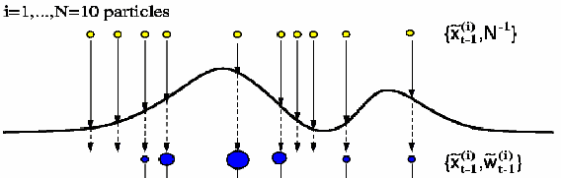
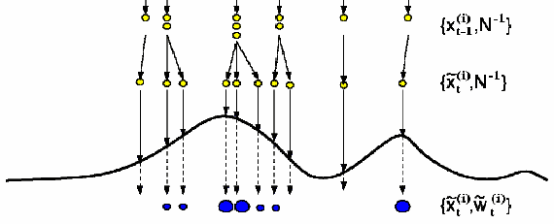
Particle Filter

Slide 17
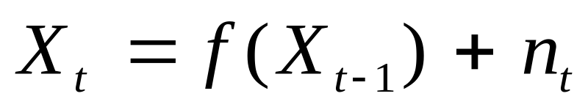
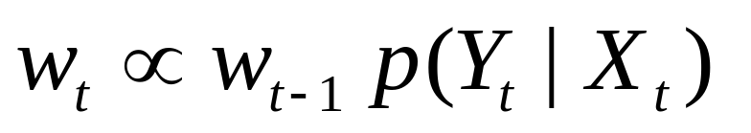
Particle Filter
For each particle, do the following:
Prediction:
Update:
Function f(.) is known a-priori and can be non-linear.
Notes:
Weights multiplied by likelihood

Slide 18
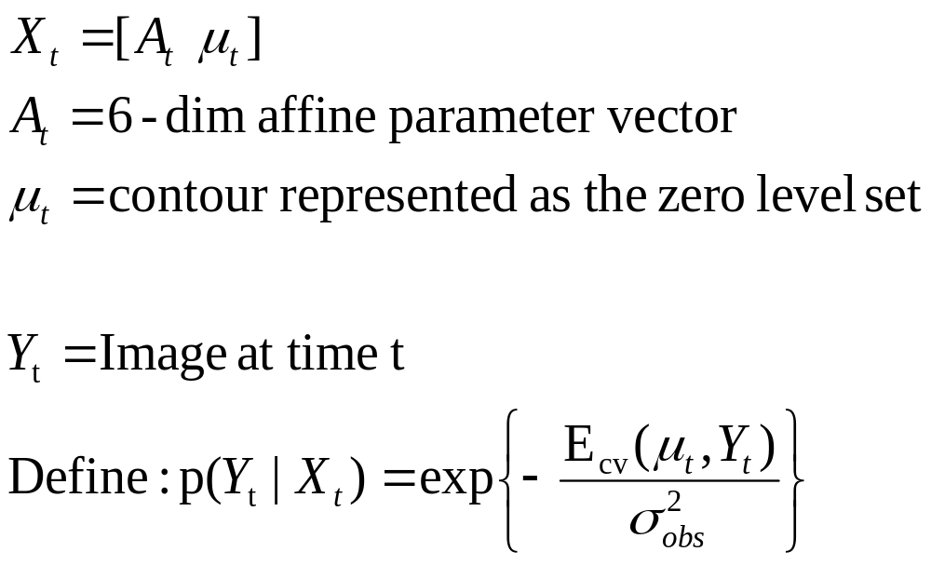

The State Space Model - Method I
Let the state be given by
Notes:
In our case particles are : shapes + affine parameters

Slide 19
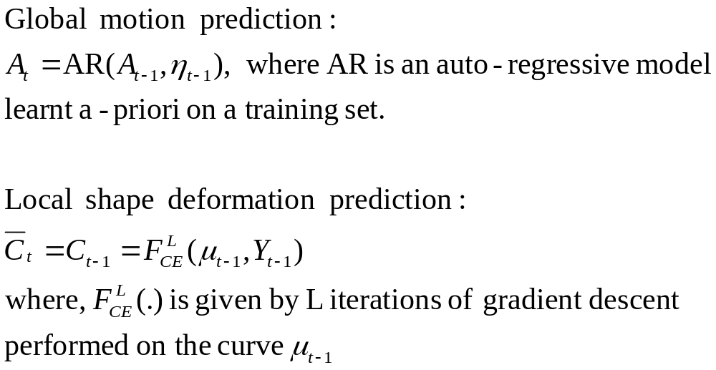
The State Space Model(2)
Prediction:

Slide 20
The State Space Model(3)
Perform only L iterations of gradient descent, i.e., do not evolve until convergence.
If all particles in the particle filter are evolved until convergence, then, the evolved contour will only depend on the current observation and will loose its dependence on the state at time t-1.
This will in turn reduce the variance of the distribution leading to sample degeneracy.
Choice of L depends on how much one trusts the system model versus the observation model.

Slide 21
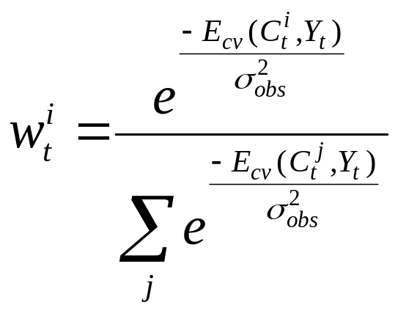
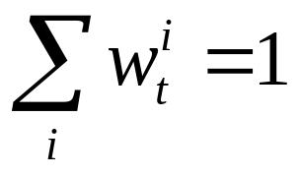
The State Space Model(4)
Update:
Use the energy itself for finding the weights and then normalize the weights as given below:
Notes:
Standard technique is to use the energy itself for finding the weights

Slide 22
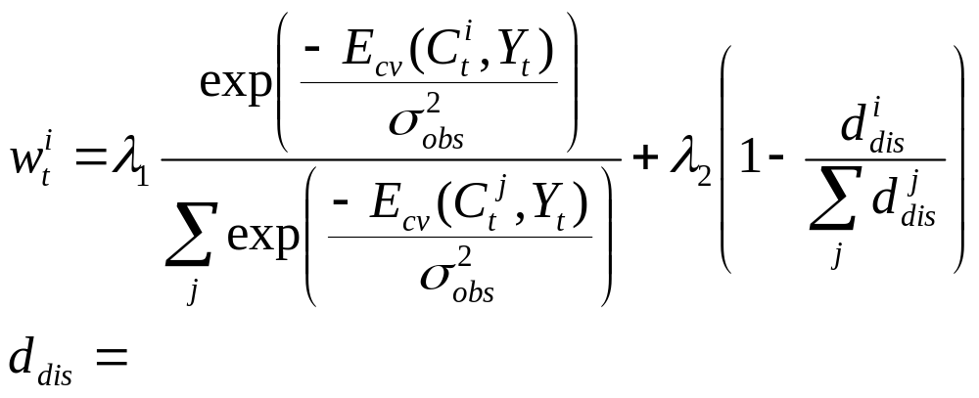
Dealing with Occlusions
Any shape dissimilarity measure
This ensures that only particles which are similar to a template shape are selected in the resampling step

Slide 23
Multiple Object Tracking
Avoiding sample impoverishment:
Find clusters within the state density
Resample within each cluster
D. Tweed et al, “Tracking many objects using subordinated condensation”, BMVC 2002
P(x)
Object 1
Object 2
x

Slide 24
The State Space Model – Method II
Method I –
Does not use the current observation (image) .
Prediction model for the shape (curve) is assumed to be identity.
Method II – Use Importance Sampling
Incorporates the current observation.
Allows to sample from a proposal distribution whose support
includes the region of high likelihood.
Doucet et al, “Sequential Monte Carlo methods in practice”, Springer, 2001

Slide 25
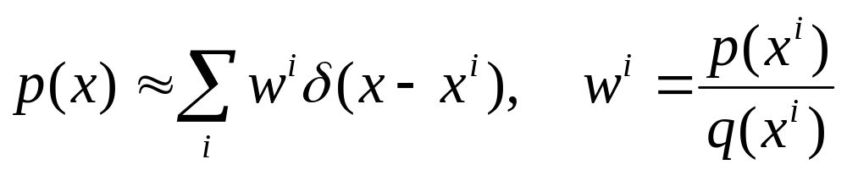
Importance Sampling
Suppose p(x) is a distribution from which it is difficult to obtain samples and q(x) is a proposal density which is easy to sample from, then

Slide 26
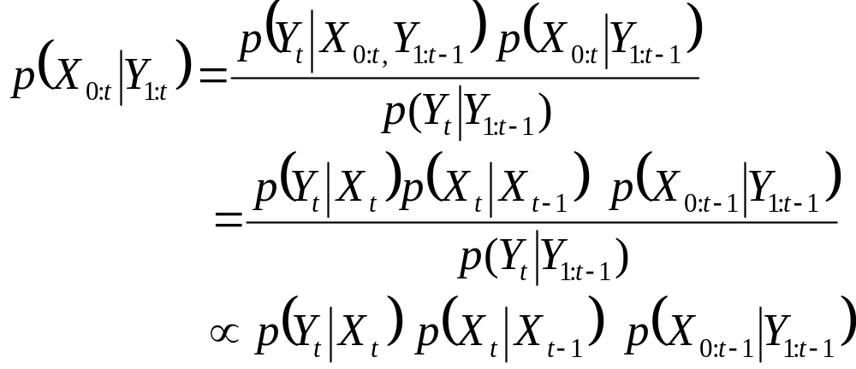
Importance Sampling
Assumptions:
State process is a first order Markov process.
Successive observations are independent.
By Bayes Rule:

Slide 27
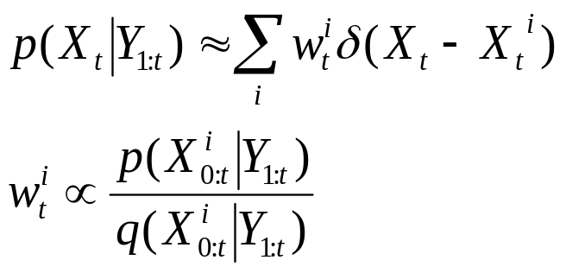
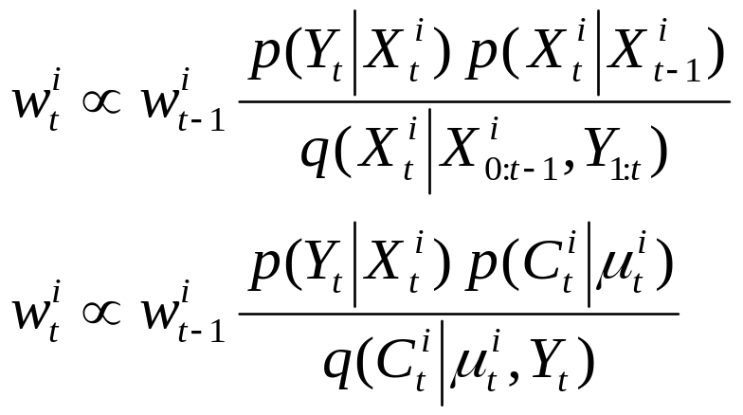
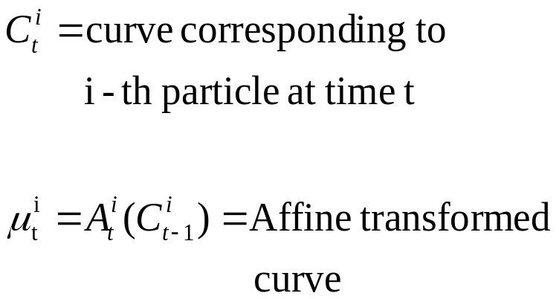
Importance Sampling (2)
In our case,
Notes:
In method I, assumed that p(Ct,\mut) = q(Ct,\mut,Yt)

Slide 28
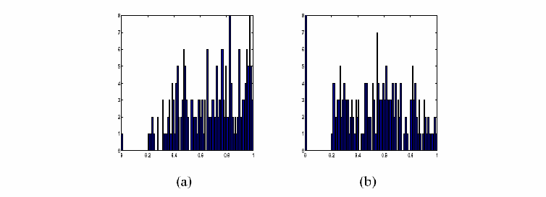
Importance Sampling (3)
Likelihood probability distribution (a) with, (b) without using importance sampling distribution q(.) for frame 2 of car sequence (200 particles).

Slide 29
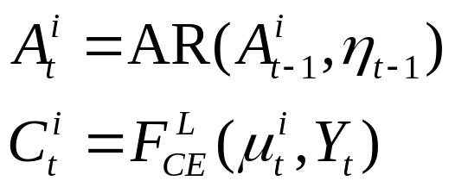
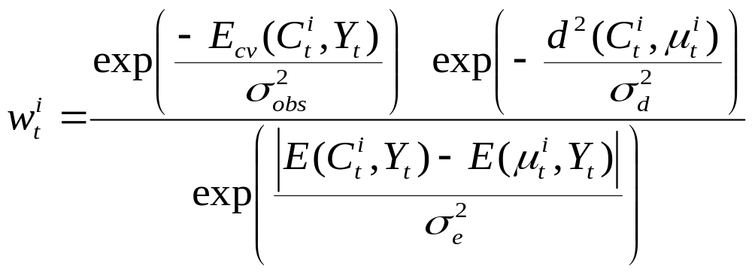
Algorithm
Importance Sampling:
Weighting:
Perform Resampling so that only good particles are carried forward

Slide 30
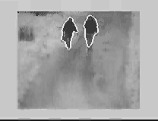
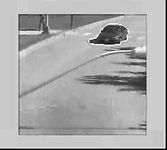
Results
Car Sequence
Walking Couple

Slide 31
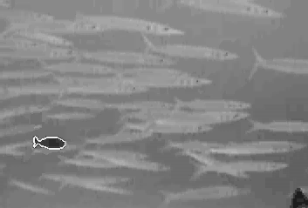
Results
Fish Sequence

Slide 32
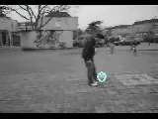
Results
Soccer Tracking by doing Importance sampling for rigid (translation) parameters only (Method II).
Notes:
No motion model was learnt

Slide 33
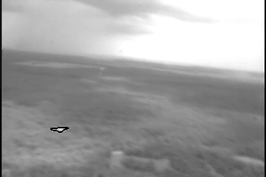

Results
Eglin Sequence
Proposed method : 30 particles
Condensation with 2000 particles

Slide 34
Shape Analysis

Slide 35
Learning Shape Variations
Linear Manifold
Linear PCA
Non-Linear Manifold
Kernel PCA

Slide 36

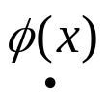

Kernel PCA
Non-linear map
Kernel or feature space
Input space
Inner product in feature space defined by the kernel k
Scholkopf B., “Nonlinear component analysis as a kernel eigenvalue problem” Neural Computation 1998

Slide 37
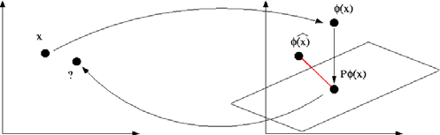
Kernel PCA: Pre-Image Problem
How to find the Pre-image of the Projection ?
Very easy in Linear PCA, but not straight forward for Kernel PCA
Notes:
Explain Kernel PCA. Transfer a point from input space to a higher dim space using a non-linear mapping \Phi and do PCA in this new space.

Slide 38
Existing Methods
Use fixed point algorithm to reconstruct the pre-image of the projection.
Problem: Solution depends on starting point !
Method by Kwok et. al., uses MDS (multi-dimensional scaling) for reconstruction and requires 2 approximations (one in the non-linear kernel space and one in the input space).

Slide 39
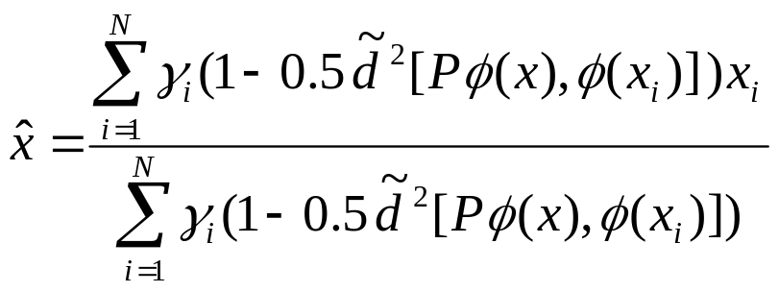
Proposed Method
A closed form solution can be obtained by minimizing the following:
The above result is for a Gaussian kernel.
Notes:
Trick is to use the relation between distance in feature space and input space for invertible kernels.

Slide 40
Proposed Method
Advantages:
Can be used with any type of distances between shapes and any invertible kernel function.
Non-iterative scheme, hence no local minima.
Uses only the distances in the feature space (kernel space) for reconstruction and does not require MDS.
Results are accurate in the least square sense.

Slide 41
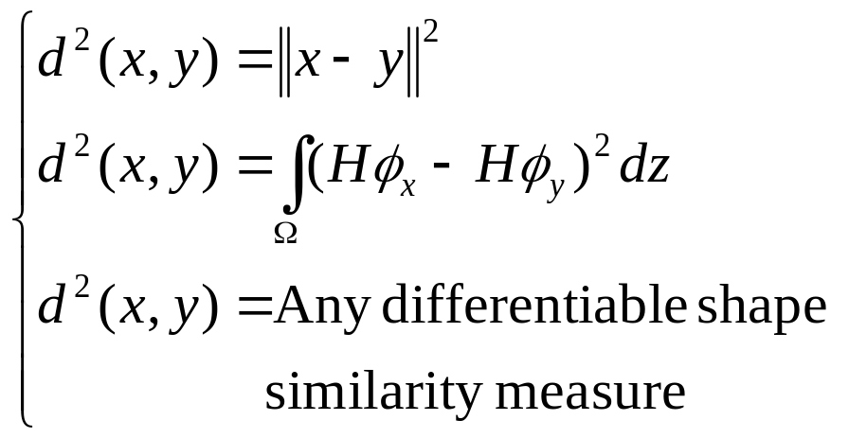
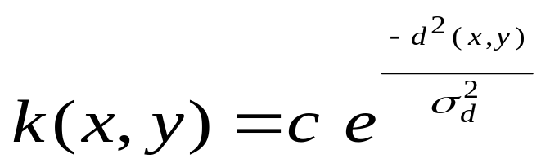
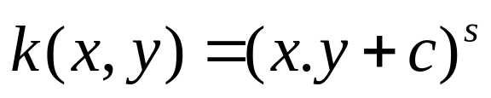
Kernels and Distances

Slide 42
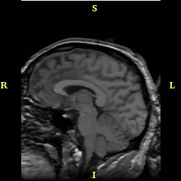


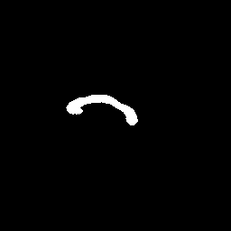

Applications - Segmentation
Training Set
Corpus Callosum

Slide 43


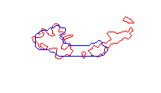

Properties: Robust to Occlusion
Leventon et al, “Statistical shape influence in geodesic active contours” CVPR 2000

Slide 44
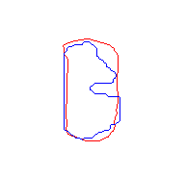
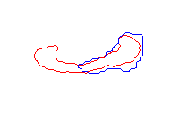
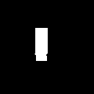

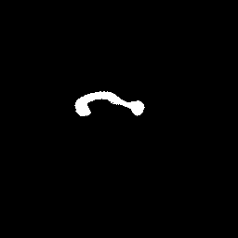

Properties: Multiple Object Learning
Original shape
Reconstruction
Multiple object shapes were learnt (rectangles and corpus callosii ).

Slide 45




Shape Statistics
+2σ variation
-2σ variation
First Mode
Second mode
Modes of variation in the kernel space
Notes:
Because of a unique reconstructed image, one can see the modes of variation of shape in the feature/kernel space, not possible before

Slide 46
Kernel PCA for segmentation
Assume the z-axis of a 3D volume to be the time axis and apply the previously described method (Particle Filter + GAC) for doing segmentation, slice by slice.
Use Kernel PCA to learn 3D shapes as a bunch of slices.

Slide 47
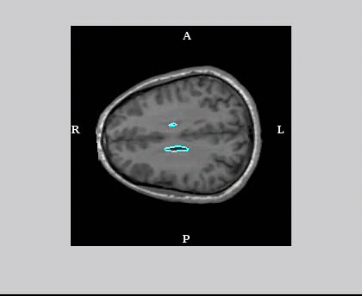
Segmentation
Without shape prior
With shape prior using kernel PCA

Slide 48
Locally Linear Embedding (LLE)
Alternative method to represent a shape if the training set contains samples from a non-linear manifold.
LLE attempts to discover non-linear structure in high dimensional data by exploiting the local symmetries of linear combinations.
w₂
w₁
w₃
w_{n}

Slide 49
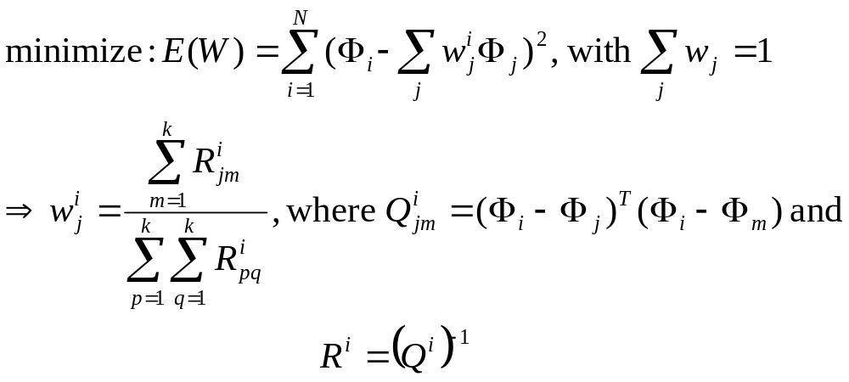
Locally Linear Embedding (LLE)
Ridder D., et al “Locally linear embedding for classification” – PAMI 2002

Slide 50




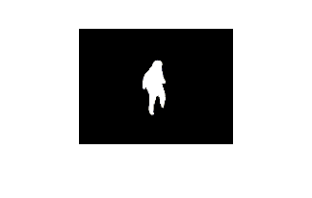
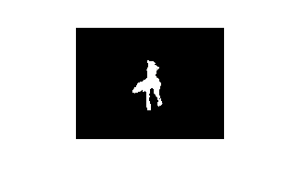
LLE Vs Linear PCA
Some shapes in training set (embedded in signed distance function)
Original shape
Reconstruction using LPCA

Slide 51
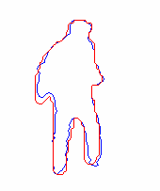
LLE Vs Linear PCA
Red curve – Reconstruction using 2 of the nearest neighbors

Slide 52
LLE – Future Work
Could be used to provide dynamic shape prior information in the particle filtering framework for tracking deformable objects and in segmentation of 2-D or 3-D structures in medical images.
Work in progress to obtain a formulation of LLE in the kernel space (feature space) i.e., kernel LLE. One advantage of doing this would be low cost of computation compared to kernel PCA.

Slide 53
Future Work
Dynamic Shape Prior
Existing Algorithm
Robust to Occlusions
LLE
Predict Region Statistics
Existing Algorithm
Robust to Leaks
At a later stage the above approaches will be combined.

Slide 54
Future Work
Kernel PCA and Kernel LLE can be used to provide shape prior to segment objects in 2D and 3D images. This can be done in a variational framework by using the reconstructed contour from the feature space.
Tracking/Segmentation can also be done by evolving the kernel PCA coefficients itself in the kernel (feature) space.
Compare LPCA, Kernel PCA, Kernel LLE and other wavelet based methods for shape analysis.

Slide 55
Time line for Future Work
Currently working with Prof. Eric Johnson on tracking real sequences – plan to finish it by Nov. 2005
Implement the generic framework for tracking – Mar 2006
Use Kernel PCA/LLE to segment 3D structures (caudate nucleus) – May 2006
PhD Defense by Sept. 2006

Slide 56
Publications
Rathi Y., Vaswani N., Tannenbaum A., Yezzi A.,: “Particle filtering for geometric active contours with application to tracking moving and deforming objects” – CVPR 2005
Rathi Y., Vaswani N., Tannenbaum A., Yezzi A.,: “Tracking deforming objects using particle filtering for geometric active contours” – submitted PAMI 2005
Rathi Y., Dambreville S., Tannenbaum A.,: “Statistical shape analysis using kernel PCA” – accepted SPIE 2006
Rathi Y., Tannenbaum A.,: “Particle filtering with dynamic shape prior” – submitted ECCV 2006
Dambreville S., Rathi Y., Tannenbaum A.,: “Shape based segmentation using kernel PCA” – accepted SPIE 2006
Vaswani N., Yezzi A., Rathi Y., Tannenbaum A.,: “Particle filters for deforming object tracking using time-varying finite dimensional contour deformation models” – submitted ECCV 2006
Dambreville S., Rathi Y., Tannenbaum A.,: “Tracking deformable objects with unscented Kalman filtering and geometric active contours” – submitted ACC 2006

Slide 57
Thank you
Thanks to Namrata Vaswani and Samuel Dambreville.
Thanks to all my other colleagues in the lab for a lot of fruitful discussions on various topics.

Slide 58
Thank you
Questions ?

Slide 59
Contributions
The Proposed algorithm:
Shows how to perform filtering for closed curves (in infinite dimensional space of curves).
Can be applied to track highly deformable objects (one or more).
Combines the advantages of filtering and Geometric Active Contours.

Slide 60
Why Unscented Kalman Filter (UKF)?
Particle filters require a huge number of particles for successful tracking.
UKF allows a non-linear state model but with very few “sigma points” which are deterministically chosen.

Slide 61
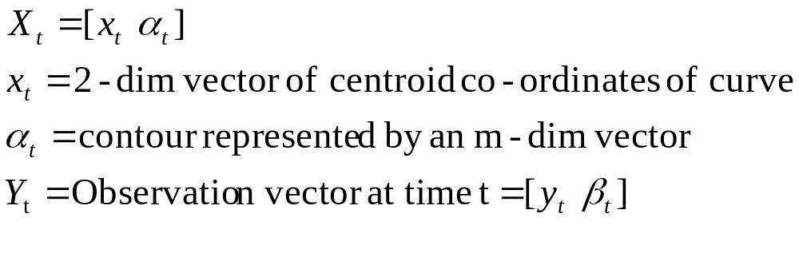
Tracking with UKF
~ Joint work with Samuel Dambreville

Slide 62

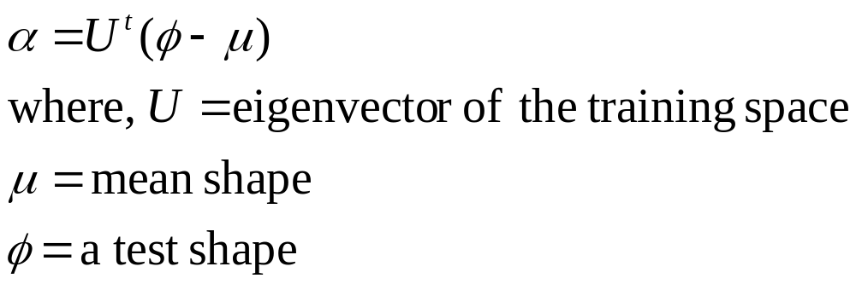
Tracking with UKF (2)
Obtain as follows:
Align a set of training shapes.
Find the principal components by doing PCA.
Then,
Leventon et al, “Statistical shape influence in geodesic active contours” CVPR 2000

Slide 63
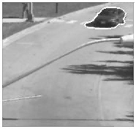

Tracking with UKF (3)
Use the UKF to do tracking.

Slide 64
Shape Statistics
+2σ variation
-2σ variation
Second mode of variation in the kernel space

Slide 65


Introduction
Filtering is required in many applications, most notably for tracking objects.

Slide 66
Conclusion
Demonstrates how to incorporate infinite-dimensional curve space into the Particle/Unscented Kalman Filtering framework.
Can track highly deformable objects.
Can deal with occlusions.
Track multiple objects.

Slide 67
Future Work
Current formulation of the particle filtering algorithm puts no restrictions on the shape of the object being tracked, hence there can be problems if there is a major occlusion.
Future work involves incorporating dynamic shape prior into the tracking algorithm.
We also plan to include image statistics in the prediction model of the particle filter and drive the contour using a combination of the image and the model statistics, i.e., one can predict the mean intensity and variance of the object and curve evolution equation formulated which moves the curve based on these statistics and the image information.

Slide 68
Limitations & Future Work
Computationally very expensive, since one has to perform curve evolution for each of the particles
Need to use a shape template in order to deal with occlusions
Modified the algorithm so that the latest observation can be used in the update step (submitted :Tran. Automatic Control)
Looking at other filters that can be used instead of the particle filter

Slide 69

Geometric Active Contours
Figure taken from: Level Set Methods by J. A. Sethian

Slide 70
Particle Filter
Most of the existing methods assume the state vector to be finite-dimensional.
Challenge:
How to incorporate an infinite-dimensional space of curves into the particle filtering framework ?

Slide 71


Properties: Robust to Occlusion
Kernel PCA
Linear PCA

Slide 72

Shape in Filtering
Problem:
Incorporates only edge information.
Such methods can only track rigid motions of an object !
Notes:
Example shows tracking using Condensation : Tell that learning was performed using AR model for 90 frames.

Slide 73
Particle Filter
For each particle, do the following:
Prediction:
Update:
Function f(.) is known a-priori and can be non-linear.
# of particles
w_{t}
Notes:
Weights multiplied by likelihood

Slide 74

Particle Filter
Merwe et al, “The unscented particle filter” Technical Report 2000

