Slide 1
NBA Player Prediction Tool
By Jack Motta

Slide 2
Introduction
Predict Pts, Ast, Reb, 3PM, Stl, and Blk
Help sports bettors and fantasy owners
Prediction over interpretability
Shiny App
Reactable of daily generated predictions
Column selector
Implied probability calculator
Model metrics tab w/ user-friendly explanations

Slide 3
Data Sources
HoopR package
Player gamelogs, game spreads, and upcoming schedule
2022-2025 season data
Filtered where DNP is False
Odds API
Scraped upcoming player props to help filter out irrelevant players from predictions
StatSurge
NBA Injury Database
Used to flag when starter teammates are injured

Slide 4
Feature Engineering
Lags of target and target-adjacent variables
Player Seasonal Expanding Averages
Player EWM Average, Momentum, Z-score, Rank, and Trend Slopes
Smoothed trends over spans of 5, 9, and 19
Hot/Cold Streaks
Opponent Context Features
EWM of Stats Allowed by Opponents
Rolling averages of how much opponents allow (e.g., rebounds allowed)
Used to create player-opponent interaction terms
Missing Flag Indicator
Starter Teammate Injured Indicator
Days Since Last Game and Back-to-Back Game Indicator
Playoff/Play-In Game Indicator

Slide 5
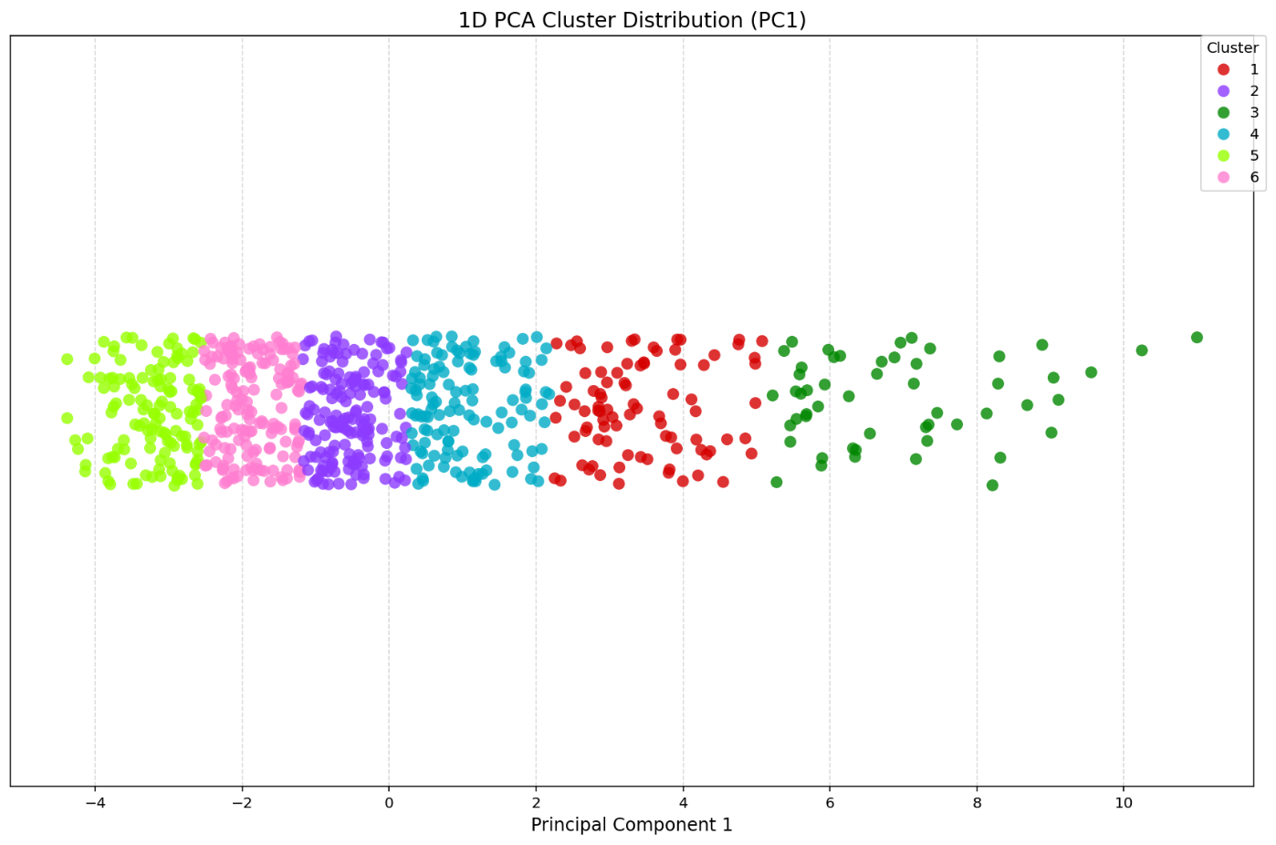
Clustering
Feature | Loading
points_ewm_mean_span9 | 0.342
field_goals_attempted_ewm_mean_span9 | 0.340
field_goals_made_ewm_mean_span9 | 0.339
minutes_ewm_mean_span9 | 0.327
free_throws_made_ewm_mean_span9 | 0.307
free_throws_attempted_ewm_mean_span9 | 0.303
assists_ewm_mean_span9 | 0.280
3PA_ewm_mean_span9 | 0.263
3PM_ewm_mean_span9 | 0.258
steals_ewm_mean_span9 | 0.257
rebounds_ewm_mean_span9 | 0.240
blocks_ewm_mean_span9 | 0.147
K-Means Clustering on PC1 of aggregated target/target-adjacent predictors by player
Retained ~80% variance
Trained on pre-2025 season data
Median Imputation on missing data
K=6 led to best RMSE

Slide 6
Preprocessing
Temporal Train/Test Split
Train: < 2025
Test: 2025
Numerical Features:
Median Imputation
Normalization
Categorical Features:
Imputed “missing” placeholder for NAs
One-hot encoded nominal predictors
Post-Transformation:
Removed near-zero variance predictors (threshold=0.05)
Training Data: 83680 rows, 251 columns
Test Data: 27682 rows, 251 columns

Slide 7
Modeling Framework
Base Learners
251 predictors
Ridge Regression
Pts, Reb, Ast, Stl, Blk, 3PM, 3PA, Min, FGA, FGM, FTA, and FTM
Logistic Regression (General Performance)
Binned above targets into binary outcomes
Isotonic Calibration
Logistic Regression (Explosive Performance)
Binary classification
Isotonic Calibration
Meta-Model
299 predictors
XGBoost
Tuned using randomized search with 3-fold cross-validation.
Optimized: depth, learning rate, regularization, and both feature and row subsampling
Tweedie objective to model skewed, non-negative continuous data
Stacks base learners’ predictions with original features

Slide 8
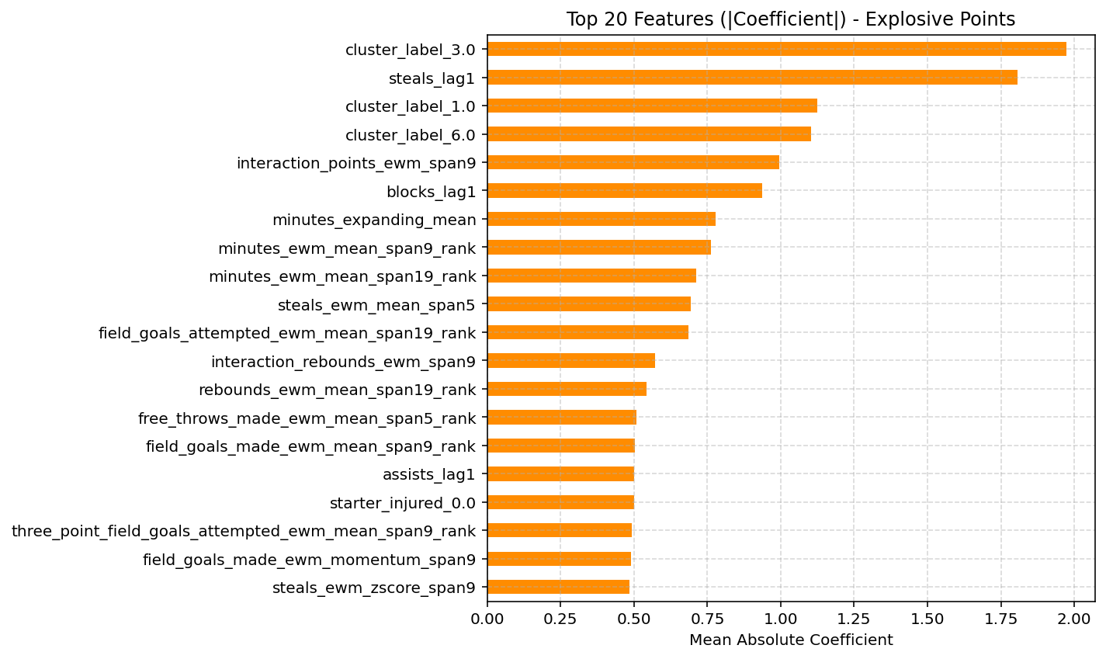
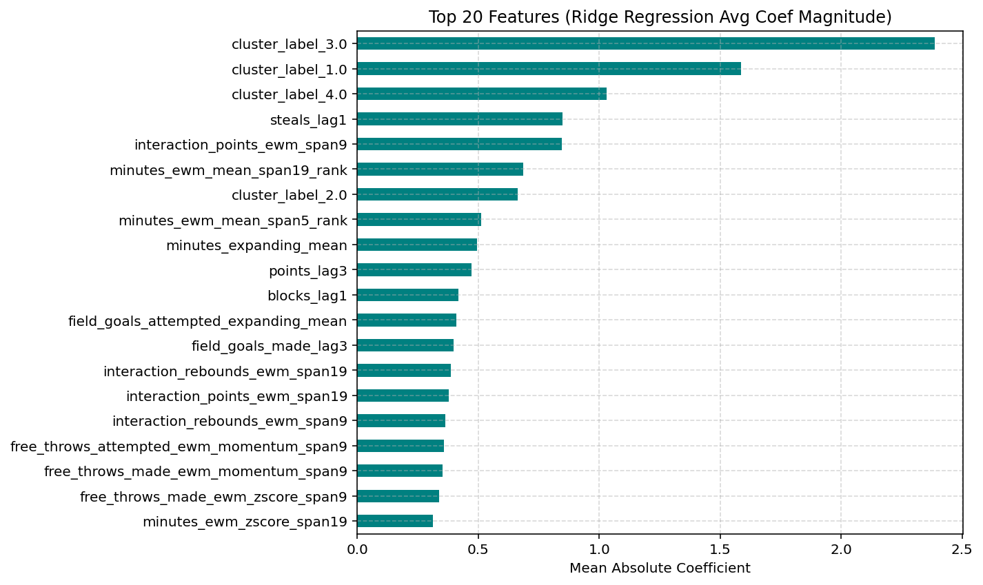
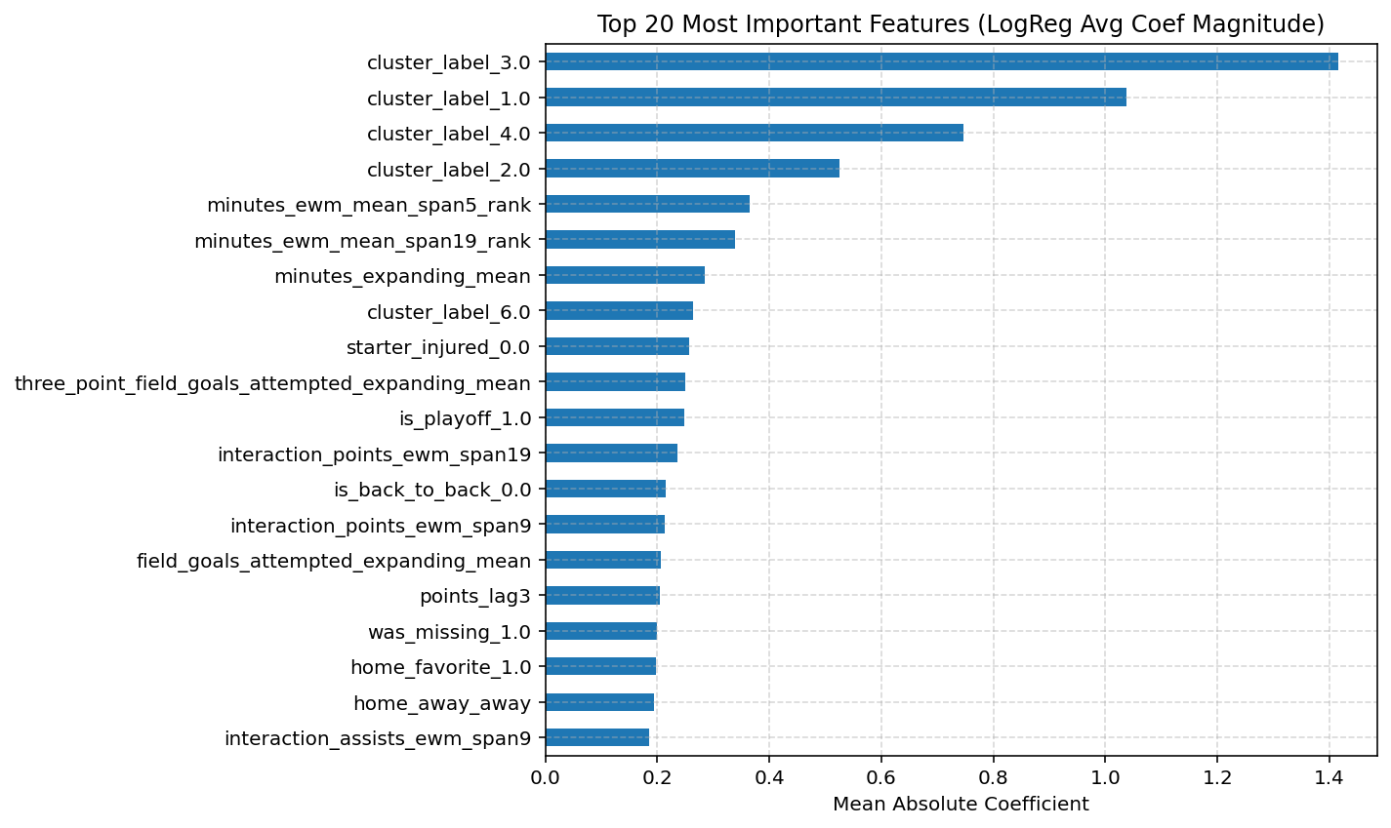
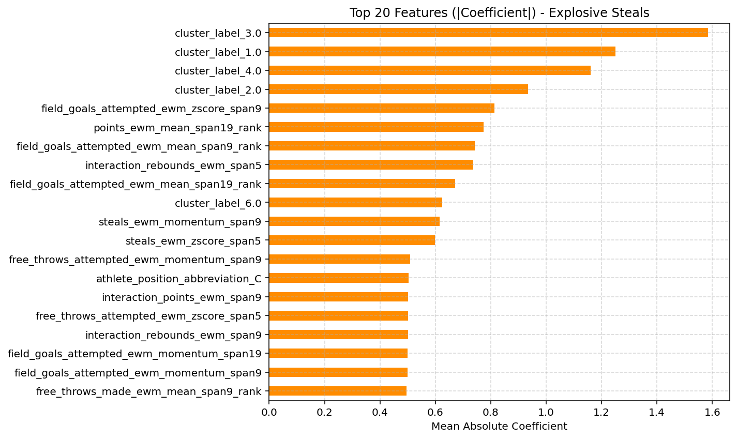
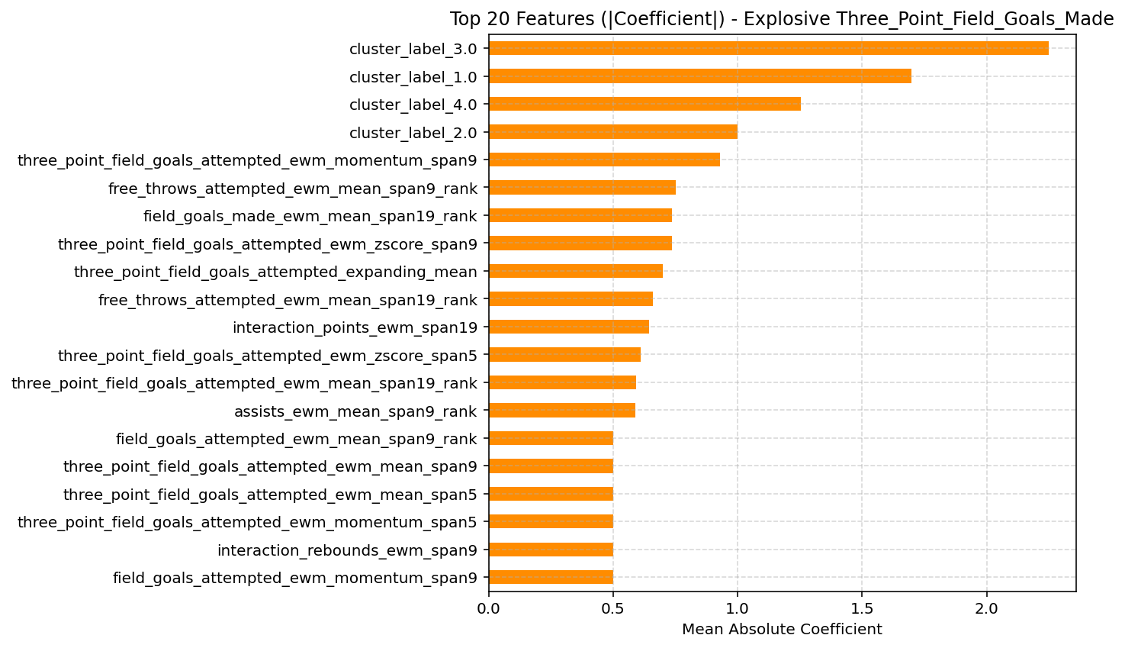
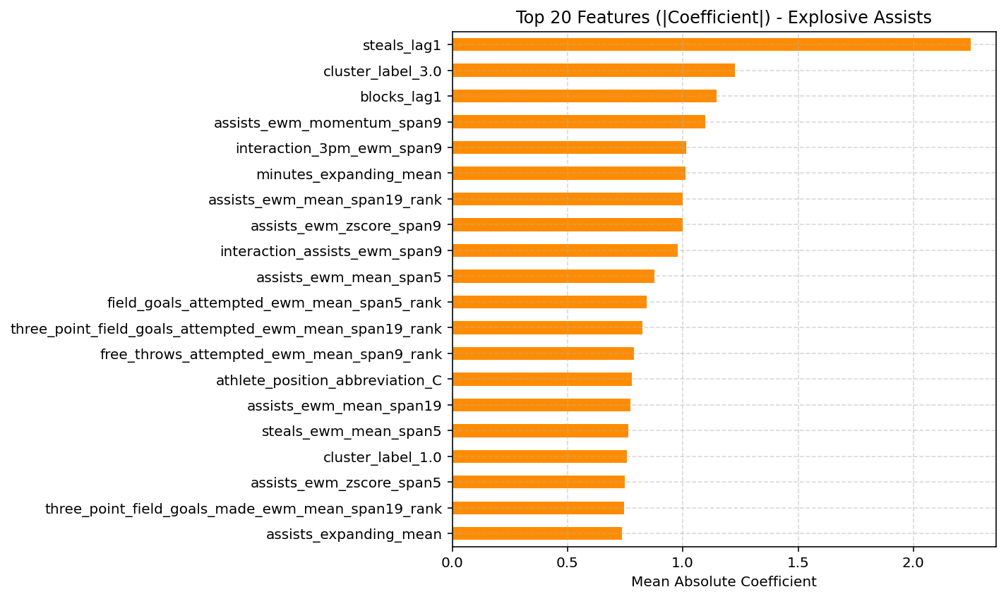
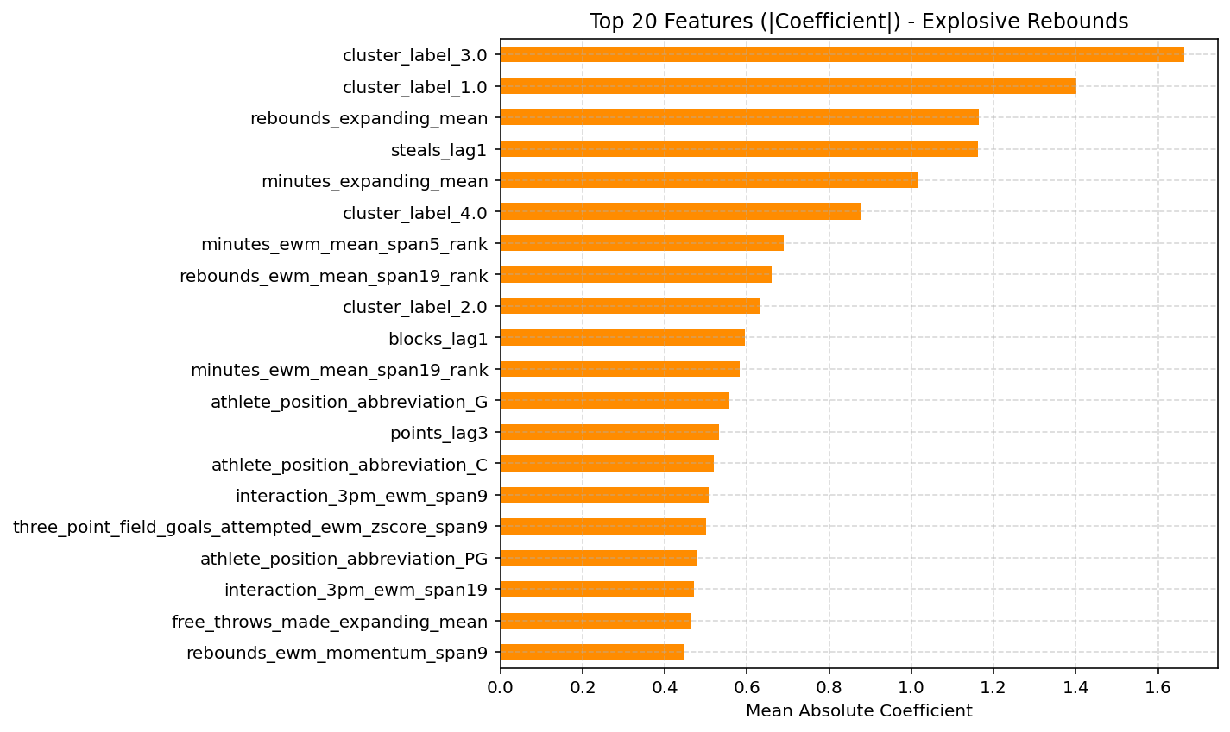
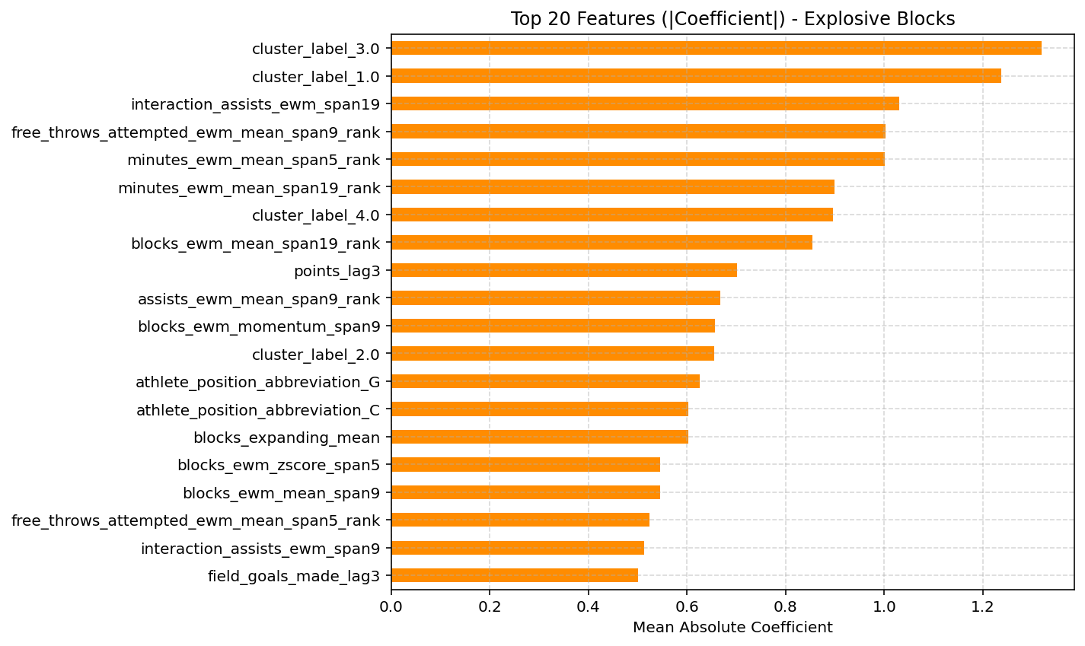
Base Learners Feature Importance
Cluster labels contributed significantly
Interactions prove to be useful
Position is likely correlated to certain targets
EWM features and lags contribute significantly across all targets
Playoffs aren’t a top 20 feature
Injured starting teammate only contributes a lot towards points

Slide 9
Meta-Model Performance
Struggles with 90th percentile more than 10th percentile
Struggles with low variance targets (steals, blocks)
Feature engineering improved R² by 0.06-0.2
MAE prioritized due to explosive outliers
Target | RMSE | MAE | R² | Pinball Loss (α=0.1) | Pinball Loss (α=0.9)
3PM | 1.25 | 0.88 | 0.33 | 0.42 | 0.46
Rebounds | 2.53 | 1.90 | 0.47 | 0.91 | 0.99
Assists | 1.82 | 1.32 | 0.52 | 0.64 | 0.69
Steals | 0.93 | 0.70 | 0.11 | 0.32 | 0.38
Blocks | 0.74 | 0.51 | 0.19 | 0.24 | 0.27
Points | 6.00 | 4.56 | 0.54 | 2.16 | 2.40

Slide 10
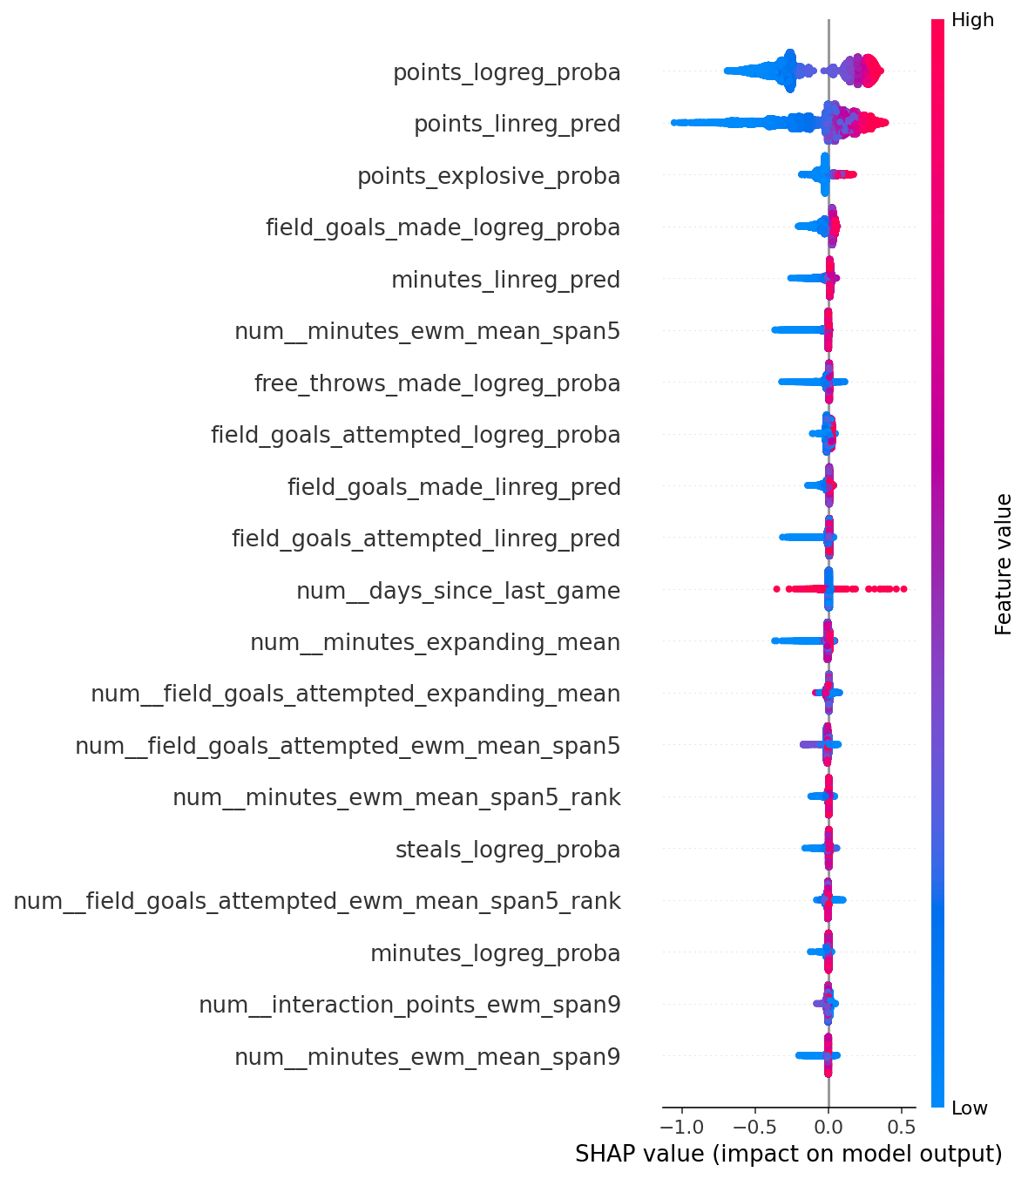
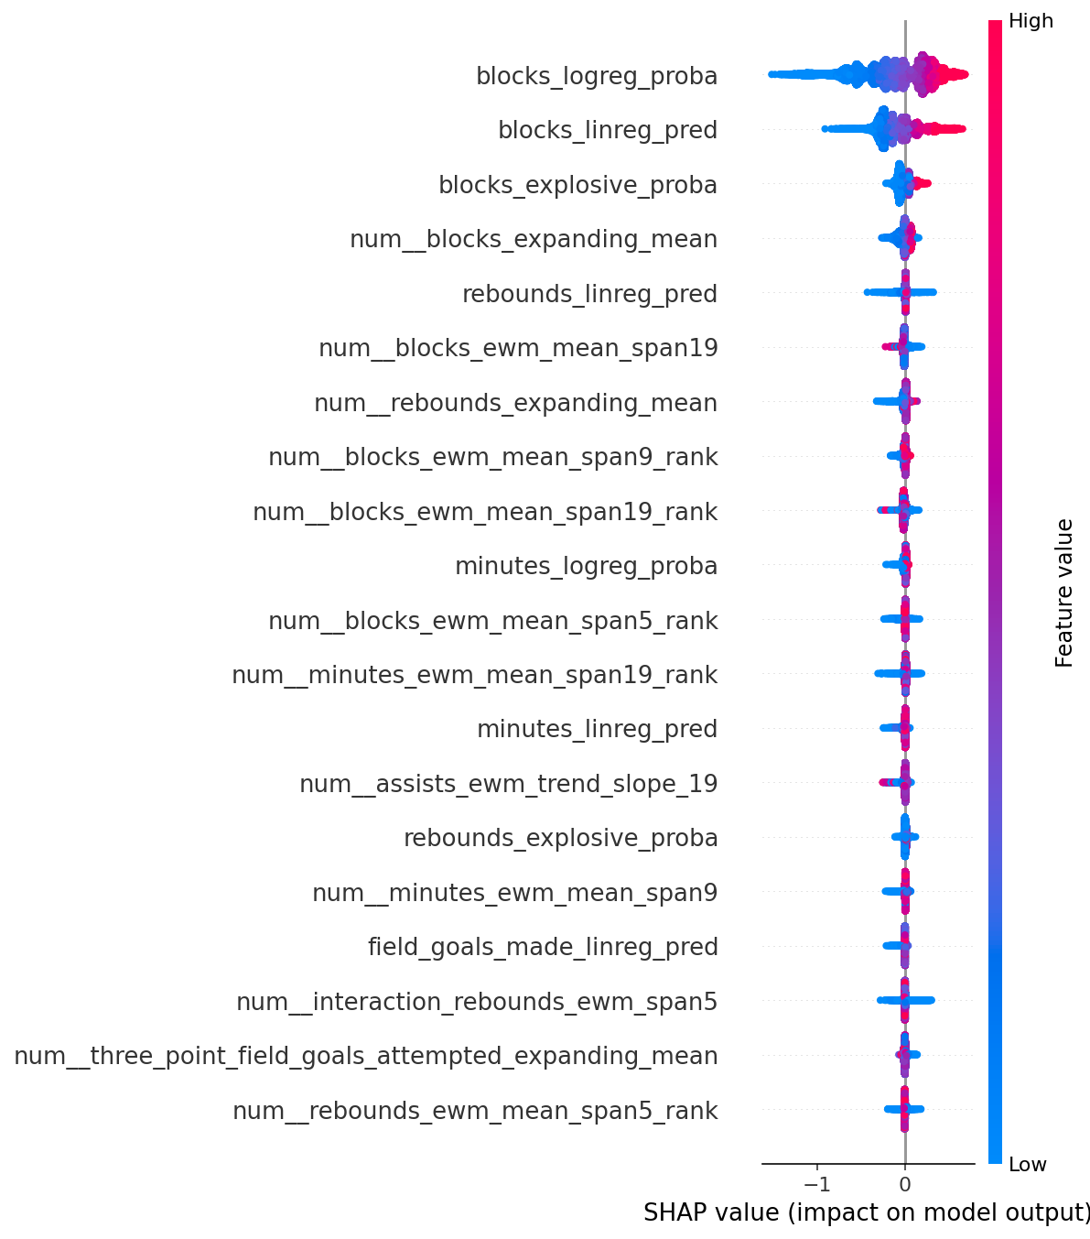
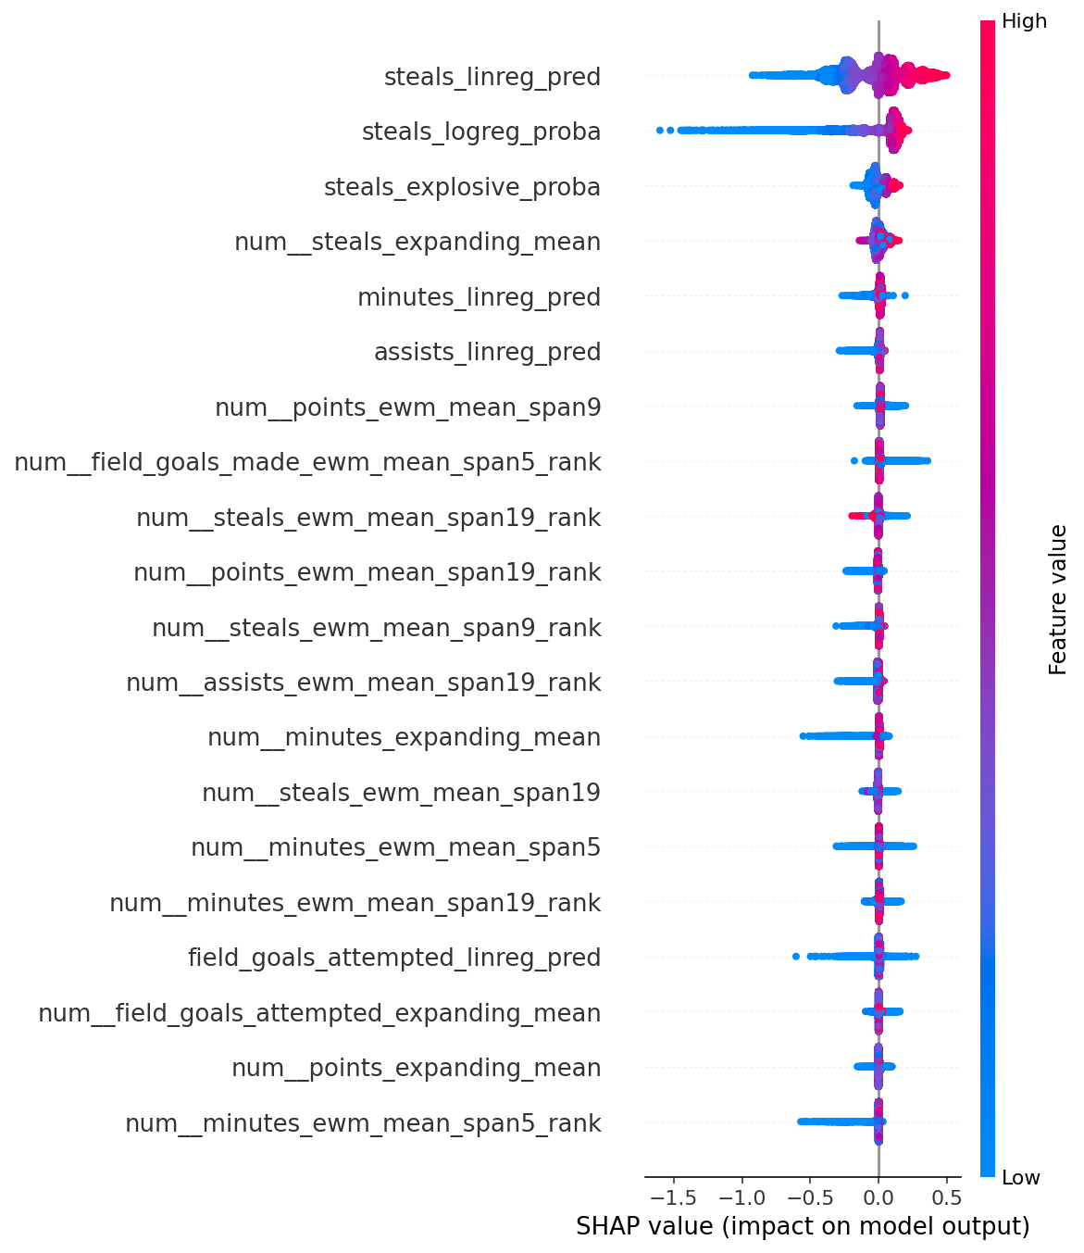
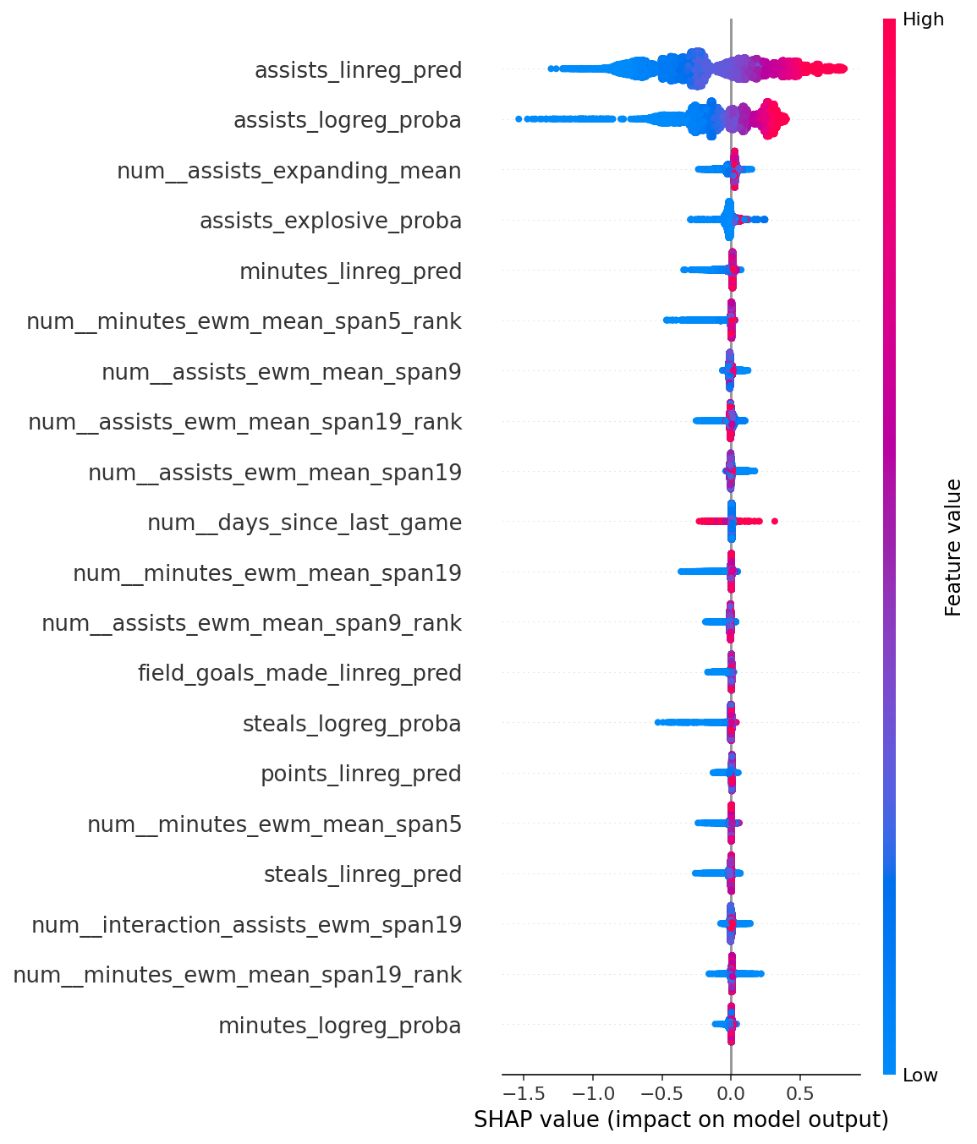
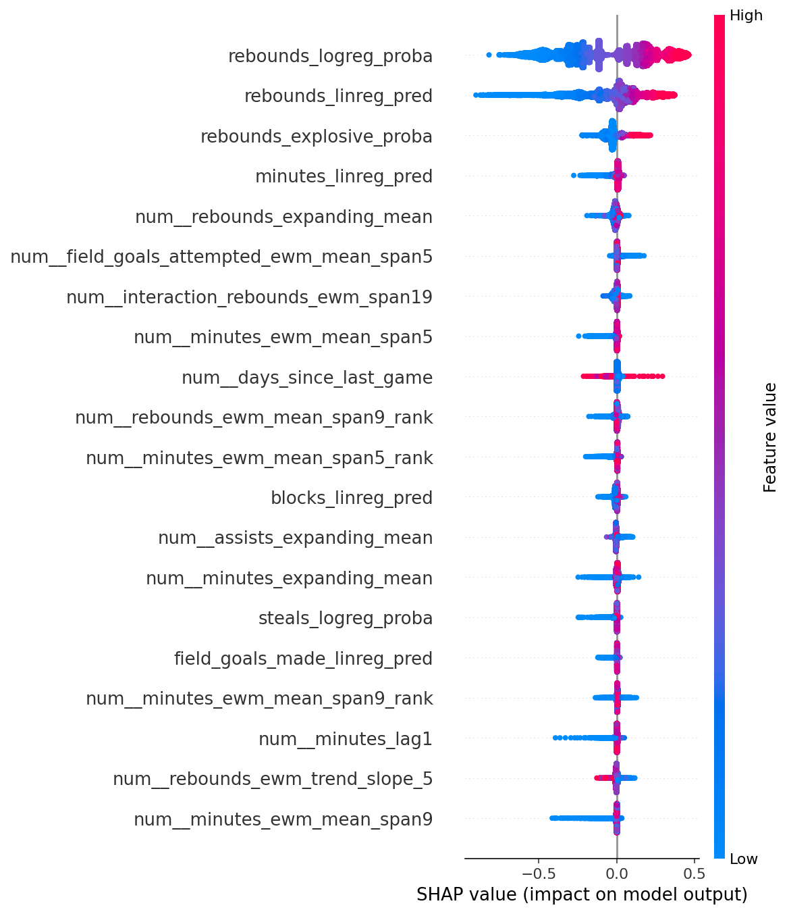
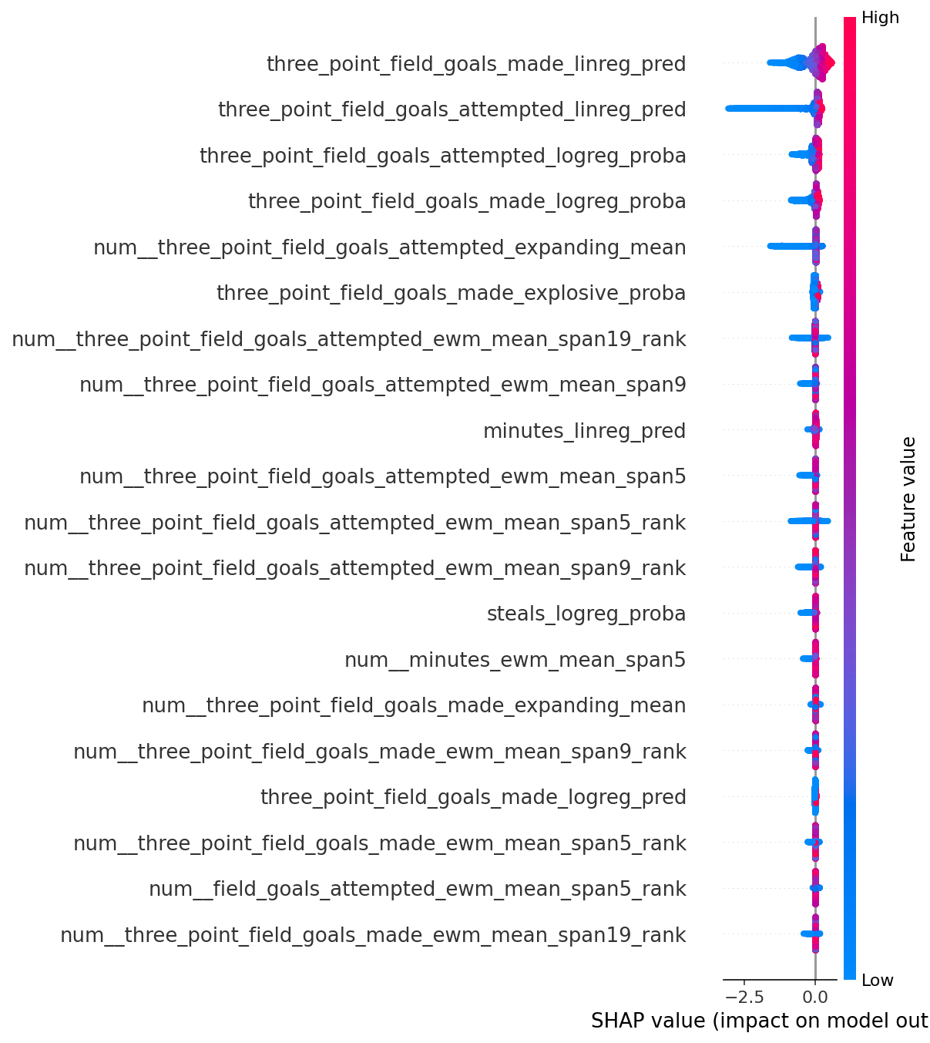
SHAP Analysis
Points
Classification dominates predictions
Regression still adds value
Minutes and FGA drive results
Explosive label moderately helpful
Blocks
Classification probability leads
Past blocks highly influential
Rank-based trends relevant
Minutes and rebounds contribute
Assists
Regression, classification drive output
EWM + expanding means matter
Time-based trends add value
Game context has impact
Three-Pointers Made
Prior model outputs dominate
Shot volume metrics matter
Momentum and trends informative
Explosive tag adds signal
Rebounds
Predictions from models key
Historical averages contribute strongly
Interaction terms influence predictions
Minutes and spacing relevant
Steals
Model outputs lead prediction
Explosive tag moderately useful
Momentum-based stats matter
Minutes + assists have signal

Slide 11
Shiny App
https://jmotta31.shinyapps.io/NBA_Prediction_Tool/

Slide 12
Next Steps and Notes
Handling Outliers
Further Feature Engineering
Dimensionality Reduction
Improve explosive game predictions
Adjust filtering
Keeping low minute games improved metrics likely due to easily predicting 0s for players with negligible minutes
Quantile modeling hindered predictions
Calibration improved predicted probabilities
Bias corrections hindered predictions

Slide 13
Thanks For Listening!

