Slide 1
Final Project Attack

Slide 2
Motivation
Comparing all papers covering in this class, Dr. Botacin’s method proved to yield the highest evasion rates.
We decided to take the existing example on Github and augment it with improvements.

Slide 3
Baseline Attack
Combined Dr. Botacin’s filesystem.exe and inmemory.dll droppers into a single dropper that:
Compiled into an executable
Contained a single resource
XOR decrypted the resource
Base64 decoded the resource
Wrote the resource to file
Launched the resource
Dynamically loaded 90% of APIs
Encoded strings as int arrays
Mimicked the NTDLL.dll

Slide 4
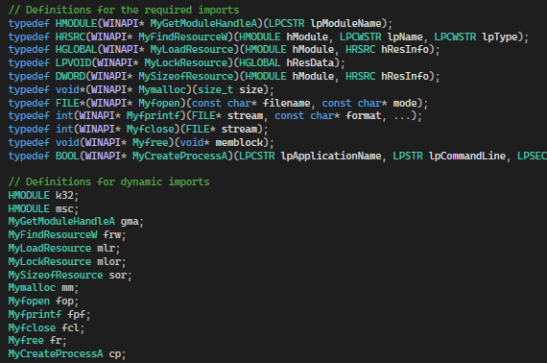
Baseline Attack Visualization

Slide 5
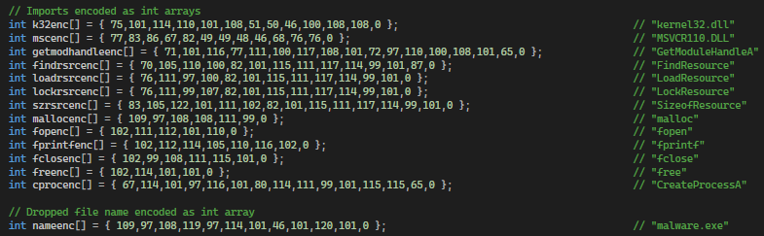
Baseline Attack Visualization

Slide 6
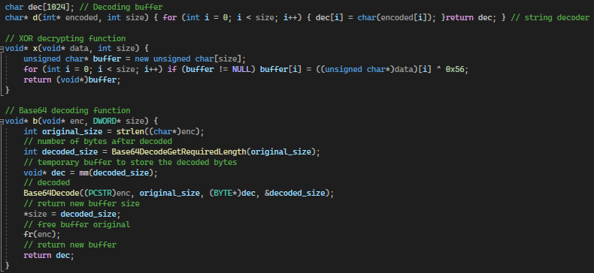
Baseline Attack Visualization

Slide 7
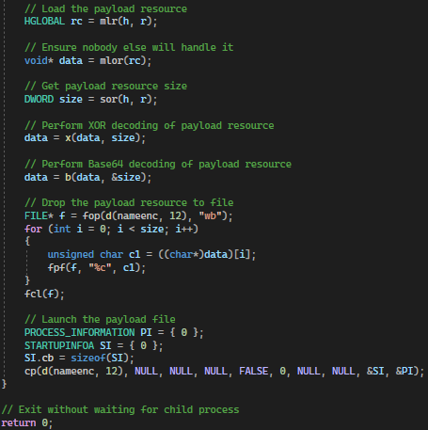
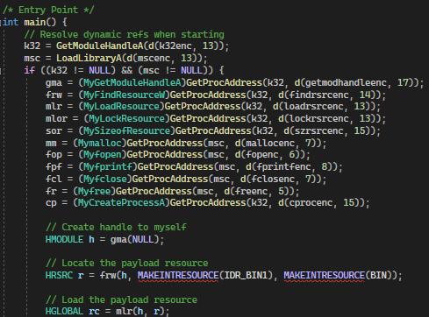
Baseline Attack Visualization

Slide 8
Attack v1 Summary
A list of improvements added:
Removed all but 3 static APIs from original attack
GetModuleHandleA
GetProcAddress
LoadLibraryA
Replaced original handle reference to Kernel32.dll
Further encrypted the int arrays by applying ROT1
Implemented manual Base64 decoding

Slide 9
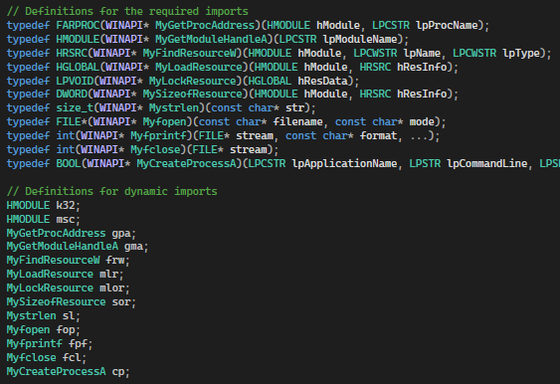
Attack v1 Visualization

Slide 10
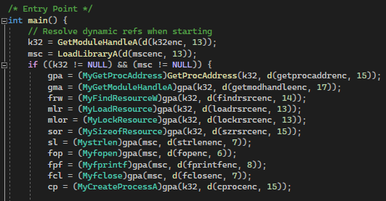
Attack v1 Visualization

Slide 11
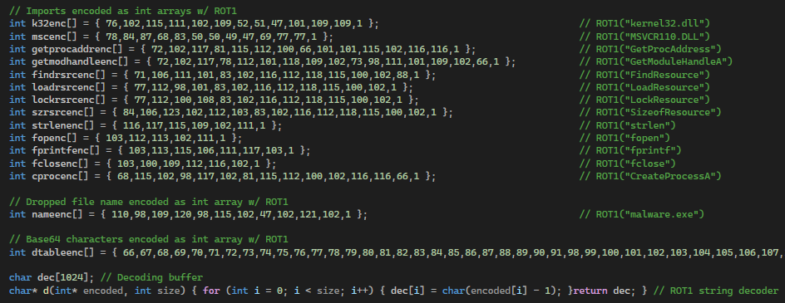
Attack v1 Visualization

Slide 12
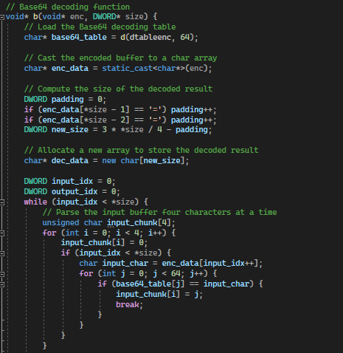
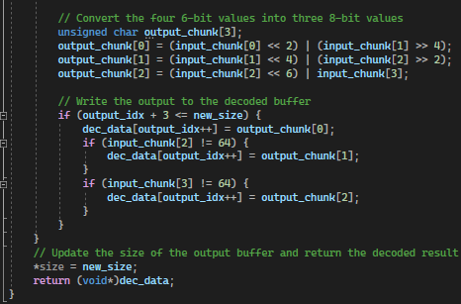
Attack v1 Visualization

Slide 13
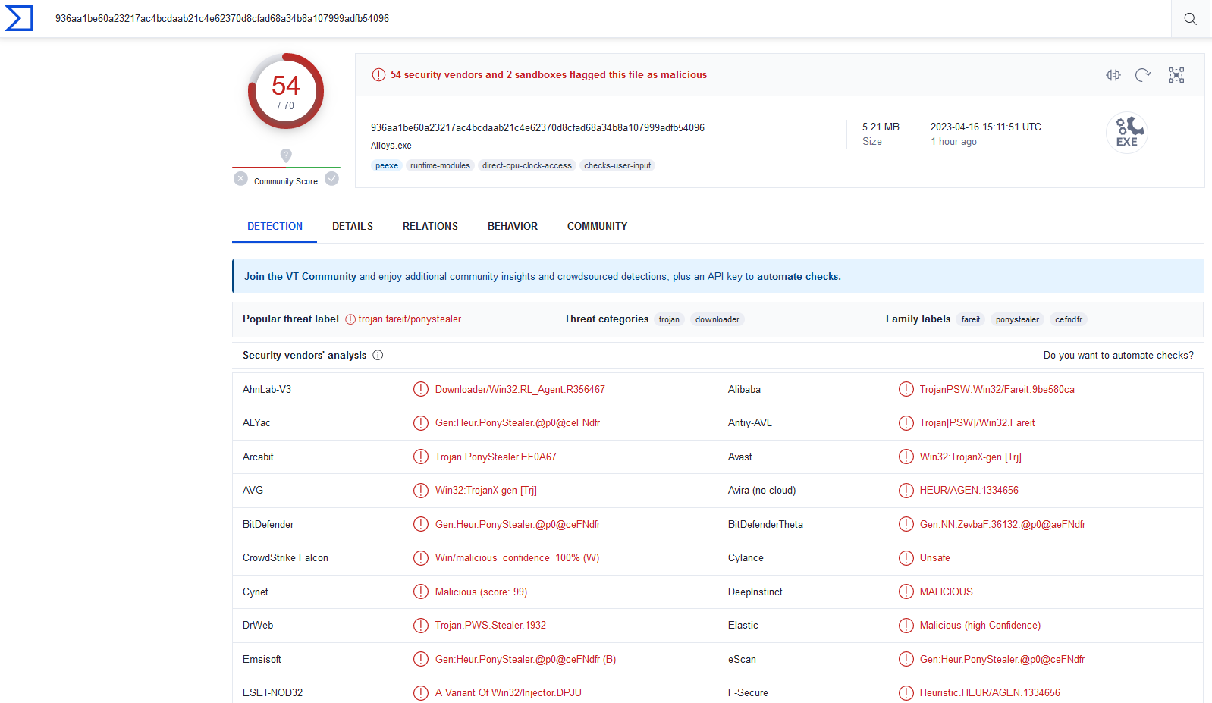
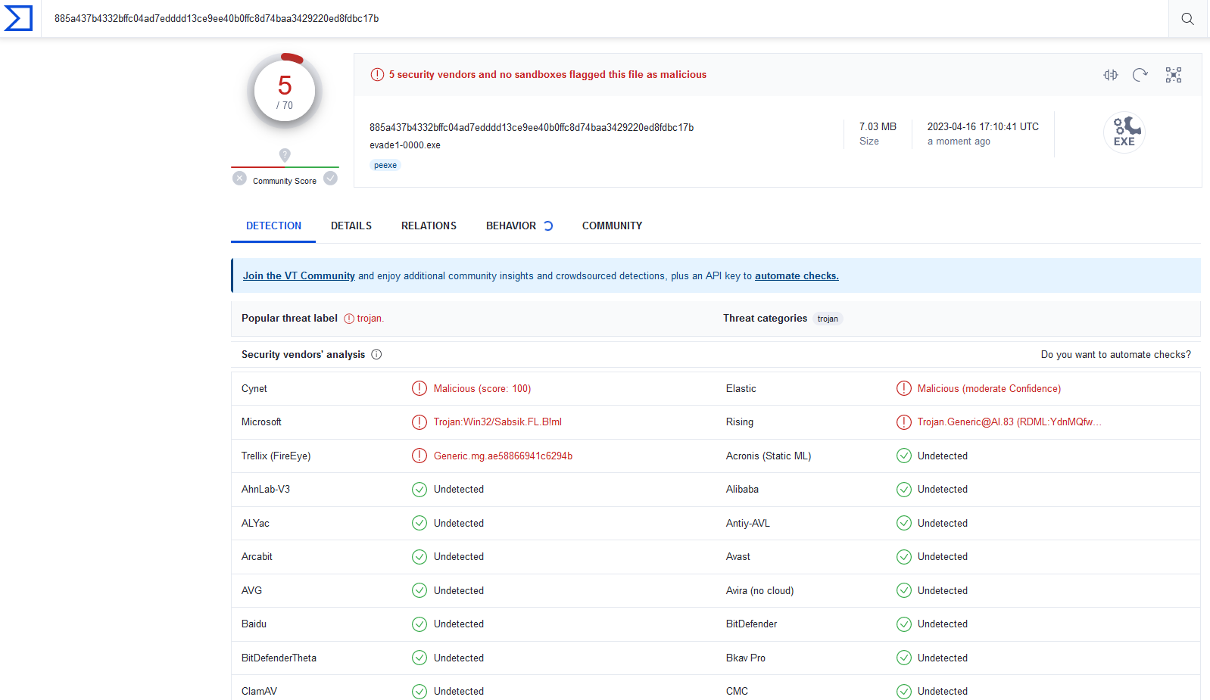
Attack v1 Results
VirusTotal of Evade1-0000 before and after
Before
After

Slide 14
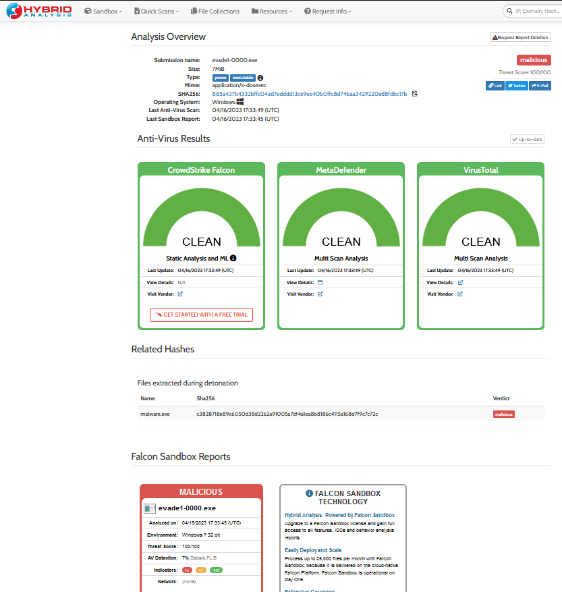
Attack v1 Results
Hybrid Analysis

Slide 15
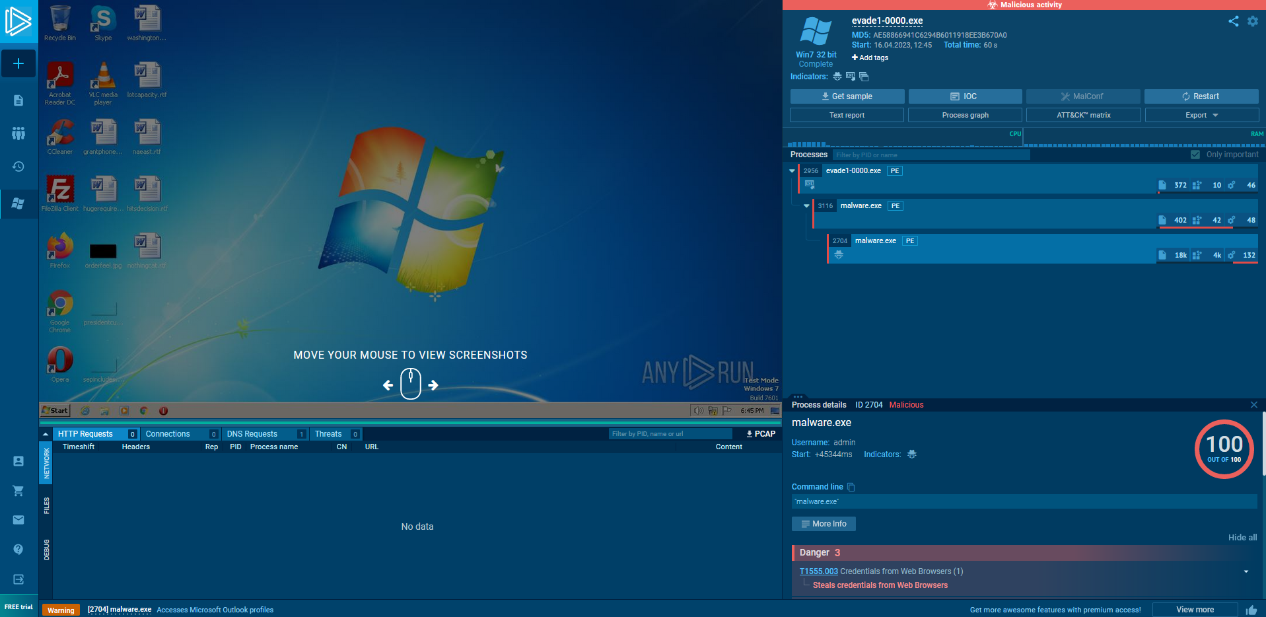
Attack v1 Results
Sandbox Execution

Slide 16
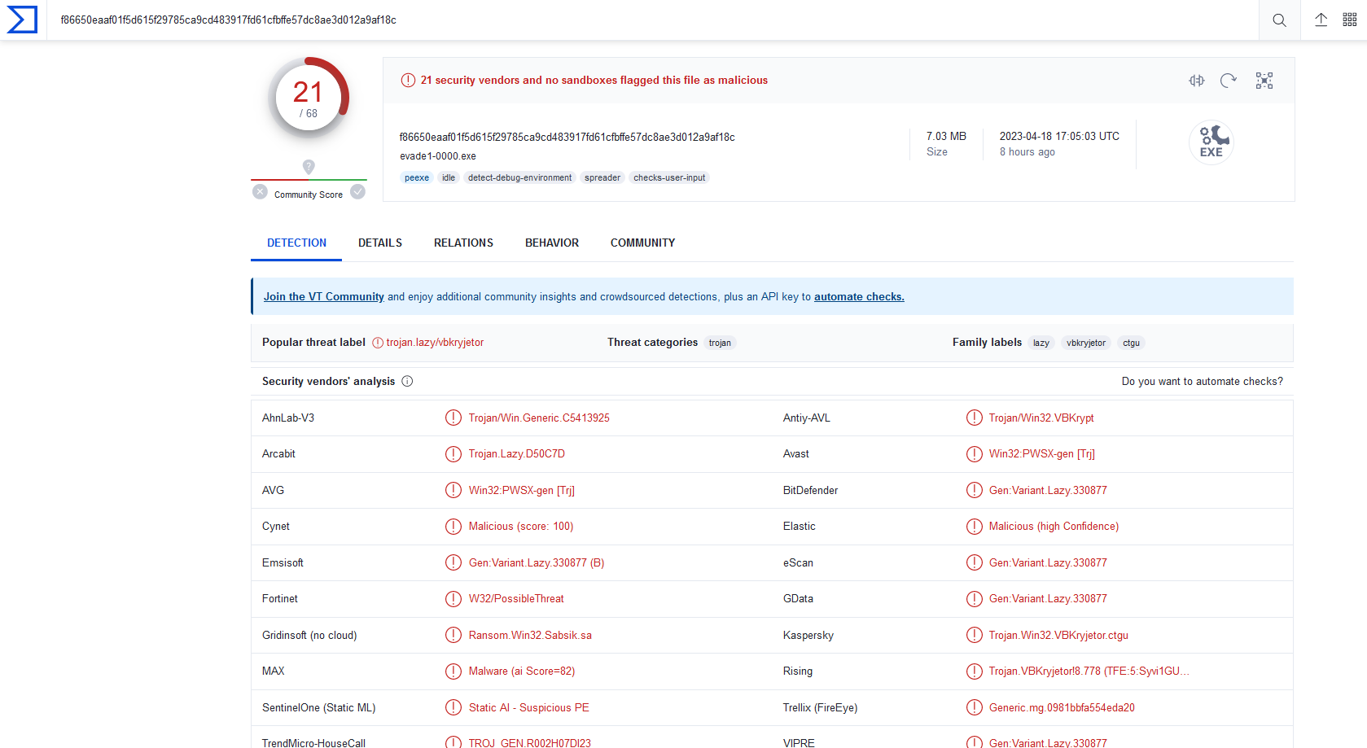
Attack v1 Additional Note
Changing nothing and running Evade1-0000 24 hours later
Indicates industry information sharing and quick retrain

Slide 17
Attack v2 Summary
A list of improvements added:
Manually parsed Kernel32.dll to find GetProcAddress
Added dynamic reference for LoadLibraryA
Implemented manual computation of int array length
Implemented manual conversion of GETINTRESOURCE
Added error checking at each stage of dynamic loading

Slide 18
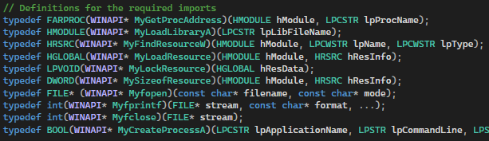
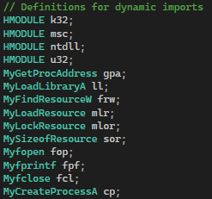
Attack v2 Visualization
Reduced dynamic APIs

Slide 19
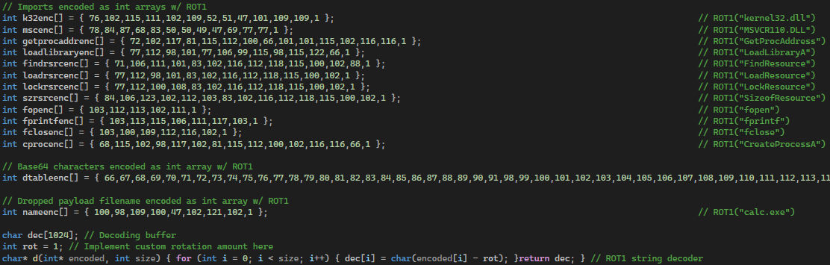
Attack v2 Visualization
Reduced encoded API strings

Slide 20
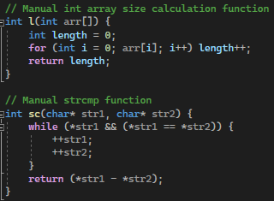
Attack v2 Visualization
Manual int array size calculation and strcmp

Slide 21
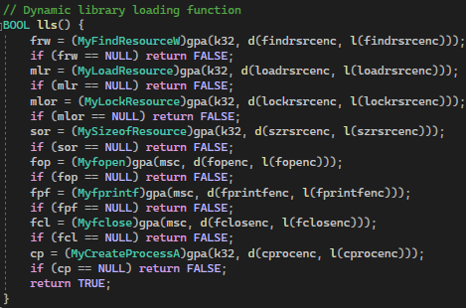
Attack v2 Visualization
Library loading error checking and abstraction

Slide 22
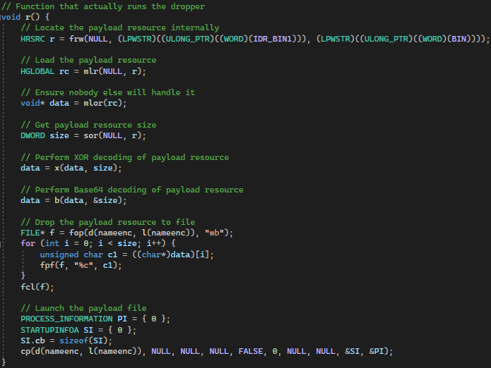
Attack v2 Visualization
Actual dropper run abstraction and GETINTRESOURCE obfuscation

Slide 23
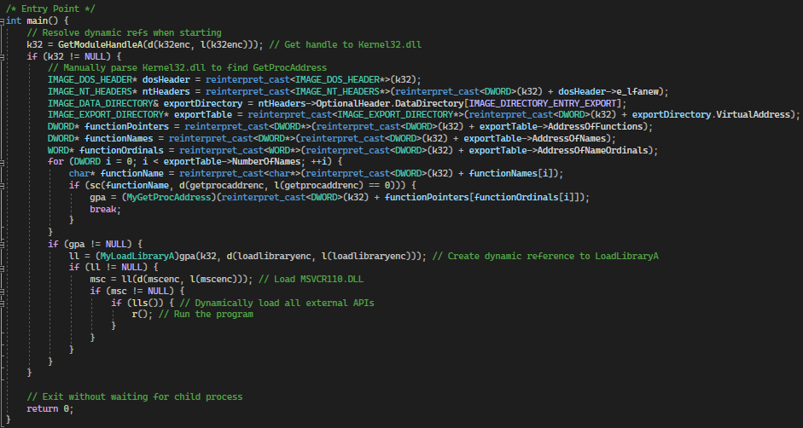
Attack v2 Visualization
Final main with manual Kernel32.dll parsing and dynamic loading

Slide 24
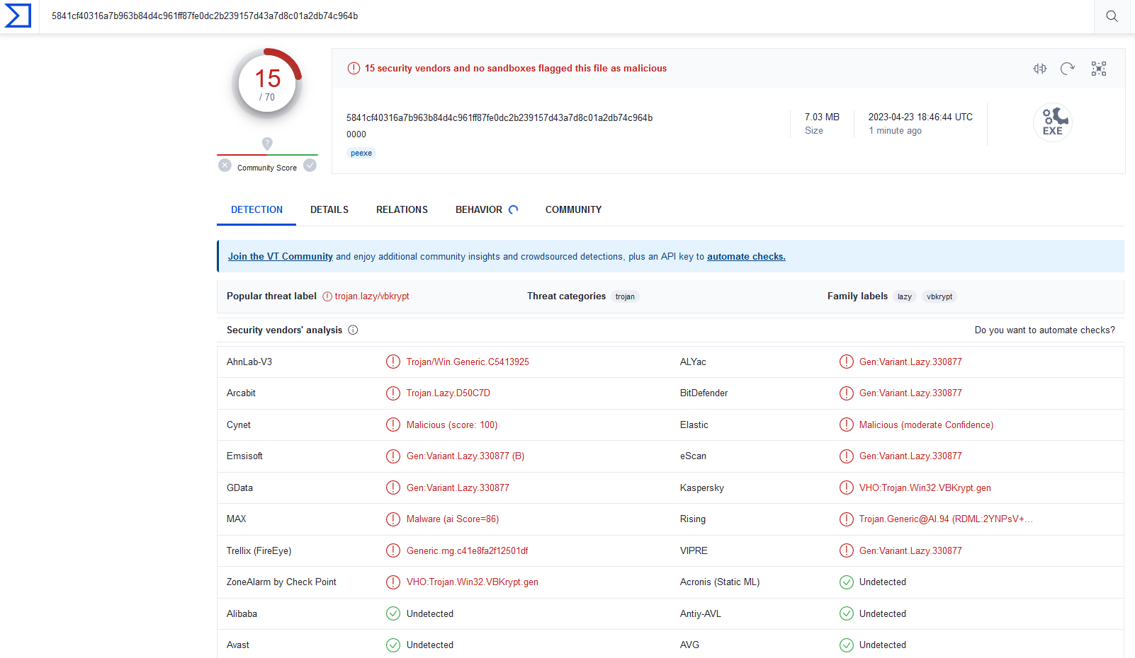
Attack v2 Results
VirusTotal of Evade1-0000

Slide 25
Attack v3 Summary
A list of improvements added:
Added 60 second wait timer before execution
Added sandbox environment detection
Added debugger detection

Slide 26
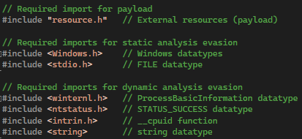
Attack v3 Visualization
New imports for dynamic analysis evasion

Slide 27
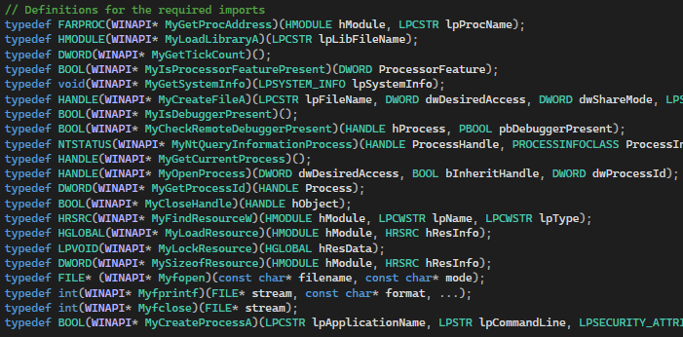
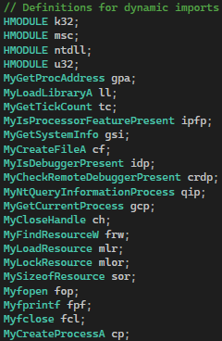
Attack v3 Visualization
New dynamic imports for dynamic analysis evasion

Slide 28
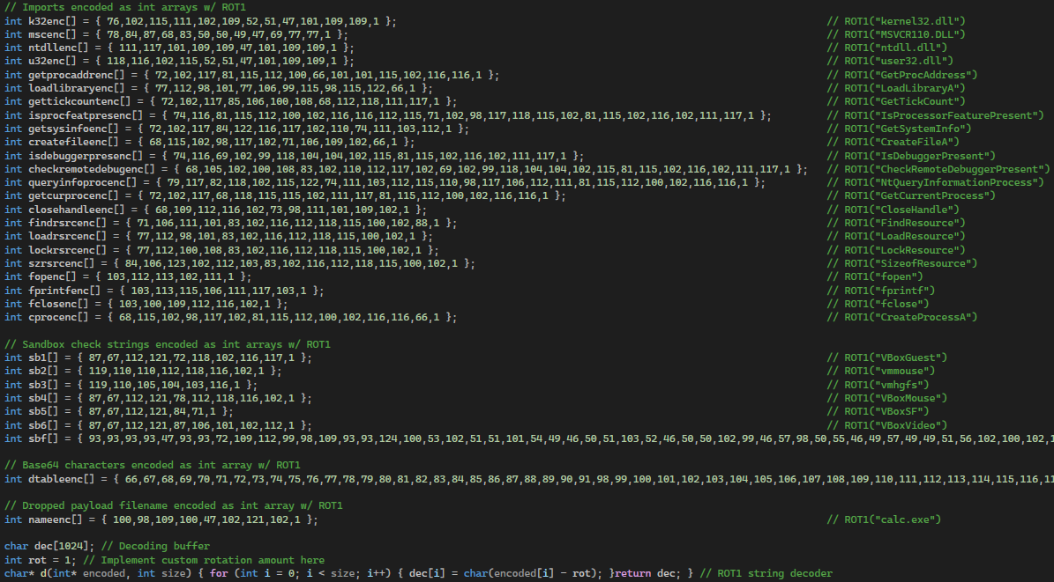
Attack v3 Visualization
New encoded API strings for dynamic analysis evasion

Slide 29
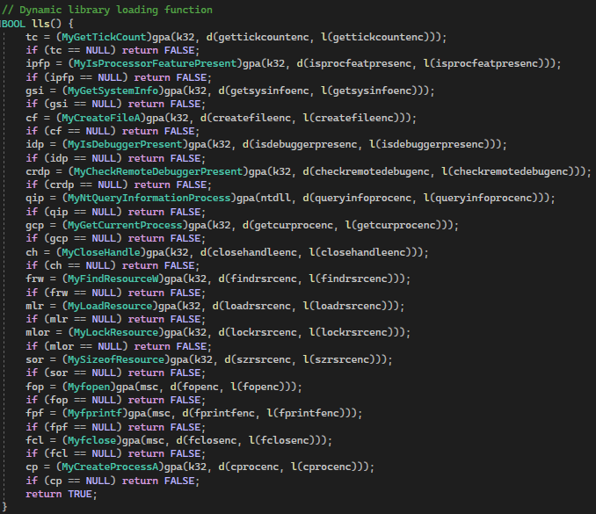
Attack v3 Visualization
Loading of new dynamic APIs for dynamic analysis evasion

Slide 30
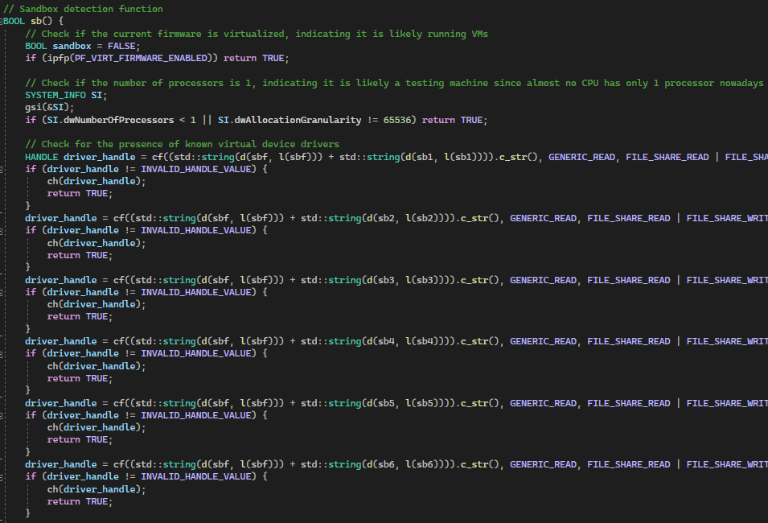
Attack v3 Visualization
Sandbox environment detection for dynamic analysis evasion (Ch1-3)

Slide 31
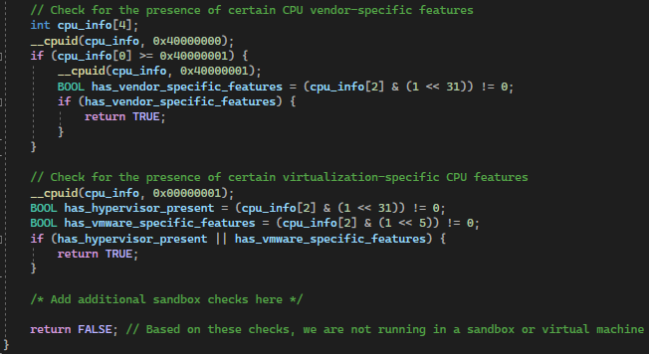
Attack v3 Visualization
Sandbox environment detection for dynamic analysis evasion (Ch4-5)

Slide 32
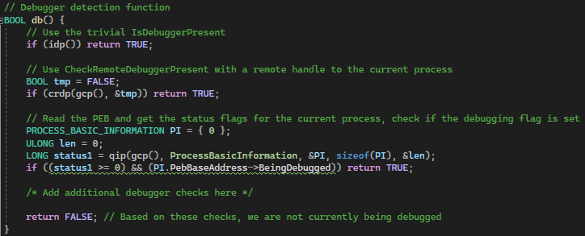
Attack v3 Visualization
Debugger detection for dynamic analysis evasion

Slide 33
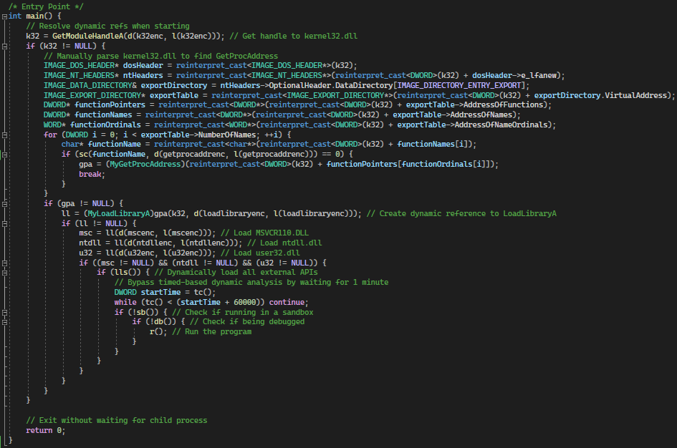
Attack v3 Visualization
Final main with 1 minute wait timer to evade dynamic analysis

Slide 34
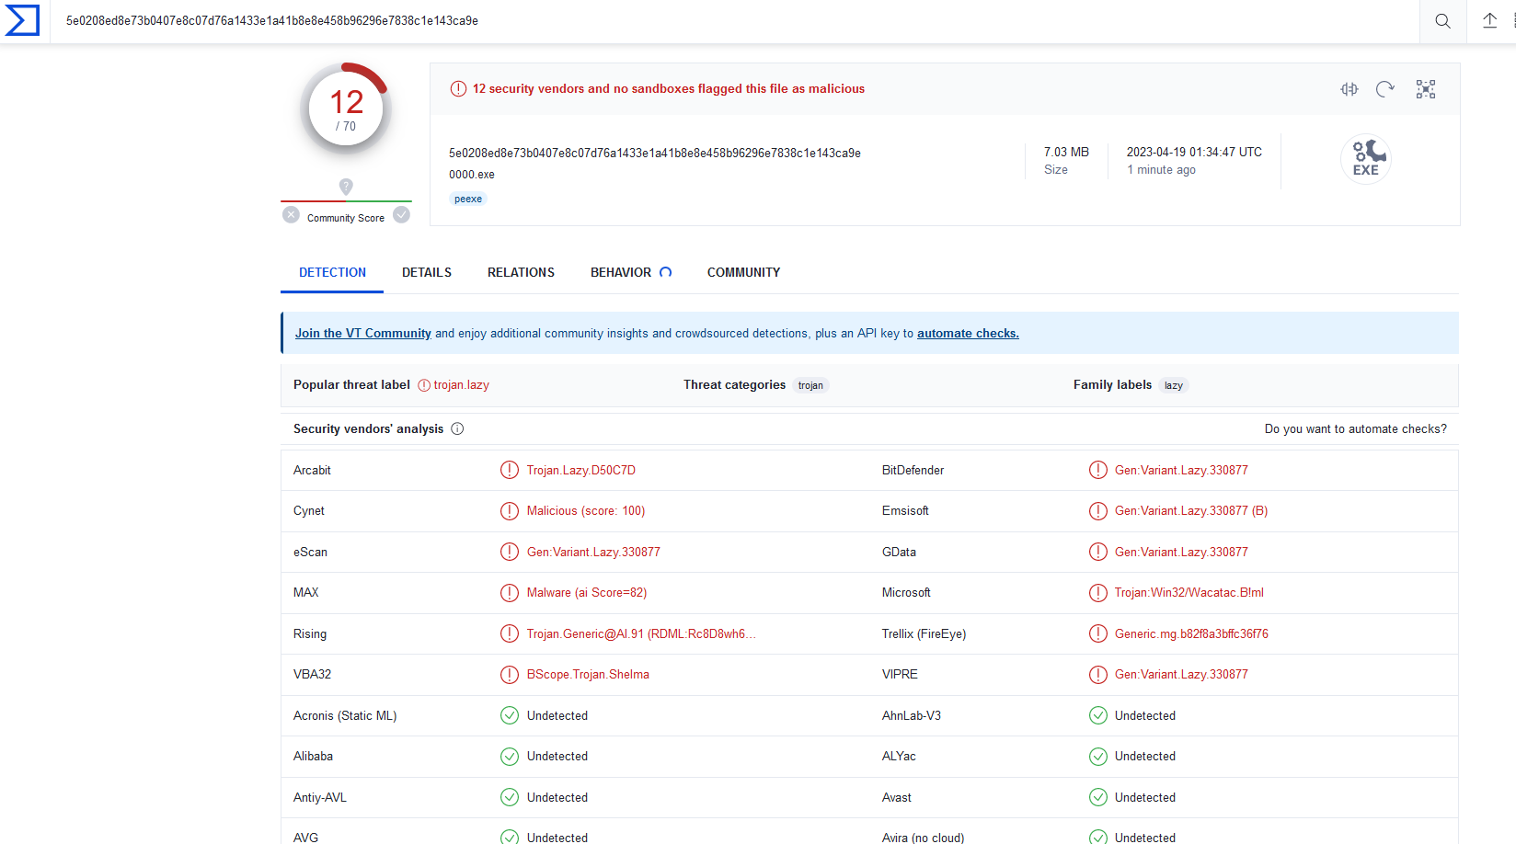
Attack v3 Results
VirusTotal of Evade1-0000

Slide 35
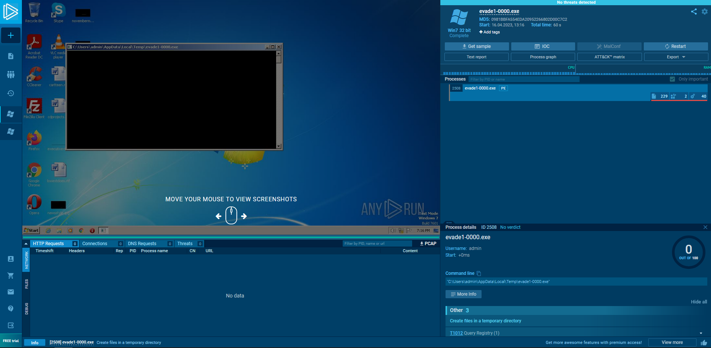
Attack v3 Results
Sandbox Execution

Slide 36
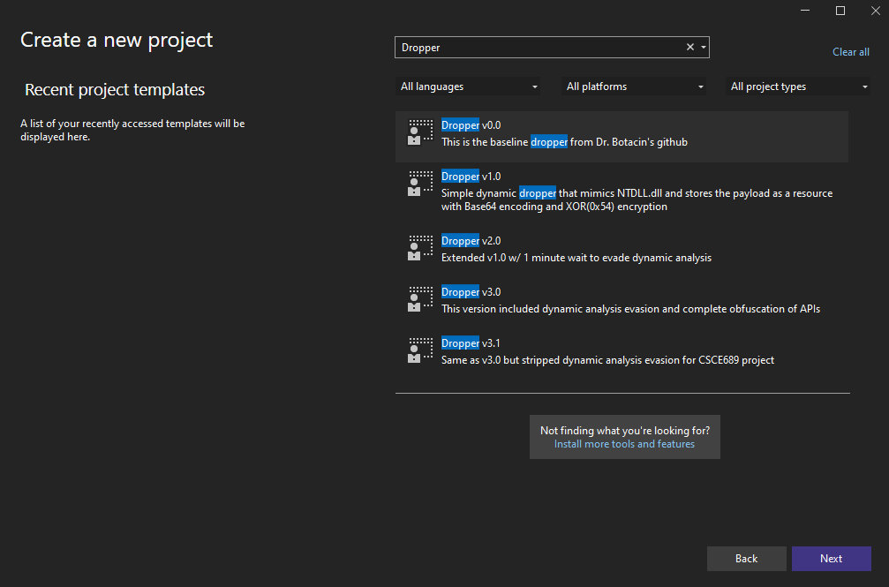
Additional Tools – VS Ease of Use

Slide 37
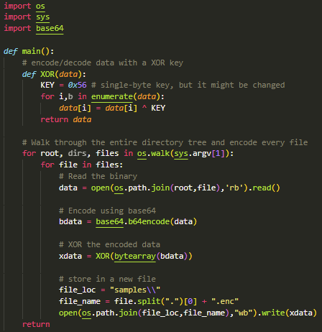
Additional Tools – Creating Encoded Resources

Slide 38
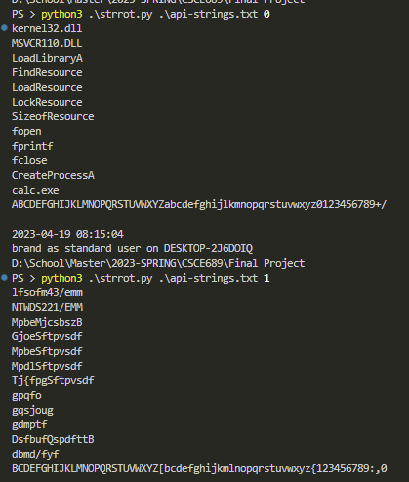
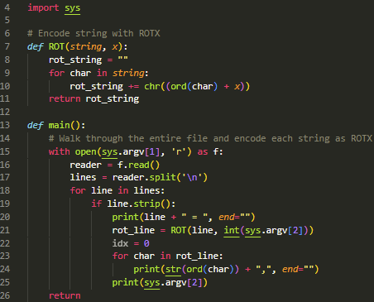
Additional Tools – Creating ROT1 int Arrays

Slide 39
Future Work
Embed dropper in different file type
Python executable (auto-py-to-exe) [1] [2]
Excell plugin (XLL) [1] [2]
Incorporate different method to launch process
Inject into own process then return execution after [1]
Doppelgӓng another legitimate process [1]
Add more sandbox and debugger detection methods
Wait to execute until after reboot [1]
Lock kernel32.dll to prevent analysis programs from using [2]

