Slide 1
Final Project Attack

Slide 2
Motivation
Comparing all papers covering in this class, Dr. Botacin’s method proved to yield the highest evasion rates.
We decided to take the existing example on Github and augment it with improvements.

Slide 3
Baseline Attack
Combined Dr. Botacin’s filesystem.exe and inmemory.dll droppers into a single dropper that:
Compiled into an executable
Contained a single resource
XOR decrypted the resource
Base64 decoded the resource
Wrote the resource to file
Launched the resource
Dynamically loaded 90% of APIs
Encoded strings as int arrays
Mimicked the NTDLL.dll

Slide 4
Baseline Attack Visualization

Slide 5
Attack v1 Summary
A list of improvements added:
Removed all but 3 static APIs from original attack
GetModuleHandleA
GetProcAddress
LoadLibraryA
Replaced original handle reference to Kernel32.dll
Further encrypted the int arrays by applying ROT1
Implemented manual Base64 decoding

Slide 6
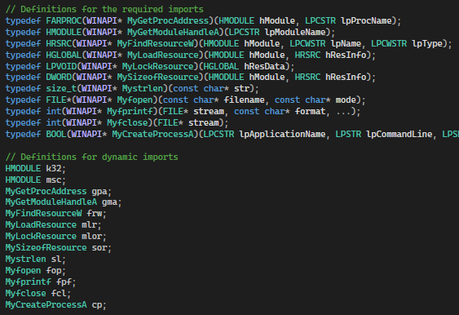
Attack v1 Visualization

Slide 7
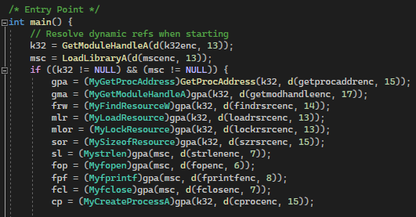
Attack v1 Visualization

Slide 8
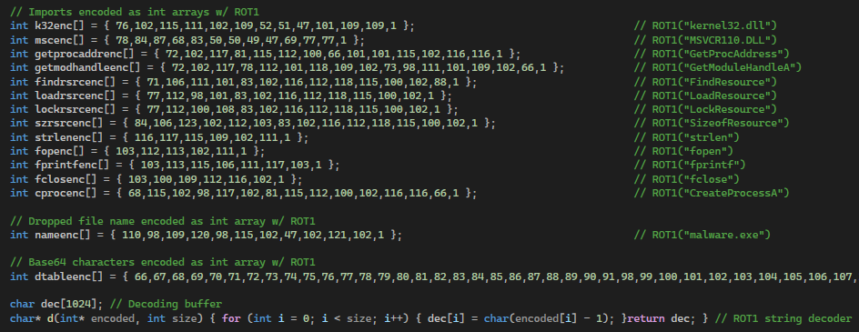
Attack v1 Visualization

Slide 9
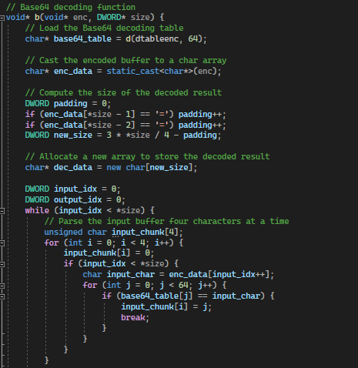
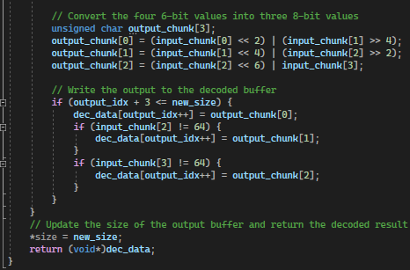
Attack v1 Visualization

Slide 10
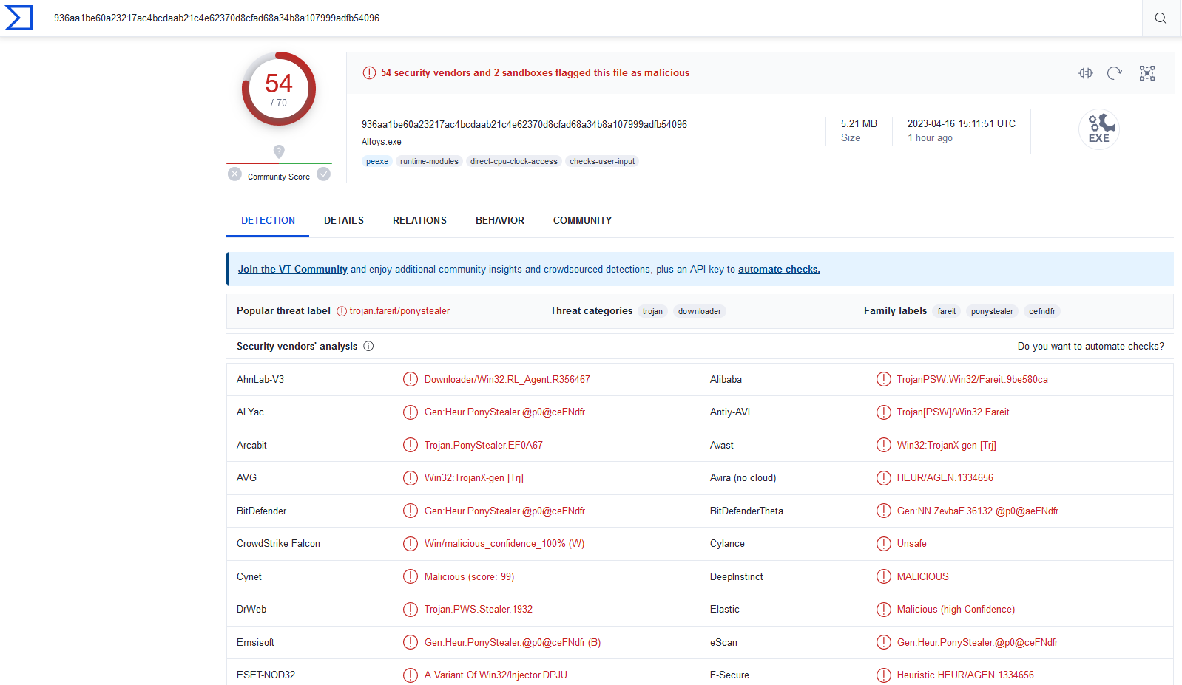
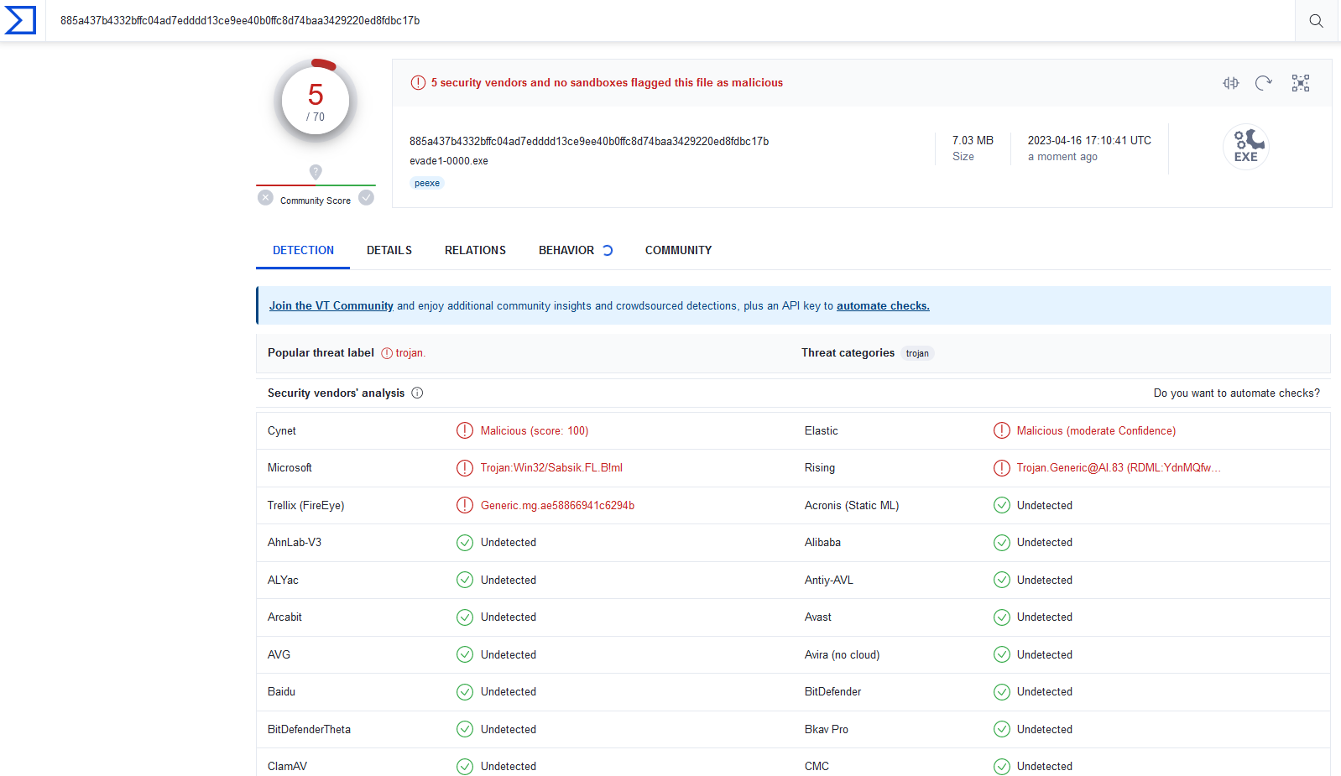
Attack v1 Results
VirusTotal of Evade1-0000 before and after
Before
After

Slide 11
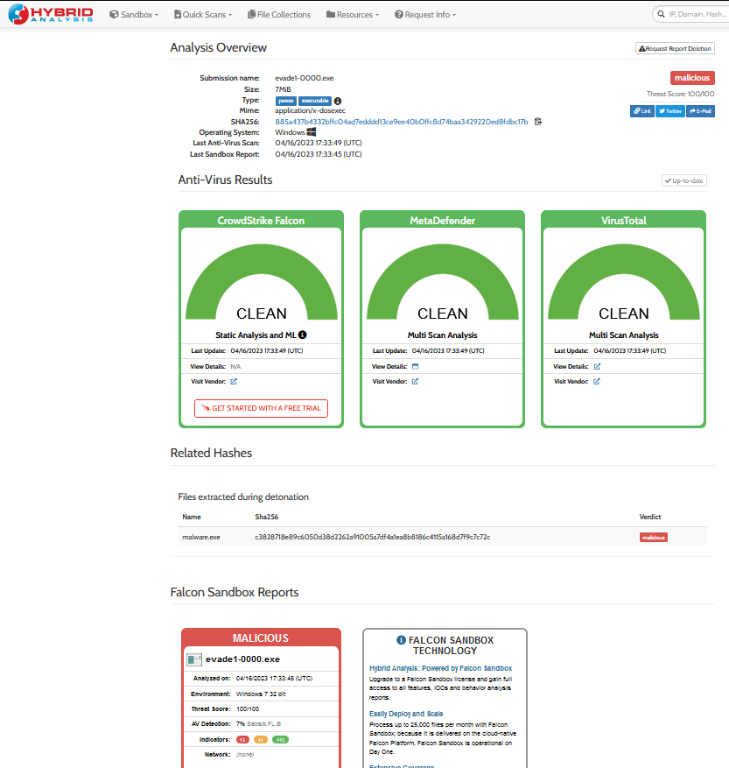
Attack v1 Results
Hybrid Analysis

Slide 12
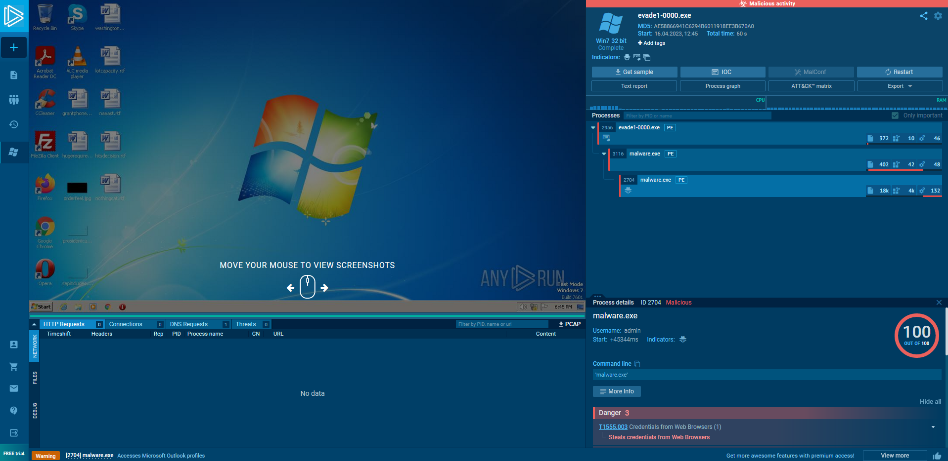
Attack v1 Results
Sandbox Execution

Slide 13
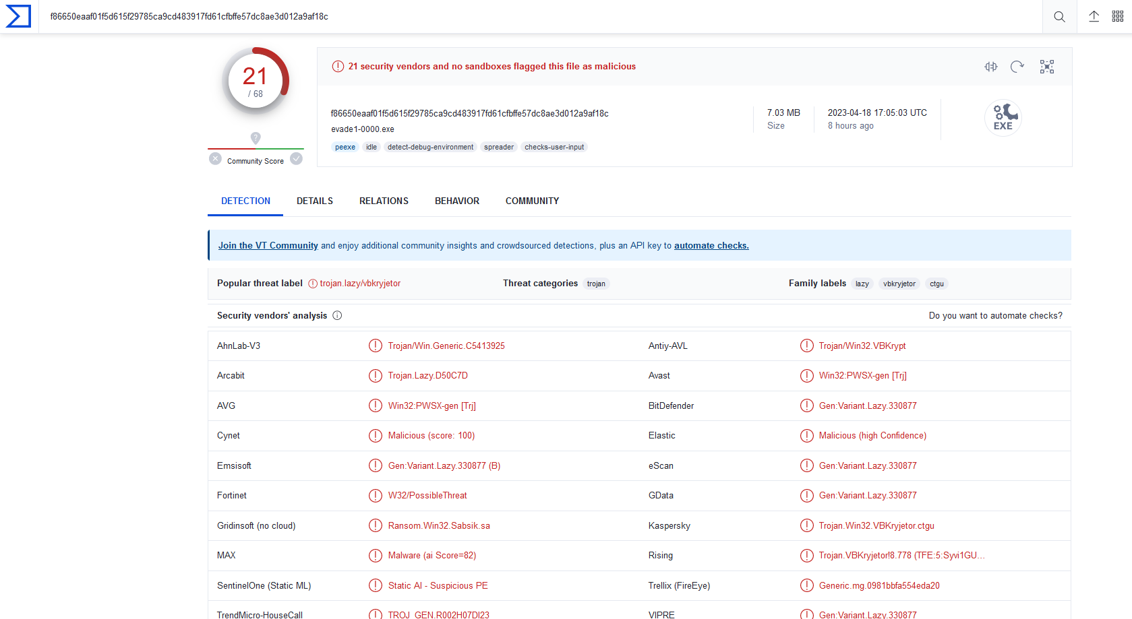
Attack v1 Additional Note
Changing nothing and running Evade1-0000 24 hours later
Indicates industry information sharing and quick retrain

Slide 14
Attack v2 Summary
A list of improvements added:
Manually parsed Kernel32.dll to find GetProcAddress
Added dynamic reference for LoadLibraryA
Implemented manual computation of int array length
Implemented manual conversion of GETINTRESOURCE
Added error checking at each stage of dynamic loading

Slide 15
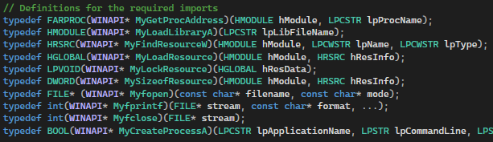
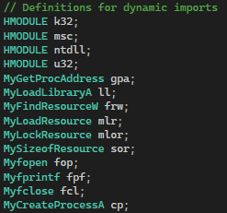
Attack v2 Visualization
Reduced dynamic APIs

Slide 16
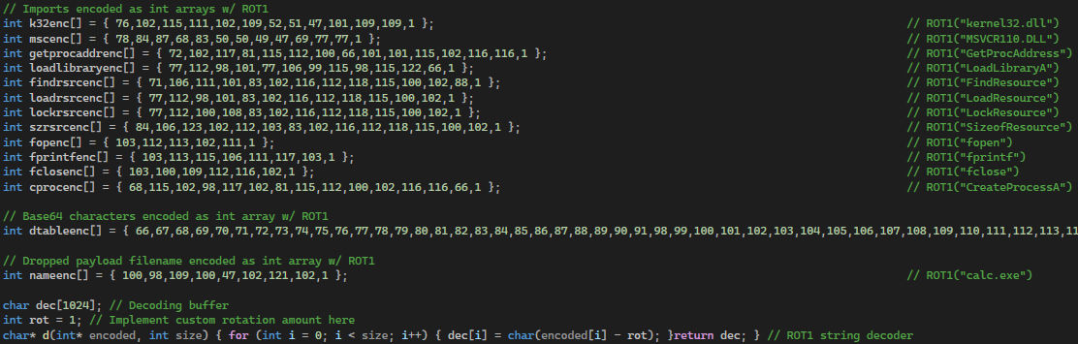
Attack v2 Visualization
Reduced encoded API strings

Slide 17
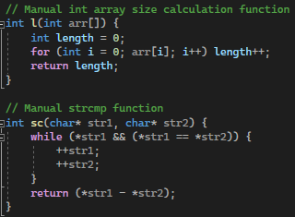
Attack v2 Visualization
Manual int array size calculation and strcmp

Slide 18
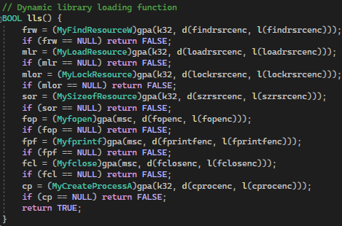
Attack v2 Visualization
Library loading error checking and abstraction

Slide 19
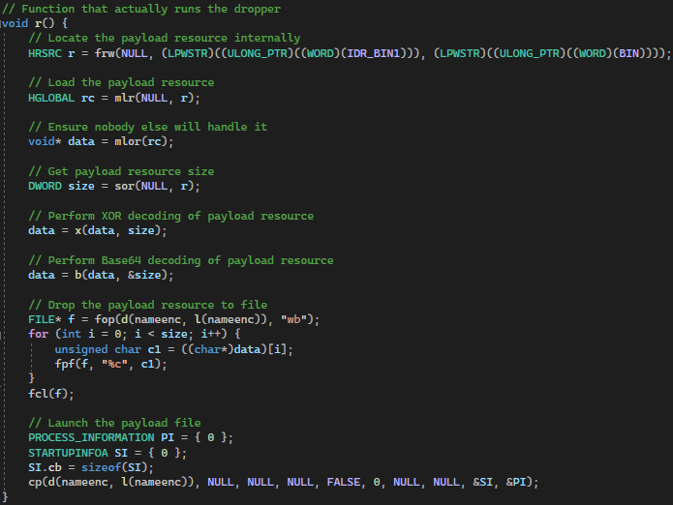
Attack v2 Visualization
Actual dropper run abstraction and GETINTRESOURCE obfuscation

Slide 20
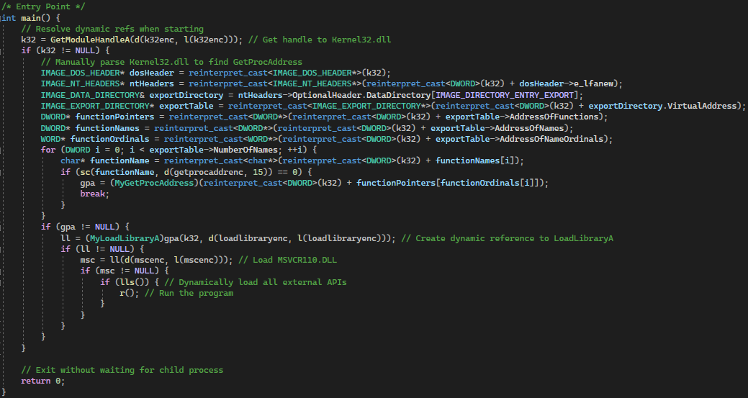
Attack v2 Visualization
Final main with manual Kernel32.dll parsing and dynamic loading

Slide 21
Attack v2 Results
VirusTotal of Evade1-0000

Slide 22
Attack v3 Summary
A list of improvements added:
Added 60 second wait timer before execution
Added sandbox environment detection
Added debugger detection

Slide 23
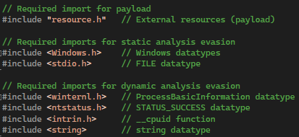
Attack v3 Visualization
New imports for dynamic analysis evasion

Slide 24
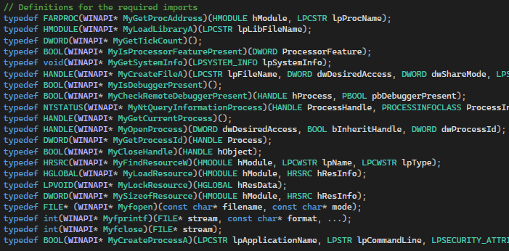
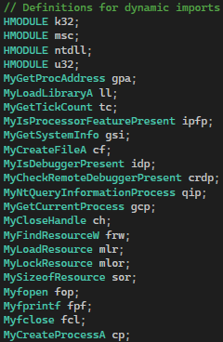
Attack v3 Visualization
New dynamic imports for dynamic analysis evasion

Slide 25
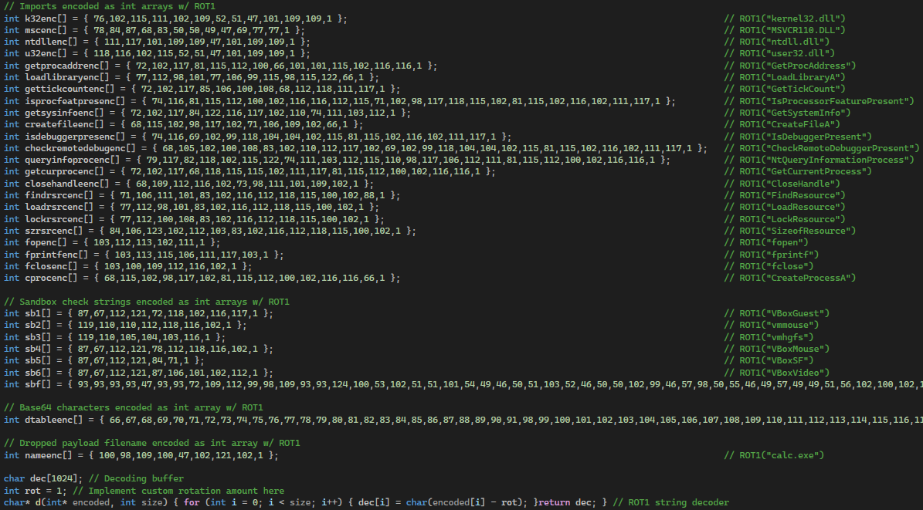
Attack v3 Visualization
New encoded API strings for dynamic analysis evasion

Slide 26
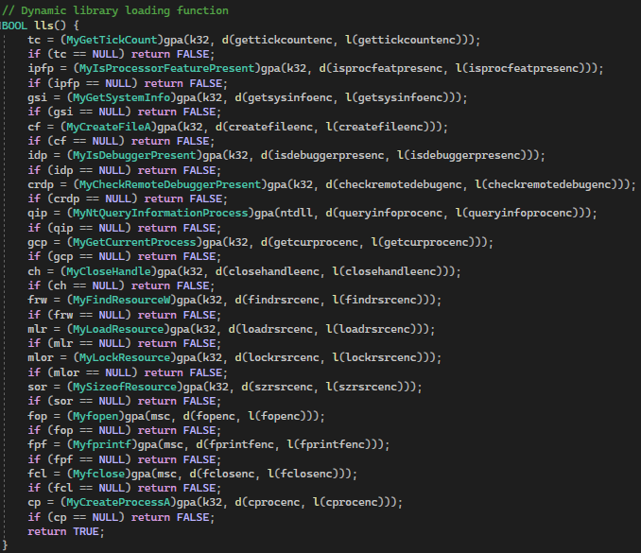
Attack v3 Visualization
Loading of new dynamic APIs for dynamic analysis evasion

Slide 27
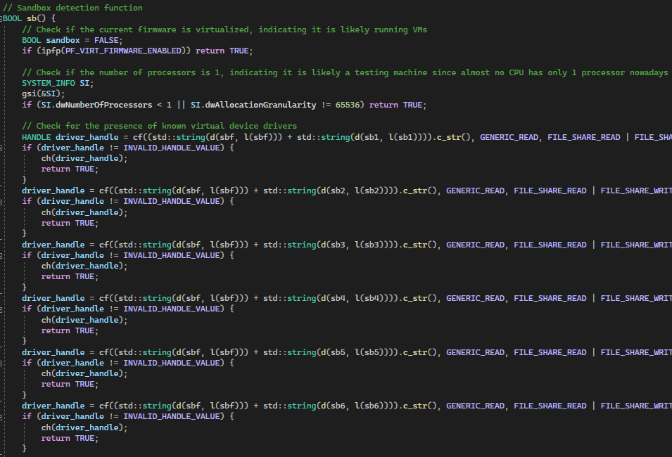
Attack v3 Visualization
Sandbox environment detection for dynamic analysis evasion (Ch1-3)

Slide 28
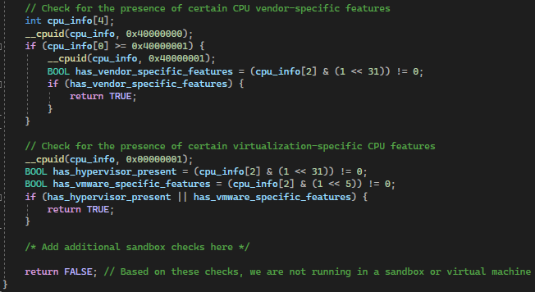
Attack v3 Visualization
Sandbox environment detection for dynamic analysis evasion (Ch4-5)

Slide 29
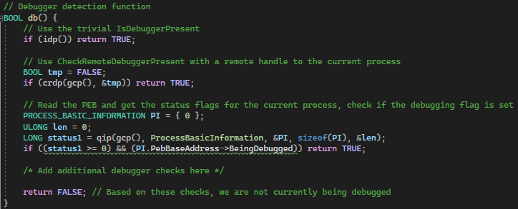
Attack v3 Visualization
Debugger detection for dynamic analysis evasion

Slide 30
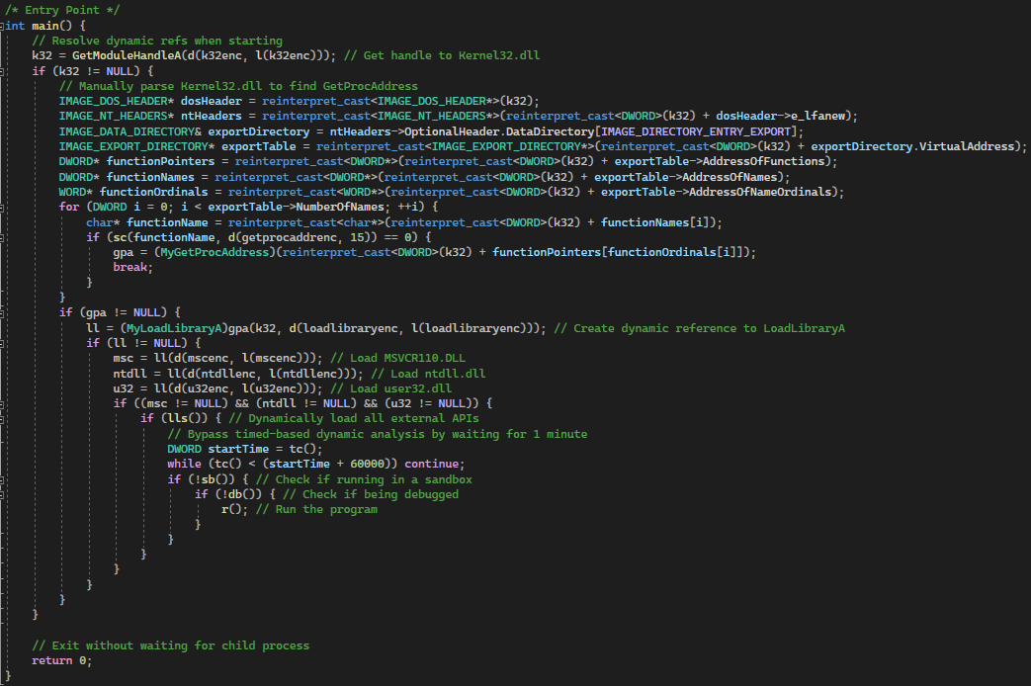
Attack v3 Visualization
Final main with 1 minute wait timer to evade dynamic analysis

Slide 31
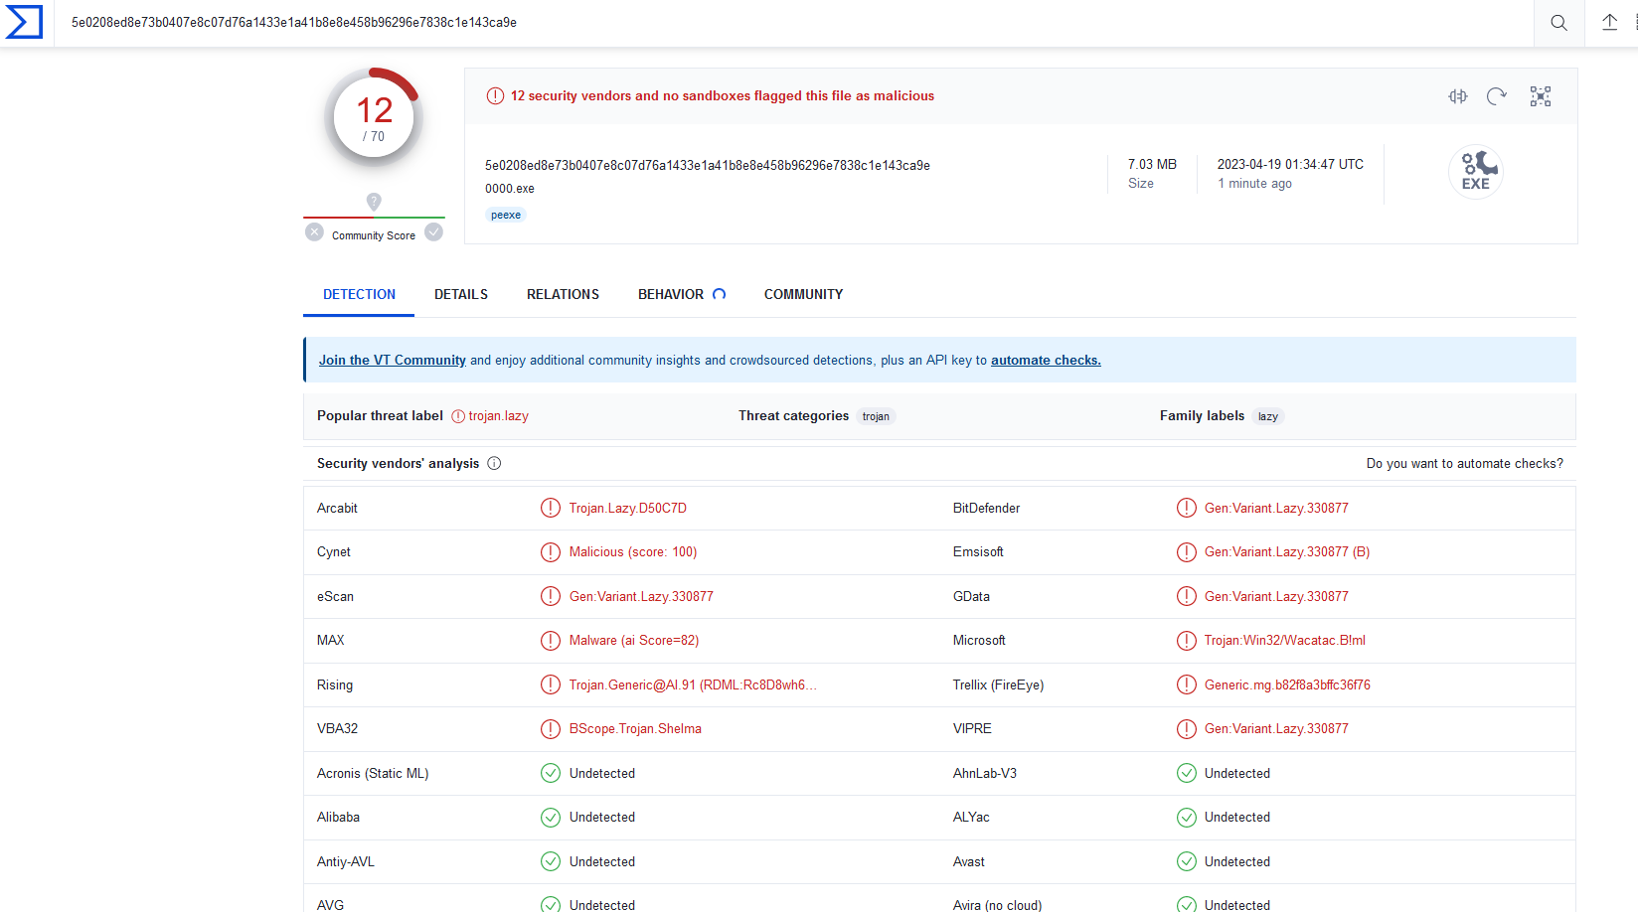
Attack v3 Results
VirusTotal of Evade1-0000

Slide 32
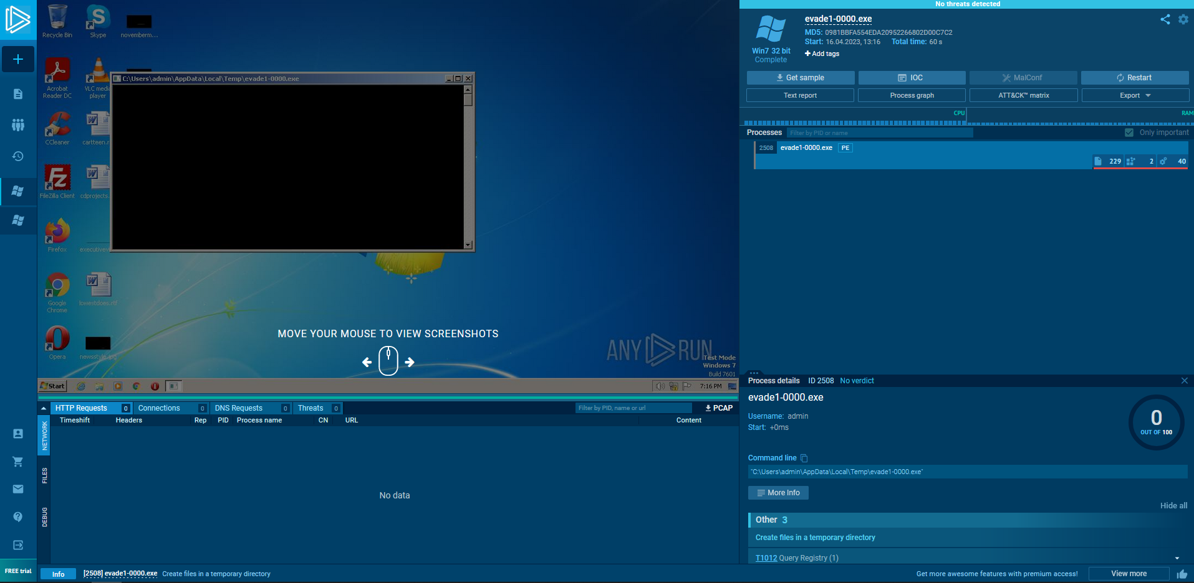
Attack v3 Results
Sandbox Execution

Slide 33
Additional Tools – Creating Encoded Resources

Slide 34
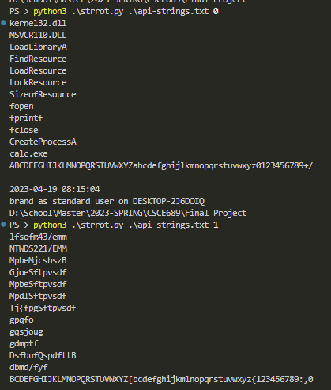
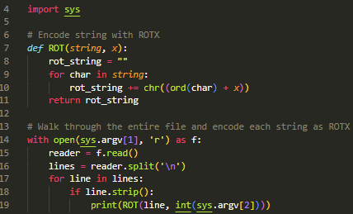
Additional Tools – Creating ROT1 int Arrays

