Slide 1
Final Project Defense

Slide 2
Submitted Model
RandomForest (n_estimators=1000, max_depth=5)
Dataset:
1000 - Windows default binaries
500 - Vendor 64-bit binaries
500 - Vendor 32-bit binaries
250 - Initial malware samples for adversarial portion
250 - Our adversarial samples
500 - Most recent malwares uploaded in last week (malware bazar)

Slide 3
Feature Extraction - Summary
414 features in total extracted
14 header features
200 bi-gram byte features
100 bi-gram opcode features
100 tri-gram opcode features
n-gram: sequence of of n adjacent bytes within the binary file. Frequency is computed. This can help capture the semantics of each file.

Slide 4
Byte file
We run pe.get_data()
if pe.OPTIONAL_HEADER.SizeOfCode > maxBytes (50,000 for our test)
byte_file = pe.get_data(pe.OPTIONAL_HEADER.BaseOfCode, MAX_BYTES)
else:
byte_file = pe.get_data(pe.OPTIONAL_HEADER.BaseOfCode, pe.OPTIONAL_HEADER.SizeOfCode)

Slide 5
ASM file
We get the byte file
Disassemble into ASM using the dis library
Split by new lines to get each instruction line
Split each instruction line to get the opcode
return list of opcodes

Slide 6
Header feature - selection
Every static header feature from the PE file is being processed into a single feature vector
Selected top 14 most influential header features from the PE file were used for classification
We selected the features using the RandomForest (n_estimators=1000, max_depth=5) classifier

Slide 7
Header feature – 14 selected results
FILE_HEADER.MACHINE - target architecture for the file (e.g., Intel x86, AMD64, ARM).
FILE_HEADER.CHARACTERISTICS - 16-bit value that denotes different features and properties of the file. These features are defined using a bitwise OR combination of multiple constants that establish the traits of the executable file.
FILE_HEADER.SIZEOFOPTIONALHEADER: This field specifies the size of the optional header that immediately follows the file header.

Slide 8
Header feature – 14 selected results
OPTIONAL_HEADER.IMAGEBASE: This field specifies the preferred address of the first byte of the image when it is loaded into memory.
OPTIONAL_HEADER.MAJOROPERATINGSYSTEM: This field specifies the major version number of the operating system required to run the file.
OPTIONAL_HEADER.MAJORSUBSYSTEMVERSION: This field specifies the major version number of the subsystem required to run the file.
OPTIONAL_HEADER.DLLCHARACTERISTICS: This field specifies various attributes and characteristics of the file, such as whether it is a DLL or a driver.
OPTIONAL_HEADER.SUBSYSTEM: This field specifies the subsystem required to run the file, such as Windows or Console.

Slide 9
Header feature – 14 selected results
PE_SECTIONS.MAXENTROPY: This field represents the maximum entropy value of the binary sections of the PE file. Entropy is a measure of the randomness or unpredictability of data, and high entropy values can indicate that a section of the binary code may be obfuscated or encrypted.
PE_SECTIONS.MINENTROPY: This field represents the minimum entropy value of the binary sections of the PE file.
PE_SECTIONS.MEANENTROPY: This field represents the mean entropy value of the binary sections of the PE file.
RESOURCES.MAXENTROPY: This field represents the maximum entropy value of the resources section of the PE file.
RESOURCES.MINENTROPY: This field represents the minimum entropy value of the resources section of the PE file.
VS_VERSIONINFO.Length: This field specifies the length, in bytes, of the VS_VERSIONINFO resource.

Slide 10
Bi-gram byte feature - selection
Unique set of every bi-gram byte encountered in all samples
Selected top 200 most influential bi-gram bytes from the unique set
We selected the features using the RandomForest (n_estimators=1000, max_depth=5) classifier
One-hot encoded each of the sample with the presence of each selected bi-gram byte

Slide 11
Bi-gram opcode feature - selection
Unique set of every bi-gram opcode encountered in all samples
Selected top 100 most influential bi-gram opcodes from the unique set
We selected the features using the RandomForest (n_estimators=1000, max_depth=5) classifier
One-hot encoded each of the sample with the presence of each selected bi-gram opcodes

Slide 12
Tri-gram opcode feature - selection
Unique set of every tri-gram opcode encountered in all samples
Selected top 100 most influential bi-gram opcodes from the unique set
We selected the features using the RandomForest (n_estimators=1000, max_depth=5) classifier
One-hot encoded each of the sample with the presence of each selected tri-gram opcodes

Slide 13
Tri-gram opcode feature - selection
Unique set of every tri-gram opcode encountered in all samples
Selected top 100 most influential bi-gram opcodes from the unique set
We selected the features using the RandomForest (n_estimators=1000, max_depth=5) classifier
One-hot encoded each of the sample with the presence of each selected tri-gram opcodes

Slide 14
Weakness
Any time the header feature is not there we have it encoded as 0
We don’t have a pipeline for checking different features yet like some of the other teams
We don’t have the confidence interval like other team for more explainable results
Small dataset not representative of real-world samples
We are only analyzing the first 50,000 bytes of the file

Slide 15
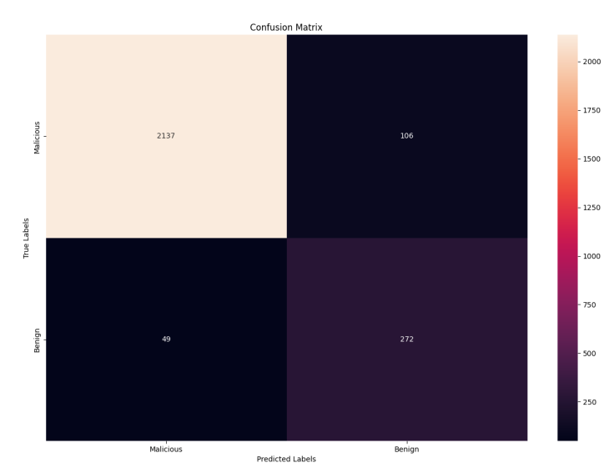
Result

