Slide 1
Dept. of Computer Science and Engineering, Texas A&M University
CLIENT: FASHION NXT
CUSTOMER: Mr. Tito Chowdhury
PROJECT NAME: EVENT NXT
TEAM NAME: The Sprinters
Project Description:
The main customer requirement was to improve the legacy application.
The customer, Mr.Tito Chowdhury, encouraged us to explore other event management tools like Eventbrite, Evite, Ticketmaster, etc., to fill in the gaps in the current project.
EventNXT is expected to be a well-rounded tool for event producers, organizers, promoters, and patrons.
Features:
Box office ticket sales
Guest list and RSVP management
Referral reward system for customer acquisition which tracks referrals.
Manage Guest List via spreadsheet.
RSVP Invitation, Confirmation, and Referral emails.
Seating arrangement levels.
Expiring the RSVP link after a given date time.

Slide 2
Dept. of Computer Science and Engineering, Texas A&M University
Workflow Design
Introduction
User/Event Organizer
Login
Create event
Add/Edit:
-Category
-Capacity
Add Seating
-Add Perks
-Assign seat category
-Set event expiry
View seat summary
Add Guest
Load Box Office Data
-Load Data on UI
-Saving header mapping
Guests Refer friends using their email ids
Referred Guests get an email with a link to buy tickets
Send RSVP Invitation
Send Referral Email
Add/Edit:
- Email, Name
- Other details
- Send Bulk Email
Get RSVP
Assign Seat Category
Send Confirmation Email

Slide 3
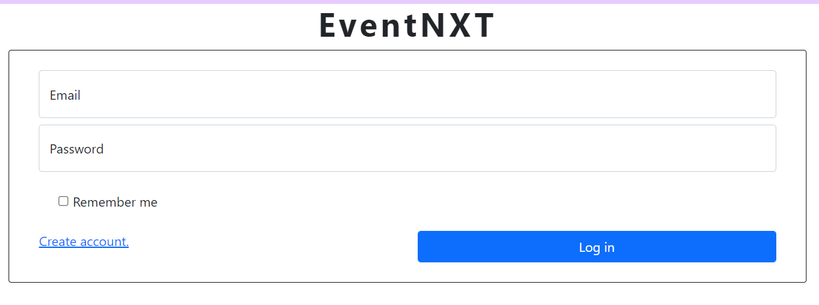
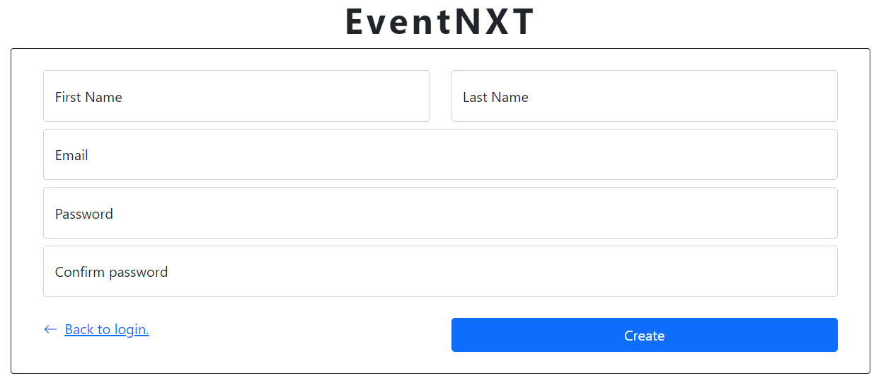
Introduction
Login and Sign up Page
Dept. of Computer Science and Engineering, Texas A&M University

Slide 4
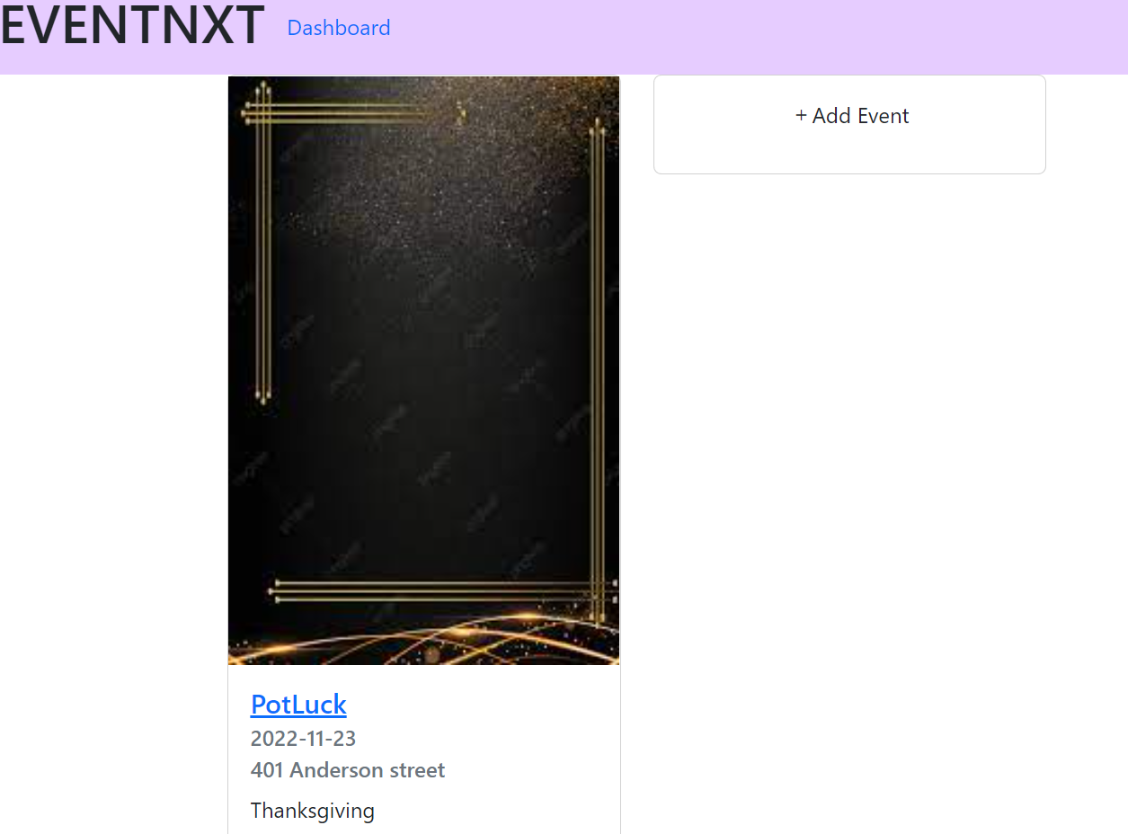
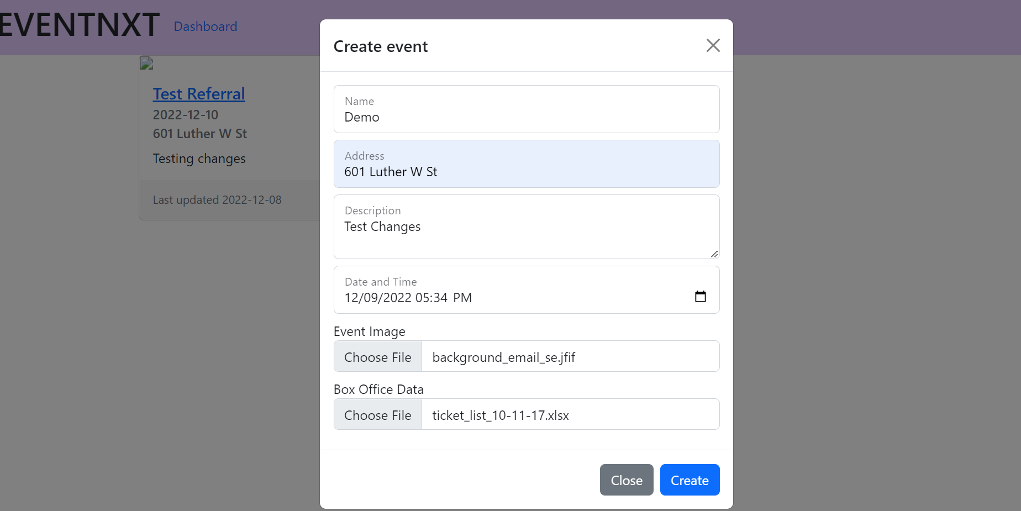
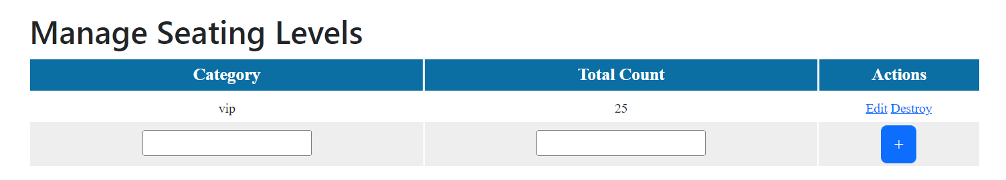
Dept. of Computer Science and Engineering, Texas A&M University
Introduction
Event Functionalities:
Dashboard:
Event Creation:

Slide 5
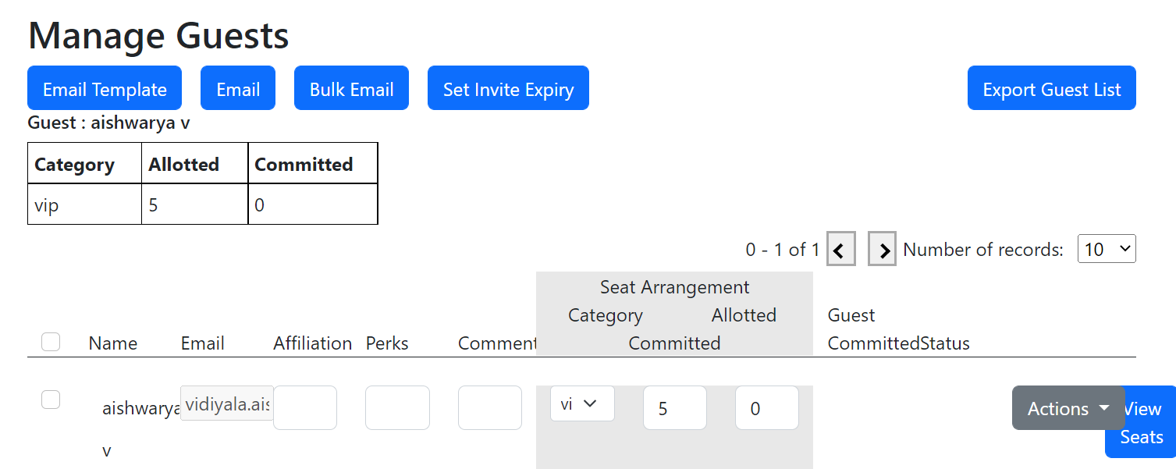
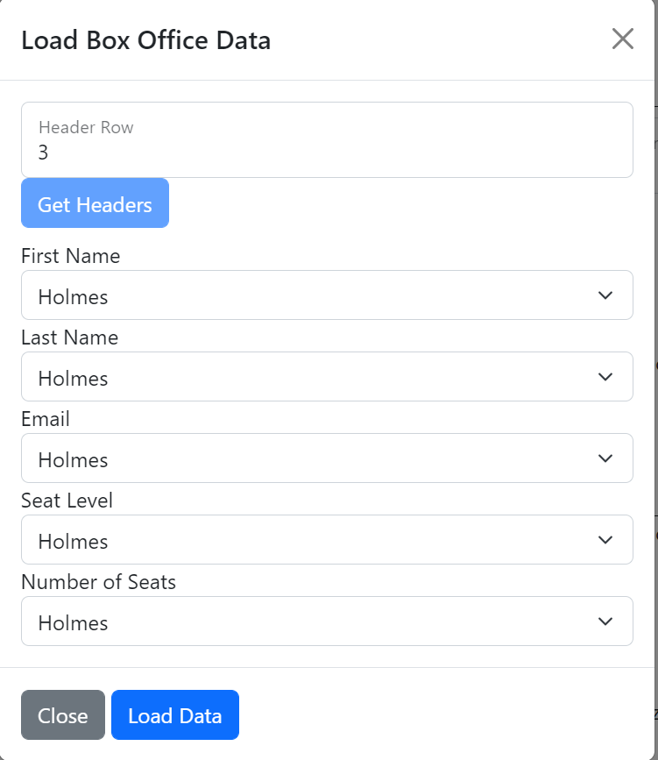
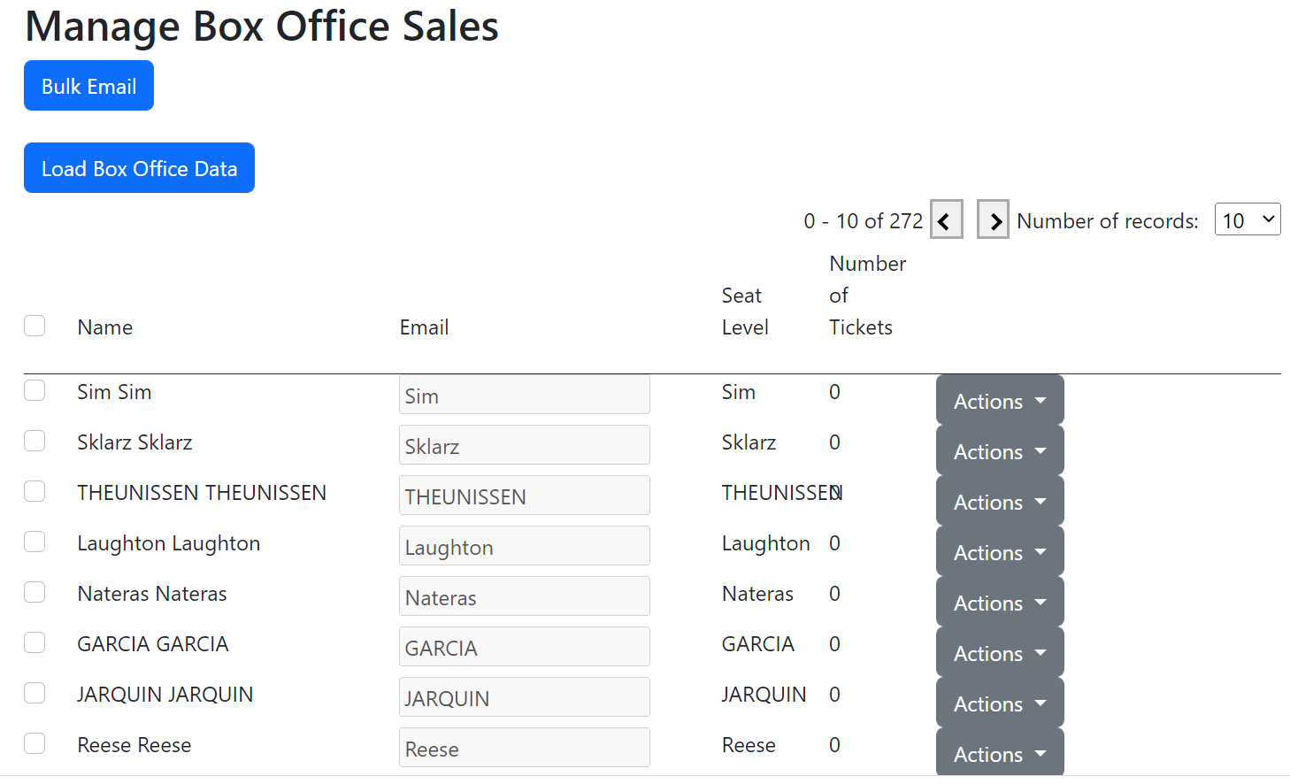
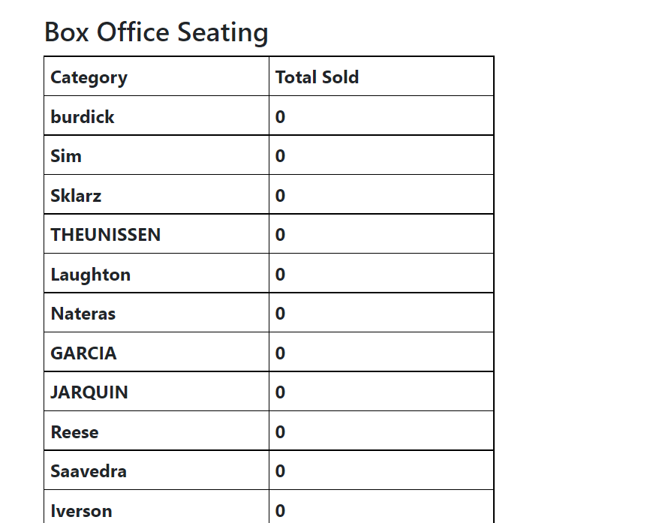
Dept. of Computer Science and Engineering, Texas A&M University
Introduction
Box Office Data Seating Summary:

Slide 6
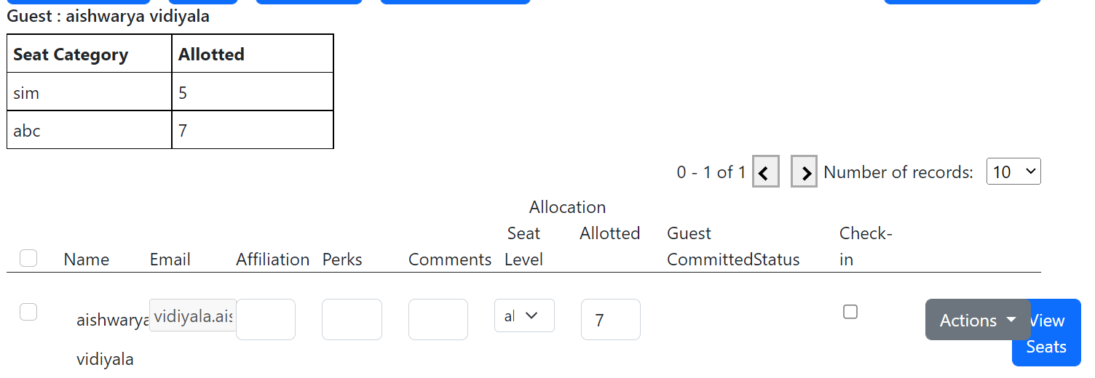
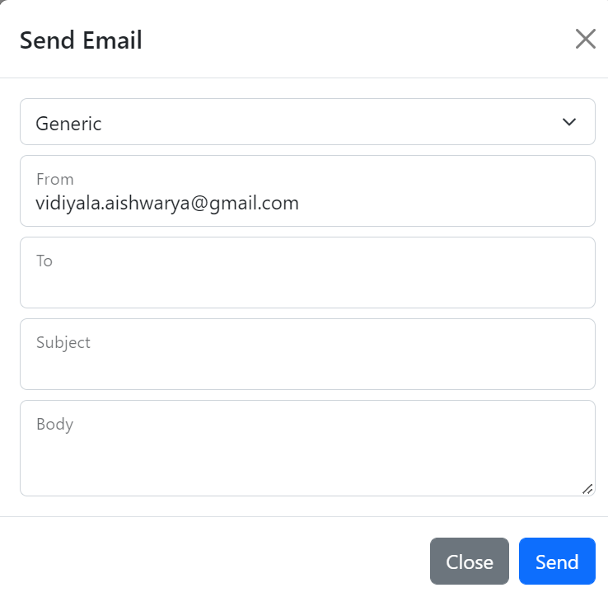
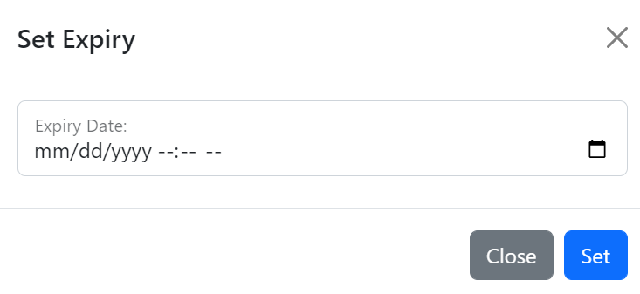
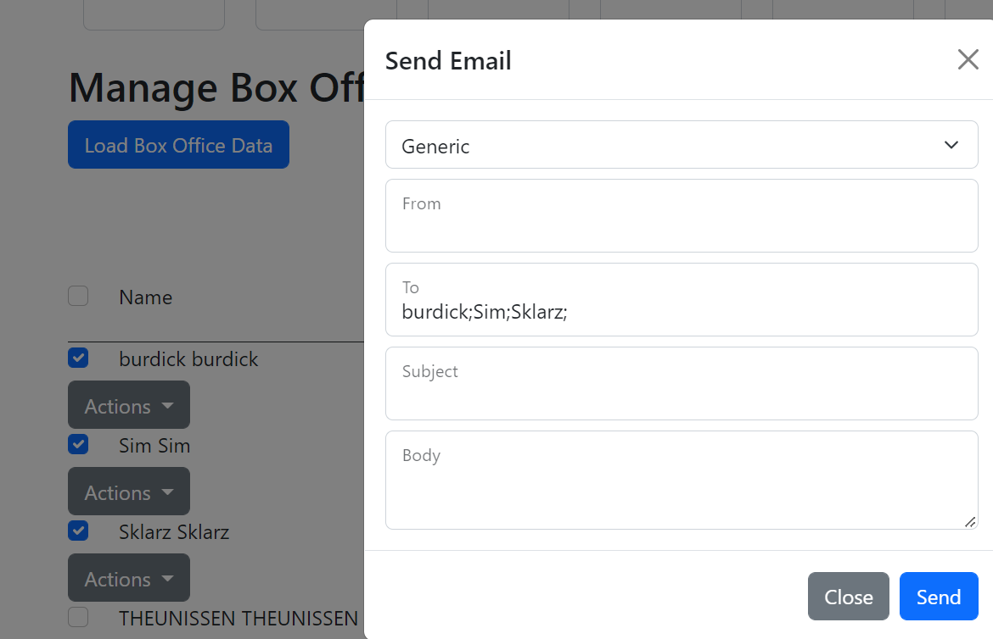
Dept. of Computer Science and Engineering, Texas A&M University
View Seats:
Introduction
Email Template:
Expire RSVP Link:
Bulk Email:

Slide 7
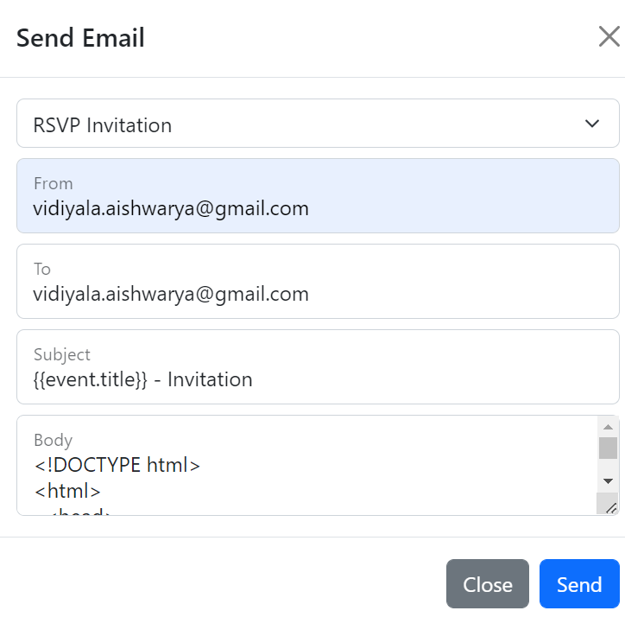
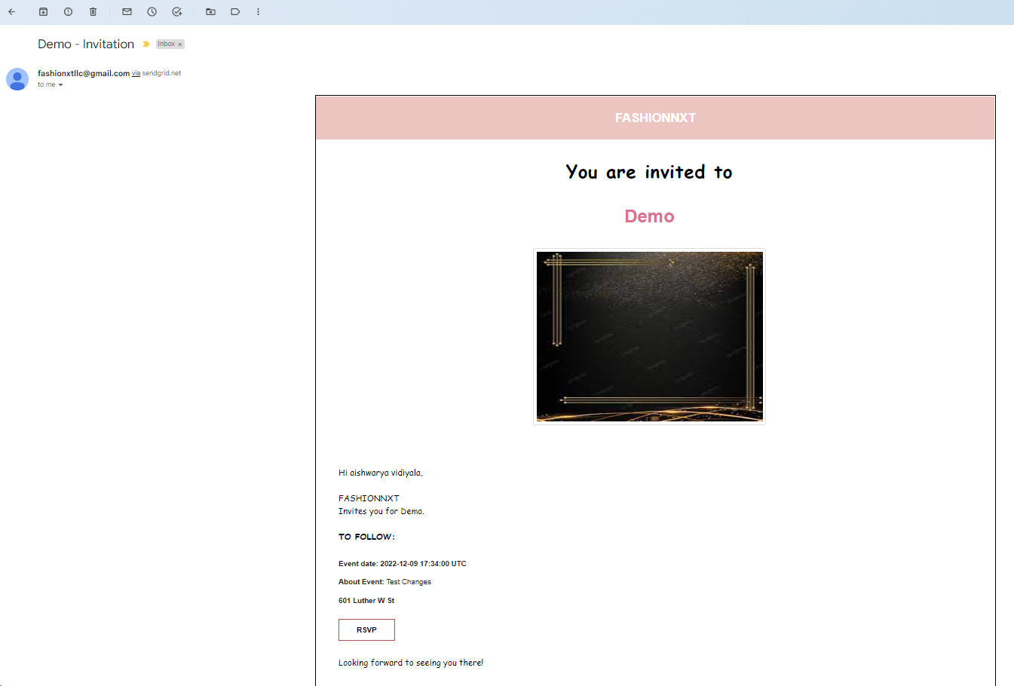
Dept. of Computer Science and Engineering, Texas A&M University
RSVP Invitation Email:
Invitation Email:
Introduction

Slide 8
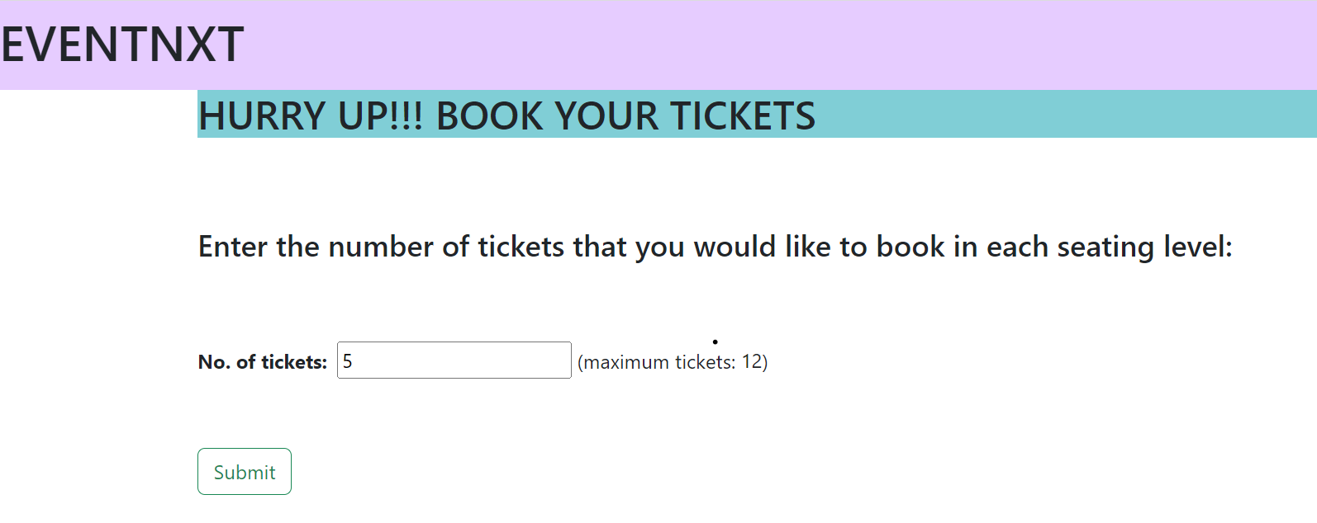
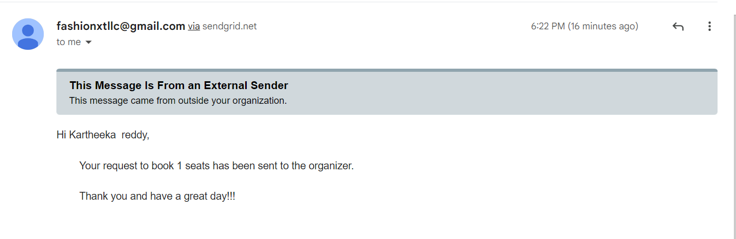
Dept. of Computer Science and Engineering, Texas A&M University
RSVP Link:
Introduction
Confirmation Email:

Slide 9
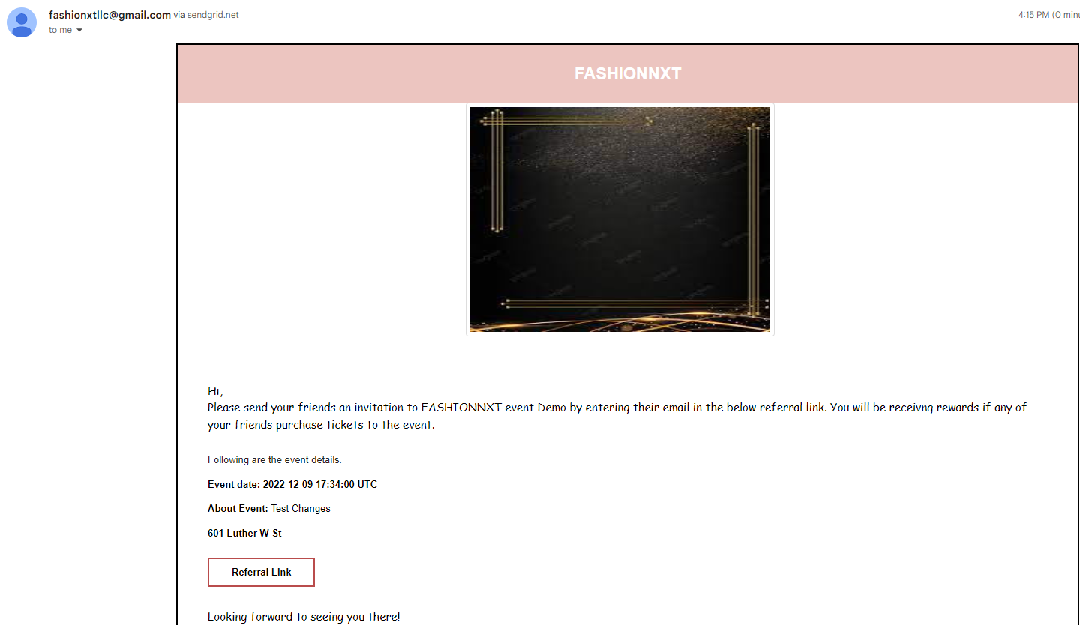
Dept. of Computer Science and Engineering, Texas A&M University
Introduction
Referral Email:

Slide 10
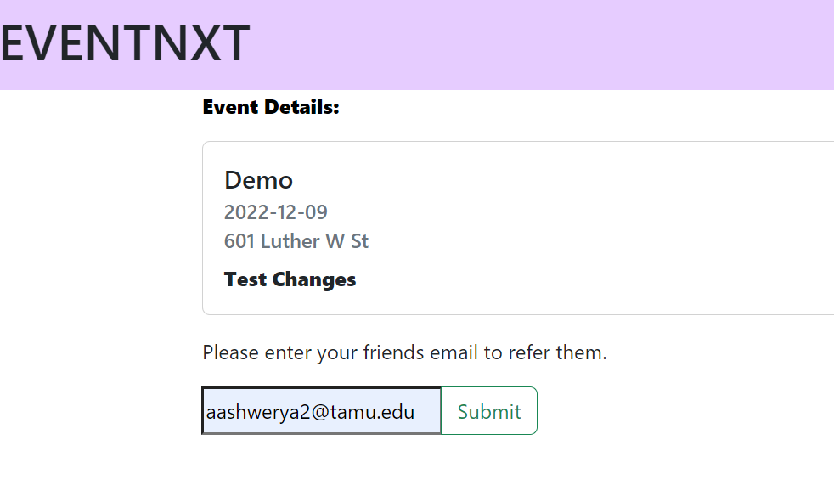
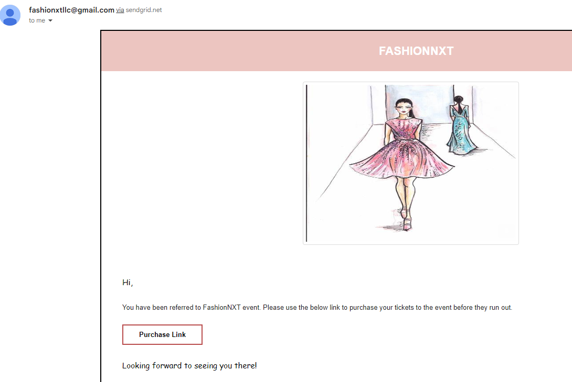
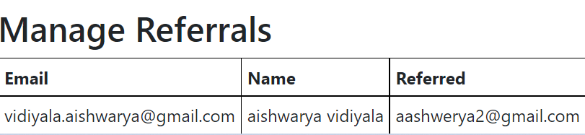
Dept. of Computer Science and Engineering, Texas A&M University
Introduction
Referral Link
Purchase Tickets Email to Referred Guest

Slide 11
Dept. of Computer Science and Engineering, Texas A&M University
Introduction
Lessons Learned:
Challenges:
The first thing we learned is to understand the code base before changing it.
During this project we learned how to work with Ruby on Rails.
We also learned how to deploy code to Heroku and set up Docker and Postgres Database.
Another thing we learned is that documentation is equally necessary for legacy projects.
We ensured that are code changes did not break any existing functionalities.
Since it was a legacy project understanding the code base took us a considerable amount of time.
The existing code had many bugs which we had to fix before implementing any new features.
Loading Box Office data on UI was one of the important features of the tool in which we faced challenges as we had to use a spreadsheet that was generated via a third-party application.
The complexity of the project is another challenge we faced.

Slide 12
Dept. of Computer Science and Engineering, Texas A&M University
Introduction
Conclusion
The user experience was improved for the automation system for creating and managing events by implementing additional functionalities in the backend along with redesigning existing modules.
Our team had a meaningful experience implementing this project and interacting with the client.
This system combines both RSVP and ticket management into one portal. It also tracks referrals using a referral reward system.
A user can manage event tickets, promotion strategies, and guest referrals.
Future Scope
The future scope of this project would be to bring in a referral reward system that keeps track of the person who was referred by maintaining a system for Promo codes.
Additionally, adding a Forgot Password Button on the Login Page, Integrate different statuses to the status column in the guest table and displaying it on the UI, and Displaying a message on validating the Username and Password in the Login page can be some other features in the future scope of this project.

