Slide 1
Project – Movies Data
Team Darmstadt

Slide 2
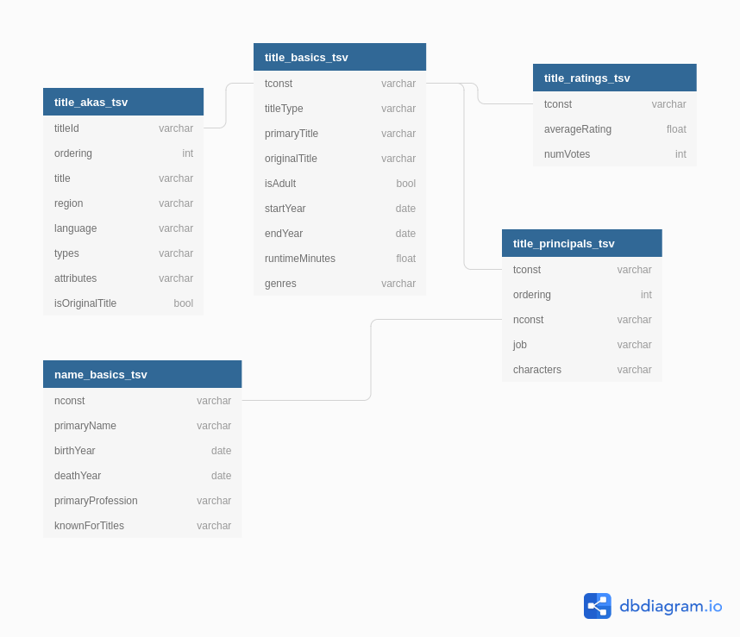
Data files

Slide 3
Infrastructure
Databricks
AWS
SageMaker
GitHub
AWS S3a

