Slide 1
Project – Movies Data
Team Darmstadt
Datenbändiger - Simon Harston
Algorithmus Souffleur - Falk Lutz
Model Jockey - Julian Godley

Slide 2
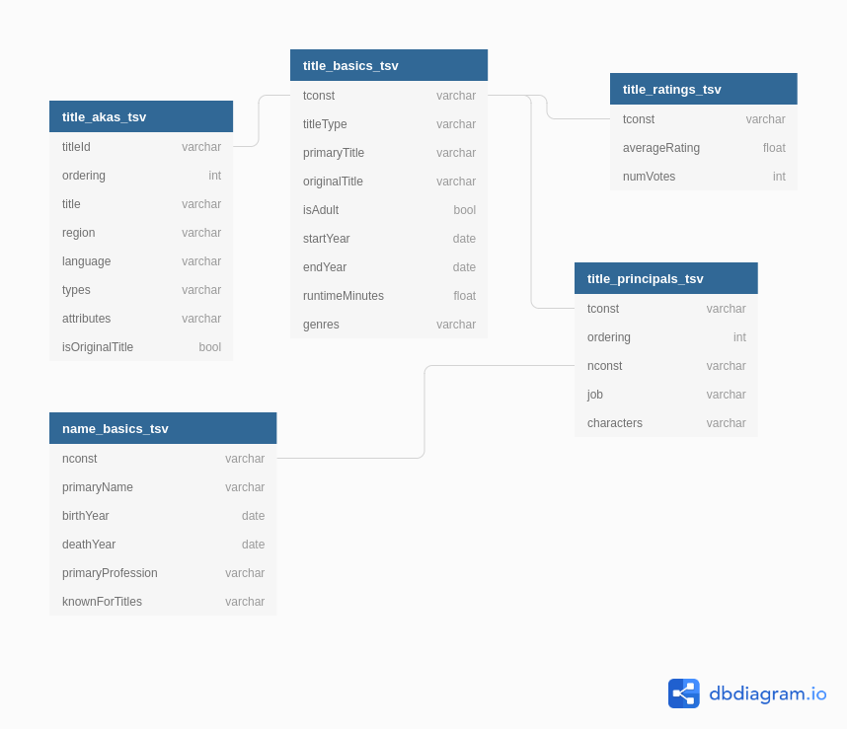
Data files
Built using DBML on dbdiagram.io (https://dbdiagram.io/d/5fb255513a78976d7b7c121c)

Slide 3
Project Infrastructure
GitHub
Databricks
AWS
SageMaker
AWS S3a
Buckets:
- aida-project
Source files
- sjf-project
Team‘s files
Repository:
- root: code
- /docs: documentation
Data Preprocessing:
-
-
Models:
- SageMaker model engine-Linear Learner
- SageMaker model engine-XGBoost
Endpoints:
- sjf-linear*
- sjf-xgboost*

Slide 4
S3 Databuckets
Source Data provided in S3 Bucket – can be linked to all other modules as a common data source.
Project team utilized a project specific S3 Bucket generated for intermediate data storage.

Slide 5
S3 Databuckets
The project specific S3 Bucket contains the following:
Series of subset files for:
train, valid and test
Each of which has different series suffixes:
*_sample.csv - small initial dataset series
*_data_trial.csv - larger intermediate series
*_data_avg.csv - intermediate series with "avg rating" as target
*_data_weighted.csv - intermediate series with "weighted rating" as target
*_data.csv - final dataset series with "average rating" as target
AND the Dream_Movie record (dream_movie.csv)

Slide 6
GitHub – Digital Exchange
Although a more logical choice may have been AWS Code Commit, the „client“ defined GitHub as the respository of choice.
This was installed and structured accordingly:
root – code files (Jupyter notebooks)
/docs – documentational files & this presentation

Slide 7
Databricks
Databricks was chosen for data exploration and wrangling.
For example, the source data was taken from the aida-project S3 bucket processed and the resultant files placed on the sjf-project S3 bucket for training and predictions.

Slide 8
AWS SageMaker – Model Engine
After the data preprocessing in Databricks, the finished train, validation and test datasets were then utilized in the model specific Jupyter(lab) Notebooks hosted on the flutz notebook instance on AWS SageMaker.

Slide 9
AWS SageMaker – Model Engine
Key learnings were – not all models are equal and some hyperparameters don‘t change anything …
Models used:
Linear Learner and
XGBoost with objectives:
- reg:linear and
- reg:squarederror
Linear Learner takes time multiples of XGBoost
The different objectives for XGBoost generate the same results. Therefore there is no value in utilizing both. (reg:linear was dropped -> there is no Jupyter Notebook for that model variant)

Slide 10
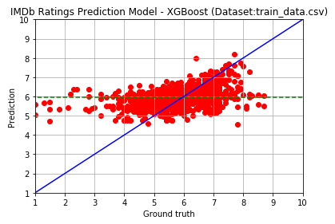
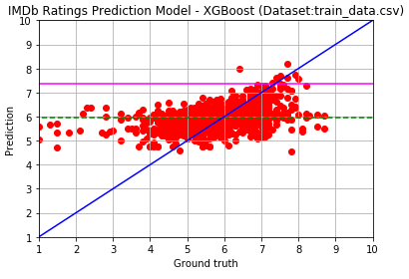
Results
Yes, we have some results (XGBoost num_round = 30)
7.366237163543701
RMSE: 0.9754989362978466

Slide 11
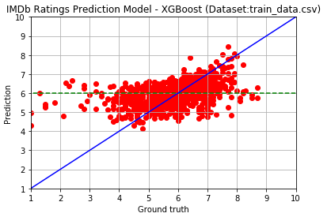
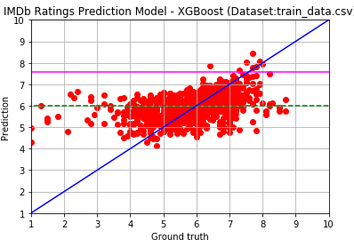
Results
… and even more – XGBoost num_round = 500
7.556224346160889
RMSE: 0.9580140973286809

Slide 12
Results
Yes, we have some results
7.366237163543701
RMSE: 0.9754989362978466

