Slide 1
Airplane Recommendations

Slide 2
Wide Body and Narrow Body Commercial Jets
Make | Model
Airbus | A220
 | A319
 | A320
 | A321
 | A330
 | A340
 | A350
Boeing | 737
 | 767
 | 777
 | 787

Slide 3
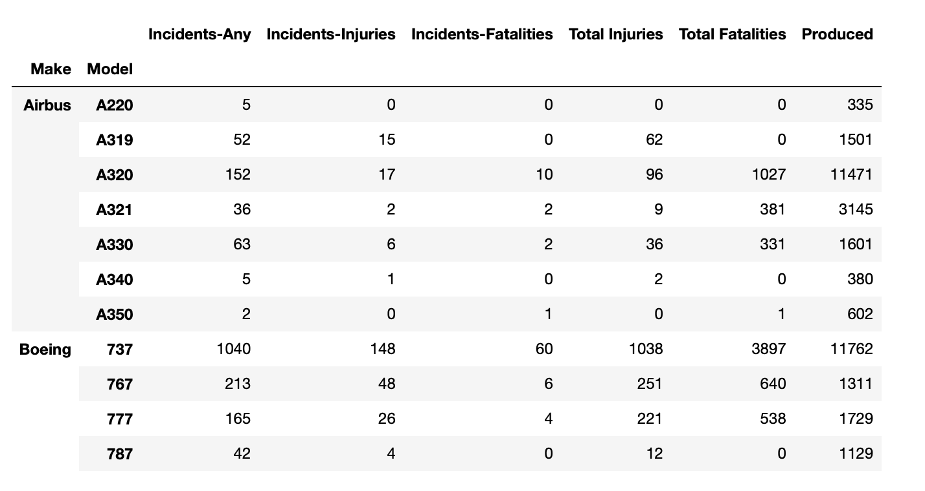
NTSB Incident Investigations

Slide 4
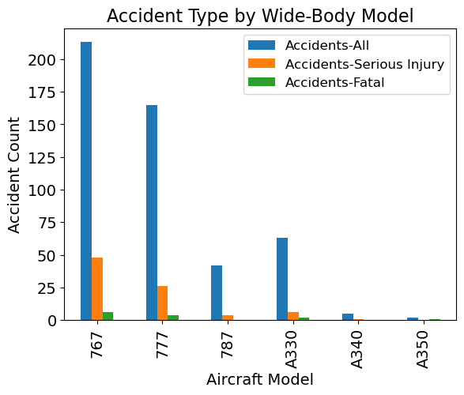
Wide-Body Airplanes

Slide 5
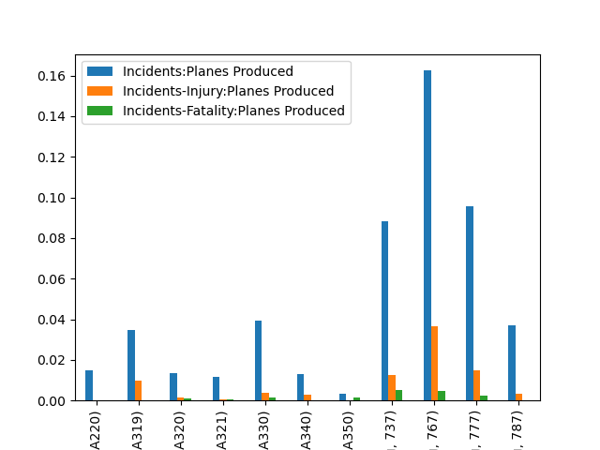
Ratio

