Slide 1
NTSB Accident Review

Slide 2
Wide Body and Narrow Body Commercial Jets
Make | Model
Airbus | A220
 | A319
 | A320
 | A321
 | A330
 | A340
 | A350
Boeing | 737
 | 767
 | 777
 | 787

Slide 3
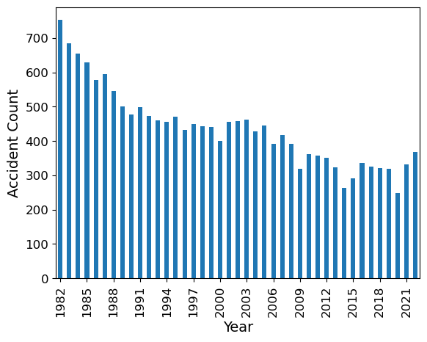
Total Accidents by Year

Slide 4
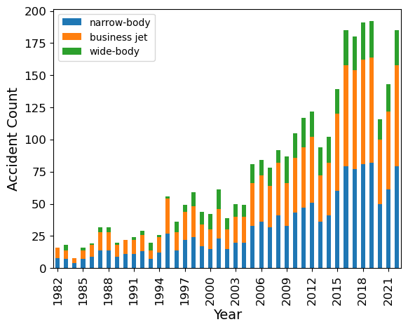
Total Accidents by Type

Slide 5
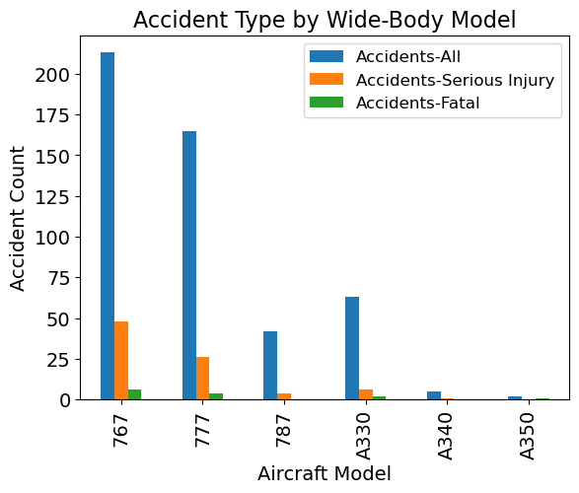
Wide-Body Airplanes

Slide 6
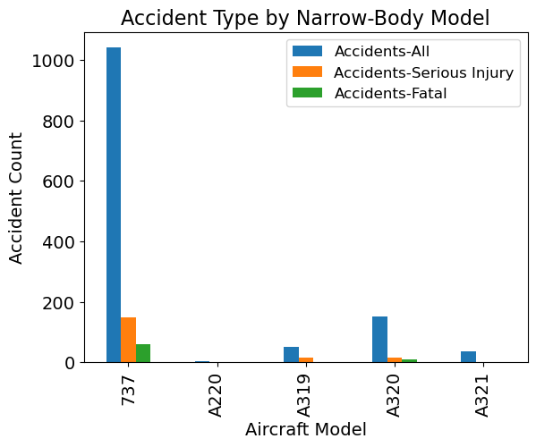
Narrow-Body Airplanes

Slide 7
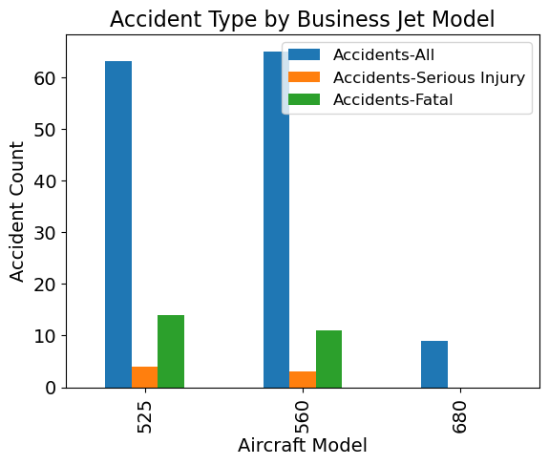
Business Jet

Slide 8
Recommendations

