Slide 1
NTSB Accident Review

Slide 2
Steps
Select aircraft type to purchase
Business-Jet
Narrow-Body
Wide-Body
Select an aircraft model to purchase

Slide 3
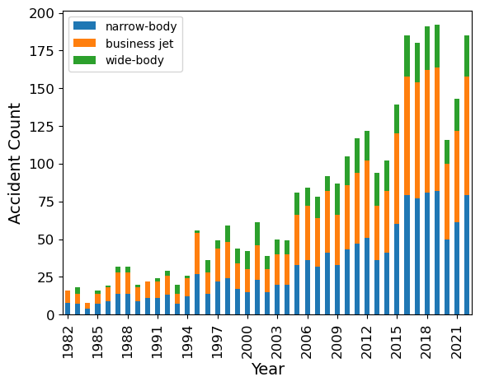
Total Accidents by Type

Slide 4
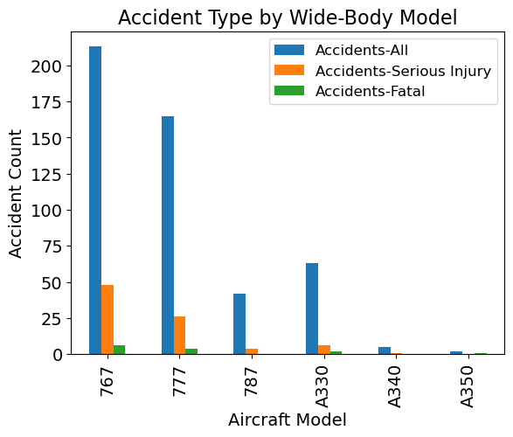
Wide-Body Airplanes

Slide 5
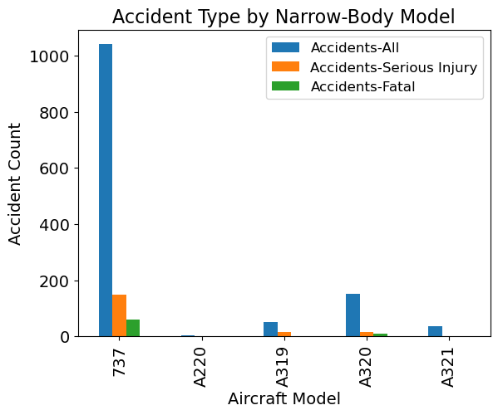
Narrow-Body Airplanes

Slide 6
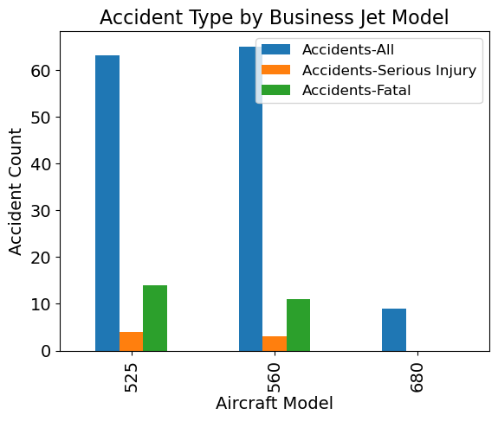
Business Jet

Slide 7
Recommendations
Type of Aircraft
Wide-Body or Business Jet
Model to Select:
Wide-Body: Airbus A350
Business Jet: Cessna 680

Slide 8
Next Steps
Control for different numbers of planes in field
Determine if differences are statistically significant

