Slide 1
Airplane Safety Review
NTSB Accident Database

Slide 2
Safety Review of Aircraft
Defining Safety of an Airplane:
Frequency of accidents
Severity of accident (serious injury or fatality)
Airplane features to consider:
Engine type
Airplane type
Boeing vs. Airbus

Slide 3
Safety Review of Aircraft
Three questions:
Does the type of engine on an aircraft affect the severity of accident?
Does the type of aircraft affect the severity of accident?
Do Boeing or Airbus planes get in more accidents?

Slide 4
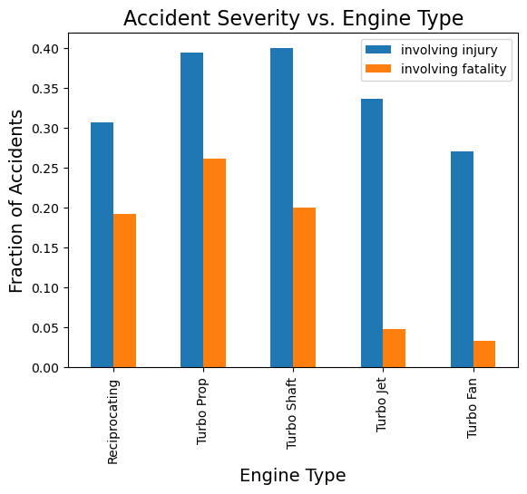
Type of Engine

Slide 5
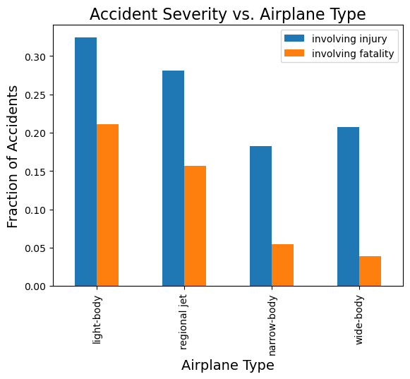
Type of Airplane

Slide 6
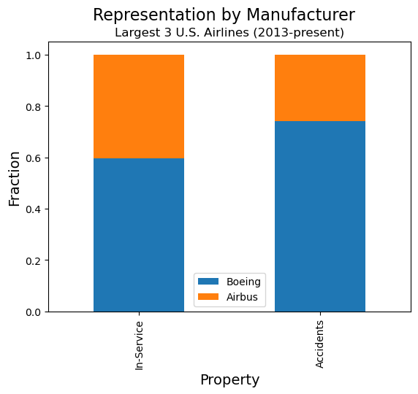
Make

Slide 7
Conclusions
These features can help to minimize the safety risk of an airplane:
Engine Type: Turbo Jet or Turbo Fan
Airplane Type: Narrow-Body or Wide-Body
Make: Airbus

Slide 8
Next Steps
Control for different numbers of planes in field
Determine if differences are statistically significant
Account for accident causes

Slide 9
Questions?

